Slide 1
Economics and Development International trade, Lecture 10
Giorgia Giovannetti
Professor of Economics, University of Firenze
E-mail: giorgia.giovannetti@unifi.it
Notes:
1

Slide 2
International Trade, September 16th- December 8th
1 | 16/9 |  | Introduction: The main issues
2 | 19/9 |  | Introduction, 2 detailed presentation of the course
3 | 23/9 |  | Introduction, 3; Measuring globalization
4 | 26/9 |  | Measuring Globalization, (VA) and overview of models
5 | 30/9 |  | Overview trade models (Bernard et al 2007; 2011)
6 | 3/10 |  | Gravity model
7 | 7/10 |  | Gravity, Melitz intro
8 | 10/10 |  | Melitz
9 | 14/10 |  | Trade models: Ricardo
10 | 17/10 |  | Trade models: Ricardo and H-O
11 | 21/10 |  | Trade models: H-O,2, Leontieff
12 | 24/10 |  | H-O, end, Trade and Imperfect competition, 1
13 | 28/10 |  | Trade and imperfect competition, end
14 | 31/10 |  | Mid term (indicators, gravity, Ricardo, H-O, imp. Comp)
15 | 4/11 |  | Hysteresis, Heterogeneous firms
16 | 7/11 |  | The Melitz model
17 | 11/11 |  | Networks of tradeFDI/migrants
18 | 14/11 |  | FDI and Multinationals: OLI theory
19 | 18/11 |  | FDI and Multinationals Offshoring/trade in tasks
20 | 21/11 |  | Trade policy
21 | 25/11 |  | Trade policy- trade wars
22 | 28/11 |  | China and India (BRICS)
23 | 2/12 |  | Granularity and aggregate shocks
24 | 5/12 |  | Final test
Plan of the
course/lectures

Slide 3
Outline
Groups
Ricardo, summary and trade cone
H-O introduction
Examples of comparative advantages

Slide 4
Groups and topics
Please send me an email with names and topic

Slide 5
How to determine who has the comparative advantage in what
Input per unit of output data
1. Determine the input per per unit of output for each agent
2. Make an opportunity cost table (agents by goods)
3. For each good (column) choose a unit of exchange
4. Determine the opportunity cost of each good in terms
of the unit of exchange by dividing the input use of each good
by the input use of the unit of exchange
5. The country with the lower opportunity cost has a comparative advantage in the production of each good

Slide 6
Ricardian Model
To develop a Ricardian model of trade, we used an example with two goods: wheat and cloth.
Home as the country exporting wheat and importing cloth.

Slide 7
Ricardian Model
The Home Country
We will assume that labor is the only resource used to produce both goods.
One worker can produce 4 bushels of wheat or 2 yards of cloth.
The Marginal Product of Labor is the extra output obtained by using one more unit of labor.
MPL_{W} = 4 and MPL_{C} = 2.

Slide 8
the Ricardian Model
Home Production Possibilities Frontier
We have assumed 25 workers in Home, MPL_{W} = 4, MPL_{C} = 2; Q_{W} = MPL_{W}(L) = 25(4) = 100; Q_{C} = MPL_{C}(L) = 25(2) = 50
If all the workers were employed in wheat, the country could produce 100 bushels.
If they were all employed in cloth they could produce 50 yards.
The PPF connects these two points.

Slide 9
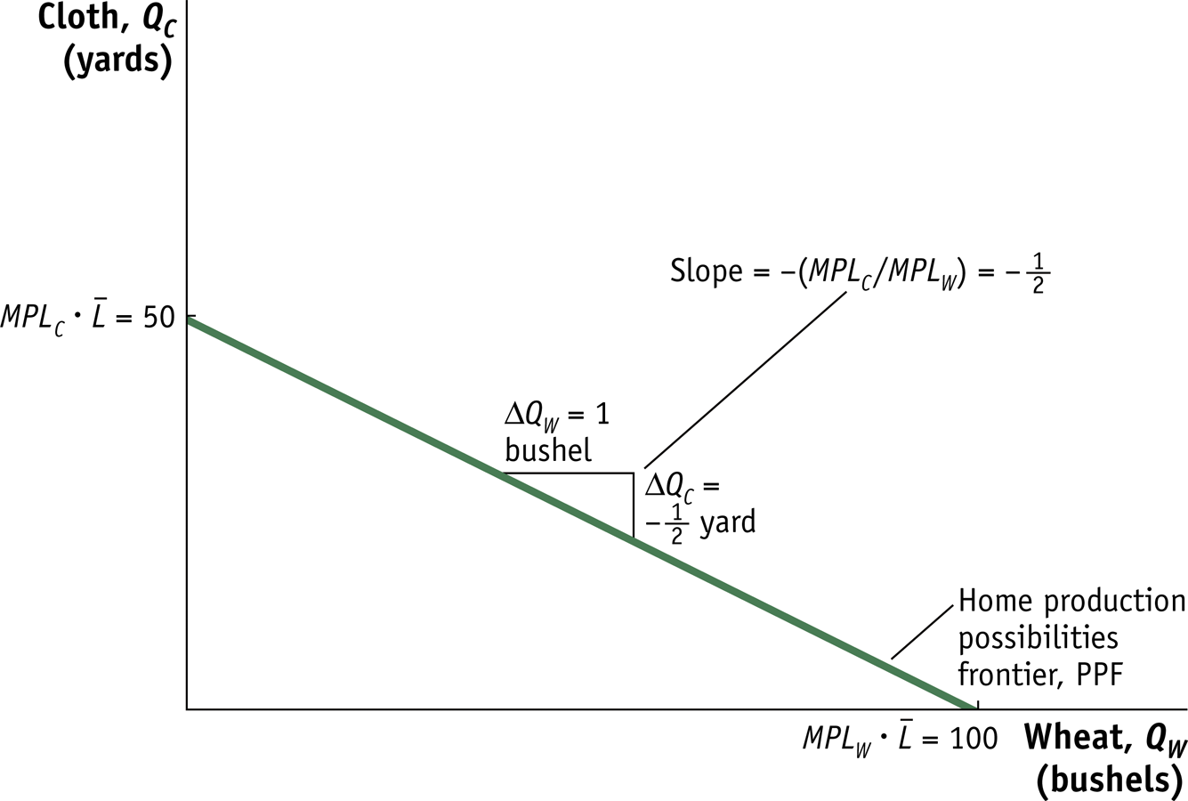
Ricardian Model: Home Production Possibilities Frontier
Notes:
Figure 2.1 Home Production Possibilities Frontier The Home PPF is a straight line between 50 yards of cloth and 100 bushels of wheat. The slope of the PPF equals the negative of the opportunity cost of wheat, that is, the amount of cloth that must be given up (yard) to obtain 1 more bushel of wheat. Equivalently, the magnitude of the slope can be expressed as the ratio of the marginal products of labor for the two goods.

Slide 10
Ricardian Model
Opportunity Costs for Goods in Home and Foreign
 | Cloth (1 Yard) | Wheat (1 Bushel)
Home | 2 Bushels of Wheat | ½ Yard of Cloth
Foreign | 1 Bushel of Wheat | 1 Yard of Cloth

Slide 11
The Ricardian Assumptions—Preferences
The preferences of all consumers in the world are identical.
For any individual, the Marginal Rate of Substitution is independent of the scale of consumption.
An individual’s MRS of wheat for cloth is the maximum amount of wheat that he/she would be willing to pay for one unit of cloth.
Under this assumption, if the amounts of cloth and wheat being consumed are, say, doubled, then the MRS remains unchanged.
In other words, the MRS does not change if the ratio of the amounts of cloth and wheat consumed, cloth/ wheat, does not change.

Slide 12
Marginal Rate of Substitution
Note that a consumer’s MRS of wheat for cloth is, simply, a measure of how much the consumer likes cloth.
We assume that MRS_{WC} decreases as the consumption of cloth increases relative to the consumption of wheat …
…And remains unchanged if the consumption of cloth remains unchanged relative to the consumption of wheat.

Slide 13
The Ricardian Assumptions—Technology
Goods are produced (out of resources) with technologies that satisfy Constant Returns to Scale.
That is, if the producer of a commodity, say, doubles the amounts used of all resources, then the amount produced will also double.

Slide 14
The Ricardian Assumptions
There is perfect competition in all markets.
That is, no buyer or seller of a commodity has the power to affect the price of the commodity by himself.
More specifically, the market for a commodity is said to be perfectly competitive if:
There are many sellers
There are many buyers
All sellers sell the exact same product
Individuals make decisions so as to maximize happiness, whereas
Firms make decisions so as to maximize profits
Governments do not interfere with the smooth functioning of markets; there are no taxes, subsidies, tariffs, quotas, etc.

Slide 19
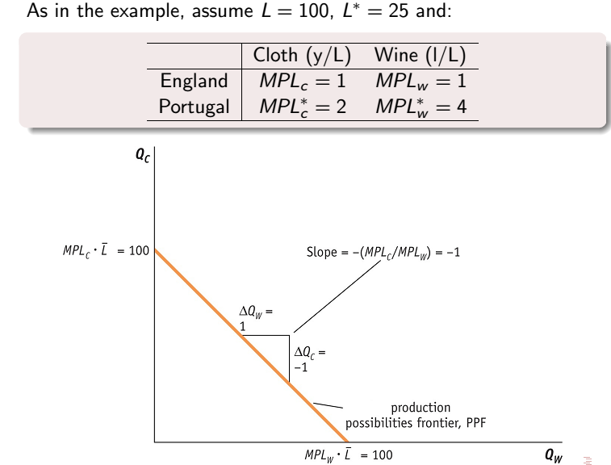

Slide 20
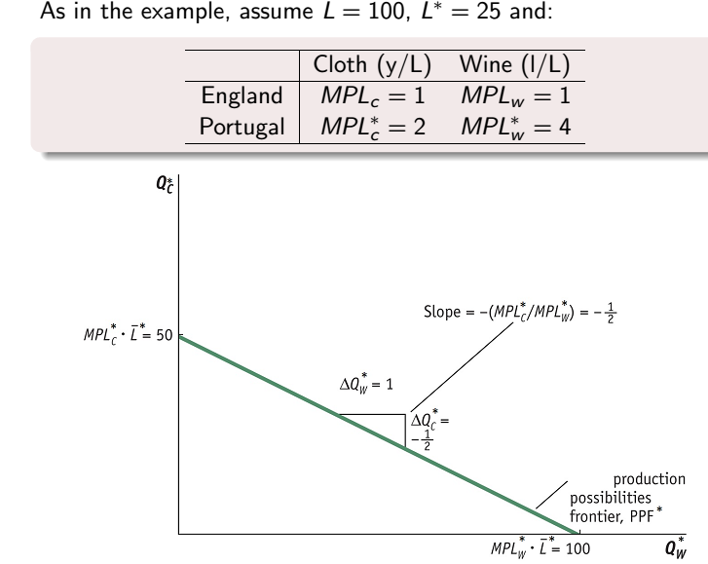

Slide 21
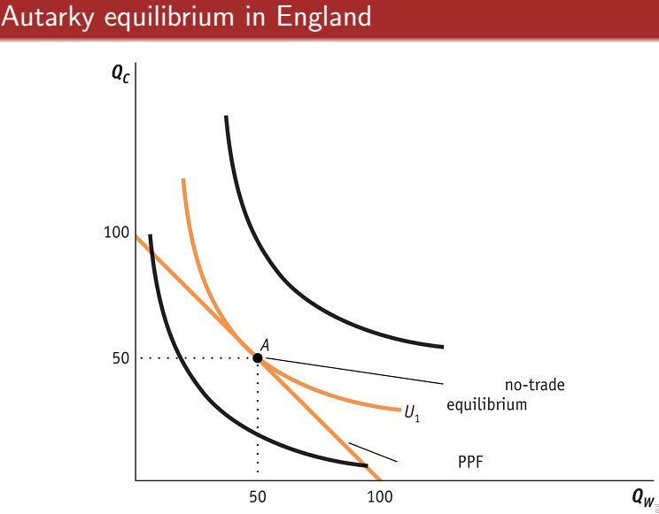

Slide 22
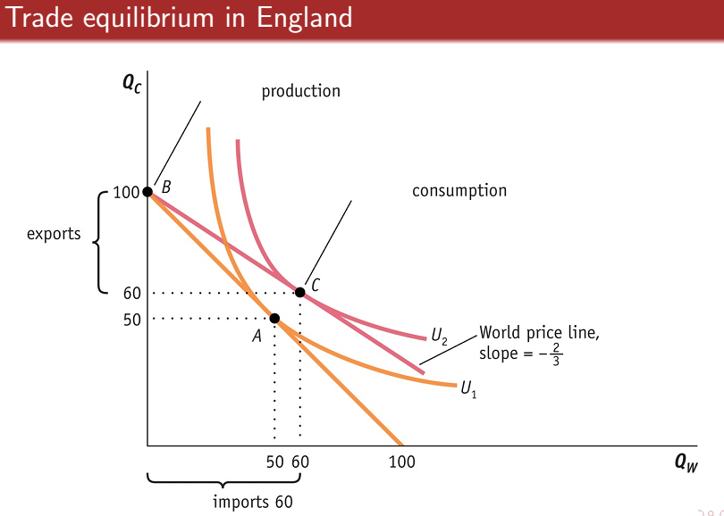

Slide 23
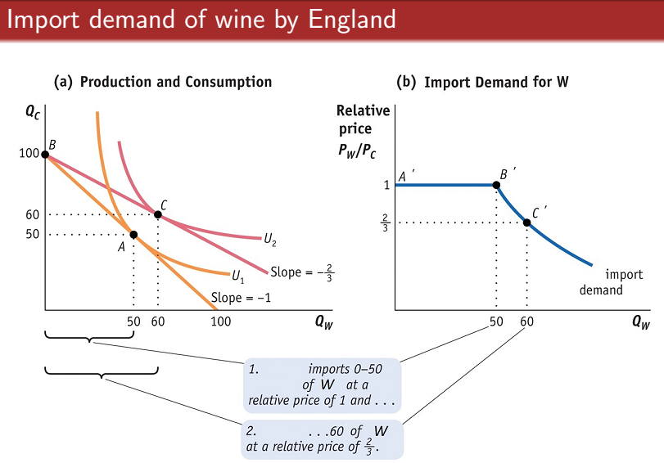

Slide 24
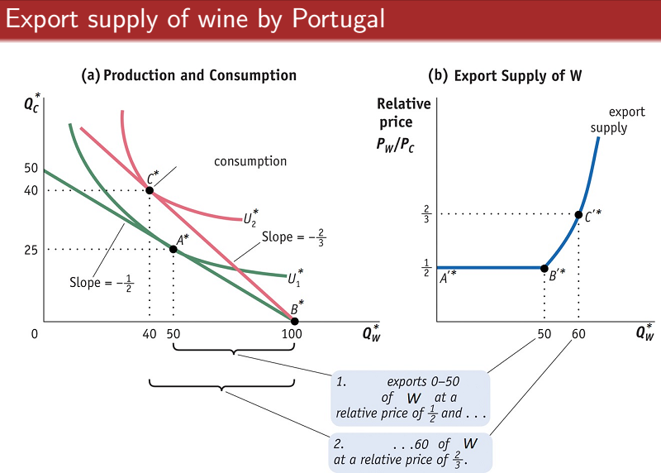

Slide 25
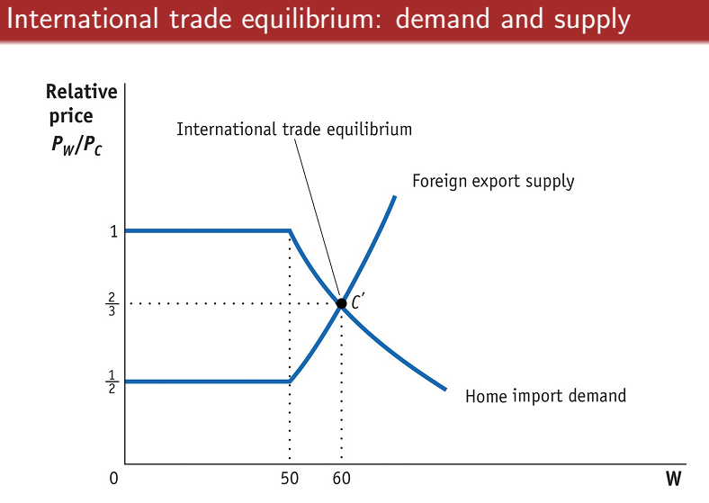

Slide 27
Ricardian Model: Main Lessons
Trade occurs because technology varies from country to country
Even backward can gain from trade with advanced
Advanced countries can gain from trade even if their workers have to compete with “cheap labor” countries

Slide 28
Summary: The Ricardian Assumptions—Basics
There are
two countries, Home and Foreign
two goods, Cheese and Wine, and
one resource, Labor
Labor is used to produce cheese and wine

Slide 29
Summary: The Ricardian Assumptions—Preferences
The preferences of all consumers in the world are identical.
Q: This is obviously untrue. Why then does David Ricardo assume identical preferences?
A: Ricardo wants to show that technological differences between countries can lead to trade. To accomplish this goal he needs to show the existence of trade among two countries that differ only in technology.

Slide 30
Summary: Relative Price of Cheese
The dollar price of wine, P_{W}, is $5 per gallon
The dollar price of cheese, P_{C}, is $20 per pound
Then the relative price of cheese is 4 gallons of wine per pound of cheese, and
Therefore, the relative price of cheese is the wine-equivalent of whatever one pays to buy cheese (P_{C}/P_{W})

Slide 31
Summary: Relative Price of Wine
The dollar price of wine, P_{W}, is $5 per gallon
The dollar price of cheese, P_{C}, is $20 per pound
Then the relative price of wine is ¼ pound of cheese per gallon of wine, and
Therefore, the relative price of wine is the cheese-equivalent of whatever one pays to buy wine (P_{W}/P_{C})

Slide 32
Summary: Relative Prices
We just saw that the relative price of wine is P_{W}/P_{C} and the relative price of cheese is P_{C}/P_{W}
Therefore, the relative price of wine and the relative price of cheese are reciprocals
Their product must be the number one (1)
Therefore, if one relative price increases, the other necessarily decreases

Slide 33
The Relative Demand Curve
The relative demand curve shows the relative quantities bought by consumers at all possible values of the relative price
P_{C}/P_{W}
RD
Q_{C}/Q_{W}
As cheese becomes more expensive relative to wine (P_{C}/P_{W}↑) the consumption of cheese decreases relative to wine (Q_{C}/Q_{W}↓).

Slide 34
Ricardian model in pills:
trade as mutually beneficial even if one country is more efficient than another
principle of comparative advantage – each nation should specialize in production of those goods for which it is relatively more efficient with a lower opportunity cost
not possible for one country to have a comparative advantage in everything

Slide 35
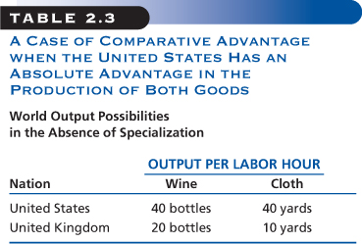
Comparative Advantage - Example
The U.S. can produce twice as much wine as the U.K. but four times as much cloth. Therefore the U.S. should specialize in producing cloth while the U.K. specializes in producing wine.

Slide 36
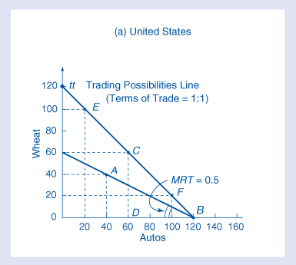
Production Possibilities Schedule (PPS)
PPS - various combinations of two goods that a nation can produce using all available factor inputs

Slide 37
Marginal Rate of Substitution (MRT)
amount of one good a country must sacrifice to get one more unit of another good
synonymous of opportunity cost
equal to the absolute value of the slope of the production possibilities schedule
∆ good Y
∆ good X
MRT =

Slide 38
MRT (cont.)
In this graph the MRT equals 0.5 because wheat output falls by 20 when auto rises by 40

Slide 39
Basis for Trade
The MRT or opportunity cost for each nation will indicate the direction of trade.
The MRT or opportunity cost can also indicate the potential gains from trade.
We begin with an assumption of constant opportunity costs.
Benefits will be measured in terms of both improved production and consumption.

Slide 40
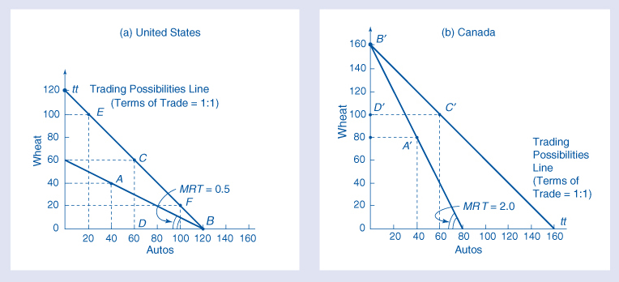
Gains from Specialization
1 additional auto in the U.S. => loss of 0.5 bushel of wheat
1 additional auto in Canada => loss of 2 bushels of wheat

Slide 41
Gains from Specialization (cont.)
Since the U.S. has a lower opportunity cost of auto production, it will be mutually beneficial for the U.S. to produce autos and trade them to Canada for wheat.

Slide 42
Production Gains
Without trade or specialization, world production is 80 autos and 120 bushels of wheat.
If both nations specialized based on their comparative advantages, world production would increase to 120 autos and 160 bushels of wheat.

Slide 43
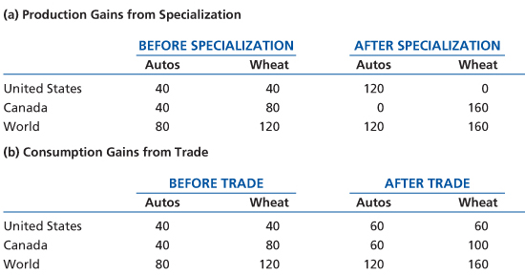
Consumption Gains
If the U.S. trades 60 autos for 60 bushels of wheat, then consumption will increase in each country.

Slide 44
Consumption Gains (cont.)
Graphically consumption could increase from A to C for the U.S. and A’ to C’ for Canada or elsewhere along the Trading Possibilities Lines.

Slide 45
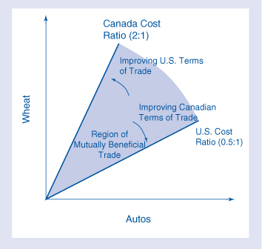
Distributing Gains from Trade
comparative advantage => only outer limits for the terms of trade
based on domestic cost ratios
form no-trade boundaries and region of mutually beneficial trade

Slide 46
Equilibrium Terms of Trade
John Stuart Mill – Theory of Reciprocal Demand
terms of trade determined by the relative strength of each nation’s demand for the other nation’s product
nations of roughly equal size => gains from trade distributed roughly equally
one nation larger => smaller nation attains most of the gains from trade because trade occurs closer to the larger nation’s existing price ratio – “importance of being unimportant”

Slide 47
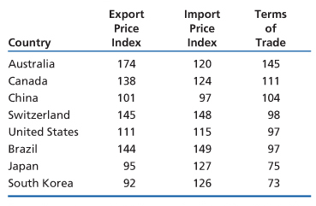
Terms of Trade Estimates
export price index
import price index
terms of trade = × 100
prices of exports rise in relation to imports shows improvement
2006 terms of trade data using 2000 as the base year

Slide 48
More on Ricardian Assumptions—Technology
Goods are produced (out of labor) with technologies that satisfy Constant Returns to Scale.
That is, if the amount of labor employed in wine (respectively, cheese) production is doubled, then the amount of wine (respectively, cheese) produced will also double.
Put another way, the unit labor requirement in wine (respectively, cheese) production is constant

Slide 49
Technology: An Example
Unit Labor requirements
 | Cheese | Wine
Home | 1 hour per pound a_{C,H} = 1 | 2 hours per gallon a_{W,H} = 2
Foreign | 6 hours per pound a_{C,F} = 6 | 3 hours per gallon a_{W,F} = 3
We will be using this specific example throughout this lecture

Slide 50
Summary: Opportunity Costs
The opportunity cost of a gallon of wine is the number of pounds of cheese you will no longer have the resources to produce if you produce a gallon of wine (C_{WC})

Slide 51
Example: Opportunity Cost
Unit Labor requirements
 | Cheese | Wine
Home | 1 hour per pound | 2 hours per gallon
Foreign | 6 hours per pound | 3 hours per gallon
Opportunity Cost
 | Cheese C_{CW} | Wine C_{WC}
Home
Foreign

Slide 52
Example: Opportunity Cost
Unit Labor requirements
 | Cheese | Wine
Home | 1 hour per pound | 2 hours per gallon
Foreign | 6 hours per pound | 3 hours per gallon
Opportunity Cost
 | Cheese C_{CW} | Wine C_{WC}
Home | ½ gallons of wine
Foreign

Slide 53
Example: Opportunity Cost
Unit Labor requirements
 | Cheese | Wine
Home | 1 hour per pound | 2 hours per gallon
Foreign | 6 hours per pound | 3 hours per gallon
Opportunity Cost (A commodity’s opportunity cost is computed as its unit labor requirement divided by the other commodity’s unit labor requirement.)
 | Cheese C_{CW} | Wine C_{WC}
Home | ½ gallons of wine | 2 pounds of cheese
Foreign

Slide 54
Example: Opportunity Cost
Unit Labor requirements
 | Cheese | Wine
Home | 1 hour per pound | 2 hours per gallon
Foreign | 6 hours per pound | 3 hours per gallon
Opportunity Cost (A commodity’s opportunity cost is computed as its unit labor requirement divided by the other commodity’s unit labor requirement.)
 | Cheese C_{CW} | Wine C_{WC}
Home | ½ gallons of wine | 2 pounds of cheese
Foreign | 2 gallons of wine

Slide 55
Example: Opportunity Cost
Unit Labor requirements
 | Cheese | Wine
Home | 1 hour per pound | 2 hours per gallon
Foreign | 6 hours per pound | 3 hours per gallon
Opportunity Cost (A commodity’s opportunity cost is computed as its unit labor requirement divided by the other commodity’s unit labor requirement.)
 | Cheese C_{CW} | Wine C_{WC}
Home | ½ gallons of wine | 2 pounds of cheese
Foreign | 2 gallons of wine | ½ pounds of cheese

Slide 56
Rational Producers
If P_{C}/P_{W} > C_{CW}, producers will be specialized in cheese production; no rational producer will make wine
Similarly, if P_{C}/P_{W} < C_{CW}, producers will be specialized in wine production
Therefore, both wine and cheese will be produced only if P_{C}/P_{W} = C_{CW}.
This is the autarky outcome

