Slide 1
International Trade
Poland vs. UK
Impact of BREXIT on Poland
Anna Tereshchenko
Viktoriia Kovryha

Slide 2
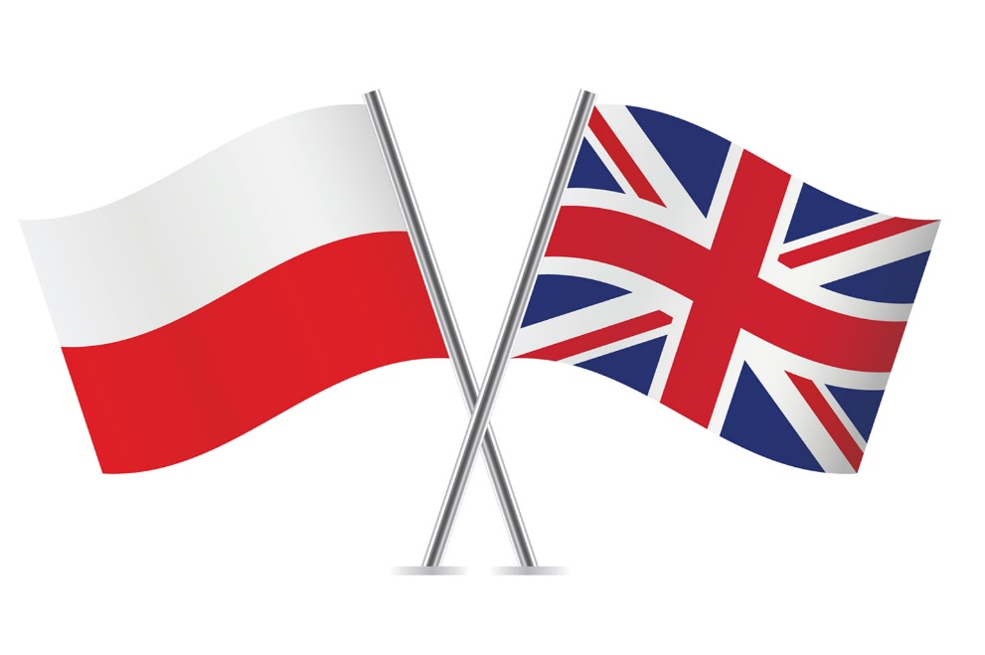
Agenda
Main facts about Poland and UK
Polish-British cooperation Statistical data
Poland’s export to the UK
Poland’s import from the UK
FDI
Migration
Impact of Brexit on Poland

Slide 3
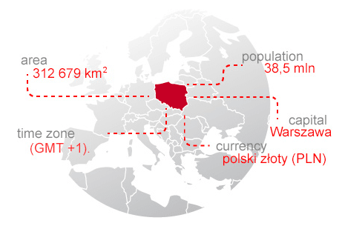
Introduction
Despite a certain geographical distance, Poland is historically strongly associated with Great Britain
The events of the last 30 years, political changes and the accession of Poland to the European Union, have strengthened the relationship between the two countries
Poles have become one of the largest national minority in the UK and British companies support the development of key sectors and innovation of Polish economy

Slide 4
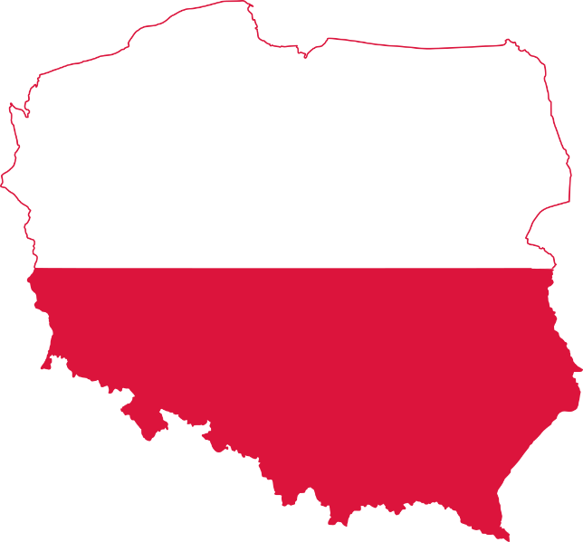
Main facts about Poland and UK
In the year 2018
Poland
GDP – 585.78 bln USD
(0.94% of the world economy)
Population – 38 mln people
GDP per capita – 16 640 USD
UK
GDP – 2825.21 bln USD
(4.56% of the world economy)
Population – 66.2 mln people
GDP per capita – 42 986 USD
Trading Economics, https://tradingeconomics.com/poland
Trading Economics, https://tradingeconomics.com/united-kingdom

Slide 5
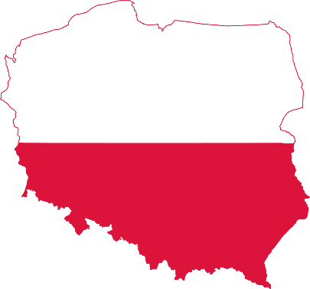
In the year 2018
Poland
Average annual inflation rate – 1.7 %
Average unemployment rate – 6.1%
37th most competitive country in the world out of 140 countries
33rd among 190 economies in the ease of doing business
UK
Average annual inflation rate – 2.4%
Average unemployment rate – 4.1%
8th most competitive country in the world out of 140 countries
9th among 190 economies in the ease of doing business
Trading Economics, https://tradingeconomics.com/poland
Trading Economics, https://tradingeconomics.com/united-kingdom

Slide 6
Polish-British cooperation Statistical data
115 000
people
The number of employees who was working in British companies in Poland in 2018 year
905 000 people
The number of Polish people living in the UK in 2018 year
7.3%
Poland export 7,3% of total amount of services to the United Kingdom
It takes 3rd place, after Germany and Switzerland
Deloitte, https://www2.deloitte.com/content/dam/Deloitte/pl/Documents/Reports/pl

Slide 7
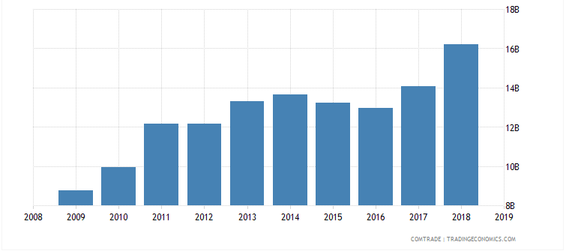
Poland’s export to the UK
Poland’s export to United Kingdom was 16,2 bln USD during 2018
The top export destinations of Poland are Germany (54.5 bln USD), the UK (16,2 bln USD), the Czech Republic (12.7 bln USD), France (11.7 bln USD) and Italy (11 bln USD)
Trading Economics, https://tradingeconomics.com/poland

Slide 8
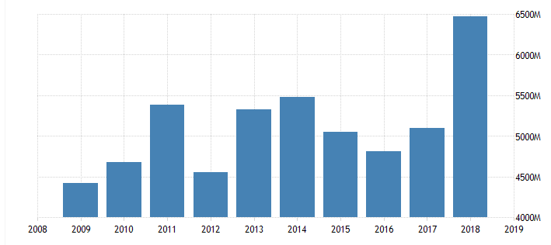
Poland’s import from the UK
Poland’s import from United Kingdom was 6.48 bln USD during 2018
The top import origins are Germany (55.2 bln USD), China (25.9 bln USD), Italy (12 bln USD), Russia (11.5 bln USD), France (8.94 bln USD) and UK (6.5 bln USD)
OEC., https://oec.world/en/profile/country/pol/

Slide 9
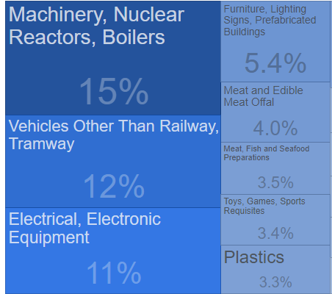
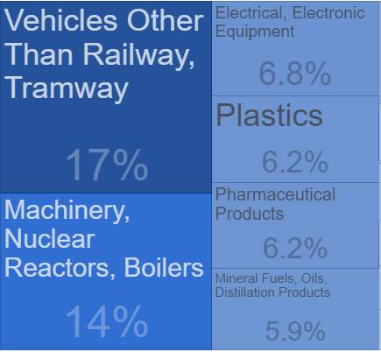
Poland Exports to United Kingdom in 2018
Poland Imports from United Kingdom in 2018
Trading Economics, https://tradingeconomics.com/poland

Slide 10
FDI
Poland is among the top European markets for FDI in 2019, according to a new report made by Ernst & Young
272 FDI projects were completed in Poland in 2018, compared to 197 in 2017
FDI in Poland were accounted for over 45% of GDP in 2018, while Polish direct investment abroad were only 5.4% of GDP
The United Kingdom was the 5th largest investor in Poland in 2017
Poland attracts investors due to its good location with a relatively faster economic growth rate than in Western Europe. The key advantages are such as lower labor costs, high qualifications and employee productivity
In the year 2017 the UK invested 12 bln USD in Poland, compared to 44 bln USD of the investment made by a leader country – Germany in the same period
Polish investment and trade agency, https://www.paih.gov.pl/poland_in_figures/foreign_direct_investment

Slide 11
The biggest UK investors
The biggest British investors in Poland are the global key players in their sectors and leaders in Poland as well. Most of them have entered Poland due to market size and nowadays have a well-grounded position in their sectors.
The main companies from the UK include:
Tesco Plc (supermarkets)
Imperial Tobacco Plc (tobacco industry)
GlaxoSmithKline (GSK - pharmaceuticals)
AVIVA Plc (financial services)
Bates Ltd (transportation warehousing)
Shell Overseas Holdings Ltd. (oil products)
Rolls-Royce
Polish investment and trade agency, https://www.paih.gov.pl/poland_in_figures/foreign_direct_investment

Slide 12
Migration
Nowadays, the world can observe a high level of migration of Polish people to the UK, that was one of the first countries opened its labor market just after Poland's accession to the EU in 2004
As a result the UK had a large inflow of migrants from Poland, who are currently the largest minority there
The attractiveness of the UK for Poles was mainly determined by the popularity and knowledge of English as well as high earnings compared to wages in mature country
The Migration Observatory, https://migrationobservatory.ox.ac.uk/resources/briefings/migrants-in-the-uk-an-overview/

Slide 13
Polish, Romanian and Indian people are the top three nationalities accounted respectively for 15%, 7% and 6% of foreigners in the UK
Top 10 nationalities of foreigners, UK 2018
The Migration Observatory, https://migrationobservatory.ox.ac.uk/resources/briefings/migrants-in-the-uk-an-overview/

Slide 14
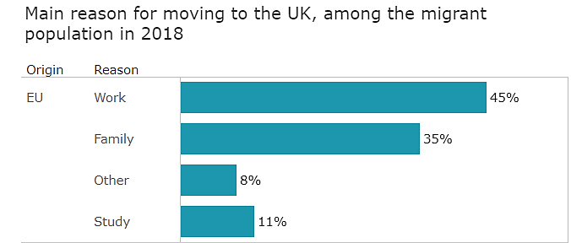
The Migration Observatory, https://migrationobservatory.ox.ac.uk/resources/briefings/migrants-in-the-uk-an-overview/

Slide 15
Migrants' transfers to Poland in 2017
Transfers
(mln USD)
Total transfer
%
The number of migrants
(thousand people)
Transfers
per 1 migrant
Share in GDP
%
Germany
UK
Netherlands
Ireland
Total
Deloitte, https://www2.deloitte.com/content/dam/Deloitte/pl/Documents/Reports/pl

Slide 16
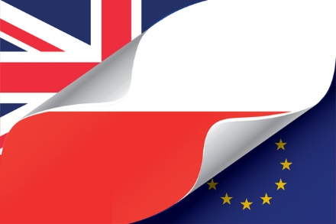
Impact of Brexit on Poland
The UK is one of the biggest net payers into the EU budget
Poland is one of the largest net beneficiaries of the EU budget both in absolute terms and net of its own contribution
The funds that Poland raises from EU are an important source of investment in various areas of its economy
After Brexit Poland’s position will depend on the ability of its government to safeguard the current level of transfers
Polish Economic Institute, http://pie.net.pl/wplyw-brexitu-na-polske/

Slide 17
The format of future relations between the UK and the EU is uncertain and will be the outcome of long negotiations between the two parties
In case of no-deal Brexit, economic relations between the UK and Poland will be based on the principles of the WTO
Brexit will certainly affect all the budgetary lines in EU and the loss in case of Poland could be about 7-8%
For Polish exporters Brexit means also that funds allocated for co-financing export activities will be potentially smaller
In case of no-deal Brexit, Polish exports to the United Kingdom could decrease by 0.5 billion USD or even more as the final tax rates aren`t still available
Polish investment and trade agency, https://www.paih.gov.pl/poland_in_figures/foreign_direct_investment

Slide 18
Conclusion
Relatively low labor and rent costs in Poland along with free access to the EU Single Market may motivate some of the UK`s companies to reallocate their activity to this country
As a result of Brexit, we could see also that cooperation between Poland and closest neighbors like Germany will increase
Brexit could also increase the likelihood of Polish entrepreneurs seeking alternative outlets for their products due to new taxes, different tariffs and customs supervision
Taking into account the potential impact of Brexit on FDI and trade flows, migration, political cooperation and the EU budget, Poland should be in favour of a rather ‘soft’ Brexit, with the UK contributing to the EU budget, retaining access to the Single Market and remaining open to exports from such EU countries as Poland.

Slide 19
References
Trading Economics: Poland, https://tradingeconomics.com/poland
Trading Economics: United Kingdom, https://tradingeconomics.com/united-kingdom
Deloitte, https://www2.deloitte.com/content/dam/Deloitte/pl/Documents/Reports/pl
OEC, https://oec.world/en/profile/country/pol/
Polish investment and trade agency, https://www.paih.gov.pl/poland_in_figures/foreign_direct_investment
The Migration Observatory, https://migrationobservatory.ox.ac.uk/resources/briefings/migrants-in-the-uk-an-overview/
Vox EU, https://voxeu.org/article/poland-uk-relations-after-brexit
Polish Economic Institute, http://pie.net.pl/wplyw-brexitu-na-polske/
Tax portal of Ministry of finance in Poland, https://www.podatki.gov.pl/clo/brexit/

Slide 20
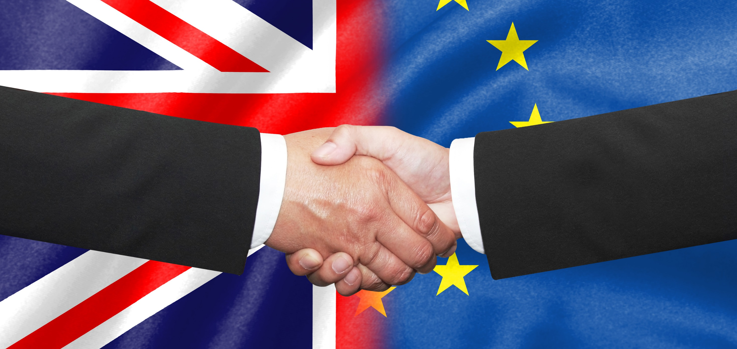
Thank you for attention!

