Slide 1
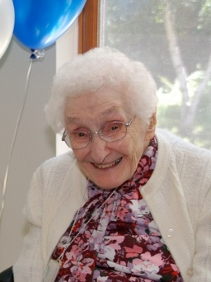
Percent prevalence of low idea density in early life autobiographies by late life cognitive state at the last examination for 180 participants in the Nun Study.
Percent prevalence of low idea density (95% CI)
Cognitive State Last Exam
Memory intact 10 (3-22)
Memory impaired Mild impairment 45 (23-68)
Global impairment 50 (19-81)
Dementia 62 (47-75)
Tangles and plaques are lower in high idea density than in low idea density nuns.
Riley et al., 2005 Effects of experience in childhood and youth??

Slide 2
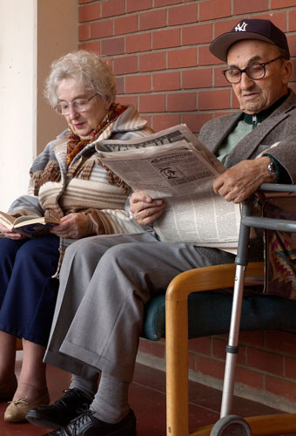
EE on cognitive decline in humans
Can an “enrichment” which begins in old age be effective?

Slide 3
Brain reserve and dementia: a systematic review
Valenzuela MJ, Sachdev P
Psychol Med. 2006 Apr;36(4):441-54
Meta-analysis of 22 studies, median follow up 7.1 years, data across 29000 individuals
Brain reserve and cognitive decline: a non parametric systematic review
Valenzuela MJ, Sachdev P
Psychol Med. 2006 Apr;36(8):1065-73
Meta-analysis of 18 studies, data from 47000 individuals
Complex patterns of mental activity in early, mid- and late-life stages is associated with a significant reduction in dementia incidence

Slide 4
Midlife activity predicts risk of dementia in older male twin pairs.
Carlson et al., 2008
147 male twin-pairs who were discordant for dementia or age of dementia onset
“Participation in a range of cognitively and socially engaging activities in midlife reduced risk for dementia and AD in twins discordant for onset, particularly among monozygotic twin pairs at elevated genetic risk, and might be indicative of an enriched environment”

Slide 5
Thus, cognitive reserve might be compared to the effects of an enriched environment, with components typical of childhood and youth (education), others typical of adulthood and early old age (occupational type and attainments) and other shared by all ages (cognitively stimulating leisure activities and socially engaging activities).
Separate or synergistic effects for higher educational and occupational attainment and leisure activities have been demonstrated, suggesting that each of these life experiences contributes independently to the reserve (see Stern et al., 2010; Valenzuela and Sachdev, 2009)..

Slide 6
These findings have been confirmed by Yaffe et al. (2009), who followed the time course of cognitive status of 2,509 well-functioning black and white elders enrolled in a prospective study for 7 years.
Participants were classified as cognitive maintainers, minor decliners or major decliners according to the slope of the curve describing cognitive score change with time.
Characteristics of the cognitive reserve, such as education level, literacy and life style resulted significant predictors of being a maintainer vs a minor decliner.

Slide 7
Of particular interest is the study by Paillard-Borg et al. which, in a 9 years follow-up study show that an active lifestyle including mental, physical and social activities delay the onset of clinical condition in old subjects:
when the three types of activities are combined to generate a single index, it emerges clearly that the broader the spectrum of participation in the activities, the later the onset of disease, in accordance with the concept of enriched environment.

Slide 8
Very few epidemiological studies attempted to explore, in humans, the mechanisms underlying the effects of being engaged in complex mental activity on dementia risk, and the results are not always in complete agreement.

Slide 9
Landau et al. (2012) assessed the association between lifestyle practices (cognitive and physical activity) and Aβ deposition, measured with positron emission tomography using carbon 11–labeled Pittsburgh Compound B ([11C]PiB), in healthy older individuals.
The subjects were followed for 6 years.
Cortical [11C]PiB levels (frontal, parietal, lateral temporal, and cingulate regions) were correlated with retrospective, self-report scales assessing participation in cognitive activities (eg, reading, writing, and playing games) and physical exercise.

Slide 10
The results showed that greater participation in cognitively stimulating activities across the lifespan, but particularly in early and middle life, was associated with reduced [11C]PiB uptake.

Slide 11
Particularly important is that older participants in the highest cognitive activity tertile had [11C]PiB uptake comparable to young controls, whereas those in the lowest cognitive activity tertile had [11C]PiB uptake comparable to patients with AD.
Thus, there seems to be a direct correlation between cognitive activity and [11C]PiB uptake, suggesting that lifestyle factors found in individuals with high cognitive engagement may prevent or slow deposition of Aβ, possibly influencing the onset and progression of clinical symptom of AD

Slide 12
Great help towards understanding mechanisms underlying the effects of experience on the human brain comes from animal models.
In the case of cognitive reserve, however, it is intrinsically impossible to reproduce in animal models different levels of education or occupational attainment.
Some analogies can be drawn from the effects on the aging brain of EE paradigms starting from a young or adult age.
Indeed, a prolonged and successful school experience and engaging in satisfactory and rewarding work activity might be considered akin to an “enriched environment”, although EE contains a component of physical activity not necessarily present in subjects with a high cognitive reserve.
We shall see in detail the studies in animal models later on.

Slide 13
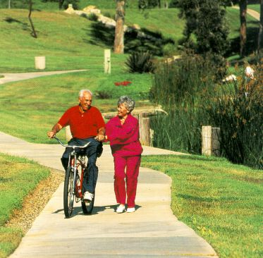
Physical exercise and cognitive decline in humans

