Slide 1
L’innovazione tecnologica
La centralità del cambiamento tecnologico
Approcci teorici
Economia neoclassica e growth accounting (Solow)
Schumpeter e i cicli
I contributi in prospettiva storica (Gerschenkron, Landes, Rosenberg)
Evolutionary economics (Nelson & §Winter)
Misure
Input
Le spese in Ricerca e Sviluppo (R&S)
Output
I brevetti
La produzione scientifica
Gli indici sintetici (Technology Achievement Index)
La critica degli indicatori
Caratteristiche istituzionali
L’Italia in prospettiva comparativa

Slide 2
Il National innovation system
Il network di istituzioni nel settore pubblico e privato le cui attività e interazioni promuovono, importano e diffondono le nuove tecnologie (Freeman)
Focus: politiche, R&S di impresa, capitale umano
Tutte le parti e gli aspetti della struttura economica e istituzionale che influenza i processi di apprendimento (Lundvall 1992)
Focus: processi di apprendimento, routines
Il set di istituzioni la cui interazione determina la performance innovativa delle imprese (Nelson 1993)
Focus: sistema della R&S

Slide 3
La spesa in R&S in alcuni paesi (1955-2010)
Countries | 1955-60 estimate | 1964 | 1970 | 1975 | 1980 | 1985 | 1990 | 1995 | 2000 | 2005 | 2010
China |  |  |  |  |  |  | 0.7 | 0.6 | 0.9 | 1.3 | 1.7
South Korea |  |  |  |  |  |  |  | 2.3 | 2.3 | 2.8 | 3.7
France | 0.8 | 1.8 | 1.8 | 1.7 | 1.7 | 2.2 | 2.3 | 2.3 | 2.2 | 2.1 | 2.3
Germany | 0.6 | 1.4 | 2.0 | 2.1 | 2.4 | 2.6 | 2.6 | 2.2 | 2.5 | 2.5 | 2.8
Japan |  | 1.5 | 1.8 | 1.8 | 2.0 | 2.5 | 2.8 | 2.7 | 3.0 | 3.3 | 3.4
Italy | 0.2 | 0.6 | 0.8 | 0.8 | 0.7 | 1.1 | 1.3 | 1.0 | 1.0 | 1.1 | 1.3
Netherlands |  | 1.8 | 1.9 | 1.9 | 1.8 | 2.0 | 2.1 | 2.0 | 1.9 | 1.9 | 1.8
United Kingdom | 1.6 | 2.3 | 2.2 | 2.0 | 2.4 | 2.2 | 2.1 | 1.9 | 1.8 | 1.7 | 1.8
Spain |  | 0.1 | 0.2 | 0.3 | 0.4 | 0.5 | 0.8 | 0.8 | 0.9 | 1.1 | 1.4
United States | 3.0 | 3.3 | 2.6 | 2.2 | 2.3 | 2.8 | 2.6 | 2.5 | 2.7 | 2.6 | 2.9
Sweden |  | 1.2 | 1.2 | 1.7 | 2.2 | 2.7 | 2.7 | 3.3 | 3.6 | 3.6 | 3.4
OECD |  | 1.1 | 1.3 | 1.3 | 1.3 | 1.5 | 1.6 | 1.6 | 1.7 | 1.8 | 2.0

Slide 4
Peso percentuale delle spese in R&S sul Pil per alcuni paesi e anni benchmark (1955-2010)

Slide 5
Numero di ricercatori (ula-tp) per 1.000 abitanti per alcuni paesi e anni benchmark (1963-64, 1981, 2010)

Slide 6
Quota brevetti registrati negli Stati Uniti (1883-2010)
 | China | France | Germany | Japan | Italy | Netherlands | South Korea | Spain | Sweden | Switzerland | United Kingdom | Others | Total
1883 | - | 17.8 | 23.3 | 0.2 | 0.3 | - | - | 0.2 | 1.2 | 2.2 | 43.2 | 11.7 | 100.0
1890 | - | 10.3 | 26.1 | 0.1 | 0.3 | 0.3 | - | 0.4 | 1.8 | 3.2 | 43.9 | 13.5 | 100.0
1900 | 0.1 | 10.9 | 34.3 | - | 1.0 | 0.8 | - | 0.2 | 1.5 | 2.5 | 34.1 | 14.4 | 100.0
1913 | 0.0 | 9.3 | 39.2 | 0.5 | 1.5 | 0.5 | - | 0.1 | 2.4 | 3.6 | 26.8 | 16.0 | 100.0
1927 | 0.1 | 11.4 | 33.1 | 0.8 | 2.5 | 1.7 | - | 0.7 | 3.3 | 4.5 | 25.8 | 16.1 | 100.0
1938 | 0.1 | 9.9 | 40.8 | 1.6 | 1.5 | 3.6 | 0.0 | 0.2 | 3.3 | 4.0 | 24.2 | 10.8 | 100.0
1950 | 0.1 | 17.5 | 0.6 | 0.1 | 1.0 | 9.1 | - | 0.5 | 7.5 | 11.0 | 40.5 | 12.2 | 100.0
1960 | - | 11.8 | 30.9 | 3.3 | 3.6 | 5.3 | 0.0 | 0.1 | 5.0 | 7.7 | 26.4 | 5.9 | 100.0
1970 | 0.0 | 10.6 | 27.3 | 16.1 | 3.5 | 3.3 | 0.0 | 0.3 | 3.9 | 6.8 | 18.1 | 9.9 | 100.0
1980 | - | 8.9 | 24.7 | 30.5 | 3.4 | 2.8 | 0.0 | 0.3 | 3.5 | 5.4 | 10.3 | 10.1 | 100.0
1990 | 0.1 | 7.0 | 18.5 | 47.5 | 3.1 | 2.3 | 0.5 | 0.3 | 1.9 | 3.1 | 6.8 | 8.9 | 100.0
2000 | 0.2 | 5.5 | 14.8 | 45.4 | 2.5 | 1.8 | 4.8 | 0.4 | 2.3 | 1.9 | 5.3 | 15.1 | 100.0
2010 | 2.5 | 4.2 | 11.6 | 41.9 | 1.7 | 1.5 | 10.9 | 0.4 | 1.3 | 1.5 | 4.0 | 18.6 | 100.0

Slide 7
Brevetti negli Stati Uniti di residenti stranieri per milione di abitanti (1883-2010)
 | Cina | Corea del Sud | Francia | Germania | Giappone | Italia | Olanda | Regno Unito | Spagna | Svezia | Svizzera
1883 |  |  | 4.5 | 5.3 | 0.1 | 0.1 |  | 12.3 | 0.1 | 2.6 | 7.7
1890 |  |  | 4.4 | 9.5 | 0.0 | 0.2 | 1.3 | 20.3 | 0.4 | 6.7 | 19.0
1900 | 0.0 |  | 8.4 | 19.7 |  | 1.0 | 5.1 | 25.8 | 0.3 | 9.0 | 23.9
1913 | 0.0 |  | 8.2 | 22.0 | 0.4 | 1.5 | 3.2 | 21.5 | 0.2 | 15.5 | 33.9
1927 | 0.0 |  | 12.0 | 22.2 | 0.6 | 2.7 | 9.9 | 24.5 | 1.2 | 23.7 | 48.5
1938 | 0.0 | 0.1 | 12.7 | 32.2 | 1.2 | 1.9 | 22.5 | 27.6 | 0.4 | 28.7 | 51.3
1950 | 0.0 |  | 16.1 | 0.4 | 0.0 | 0.8 | 35.3 | 31.7 | 0.6 | 41.9 | 91.4
1960 |  | 0.0 | 17.9 | 30.2 | 2.5 | 5.0 | 32.6 | 35.6 | 0.3 | 47.1 | 102.0
1970 | 0.0 | 0.1 | 33.3 | 57.1 | 25.2 | 10.6 | 41.7 | 53.1 | 1.7 | 78.1 | 177.4
1980 |  | 0.2 | 37.9 | 73.8 | 61.0 | 14.3 | 46.3 | 42.7 | 1.7 | 98.9 | 198.3
1990 | 0.0 | 5.2 | 49.3 | 95.9 | 158.0 | 22.2 | 64.2 | 48.6 | 3.3 | 89.7 | 187.8
2000 | 0.1 | 70.8 | 62.5 | 124.5 | 246.9 | 29.7 | 78.0 | 61.5 | 6.7 | 177.8 | 181.9
2010 | 2.0 | 240.6 | 69.1 | 150.2 | 352.6 | 30.9 | 96.6 | 70.4 | 10.2 | 158.3 | 211.5

Slide 8
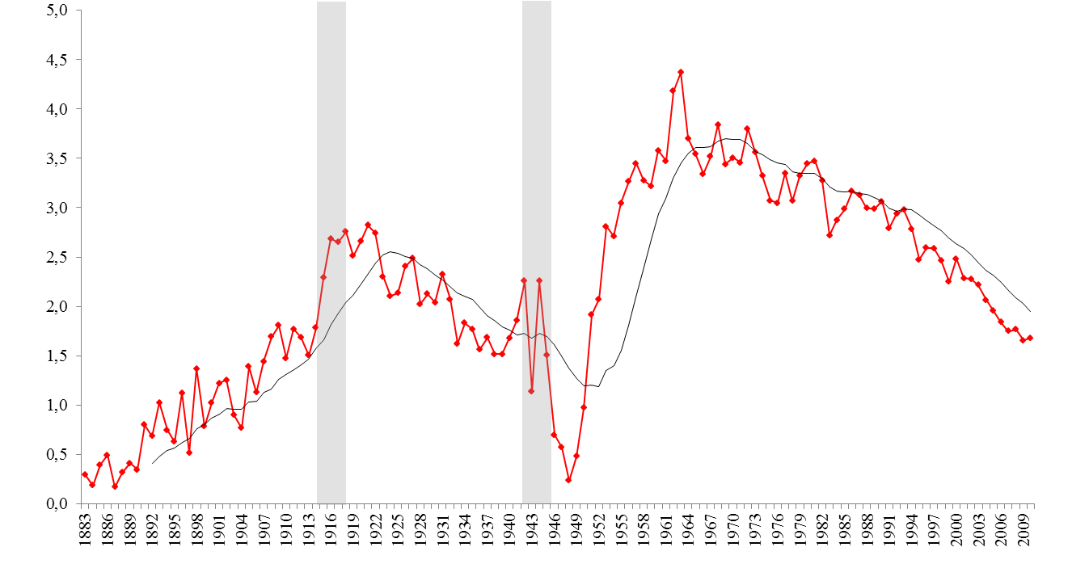
Quota dei brevetti italiani registrati negli Stati Uniti sul totale dei brevetti rilasciati a residenti stranieri (1883-2010)

Slide 9
Brevetti rilasciati negli Stati Uniti a residenti stranieri per paese (per milione di abitanti) e anni benchmark (1883, 1950, 2010)

Slide 10
Pattern di specializzazione dell’Italia per categorie tecnologiche (1963-2006
L’indice di Revealed Technological Advantage (RTA) = (Pij/ΣjPij)/(ΣiPij/ΣiΣjPij)
Codice | Categoria | 1963-1975 | 1976-1985 | 1986-1995 | 1996-2006 | 1963-2006
1 | Chimica | 1.398 | 1.240 | 1.203 | 1.307 | 1.309
2 | Computer e telecomunicazioni | 0.734 | 0.993 | 0.473 | 0.460 | 0.513
3 | Farmaci | 0.967 | 1.714 | 1.298 | 0.994 | 1.149
4 | Elettronica | 0.647 | 0.592 | 0.656 | 0.846 | 0.718
5 | Meccanica | 0.997 | 0.983 | 1.220 | 1.469 | 1.201
6 | Altri | 0.938 | 0.878 | 1.077 | 1.254 | 1.068

Slide 11
Ranking delle sub-categorie in cui l'Italia è più (meno) specializzata (RTA) (1963-2006)
Rank | 1963-1975 | 1976-1985 | 1986-1995 | 1996-2006 | 1963-2006
 | top specialized sub-categories
1 | Apparel & Textile (2.750) | Apparel & Textile (3.477) | Apparel & Textile (4.140) | Apparel & Textile (3.673) | Apparel & Textile (3.501)
2 | Resins (2.217) | Drugs (2.595) | Organic Compounds (2.360) | Receptacles (2.880) | Organic Compounds (2.208)
3 | Organic Compounds (1.977) | Organic Compounds (2.244) | Drugs (2.011) | Organic Compounds (2.222) | Receptacles (1.698)
4 | Biotechnology (1.568) | Computer Periphericals (1.268) | Receptacles (1.705) | Mat. Proc & Handling (1.895) | Resins (1.663)
 | top de-specialized sub-categories
1 | Semiconductor Devices (0.319) | Amusement Devices (0.037) | Amusement Devices (0.110) | Electronic business methods and software (0.094) | Electronic business methods and software (0.122)
2 | Electrical Lighting (0.361) | Surgery & Med Inst. (0.285) | Electronic business methods and software (0.127) | Amusement Devices (0.096) | Amusement Devices (0.190)
3 | Earth Working & Wells (0.392) | Semiconductor Devices (0.379) | Information Storage (0.325) | Computer Periphericals (0.214) | Computer Periphericals (0.317)
4 | Surgery & Med Inst. (0.453) | Nuclear & X-rays (0.391) | Nuclear & X-rays (0.348) | Communications (0.337) | Surgery & Med Inst. (0.445)

Slide 12
Ranking delle sub-categorie in cui l'Italia è più (meno) specializzata (RTA) (1963-2006)
Rank | 1963-1975 | 1976-1985 | 1986-1995 | 1996-2006 | 1963-2006
 | top specialized sub-categories
1 | Apparel & Textile (2.750) | Apparel & Textile (3.477) | Apparel & Textile (4.140) | Apparel & Textile (3.673) | Apparel & Textile (3.501)
2 | Resins (2.217) | Drugs (2.595) | Organic Compounds (2.360) | Receptacles (2.880) | Organic Compounds (2.208)
3 | Organic Compounds (1.977) | Organic Compounds (2.244) | Drugs (2.011) | Organic Compounds (2.222) | Receptacles (1.698)
4 | Biotechnology (1.568) | Computer Periphericals (1.268) | Receptacles (1.705) | Mat. Proc & Handling (1.895) | Resins (1.663)
 | top de-specialized sub-categories
1 | Semiconductor Devices (0.319) | Amusement Devices (0.037) | Amusement Devices (0.110) | Electronic business methods and software (0.094) | Electronic business methods and software (0.122)
2 | Electrical Lighting (0.361) | Surgery & Med Inst. (0.285) | Electronic business methods and software (0.127) | Amusement Devices (0.096) | Amusement Devices (0.190)
3 | Earth Working & Wells (0.392) | Semiconductor Devices (0.379) | Information Storage (0.325) | Computer Periphericals (0.214) | Computer Periphericals (0.317)
4 | Surgery & Med Inst. (0.453) | Nuclear & X-rays (0.391) | Nuclear & X-rays (0.348) | Communications (0.337) | Surgery & Med Inst. (0.445)

Slide 13
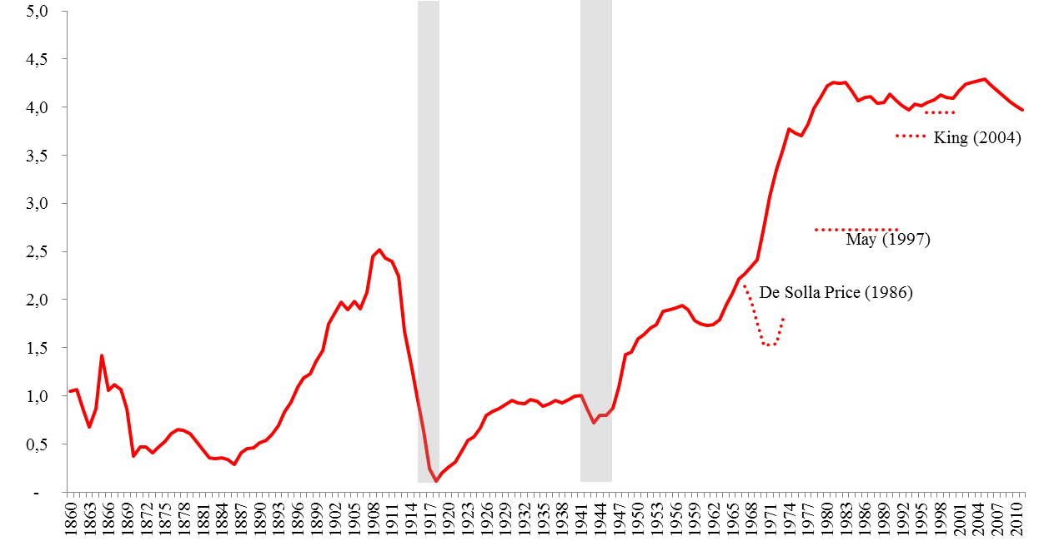
The output dimension of the Italian NIS: scientific knowledge 1/2
Share of Italian publications in AS (1860-2011)

Slide 14
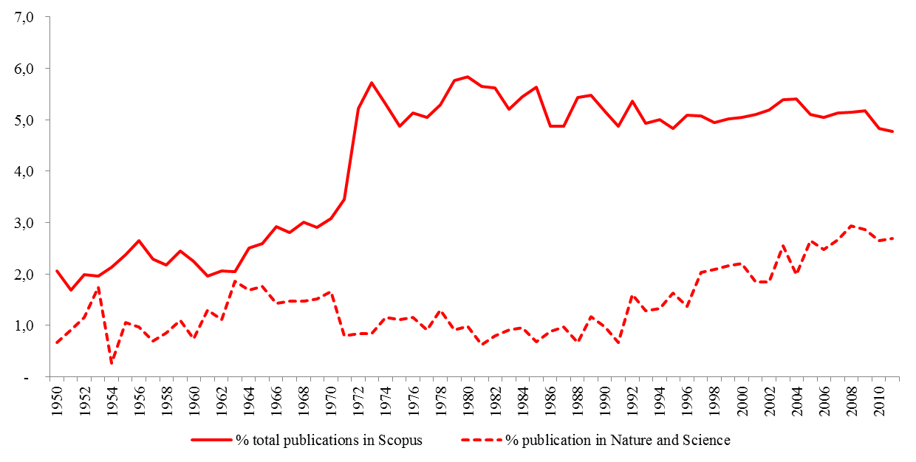
The output dimension of the Italian NIS: scientific knowledge 2/2
Share of Italian publications (AS vs N&S) on selected countries (1950-2011)

Slide 15
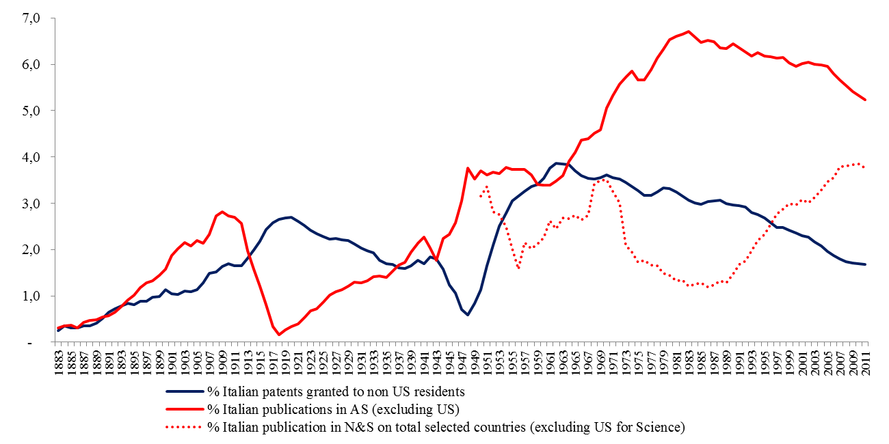
A mismatch between science and technology?
Technological activity versus research activity, Italy (1883-2011)

Slide 16
Ranking delle prime 10 imprese innovatrici italiane (1969-2004)
Ranking | Numero brevetti | Società
1 | 2133 | SGS-THOMSON MICROELECTRONICS S.R.L.
2 | 626 | G.D. S.P.A.
3 | 608 | OLIVETTI, ING. C., + C. S.P.A.
4 | 460 | MONTECATINI EDISON S.P.A.
5 | 432 | SNAM PROGETTI S.P.A.
6 | 431 | MONTEDISON S.P.A.
7 | 392 | AUSIMONT S.P.A.
8 | 383 | FIAT SOCIETA PER AZIONI
9 | 340 | FARMITALIA CARLO ERBA, S.P.A.
10 | 330 | CSELT - CENTRO STUDI E LABORATORI TELECOMUNICAZIONI S.P.A.

