Slide 1
Group Presentation: Productivity
International Trade
Giorgia Giovannetti
University of Florence
21.11.2019
Jan Hauer, Clara Barroso Raya, Victor Martin Ortega, Juan Alonso Perez

Slide 2
Agenda
Introduction What’s productivity, determination, productivity changes, intersectoral effect
European and global manufacturing trends,challenges and the way ahead
The competitiveness of European industry in the digital era
Firm growth dynamics and productivity in Europe
A revival of manufacturing in Europe Recent evidence about reshoring

Slide 3
Determination of Productivity (theoretical)
Physical productivity is the quantity of output produced by one unit of production input in a unit of time
Economic productivity is the value of output obtained with one unit of input.
Average economic productivity is determined by dividing output value and (time/physical) units of input. If the production process uses only one factor (e.g. labour) this procedure gives the productivity of that factor, in this case labour productivity.
"Total factor productivity" is the attempt to construct a productivity measure for an aggregation of factors. The meaningfulness of such an aggregation requires additional hypotheses, thus it is not assured in a general framework.
Notes:
Usual input unit’s: capital, labour
Measuring and comparing productivity by the units of output divide that by the units of input
When more than one input is used, for each factor it is possible to compute by the same procedure its productivity, called in this case "partial".

Slide 4
Changes in Productivity
Classical gain in productivity through substitution of labour by capital
Product Innovation: new product or substantial improvement which suppress competitor out of market
Process Innovation: new method, arrangement of existing techniques to improve efficiency. New methodical requirement as result of a Product Innovation (interconnection resulting in difficult differentiation)

Slide 5
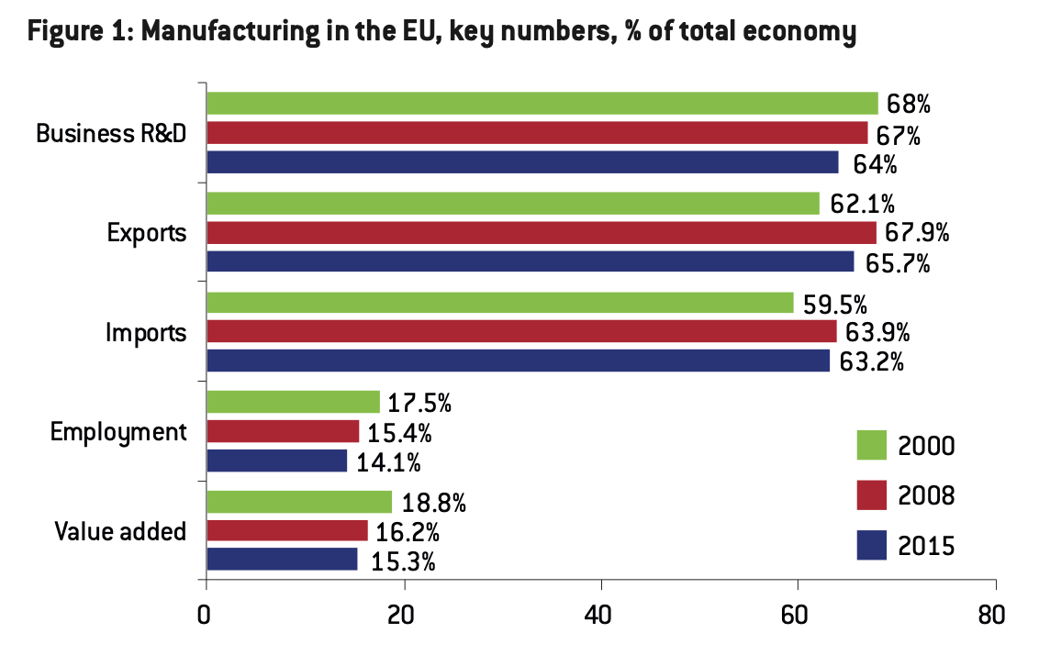
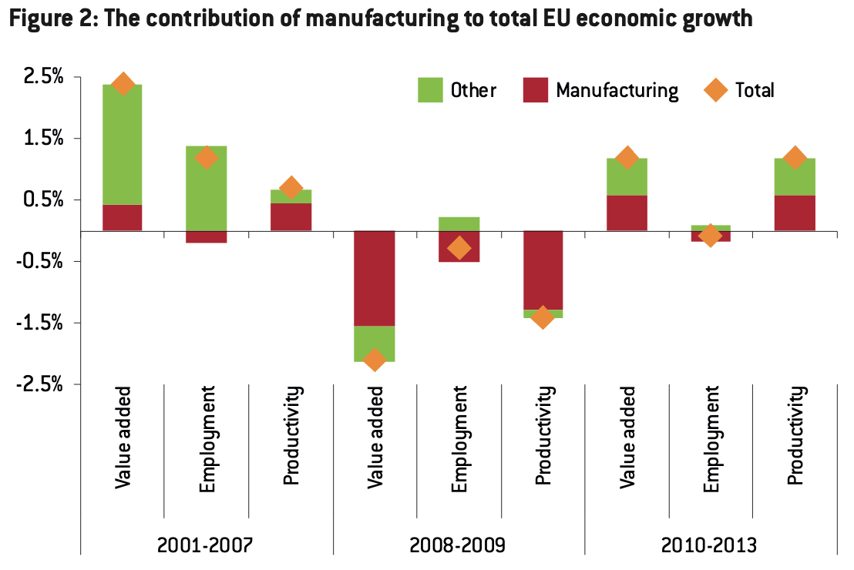
The decline of manufacturing value added and employment ongoing since the 1970s in major advanced countries. As such, the European Commission’s 20 percent target for manufacturing to contribute to EU GDP by 2020 does not look to be attainable
Source: Bruegel based on Eurostat. Note: Growth rates are annual average growth rates over the periods

Slide 6
Importance of Manufacturing
Despite its declining weight in the overall EU economy, manufacturing accounts for two-thirds of total R&D, provides half of productivity growth and represents 63 percent to 65 percent of exports and imports. Therefore, manufacturing will remain a vital sector in the EU for its innovation, productivity and trade potential.
Also highly important and not sufficiently portrayed in the former views are Up- and Downstream Services (often outsourced) that are highly interconnected the the manufacturing sector but are not accounted the neither value added or employed persons.
(Kuhlke, 2010, pp. 7-8)
Notes:
reallocation of resources is needed. What matters in this process is reallocation within manufacturing to sectors, activities and jobs with scope for high value added.

Slide 7
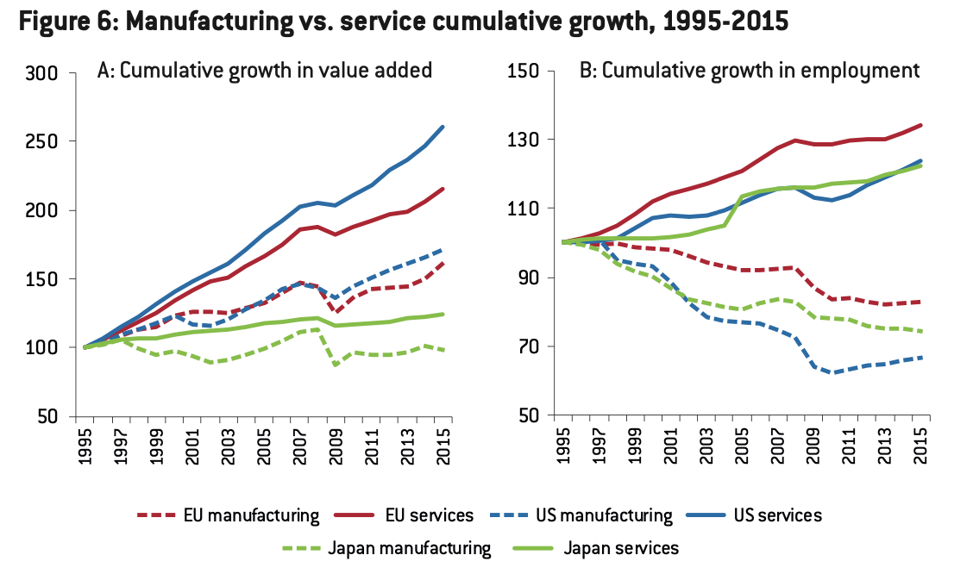
Source: Bruegel based on Eurostat, US Bureau of Economic Analysis, and Government of Japan Cabinet Office statistics.
Notes:
The absolute number of jobs in EU manufacturing has declined. At the same time output per hour and, to a lesser extent, real hourly compensation have increased in more EU countries and in the US. To put it simply, manufacturing is employing fewer workers who generate greater output for higher pay.

Slide 8
Reasons against focus on Manufacturing
Globalisation rising interaction and competition -> shorter product-life-cycle -> Higher value for knowledge intensive services
Innovation-Hypothesis: modern knowledge Economies develop radical Innovations without substitution effect on labour market (e.g. Tanning beds, Apps, Web design)
Sectoral development from 1800 has already been explained in 1960’s Explained by technological advances and income elasticity (Fourasti, 1963)
High productivity and GDP growths in “fourth sector” (ICT)
(Klier, 1999, p. 141)
(Knottenbauer, 2000, pp. 109-114) DIW, 1996, pp. 221-226)
Notes:
The EU has innovation capacity mainly in medium-high technology sectors, particularly motor vehicles, chemicals and industrial technology
the US is a leader in high R&D intensity sectors software, biotechnology and computer electronics. In this respect, there is room for the EU to expand its innovation potential by focusing on higher technology-intensive sectors including services sectors.

Slide 9
The competitiveness of European industry in the digital era
The competitiveness of European industry in the digital era

Slide 10
The macro view: manufacturing growth and its determinants
The real value added growth of the manufacturing sector is broken down into:
The contributions of TFP (Total Factor Productivity) growth
Information and Comunications Technology (ICT)
Non-ICT capital
Hours worked
Labour composition

Slide 11
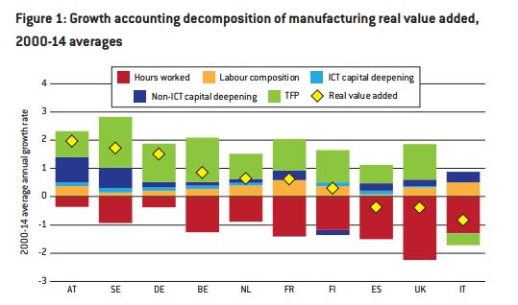

Slide 12
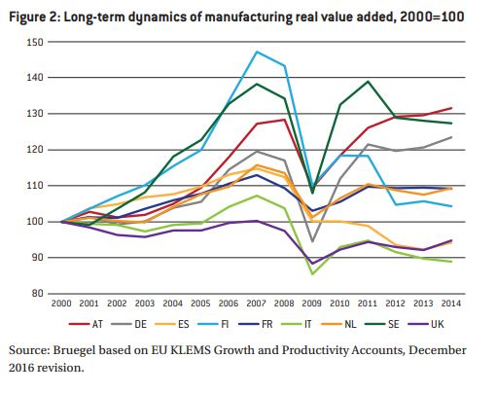
These long-term averages hide a great cyclicality of the value added generated by manufacturing. This was evident during the crisis of 2008-09, as shown by Figure 2, which also shows great variation in the speed of recovery of different countries after the crisis.

Slide 13
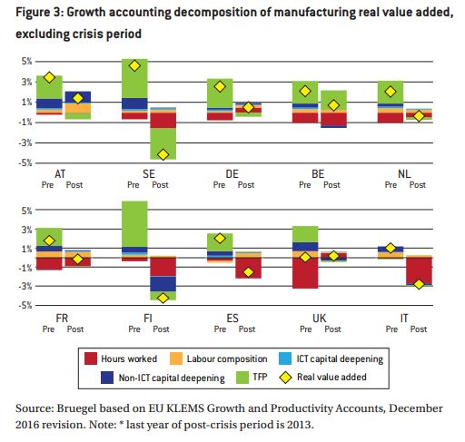
The post-crisis period has been characterized by a general slowdown in the average growth rate of real value added in the manufacturing sector mainly driven by:
Collapse in the contribution of TFP
Substantial decrease of non-ICT capital deepening.
The depressive effects were deeper in Italy, Spain and Finland due to a remarkable reduction of hours worked.

Slide 14
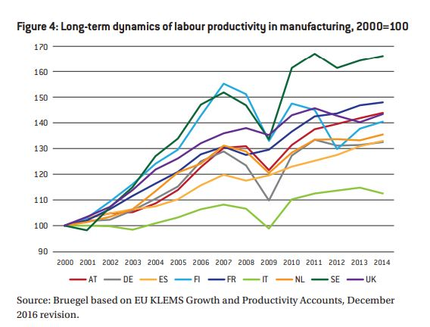
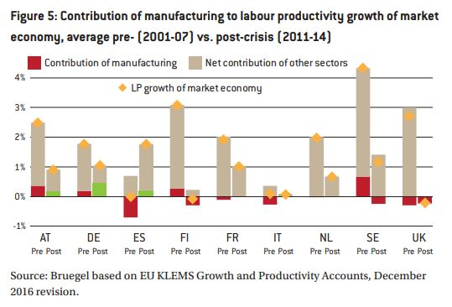
Manufacturing vs. total economy: the same output with fewer jobs?
When the trends before and after are compared, a slowdown in productivity growth clearly emerges also for labour productivity. This cyclical slowdown has been mainly driven by an ‘decoupling’ of hours worked and production.

Slide 15
From macro to micro: evidence from a new survey of firms’ strategies
We use a new firm-level dataset made avaliable by Assolombarda. The dataset is a representative sample of manufacturing firms with more than 10 employees operating in five large European regions:
Lombardy, Italy
Baden-Württemberg, Germany
Bavaria, Germany
Catalonia, Spain
Rhône-Alpes, France

Slide 16
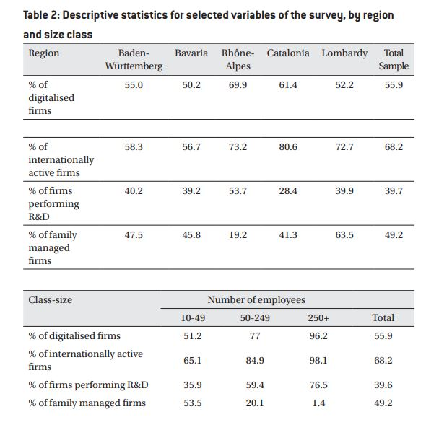
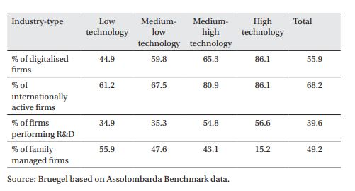

Slide 17
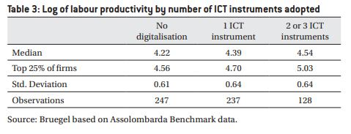

Slide 18
Firm Growth dynamics and productivity in Europe

Slide 19
European
Countries
United States
Compare
Differences between countries Policymakers
Policymakers
Differences in aggregate productivity growth and widening productivity gap

Slide 20
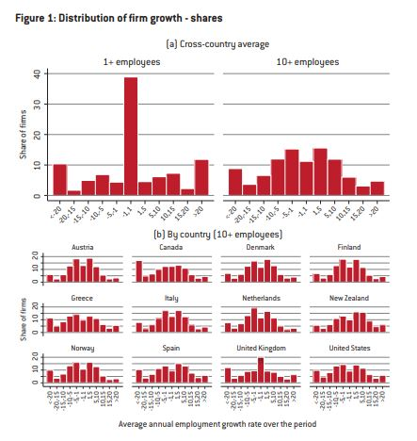
Each column indicates the share of firms average annual employment growth rates
UK will have very high job relocation rates, because of the level of growth and contraction

Slide 21
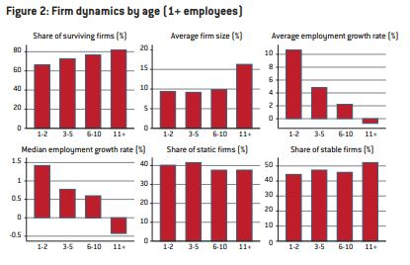
e
Less safe of surviving for the small firms but they are growing more

Slide 22
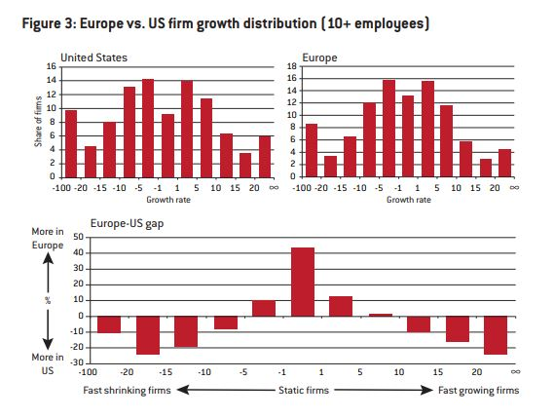
As we can see USA has a more dynamic firm growth distribution than the average European country, more growing and shrinking.
Comparison Between Europe and U.S.

Slide 23
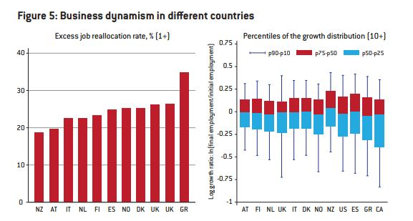

Slide 24
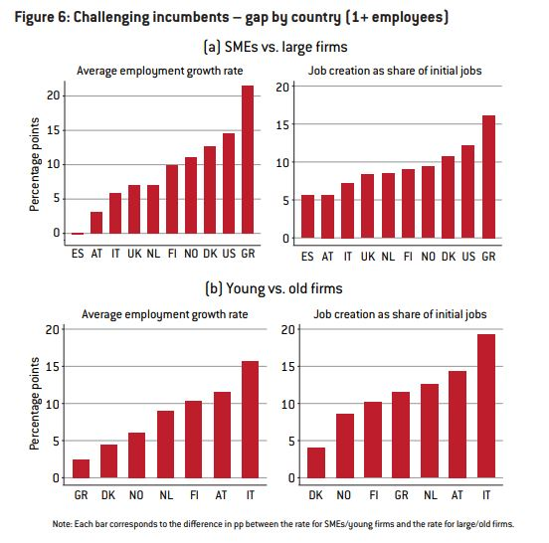
Each bar represent the difference between the SMEs/ Large firm and Young/ Old firm
The US shows a higher difference
The institutional framework makes the growth easier for SMEs and Young firms.

Slide 25
Conclusions
-There is a regular pattern in different countries and sector about the growth distribution,Most of the companies remain constant in performance. Usually the average growth dismiss with the age and the size of the firms, but not in an equal way.
-The US has more high-growth firms than Europe, but this is only one part of the picture. European coun­tries have a less dynamic firm growth overall, with slower growth and slower contraction
-European politics should think about making a new regulation for a single European market, where the faster resource reallocation between firms and make it easier for the firms to scale up around Europe,This would give the option to the start-ups to operate with the same rules and procedures across Europe.

Slide 26
A revival of manufacturing in Europe? Recent evidence on reorganization

Slide 27
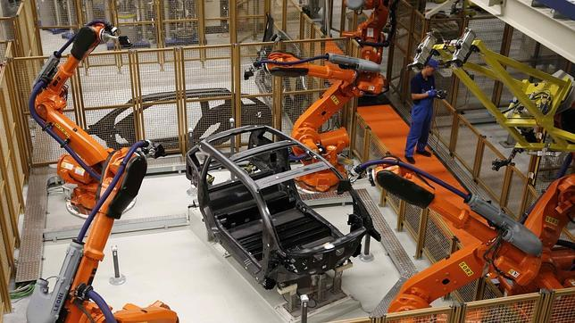
Introduction
The shipping of manufacturing jobs from western Europe and the United States, particularly to Asia and China, continues to provoke strong opinions.
Some say that offshoring will continue to characterize the manufacturing sector in the west.
Others say the digital revolution will lead to a revival of manufacturing jobs in Europe.
With robots, artificial intelligence, 3D printing and other advanced manufacturing technologies, the cost of labor will be a less important factor in deciding where to locate manufacturing facilities and jobs.

Slide 28
2. Global value chains, offshoring and reshoring
A much discussed phenomenon for the revival of manufacturing in the west is reshoring, that is the relocation of production from abroad back home.
First, the cost: structure of production is changing in emerging countries. Wages have been increasing, decreasing these countries’ cost advantages.
Second, technological advances support reshoring.
The relocation of manufacturing jobs to low-wage countries has been a major feature of globalisation since the 1990s. The new model of international division of labour evolves around global value chains.
Rapid advances in ICT have resulted in a marked reduction in the costs associated with coordination.

Slide 29
3. Recent evidence on off- and re-shoring
As offshoring destinations (or countries of origin for imported intermediates) we consider:
Southern Europe (Italy, Spain, Portugal and Greece),
Central and eastern Europe (Poland, the Czech Republic, Hungary, Slovakia, Slovenia, Romania and Bulgaria),
Emerging economies (China, India, Indonesia, Brazil and Mexico).
Among these, we look specifically at China as a important destination for offshoring. Most of these destination regions can be considered as countries with lower labour costs, compared to the origin countries. But some, like China, are also important as a destination market for consumption.

Slide 30
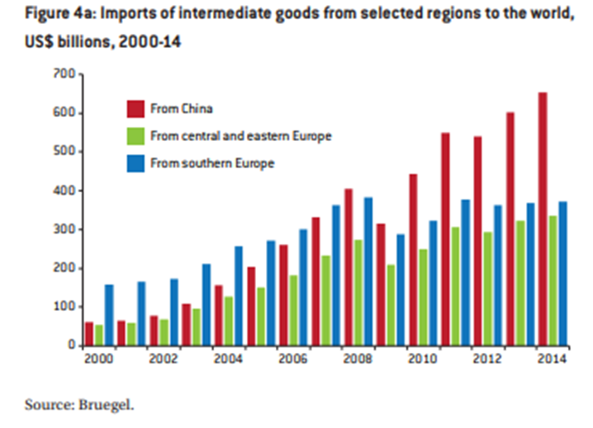
4. Offshoring destinations

Slide 31
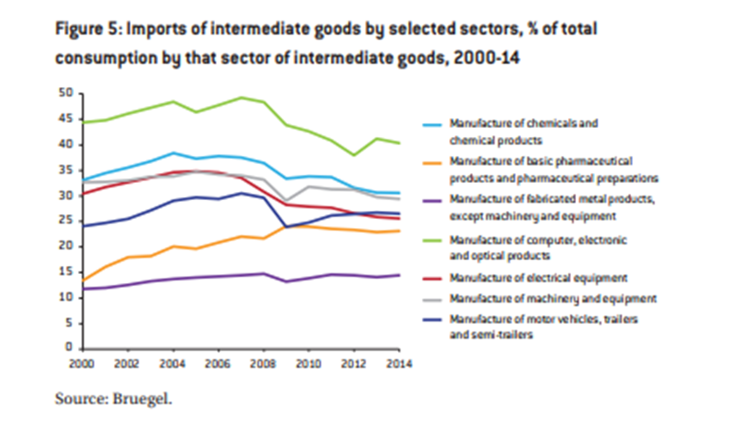
5. Sectoral Patterns

Slide 32
Sources
Main:
Veugelers, R., 2017. Remaking Europe: the new manufacturing as an engine for growth. Brussels: Blueprint
DIW, 1996, DIW Wochenbericht 14/96, s.l.: Deutsches Institut für Wirtschaftsforschung
Fourastie, J., 1963. Die große Hoffnung des Zwanzigsten Jahrhunderts. Paris: s.n.
Klier, 1999, Die Zukunft der Arbeit. Sternefels: s.n.
Kuhlke, 2010. Wirtschaftsgeographie Deutschlands. Heidelberg: s.n.
Knottenbauer, 2000. Theorie des sektoralen Struckturwandels. Hohenheim: s.n.

