Slide 1
Current Medications for HCV
Older Medications
Pegylated Interferon – PegIntron or Pegasys
Ribavirin
Older Direct Acting Antivirals
Boceprevir (Victrelis; protease inhibitor)
Telaprevir (Incivek; protease inhibitor)
New Direct Acting Antivirals
Simeprevir (Olysio HCV NS3/A4 protease inhibitor)
Sofosbuvir (Sovaldi; è un inibitore pan-genotipico dell'RNA polimerasi NS5B RNA-dipendente dell'HCV)

Slide 2
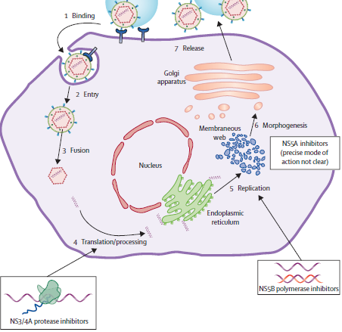
Daclatasvir
Ledipasvir
ABT- 267
Telaprevir
Boceprevir
Simeprevir
Faldapravir
ABT-450
Sofosbuvir
ABT-333
Notes:
Ns5a proteina non strutturale che ha ruolo nella replicazione del virus

Slide 3
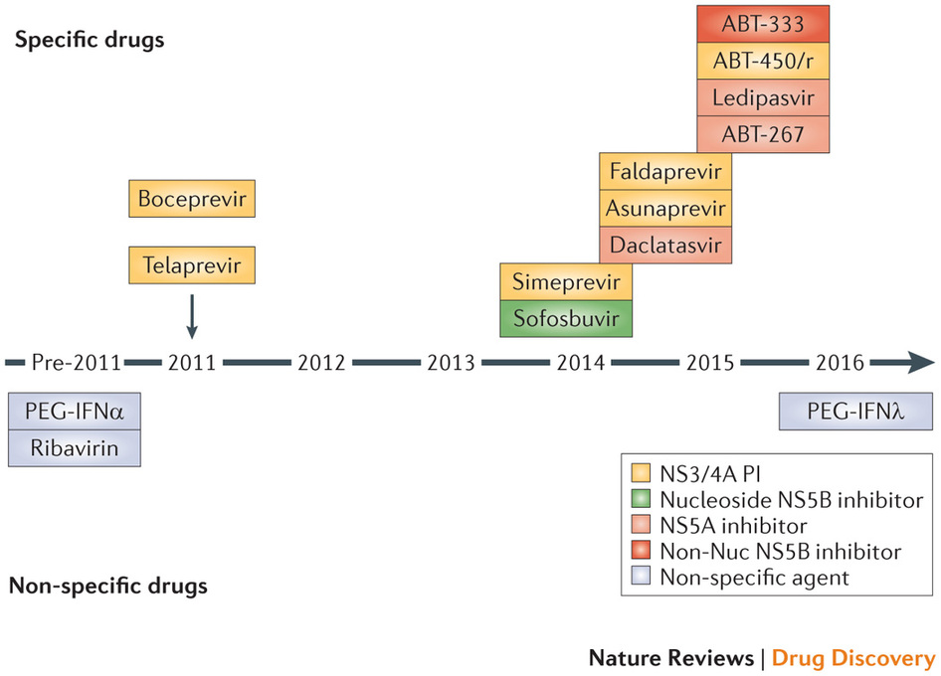

Slide 4
Challenges with Older DAA
Telaprevir (Incivek)
Rash – Black Box Warning
Anemia – Worse than Pegylated interferon + Ribavirin alone
Needs interferon and ribavirin – brings all ADRs with it too
Anorectal adverse events challenging
Only for Genotype 1 – ie not pangenotypic
Response guided therapy/stopping rules
Drug Interactions complex, especially when treating co-infection
Large pull burden (6/day), TID, now BID frequency

Slide 5
Challenges with Older DAA
Boceprevir (Victrelis)
Dygeusia –Anemia – Worse than Pegylated interferon + Ribavirin alone
Needs interferon and ribavirin – brings all ADRs with it too
4 week lead in period
Only for Genotype 1 – ie not pangenotypic
Response guided therapy/stopping rules
Drug Interactions complex, especially when treating co-infection
Large pull burden (12/day), TID frequency

Slide 6
Contraindicated medications with boceprevir and telaprevir
Drug Class | Contraindicated With BOC^{[1]} | Contraindicated With TVR^{[2,3]}
Alpha 1-adrenoreceptor antagonist | Alfuzosin | Alfuzosin
Anticonvulsants | Carbamazepine, phenobarbital, phenytoin | Carbamazepine, phenobarbital, phenytoin
Antimycobacterials | Rifampin | Rifampin
Ergot derivatives | Dihydroergotamine, ergonovine, ergotamine, methylergonovine | Dihydroergotamine, ergonovine, ergotamine, methylergonovine
GI motility agents | Cisapride | Cisapride
Herbal products | St John’s wort | St John’s wort
HMG CoA reductase inhibitors | Lovastatin, simvastatin | Lovastatin, simvastatin
Oral contraceptives | Drospirenone | N/A
Neuroleptic | Pimozide | Pimozide
PDE5 inhibitor | Sildenafil or tadalafil when used for tx of pulmonary arterial HTN | Sildenafil or tadalafil when used for tx of pulmonary arterial HTN
Sedatives/hypnotics | Triazolam; orally administered midazolam | Triazolam; orally administered midazolam
1. Boceprevir [package insert]. 2013. 2. Telaprevir [package insert]. 2013., 3. www.hep-druginteractions.org
Notes:
The actual list of absolute no-no medications, medications that cannot be utilized with either telaprevir or boceprevir, is summarized on this table. It includes alpha-1 adrenergic antagonists, certain anticonvulsants, certain antibacterial agents, ergot derivatives, GI motility agents, certain herbal products, the HMG CoA reductase inhibitors utilized to treat elevated serum cholesterol, oral contraceptives as we already mentioned, certain neuroleptics, phosphodiesterase inhibitors, and sedative hypnotic agents. These drugs listed on these table should not be utilized in patients receiving boceprevir or telaprevir at all. If patients are already on these medications, the physician should search for an alternative medication before starting therapy.

Slide 7
Concurrent Medication | Boceprevir allowed | Telaprevir allowed
Atazanavir/ritonavir (Reyataz®/Norvir®) | No | Yes
Darunavir/ritonavir (Prezista®/Norvir®) | No | No
Fosamprenavir/ritonavir (Lexiva®/Norvir®) | No, not studied to date | No
Lopinavir/ritonavir (Kaletra®) | No | No
Efavirenz (Sustiva®) | No | Yes, increase TLV dose to 1125mg Q8H
Etravirine (Intelence®) | Yes, reduced etravirine levels reported | Yes
Rilpivirine (Edurant®) | Yes | Yes
Tenofovir (Viread®) | Yes | Yes, monitor renal fx
Raltegravir (Isentress®) | Yes | Yes
Elvitegravir (in Stribild®) | ?? | Yes
Dolutegravir (Tivicay®) | Yes | Yes
Maraviroc (Selzentry®) | Yes, MRV 150mg BID | Yes, MRV 150mg BID

Slide 8
Daclatasvir
Ledipasvir
ABT- 267
Telaprevir
Boceprevir
Simeprevir
Faldapravir
ABT-450
Sofosbuvir
ABT-333
Notes:
Ns5a proteina non strutturale che ha ruolo nella replicazione del virus

Slide 9
Simeprevir FDA Approved November 22, 2013
FDA Panel recommended approval October 24, 2013, formal approval November 22, 2013
Recommend approval of simeprevir, an HCV NS3/4A protease inhibitor, in combination with pegylated interferon/ribavirin
150 mg once-daily for use by genotype 1 hepatitis C patients, either treatment-naive or prior non-responders, with food
No dosage recommendations for East Asian ancestry subjects
Janssen Research and Development. FDA Advisory Committee Recommends Approval of Simeprevir
for Combination Treatment of Genotype 1 Chronic Hepatitis C in Adult Patients. Press release. October 24, 2013.
www.olysio.com. Accessed June 4, 2014.

Slide 10
Simeprevir Key Points
Duration of Treatment with Simeprevir, peg-interferon alfa, ribavirin
 | Simeprevir, peg-interferon alfa + ribavirin | Peg-interferon alfa + ribavirin | Total treatment duration
Naïve, prior relapser, including cirrhosis | First 12 weeks | Additional 12 weeks | 24 weeks
Prior non-responders, including cirrhosis | First 12 weeks | Additional 36 weeks | 48 weeks
Simeprevir Stopping Rules
Week 4, > 25IU/mL | Discontinue simeprevir, peg-interferon and ribavirin
Week 12, > 25IU/mL | Discontinue peg-interferon alfa and ribavirin (simeprevir complete at week 12)
Week 24, > 25IU/mL | Discontinue peg-interferon alfa and ribavirin
Janssen Research and Development. FDA Advisory Committee Recommends Approval of SimeQ*)previr
for Combination Treatment of Genotype 1 Chronic Hepatitis C in Adult Patients. Press release. October 24, 2013.
www.olysio.com. Accessed June 4, 2014.

Slide 11
Drug Interactions Considerations
Simeprevir
Mild inhibitor of CYP1A2 activity and intestinal CYP3A4
Does not affect hepatic CYP3A4 activity
Inhibits OATP1B1/3 and P-glycoprotein
Multiple drug interactions expected
www.hcvguidelines.org

Slide 12
Medications to Avoid with Simeprevir
Medication and or Class | Rationale for Avoiding with Simeprevir
Anticonvulsants - carbamazepine, oxcarbazepine, phenobarbital, phenytoin | Co-administration with these medications is likely to reduce concentrations of simeprevir and lead to reduced simeprevir efficacy. Co-administration not recommended.
Antibiotics – clarithromycin, erythromycin, telithromycin | Co-administration with these medications is likely to increase concentrations of either simeprevir or the antibiotic due to CYP3A4 and P-glycoprotein (P-gp) inhibition. Co-administration not recommended.
Antifungals – fluconazole, itraconazole, ketoconazole, posaconazole, voriconazole | Co-administration with these medications is likely to increase concentrations of simeprevir due to CYP3A4 inhibition from the antifungals. Co-administration not recommended.
Antimycobacterials – rifampin, rifabutin, rifapentine | Co-administration with these medications is likely to reduce concentrations of simeprevir and lead to reduced simeprevir efficacy. Co-administration not recommended.
www.nynjaetc.org

Slide 13
Medications to Avoid with Simeprevir
Medication and or Class | Rationale for Avoiding with Simeprevir
Corticosteroids – dexamethasone | Co-administration with dexamethasone is likely to decrease concentrations of simeprevir and lead to reduced simeprevir efficacy. Co-administration not recommended.
Propulsive – cisapride | Co-administration with cisapride may result in increased concentrations of cisapride leading to potential cardiac arrhythmias.
Herbal products – Milk Thistle, St. John’s Wort | Co-administration with milk thistle is likely to increase concentrations of simeprevir. Co-administration not recommended. Co-administration with St. John’s Wort is likely to reduce concentrations of simeprevir leading to reduced simeprevir efficacy, due to intestinal P-glycoprotein (P-gp) induction associated with St. John’s Wort.
www.nynjaetc.org

Slide 14
Sofosbuvir FDA Approved, December 6, 2013
FDA Panel recommended approval October 25, 2013
Recommendation covers both use with interferon-based therapy for treatment-naive people with HCV genotypes 1 or 4
Also use in dual therapy with ribavirin for people with easier-to-treat HCV genotypes 2 or 3 - the first approved interferon-free regimen
Gilead Sciences. FDA Advisory Committee Supports Approval of Gilead’s Sofosbuvir for Chronic
Hepatitis C Infection. Press release. October 25, 2013. www.solvadi.com. Accessed June 4, 2014.

Slide 15
Sofosbuvir Key Points
Indication
NS5B nucleotide polymerase inhibitor for the treatment of chronic HCV as a component of combination anitiviral treatment regimen
400 mg tablet, once daily dosing, with no food restrictions
HCV Mono-infected and HCV/HIV Co-infected | Treatment | Duration
Genotype 1 or 4 | Sofosbuvir + PEG-interferon + ribavirin | 12 weeks
Genotype 2 | Sofosbuvir + ribavirin | 12 weeks
Genotype 3 | Sofosbuvir + ribavirin | 24 weeks
www.solvadi.com. Accessed June 4, 2014.

Slide 16
Sofosbuvir Key Points
Sofosbuvir + ribavirin ALONE for 24 weeks can be considered for GT1 if intolerant to interferon
No dosage recommendation can be made in patients with severe renal impairment or ESRD – up to 20 fold increase in SOF metabolite
Contraindications – Monotherapy, also ribavirin birth defects
www.solvadi.com. Accessed June 4, 2014.

Slide 17
Sofosbuvir Key Points
Adverse Events
Headache and fatigue most common
Anemia and insomnia, nausea when adding peginterferon + ribavirin
Additional info
HIV/HCV coinfection studied, also data on patients with HCC awaiting liver transplantation studied
Drug Interactions
Intestinal PGP inducers likely to reduce levels –ie rifampin, St Johns Wort
www.solvadi.com. Accessed June 4, 2014
Notes:
P glicoproteina

Slide 18
Drug Interactions Considerations
Sofosbuvir
Substrate for P-glycoprotein and breast cancer resistance protein
Intracellular metabolism mediated by hydrolase and nucleotide phosphorylation pathways
Minimal drug interactions expected
www.hcvguidelines.org

Slide 19
Medications to Avoid with Sofosbuvir
Medication and or Class | Rationale for Avoiding with Sofosbuvir
Anticonvulsants – carbamazepine, oxcarbazepine, phenobarbital, phenytoin | Co-administration with these medications is likely to reduce concentrations of sofosbuvir leading to reduced sofosbuvir efficacy. Co-administration not recommended.
Antimycobacterials – rifampin, rifabutin, rifapentin | Co-administration with these medications is likely to reduce concentrations of sofosbuvir leading to reduced sofosbuvir efficacy due to intestinal P-glycoprotein (P-gp) induction from rifampin.
Herbal products – St. John’s Wort | Co-administration with these medications is likely to reduce concentrations of sofosbuvir leading to reduced sofosbuvir efficacy due to intestinal P-glycoprotein (P-gp) induction associated with St. John’s Wort.
www.nynjaetc.org

Slide 20
COSMOS Study Design
Arm1
SMV+SOF+RBV
Post-treatment follow-up
Arm2
SMV+SOF
Post-treatment follow-up
Randomized
2:1:2:1
Arm 3
SMV+SOF
+ RBV
Post-treatment follow-up
Arm 4
SMV+SOF
Post-treatment follow-up
12 24 36 48
Cohort 1 – Metavir F0-F2, prior null responders
Cohort 2 – Metavir F3-F4, prior null responders or naives
Primary Endpoint: SVR12 (sustained viral response, no hcv 12 weeks after the end of treatment)
Secondary Endpoints: RVR, Tx failure, relapse rate, safety
Lawitz, etal. 49th EASL, April 9-13, 2014; Lancet, 2014.
Notes:
SMV simeprevir
The medical term for a successful hepatitis C treatment outcome is sustained viral response (SVR). Undetectable HCV for 24 or more weeks after the end of treatment is an SVR24. Recently, many studies use the term SVR12, meaning that hepatitis C is undetectable for twelve or more weeks after the end of treatment.

Slide 21
METAVIR
F0 in cui non vi è danno fibrocicatriziale ed il fegato è, nonostante l'infezione in corso, sostanzialmente normale.
F1 in cui il danno è limitato, non significativo ed è lecito pensare di rimanere in vigile attesa
F2 in cui il danno fibrocicatriziale può essere considerato significativo ed il paziente da candidare alla terapia del caso
F3 in cui il danno sclerocicatriziale, la fibrosi, è severo.
F4 in cui il paziente è da considerare pre o francamente cirrotico.

Slide 22
COSMOS, Baseline Characteristics
Characteristic | SMV/SOF+ RBV 24 weeks n=30 | SMV/SOF 24 weeks n=16 | SMV/SOF + RBV 12 weeks n=27 | SMV/SOF 12 weeks n=14 | Total n=87
Male, % | 70 | 44 | 74 | 71 | 67
White/African American | 97/3 | 81/19 | 93/7 | 86/14 | 91/9
Hispanic, Latino | 10 | 31 | 19 | 14 | 17
Median Age | 58 | 58 | 57 | 58 | 58
Median BMI | 28 | 29 | 27 | 32 | 28
GT 1a | 77 | 75 | 82 | 79 | 78
GT 1a, Q80K | 48 | 42 | 36 | 30 | 40
Median HCV VL | 6.3 | 6.6 | 6.7 | 6.7 | 6.6
Null Responders | 57 | 50 | 56 | 50 | 54
IL28B, non CC | 73 | 88 | 85 | 71 | 79
Cirrhosis | 43 | 63 | 41 | 50 | 47
Lawitz, etal. 49th EASL, April 9-13, 2014.

Slide 25
COSMOS, SVR 12 (ITT) Results
28/30
16/16
25/27
13/14
82/87
24 weeks 12 weeks Overall
Lawitz, etal. 49th EASL, April 9-13, 2014.

Slide 28
Standard Dosing
Sofosbuvir – 400mg once daily
Simeprevir – 150mg once daily
Peg Interferon – 180mcg once weekly
Ribavirin – weight based dosing
<75kg – 1000mg daily in divided doses
≥75 kg – 1200mg daily in divided doses
www.hcvguidelines.org

Slide 29
IFN Ineligible Definitions
Intolerance to IFN
Autoimmune hepatitis and other autoimmune disorders
Hypersensitivity to PEG or any of its components
Decompensated hepatic disease
History of depression, or clinical features consistent with depression
A baseline neutrophil count below 1500/μL, a baseline platelet count below 90,000/μL or baseline hemoglobin below 10 g/dL
A history of preexisting cardiac disease
www.hcvguidelines.org

Slide 30
I criteri di prioritizzazione individuano i seguenti gruppi di pazienti:
Pazienti con cirrosi in classe di Child A o B e/o con HCC con risposta completa a terapie resettive chirurgiche o loco-regionali non candidabili a trapianto epatico nei quali la malattia epatica sia determinante per la prognosi.
Epatite ricorrente HCV-RNA positiva del fegato trapiantato in paziente stabile clinicamente e con livelli ottimali di immunosoppressione
Epatite cronica con gravi manifestazioni extra-epatiche HCV-correlate (sindrome crioglobulinemica con danno d'organo, sindromi linfoproliferative a cellule B).
Epatite cronica con fibrosi METAVIR F3 (o corrispondente Ishack)
In lista per trapianto di fegato con cirrosi MELD <25 e/o con HCC all'interno dei criteri di Milano con la possibilità di una attesa in lista di almeno 2 mesi.
Epatite cronica dopo trapianto di organo solido (non fegato) o di midollo con fibrosi METAVIR ≥2 (o corrispondente Ishack).
Epatite cronica con fibrosi METAVIR F0-F2 (o corrispondente Ishack) (solo per simeprevir).
ITALIA

