Slide 1
Physical exercise reduces the risk of cognitive decline and of dementia in elders
6434 men and women >65 years, screened in 1991-1992 and subsequently in 1996-1997
In the first test, they were diagnosed as cognitively normal and the level of physical activity assessed with a questionnaire
In the second test, their cognitive status (normal, cognitive impairment without dementia (CIND), dementia, Alzheimer disease (AD, probable or possible), vascular dementia, other dementia) was assessed again and was correlated with the level of physical activity at the time of test 1
The results show that:
low, moderate and high levels of physical activity were related to lower risks for CIND
moderate and high levels were related to lower risks for AD
high levels of activity had a protective effects again cognitive loss in elderly women
Laurin et al. 2000

Slide 2
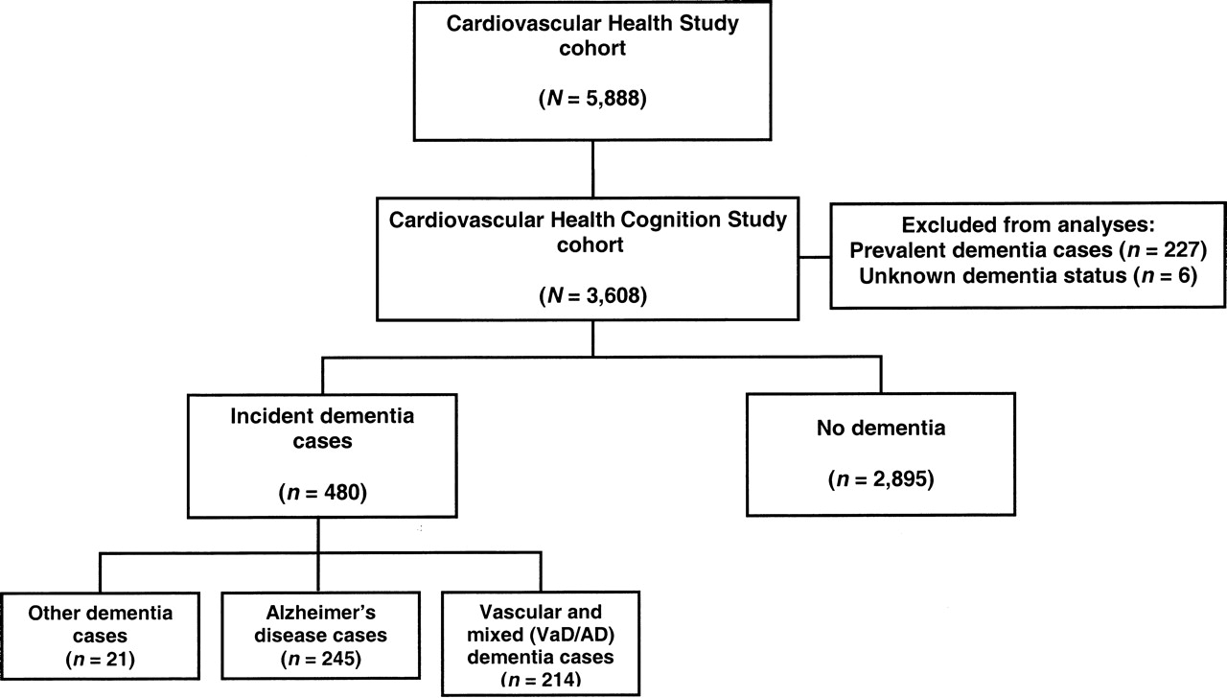
The cardiovascular health cognition study
Cardiovascular Health Cognition Study sample selection (1992–1993) and follow-up (1999–2000), United States.

Slide 3
Five-year cumulative incidence of dementia as a function of leisure-time energy expenditure
United States, Cardiovascular Health Cognition Study,
PY, person-years
Podewils et al., 2005

Slide 4
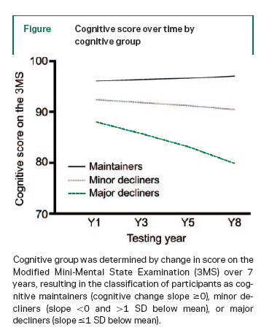
Predictors of maintaining cognitive function in older adults: The Health ABC (Aging and Body Composition) Study
Yaffe et al., Neurology, 2009
In the final multivariate-adjusted model characteristics that remained significant predictors of being a maintainer vs a minor decliner were age, having a high school education level or greater and a ninth grade literacy level or greater, engaging in weekly moderate to vigorous exercise, and not smoking at baseline. At the statistical trend level (P<0.10) cognitive maintenance was associated with working or volunteering, living with someone, and absence of the APOE 4 gene.
Elders who maintain cognitive function have a unique profile that differentiates them from those with minor decline. Importantly, some of these factors are modifiable and thus may be implemented in prevention programs to promote successful cognitive aging.
2509 subjects

Slide 5
Although, in general, the majority of the observational studies have found a positive relationship between physical activity and cognition in elders, it is important to note that some observational studies have failed to find a relationship between fitness or physical activity and cognition or dementia.
It is difficult to know which factors are most important in moderating the influence of physical activity on later life cognition and dementia.
However, some possibilities that merit further study include:
the distinction between aerobic and nonaerobic physical activities; the utility of self-report versus more objectively measured physical activities and fitness;
the role of physical activity duration, intensity, and frequency;
the nature of the components of cognition that serve as the criterion variables;
the age of participants at initial and final assessment;
genetic factors.

Slide 6
Which factors and mechanisms underly the effects of Enrichment on aging related cognitive decline and dementia?
Effects of EE in animal models

Slide 7
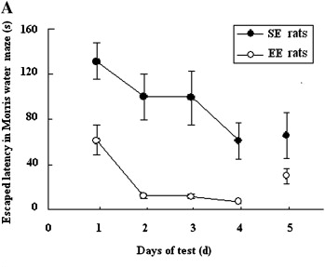
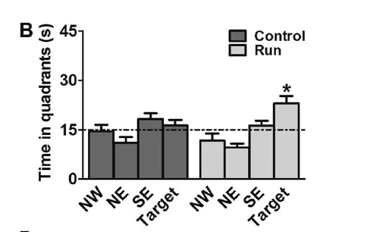
EE beneficial effects on learning and memory are present even when EE starts in old age
Marlatt et al., (2012), 9 months of age
Qiu et al., (2012),14 months of age
Female rats
Female mice

