Slide 1
Combinare estinzione e riconsolidamento
Science. 2009 May 15;324(5929):951-5. Epub 2009 Apr 2.
Extinction-reconsolidation boundaries: key to persistent attenuation of fear memories.
Monfils MH, Cowansage KK, Klann E, LeDoux JE.

Slide 2
Extinction-Reconsolidation Boundaries: Key to Persistent Attenuation of Fear Memories
The possibility that reactivated memories may be modifiable was proposed many years ago, and since then, numerous studies have demonstrated that blockade of the updating process engaged during retrieval—usually via pharmacological intervention within the reconsolidation window—prevents memory restorage and produces amnesia (loss of the specific memory that was reactivated in the presence of the drug or access to it).
Thus, in the case of aversive memories, blocking reconsolidation weakens the emotional impact of a once fear-inducing stimulus by altering the molecular composition of the memory trace.
This process generally requires the use of drugs that often cannot be readily administered to humans. (Monfils et al., 2009)

Slide 3
In contrast, fear extinction—a paradigm in which the conditioned stimulus (CS) is repeatedly presented in the absence of the unconditioned stimulus (US)—leads to progressive reduction in the expression of fear, but is not permanent because extinction does not directly modify the existing memory but instead leads to the formation of a new memory that suppresses activation of the initial trace.
The efficacy of this inhibition, however, is strongly contingent on spatial, sensory, and temporal variables.
Specifically, the reemergence of a previously extinguished fear is known to occur, in rodents and humans alike, under three general conditions:
(i) renewal, when the CS is presented outside of the extinction context;
(ii) reinstatement, when the original US is given unexpectedly;
(iii) spontaneous recovery, when a substantial amount of time has passed

Slide 4
Monfils et al devised an effective, drug-free paradigm for the persistent reduction of learned fear, capitalizing on differences between reconsolidation and extinction.
Given that extinction training reduces the threatening value of the CS, they reasoned that when applied within the reconsolidation window (after the memory is rendered unstable by presenting an isolated retrieval trial), extinction training would result in the storage of the new nonthreatening meaning of the CS and prevent renewal, reinstatement, and spontaneous recovery, thus resulting in a more enduring reduction in fear relative to extinction training conducted outside the reconsolidation window.

Slide 5
Specifically, they predicted that an extinction session presented after an isolated retrieval trial would lead to a persistent revaluation of the CS as less threatening, and/or a weakening of the stored trace or access to it, and thus would prevent the return of fear in the three aforementioned tests.

Slide 6
Six experiments were conducted.
1) Test whether their behavioral paradigm could prevent the return of fear on a spontaneous recovery test, and if so, whether the observed effect was the result of an update during reconsolidation.
They specifically designed this experiment on the basis of the premise that the lability window engaged at the time of retrieval is temporary—in rat fear conditioning, it closes within 6 hours—at which time the memory is thought to be reconsolidated.
They posited that if the interval between the isolated retrieval cue and extinction training was brief enough to enable the repeated unreinforced CSs to be presented within the lability window, then the new interpretation of the CS as no longer threatening should be incorporated during reconsolidation.

Slide 7
Rats were fear-conditioned using three tone-shock pairings, and were then divided into five experimental groups. Two groups had a retrieval-extinction interval within the reconsolidation window [10 min (n = 8) and 1 hour (n = 8)] and two groups outside the reconsolidation window [6 hours (n = 8) and 24 hours (n = 8)].
In addition to these four retrieval (Ret) groups, a fifth group (No Ret) was exposed to context but did not receive a CS retrieval (n = 12).
All procedures were conducted in context A (grid floor). All groups showed equivalent freezing for the last four trials of extinction

Slide 8
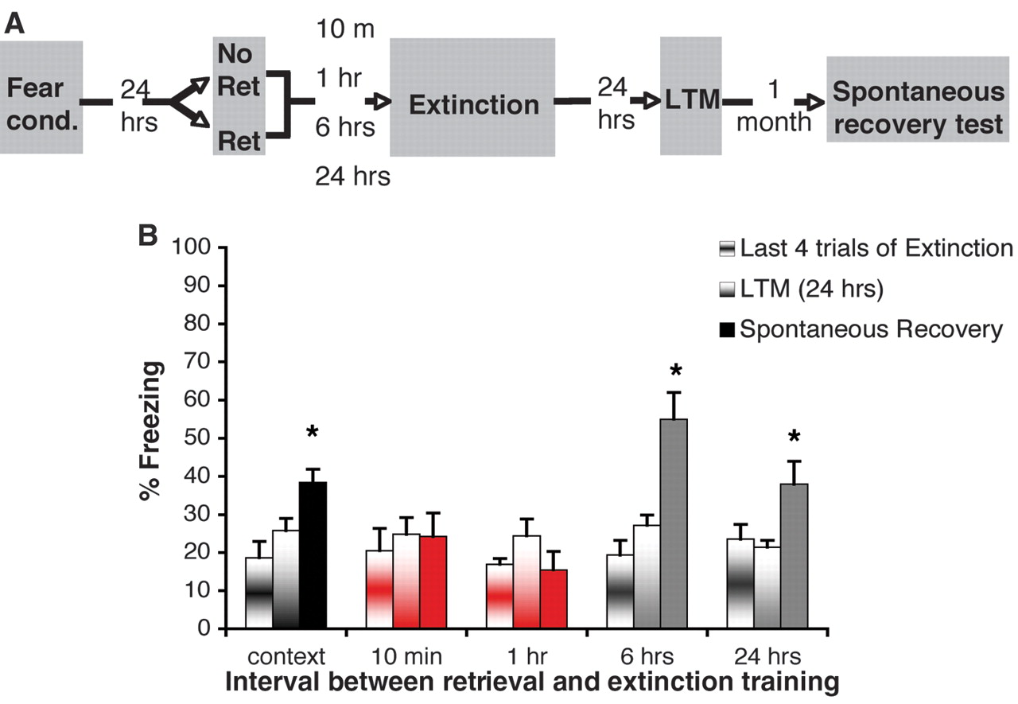
Finite lability window to prevent return of fear via post-retrieval extinction. (A) Rats were fear-conditioned (Fear Cond) with three tone-shock pairings. After 24 hours, they were exposed either to an isolated cue retrieval trial (Ret) or context only (No Ret) followed by extinction training. The time interval between the retrieval trial (or context exposure, n = 12) and the extinction was either within (10 min, n = 8; 1 hour, n = 8) or outside (6 hours, n = 8; 24 hours, n = 8) the reconsolidation window. Twenty-four hours after extinction, all groups were tested for LTM, and 1 month later for spontaneous recovery. The gray shading represents context A. (B) All groups were equivalent for the last four trials of extinction and at the 24-hour LTM test. One month later, the Ret groups with an interval outside the reconsolidation window as well as the No Ret group showed increased freezing (spontaneous recovery) relative to the 24-hour test

Slide 9
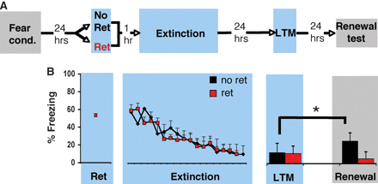
Attenuation of fear memory by presenting a single isolated retrieval trial followed by an extinction session prevents renewal. (A) Rats were fear-conditioned in context A. Twenty-four hours later, they were exposed either to an isolated cue retrieval trial (Ret, n = 8) or context only (No Ret, n = 8) in context B, followed 1 hour later by extinction training in context B. Twenty-four hours after extinction, they were tested for LTM in context B. The gray shading represents context A; the blue shading represents context B (smooth black floor and peppermint scent) (28). (B) Rats from both experimental groups froze equivalently during the LTM test (all ANOVAs, P > 0.1). When they were placed back in the acquisition context, the No Ret group (black) showed fear renewal (P = 0.012), but the Ret group (red) did not (P > 0.1), relative to their respective LTM tests

Slide 10
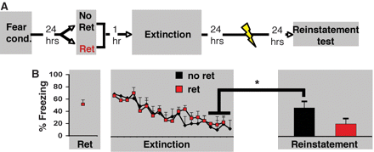
Presenting a single isolated retrieval trial before an extinction session prevents reinstatement. (A) Rats were fear-conditioned. The next day, they were exposed either to an isolated cue retrieval trial (Ret, n = 8) or context only (No Ret, n = 8), followed 1 hour later by extinction training. Twenty-four hours after extinction, they received five unsignaled footshocks, and the next day were tested for reinstatement. The gray shading represents context A. (B) The No Ret and Ret groups froze equivalently to the last four CSs of extinction; however, 24 hours after the unsignaled footshocks, the No Ret group (black) showed increased freezing (reinstatement) (P < 0.05), but the Ret group (red) did not (P > 0.05).

Slide 11
Nature 463, 49-53 (7 January 2010)
Preventing the return of fear in humans using reconsolidation update mechanisms
Schiller et al., 2010
“Research on changing fears has highlighted several techniques, most of which rely on the inhibition of the learned fear response.
An inherent problem with these inhibition techniques is that the fear may return, for example with stress.
Recent research on changing fears targeting the reconsolidation process overcomes this challenge to some extent. During reconsolidation, stored information is rendered labile after being retrieved, and pharmacological manipulations at this stage result in an inability to retrieve the memories at later times, suggesting that they are either erased or persistently inhibited.”

Slide 12
Remember that the hypothesis is that reconsolidation is an adaptive update mechanism by which new information is incorporated into old memories.
By introducing new information during the reconsolidation period, it may be possible to permanently change the fear memory.
In the present study, Schiller et al provide evidence in humans that old fear memories can be updated with non-fearful information provided during the reconsolidation window.
As a consequence, fear responses are no longer expressed.

Slide 13
If an old fear memory could be restored while incorporating neutral or more positive information provided at the time of retrieval, it may be possible to permanently modify the fearful properties of this memory.
Although this approach captures the very essence of reconsolidation, it has been surprisingly neglected in emotion research in humans and other animals.

Slide 14
The authors designed two experiments examining whether extinction training conducted during the reconsolidation window would block the return of extinguished fear.
In the first study, three groups of subjects underwent fear conditioning using a discrimination paradigm with partial reinforcement. Two coloured squares were used. One square (conditioned stimulus+, hereafter termed CS+) was paired with a mild shock to the wrist (unconditioned stimulus) on 38% of the trials, whereas the other square was never paired with shock (CS-).
A day later, all three groups underwent extinction training in which the two conditioned stimuli were repeatedly presented without the unconditioned stimulus.
In two groups the fear memory was reactivated before extinction using a single presentation of the CS+. One group (n = 20) received the reminder trial 10 min before extinction (within the reconsolidation window), whereas the second group (n = 23) was reminded 6 h before extinction (outside the reconsolidation window).
The third group (n = 22) was not reminded of the fear memory before extinction training. Twenty-four hours later, all three groups were presented again with the conditioned stimuli without the unconditioned stimulus (re-extinction) to assess spontaneous fear recovery.
The measure of fear was the skin conductance response (SCR).
At each stage, the differential fear response was calculated by subtracting responses to the CS- from responses to the CS+.

Slide 15
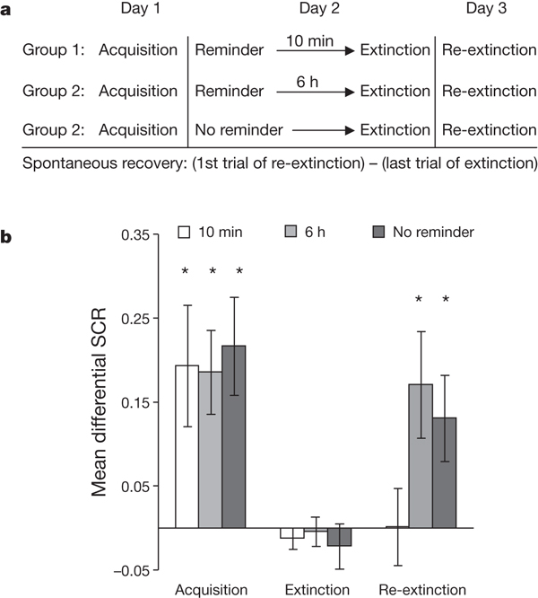
a, Experimental design and timeline. b, Mean differential SCRs (CS+ minus CS-) during acquisition (late phase), extinction (last trial) and re-extinction (first trial) for each experimental group (10-min reminder, 6-h reminder and no reminder). The three groups showed equivalent fear acquisition and extinction.
Spontaneous recovery (first trial of re-extinction versus the last trial of extinction) was found in the group that had not been reminded or that was reminded 6 h before extinction.
In contrast, there was no spontaneous recovery in the group reminded 10 min before extinction.

Slide 16
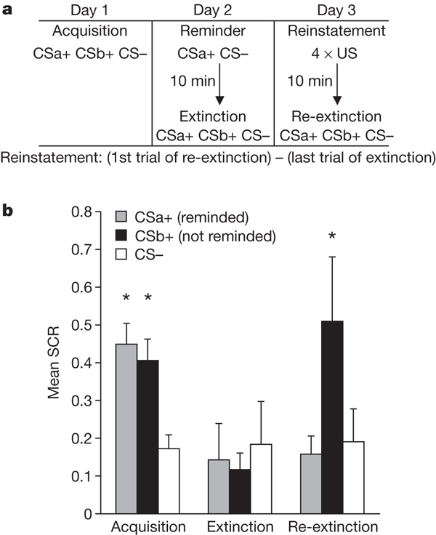
a, Experimental design and timeline. US, unconditioned stimulus. b, Mean SCRs (CSa+, CSb+ and CS-) during acquisition (late phase), extinction (last trial) and re-extinction (first trial). Subjects had equivalent levels of acquisition and extinction of conditioned fear to the two conditioned stimuli. The index of fear recovery was the first trial of re-extinction (after reinstatement) minus the last trial of extinction (before reinstatement).
Fear reinstatement was found only to CSb+ (not reminded before extinction training), but not to CSa+ (reminded 10 min before extinction training).

