Slide 1
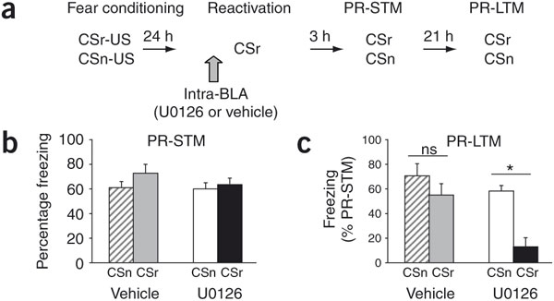
Blockade of reconsolidation is specific to the fear memory reactivated, leaving other memories intact (Doyere et al, 2007).

Slide 2
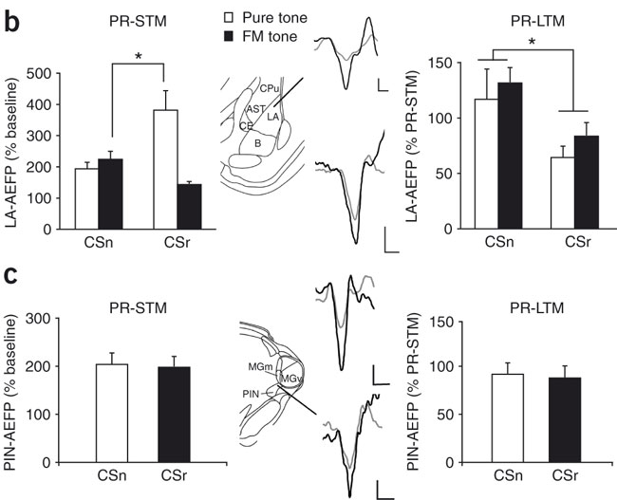
Retrieval and reconsolidation alter memories via synaptic plasticity in lateral amygdala (LA).
Changes in short-latency AEFPs in lateral amygdala. A selective additional potentiation was observed during PR-STM (left panel, P < 0.05, contrast analysis) after reactivation with the pure tone conditioned stimulus. U0126 produced a depotentiation of lateral amygdala responses to the reactivated conditioned stimulus (CSr), regardless of tone type (right panel, P < 0.05, two-way ANOVA).
(c) Changes in AEFPs in the auditory thalamus. No differential effect of reactivation or intra–lateral amygdala infusion of U0126 on either memory test was observed.

Slide 3
Fear memories erased by disrupting reconsolidation processes do not return with passage of time, or the alteration of contextual cues, or additional stress (Duvarci and Nader, 2004).
Owing to the lack of return of fear, blocking reconsolidation provides an important advantage over other techniques that might be used to regulate emotion.
If, as suggested, the memory trace is permanently altered, the inhibition of the fear memory through extinction, regulation, or adaptive action is not necessary.

Slide 4
Research on the blockade of the reconsolidation of fear memories in humans has been slow to emerge for a few reasons.
One primary reason is that the initial findings showing the blockade of reconsolidation relied on the administration of protein synthesis inhibitors, which is not a viable technique in humans.
Recently, however, two techniques that can be translated to humans have been identified.

Slide 5
La prima strategia cerca di utilizzare farmaci attivi nel bloccare il riconsolidamento ed il cui uso è autorizzato nell’uomo
La seconda strategia cerca di sfruttare i riconsolidamento non tanto per cancellare la originale traccia di memoria ma per modificarla, incorporando nuova informazione attraverso metodiche comportamentali.

Slide 6
The first uses a beta-adrenergic antagonist, propranolol, which is safe to administer to humans, to block reconsolidation. Debiec and LeDoux (2004) showed that either intra-amygdala or systemic administration of propranolol immediately after reactivation of the CS blocked the reconsolidation of conditioned fear and prevented the return of fear.

