Slide 1
PORTUGAL - BREXIT
Javier Rujas, Isabel Romero, Sergio Ledesma & Pedro Ardiaca
International Trade - Georgia Giovannetti

Slide 2
Portugal background
Member of the EU from 1 January 1986
Member of Schengen area since March 1995
Member of Euro area since 1 January 1999
Political system:
- Semi-presidential republic
Portugal inhabitants ~ EU average
Head of Government
Head of state
113.5 inhabitants/ km²
115.5 inhabitants/ km²
Prime minister
President

Slide 3
Portugal background (cont.)
Most important sectors, representing ¼ GDP:
- Wholesale
- Retail trade
- Transport
- Accommodation
- Food services
EU spending in Portugal → €3.976 B
Portugal spending in EU → €1.375 B
Intra-EU trade (exports) and imports from EU → 76%

Slide 4
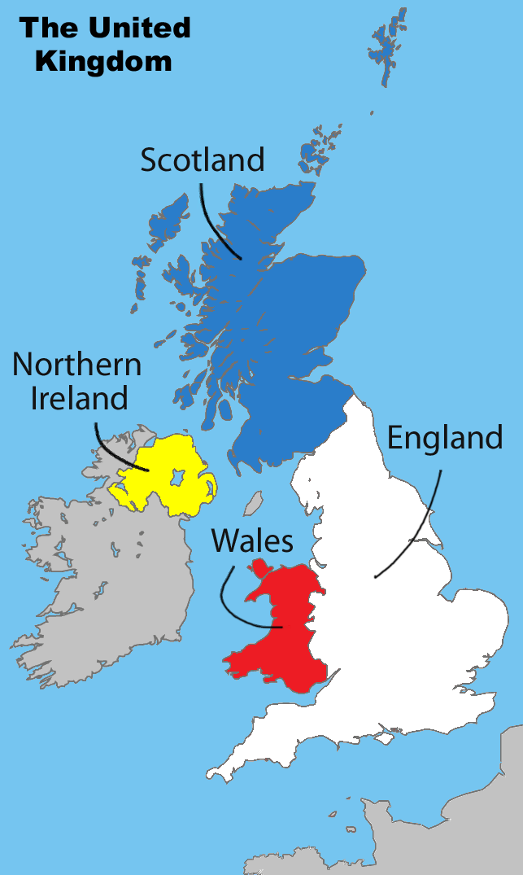
UK background
Member of the EU from 1 January 1973
No longer member of Schengen area
Political system:
- Constitutional monarchy
Head of Government
Head of state
Prime minister
Monarch
UK inhabitants ~ EU average
274 inhabitants/ km²
115.5 inhabitants/ km²

Slide 5
UK background (cont.)
Most important sectors, representing 1/5 GDP:
- Wholesale
- Retail trade
- Transport
- Accommodation
EU spending in UK → €6.326 B
UK spending in EU → €10.575 B
Intra-EU trade 47% and imports from EU 53%

Slide 6
UK ↔︎ Portugal
Main aim for both was mainly trade channels distributions → Maritime countries & Colonies
UK → Top 4 exporter for Portugal ($3.96 B) 6,7% Total Exports
What UK exports to Portugal?
Chemical products (21%)
Machines (21%)
Transportation (15%)
Metals (10%)
Portugal → No top 10 exporters to UK
What Portugal exports to UK?
Machines (23%)
Transportation (18%)
Textiles (10%)
Metals (7.3%)

Slide 7
Commerce - Introduction
Treaty of Windsor (May 1386) → Diplomatic Alliance
Methuen Treaty (1703) → Commercial Treaty
Trade opening of the global market, has allowed trade between almost every nation.
Portugal → Referred Petroleum
UK → Cars

Slide 8
Commerce - Portugal
44th largest export economy in the world
48th most complex economy according to the Economic Complexity Index (ECI).
2017:
Exported $59.3B and imported $78.3B → negative trade balance of $19B.
GDP of Portugal was $217B and its GDP per capita was $31.7k
Red - Imports
Blue - Exports

Slide 9
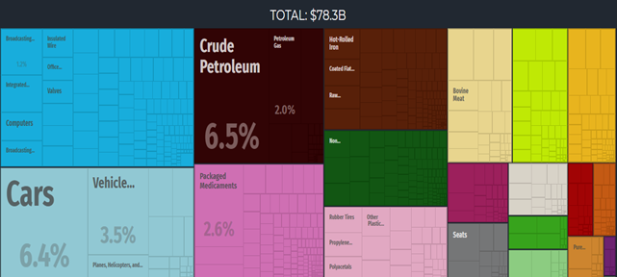
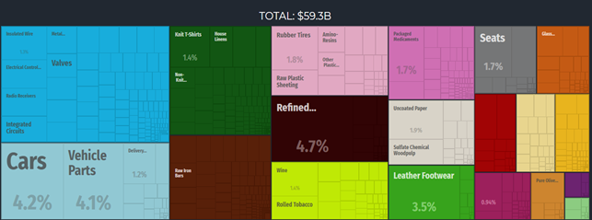
Imports
Exports

Slide 10
Destinations
Origins

Slide 11
Commerce - United Kingdom
10th largest export economy in the world and the 11th most complex economy according to the Economic Complexity Index (ECI).
2017
Exported $395B and imported $617B, resulting in a negative trade balance of $222B
The GDP of the United Kingdom was $2.62T and its GDP per capita was $43.3k.
Red - Imports
Blue - Exports

Slide 12
Imports
Exports

Slide 13
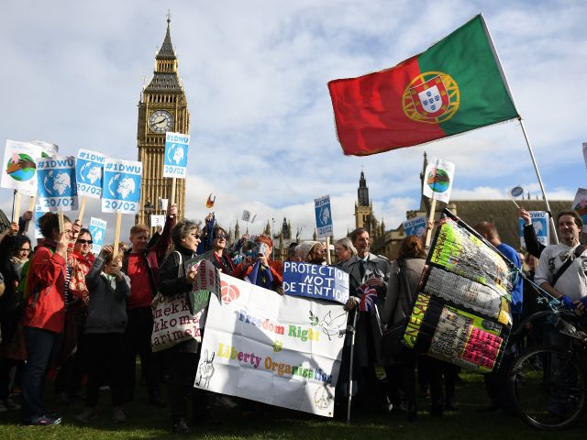
Commerce - Common
The Anglo-Portuguese Alliance has impressively withstood the passage of time and has remained intact.
The two countries have extended their relations through their membership:
- The European Union (EU)
- North Atlantic Treaty Organization (NATO).
These alliances have allowed for a significant volume of bilateral trade, foreign investment and tourism, setting the conditions for a mutual flow of the two countries commodities and nationals.

Slide 14
Cost of Brexit: European countries overview
Relative GVA impact is for Portugal (~0.3%), absolute GVA (gross value added) amount for €0.4 BN in Portugal
Post-mitigation cost per country, € BN
Cost as a
% GVA¹
Sector #1
Post-mitigation cost, € BN
Sector #2
Post-mitigation cost, € BN
Concentration of cost on top 5 impacted sectors
Germany
9.4
0.4%
Automotive
3.7
Chemicals & plastics
1.1
75%
Netherlands
4.4
0.8%
Agriculture, food & drinks
1.1
Chemicals & plastics
0.8
70%
Belgim
3.9
1.1%
Automotive
1.4
Chemicals & plastics
0.6
85%
France
3.9
0.2%
Agriculture, food & drinks
0.9
Consumer goods
0.5
70%
Italy
2.6
0.2%
Consumer goods
0.7
Agriculture, food & drinks
0.6
80%
Spain
2.5
0.3%
Automotive
0.9
Agriculture, food & drinks
0.6
80%
Ireland
2.3
0.9%
Agriculture, food & drinks
0.9
Chemicals & plastics
0.3
75%
Sweden
0.7
0.2%
Automotive
0.2
Agriculture, food & drinks
0.1
75%
Denmark
0.7
0.3%
Agriculture, food & drinks
0.3
Industrials
0.1
80%
Portugal
0.4
0.3%
Consumer goods
0.1
Automotive
0.1
75%
Note: exchange rate used: 1 GBP = 1.2 EUR
1 Pre-Brexit
SOURCE: Eurostat

Slide 15
Our analysis quantifies the impact of tariff and non-tariff barriers on direct UK-Portugal trade
The UK is an important destination of Portuguese exports (the UK is the fourth export destination for Portugal)
Direct cost of Brexit
The impact of Brexit is concentrated on three industries, accounting for 60% of the total impact:
Automotive, €90 MM (2.7%)
Agriculture, food and drinks €57 MM (0.5%)
Consumer goods €92 MM (1.0%)
For Portuguese economy, the overall impact is ~0.3% of country GVA, which is similar to the average for the EU as a whole
Under the baseline WTO scenario, at an aggregate level the trading cost of Brexit is material:
Portugal: Post-mitigation impact of ~0.3% of gross value added (GVA); ~€0.3BN
UK: Post-mitigation impact of ~1.5% of gross value added (GVA); ~€35 BN

Slide 16
Tariffs and non-tariff barriers will put ~€0.5 BN of costs in Portugal, but firms can take measures to mitigate ~€80 MM
IMPACT OF BREXIT
Costs in WTO scenario
Impact: ~€0.5 BN
Tariffs: e.g. 8% tariff on alcoholic beverages, 10% on motor vehicles
Non-Tariff barriers
“At-the-border”: Additional customs declarations
“Behind-the-border”: e.g. dual certification due to regulatory divergence between UK and EU
Mitigation potential
Potential: ~€80 MM
Adjusting operations: Localise supply chains, increase warehousing capacity to mitigate delays in JIT production
Repatriation: Reassess long-term global footprint strategy, repatriate lines of business
High sector specific impact
Moderate sector specific impact
Low sector specific impact
Tariff and non-tariff impacts
Tariff and non-tariff impacts
Tarrifs
Non-Tariff barriers
Adjusting operations
Repatriation
Agriculture, food and drink
0.4% GVA cost²: Low (2.2%) tariffs on grains, but very high (35%) tariffs on dairy
0.6% GVA cost: Additional administrative burden, uncertainty about divergence on food safety standards
Adapt production processes to ensure compliance with food and safety standards
Strategic UK investment
Bringing production closer to demand to avoid tariffs on food items
Automotive
2.4% GVA cost:10% tariff on motor vehicles, 4.5% tariff on parts & vehicle accessories
2.7% GVA cost: e.g. double certification due to potential lack of type approval validity from VCA¹
Localise supply chain
Change to more local suppliers or encourage your suppliers to localise
Strategic UK investment
Bringing production closer to demand to avoid tariffs and use low FX for strategic investment
Consumer goods
0.2% GVA cost: 2.8%
tariff on textiles
0.4% GVA cost: Currently aligned on CE mark, waste, safety and emissions standards. Potential increase in standards checks
Warehousing and buffer stock
Foresee delays to JIT production and plan ahead
Relocate (parts of the) production to the EU
Bringing production closer to demand and staying in the EU
1 VCA - UK Vehicle Certification Agency
2 Calculated with pre-mitigation figures

Slide 17
~75% of cost is concentrated in 5 sectors: consumer goods, automotive, agriculture, food and drink, chemical and plastics and industrials
IMPACT OF BREXIT: SECTOR CONCENTRATION
Represent ~75% of Portuguese cost
Distribution of sector costs – post-mitigation, € MM
Consumer goods
Automotive
Agriculture, food and drink
Chemicals and plastics
Industrials
Other
Cost as % of
Sector GVA
1.0%
2.7%
0.5%
1.7%
0.6%
0.01%
Pre-Brexit GVA, €BN
9
3
11
2
6
112

Slide 18
Deep-dive in impact in consumer goods sector
IMPACT OF BREXIT: SECTOR CONCENTRATION
Distribution of sector costs – post-mitigation, € MM
Top-5 products, cost, € MM
Consumer goods sector
Portuguese exports of clothing/apparel and footwear are the most affected by the Brexit burdens
Clothing accesories
Articles of apparel
Footwear
Men’s or boy’s clothing
Furniture & parts
Automotive sector
Portuguese exports of vehicles for transport of persons and parts/ accessories of vehicles will me most impacted by Brexit
Motor vehicles for transport of persons
Parts of vehicles
Motor vehicles for transport of goods
Road motor vehicles
Motorcycles
Agriculture, food and drink sector
Portuguese exports of alcoholic beverages and fish products are the most impacted by Brexit
Consumer goods
Automotive
Agriculture, food & drink
Chemicals & plastics
Industrials
Other
Alcoholic beverages
Fish, aqua, invertebrates, prepared , preserved
Vegetables, roots, tubers, prepared, preserved
Edible products & preparations
Fruits & nuts (excluding oil nuts), fresh or dried
30% of national GVA
70%

Slide 19
THE UNEXPECTED VICTIM OF BREXIT IS PORTUGAL

Slide 20
PORTUGAL PILLARS
TOURISM
EXPORTS

Slide 21
SOLUTION OR CONTINGENCY PLAN

Slide 22
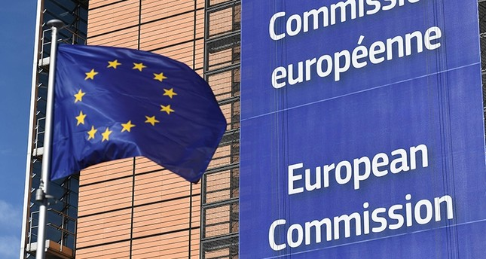
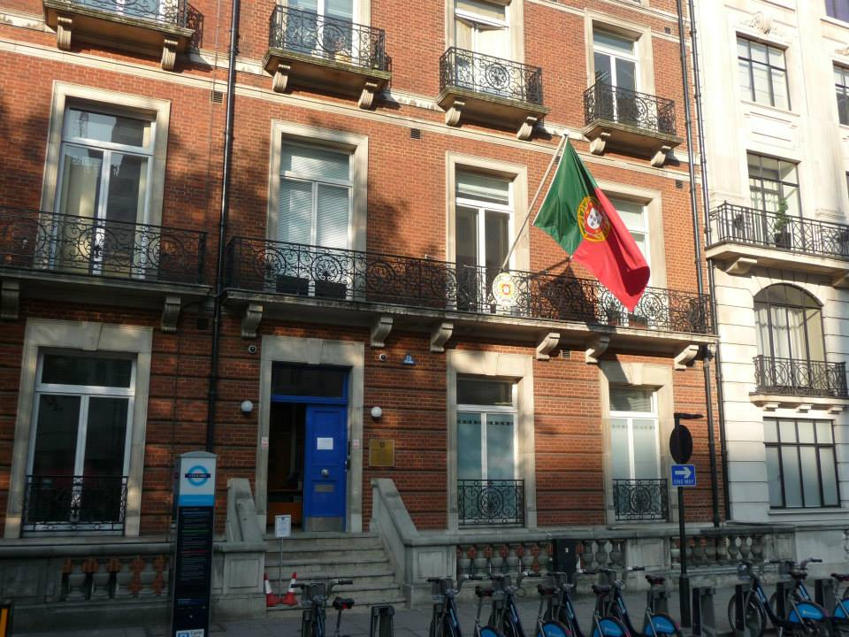
I - PREPARATION MEASURES FOR THE UNITED KINGDOM EXIT REQUIREMENTS IN ANY OF THE SCENARIOS
A) PREPARATION AT EU LEVEL
B) PREPARATION AT NATIONAL LEVEL

Slide 23
II - CONTINGENCY PLAN FOR UNITED KINGDOM EXIT EUROPEAN UNION WITHOUT AGREEMENT
- Contingency measures should not reproduce the benefits of accession to the Union, nor the terms of any transitional period Exit Agreement;
- Contingency measures will generally be temporary;
- Contingency measures will be adopted unilaterally by the EU, pursuit of their interests and may therefore, in accordance with principle be repealed by the Union at all times;
- Contingency measures should be adopted in compliance with the division of powers provided for in the Treaties and the principle of subsidiarity in the EU;
- National contingency measures should be compatible with the EU law, including the international obligations of the Union;
- Contingency measures will not compensate for delays that could prevented by timely preparation by stakeholders.

Slide 24
SOURCES
https://oec.world/es/profile/country/prt/
Commerce in the uk
https://santandertrade.com/es/portal/analizar-mercados/reino-unido/cifras-comercio-exterior#classification_by_country
Begining of the alliance
https://es.wikipedia.org/wiki/Tratado_de_Methuen
https://www.lavanguardia.com/politica/20160624/402733311448/portugal-mantendra-su-historica-relacion-con-el-reino-unido-pese-al-brexit.html
Solution
https://magnet.xataka.com/un-mundo-fascinante/que-es-lo-que-mas-exporta-e-importa-cada-pais-del-mundo-este-estupendo-mapa-te-lo-ensena
https://www.elconfidencial.com/mundo/2019-01-18/portugal-victima-inesperada-brexit-economia_1766470/
http://www.cgportugalemlondres.com/brexit.html
https://eur-lex.europa.eu/content/news/Brexit-UK-withdrawal-from-the-eu.html?locale=es
https://eur-lex.europa.eu/eli/treaty/tfeu_2012/oj?locale=es
https://tradingeconomics.com/portugal/balance-of-trade
https://wits.worldbank.org/CountryProfile/en/PRT
https://www.gov.uk/guidance/exporting-to-portugal-after-eu-exit

