Slide 2
Data about Italy

Slide 3
Data about Italy

Slide 9
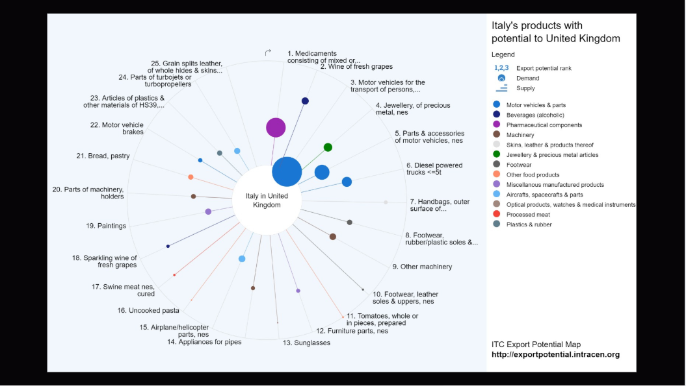

Slide 11
