Slide 1
BREXIT
HOW GERMANY IS GOING TO BE AFFECTED
Nina Kunzmann Victoria Pörings
Karoline Preuß

Slide 2
Agenda
Introduction
Who we are
Who is Germany
UK and the Brexit
Impact of Brexit to Germany
Impact on trade
Impact on business
Impact on investment
Opportunities and challenges for Germany
Possible Brexit scenarios
Conclusion
Summary 1,2,3
Bibliography

Slide 3
INTRODUCTION

Slide 4
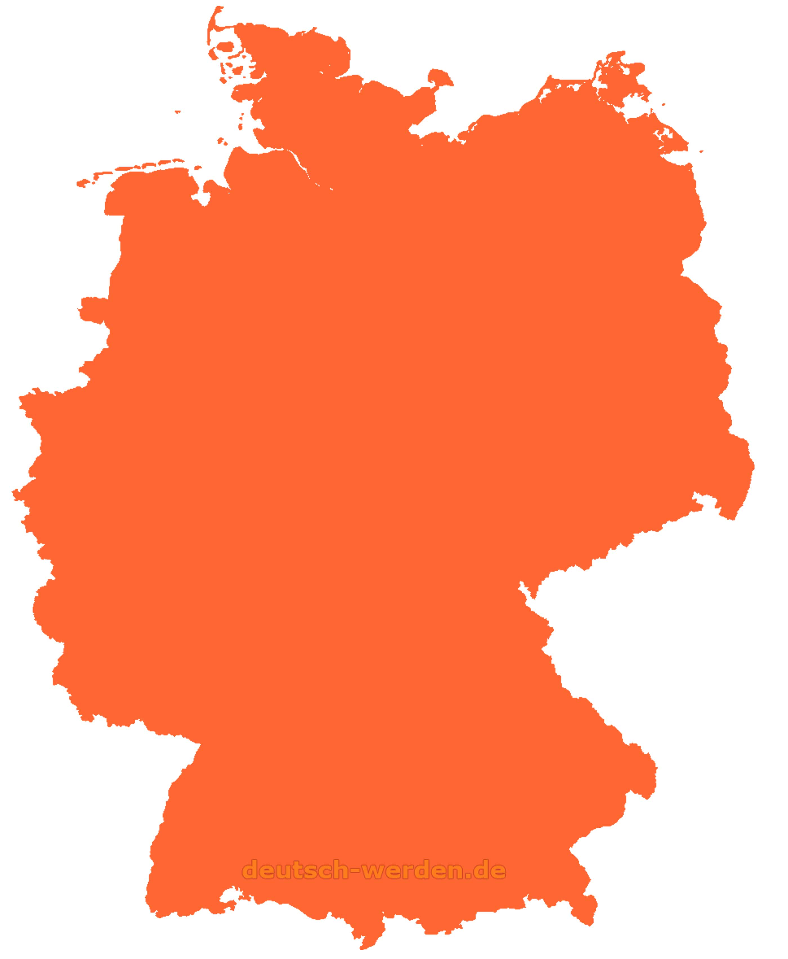
Who we are
Nina
Kunzmann
Germany
Int. Management
Victoria Pörings
Germany
Int. Management
Karoline Preuß
Germany
Int.
Economics

Slide 5
Who is GERMANY
FUN FACTS
Toilet paper in Germany has the softness of paper towels
In Germany are more football fan clubs than anywhere else in the world
Beer is considered as food in southern Germany
AND NOW LET’S HAVE A LOOK ON THE GERMAN BUSINESS…
☺

Slide 6
Who is GERMANY
 | Germany | Europe-CIS (in % of) | World (in % of)
Population (thousands) | 82 689 | 9.03 | 1.10
Current GDP (million $) | 3 677 439 | 17.18 | 4.58
GDP per capita (current $) | 44 473 | 190.21 | 416.73
Exports of goods | 1 450 215 | 21.16 | 8.57
Exports of services | 301 574 | 11.78 | 5.86
Imports of goods | 1 119 822 | 16.90 | 6.62
Imports of services | 321 048 | 14.59 | 6.54

Slide 7
Question: How would you vote?
Brexit or no Brexit?

Slide 8
UK and the brexit
REFERENDUM (July 2016): Remain or Leave
*Voter turnout: 71,8%
52% leave
48% remain

Slide 9
UK and the brexit
1. Due date: March 29th 2019 → House of Commons didn't’ approve the Brexit deal and requested for extension from the EU
2. Due date: April 12th 2019 → the deadline was extended again at the special conference in Brussels
3. Due date: October 31th 2019 → latest Brexit appointment
Withdrawal agreement: transitional period until the end of 2020 with the option to extent 1-2 years, until then everything stays the same

Slide 10
GERMANY & UK
The trade volume between Germany and the United Kingdom (UK) amounted to 119 billion euros in 2018.
Around 750,000 jobs in Germany depend on trade with the UK.
To date, German companies have built up investments worth over 140 billion euros.
About 2,500 branches of German companies are located in the UK and employ more than 400,000 people.
British companies have 1,5000 branches in Germany and employ around 270,000 people

Slide 11
IMPACT OF BREXIT TO GERMANY

Slide 12
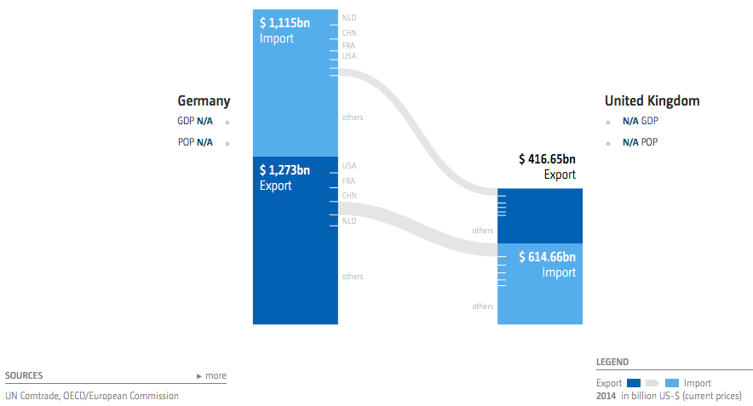
Trade relation GERMANY & UK

Slide 13
Trade relation GERMANY & UK
→ The graphic demonstrates…

Slide 14
Trade relation GERMANY & UK
In 2014 UK exported aprox. 56 billion US-$ worth of goods to Germany.
This represented 13.5% of exports from UK in all available countries and 5.00% of imports to Germany from all available countries.
In 2014 Germany exported aprox. 100 billion US-$ worth of goods to UK.
This represented 7.90% of exports from Germany in all available countries and 16.30% of imports to UK from all available countries.

Slide 15
Trade relation GERMANY & UK
Impact on German companies of the departure of the UK from the EU
Will be overwhelming negative in terms of:
Business
Investment
Trade

Slide 16
Trade relation GERMANY & UK
Impact on German companies of the departure of the UK from the EU: TRADE
The UK is the 3th largest trading partner for Germany
Around 2,500 German companies have a branch on the island and employ around 370,000 people
Since the Brexit decision, trade with the UK has grown at a much less dynamic pace
Without a Brexit deal, millions of customs declarations and billions of customs duties would be due

Slide 17
Trade relation GERMANY & UK
Impact on German companies of the departure of the UK from the EU: BUSINESS
German companies maintain about 2,500 places of business in the UK with nearly 400,000 employees
The changes in conditions for business with the UK are still unclear for companies
Only one of five German companies still reports good business in the UK

Slide 18
Trade relation GERMANY & UK
Impact on German companies of the departure of the UK from the EU: INVESTMENT
German companies have investments in the UK with a value of over EUR 140 billion
Some companies are already planning to shift their investment, primarily to other EU countries
Every 8th company with UK business is currently planning to relocate its investments to other markets

Slide 19
EXAMPLE - BAYER
German companies have been preparing for a tough Brexit for months
For example: the pharmaceutical company Bayer has leased additional storage space in the United Kingdom and created emergency supplies of medicines because of fear of being unable to sell them on the island

Slide 20
Germany & UK
Opportunities for Germany | Challenges for Germany
Many financial service providers leaving London could settle down in Germany while searching a new office to operate as usual in Europa e.g. Frankfurt | High uncertainty for German companies doing business in the UK and visa verse + high short-term costs for new structures
The weakened position of the British could lead the USA to seek a new partner in Europe. | In case of UK resignation, many companies will move from UK to Germany also. The real estate prices in metropolitan areas would rise drastically.
New political constellations without the membership of UK could open economic opportunities for the German economy | The exit will shift the weights within the EU. In economic policy decisions, the British were often an ally of Germany.

Slide 21
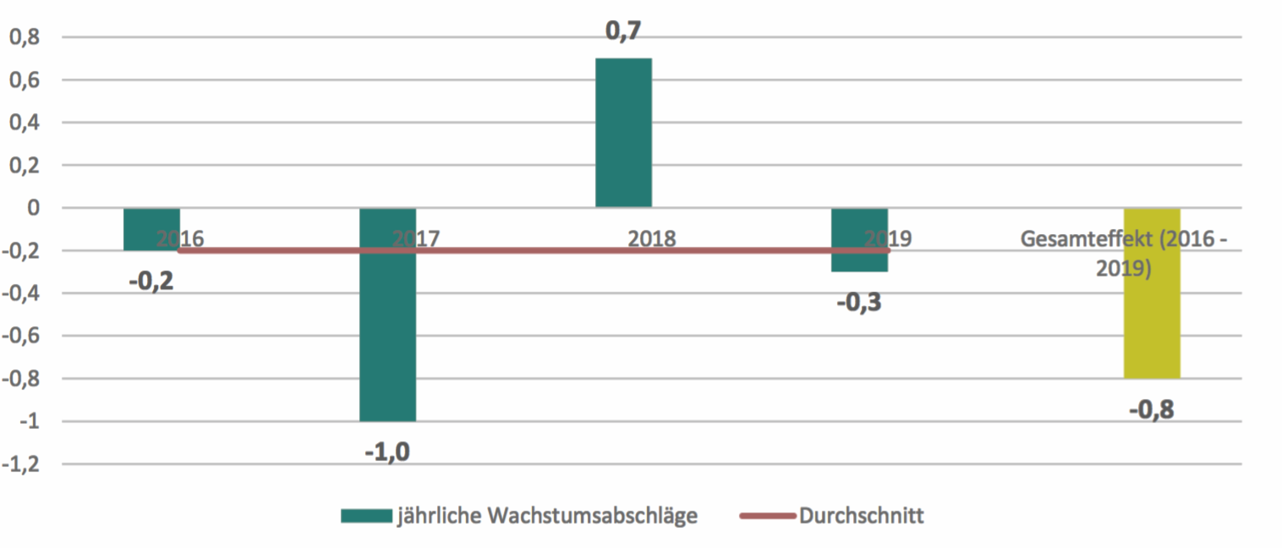
GerMan Economy and the possible brexit scenarios
Since Brexit Decision:
Yearly GDP growth decreased by ca 0.2 percentage points
This year even by 0.3 percentage points

Slide 22
GerMan Economy and the possible brexit scenarios
Soft Brexit:
Germany would face absolute trade costs of 5 billion € due to increasing trade costs and its consequences
Depends on negotiations of the deal
But in case of a hard Brexit…

Slide 23
GerMan Economy and the possible brexit scenarios
Hard Brexit:
Constraints for mobility of labour, goods, services, capital between Germany and the UK
GDP growth rate would be 0.4 percentage points smaller in 2020 than with a soft Brexit (2021: 0.3 percentage points smaller)
Export expansion would be expected to be 1.3 percentage points lower than usual in 2020 (2021: 0.8 percentage points lower)
Investment growth rate would be expected to be 0.3 percentage points lower than usual in 2020 (2021: 0.1 percentage points lower)

Slide 24
CONCLUSION

Slide 25
Trade relation GERMANY & UK
SUMMARY 1: The Brexit is already a burden for companies
The business situation of the companies has deteriorated considerably → only one of five German companies still reports good business in the UK
German trade with the UK is already decreasing significantly
Every 8th company with UK business is currently planning to relocate its investments to other markets

Slide 26
Trade relation GERMANY & UK
SUMMARY 2: An unclear Brexit and a disorganized transition are creating uncertainty
The details of the impact is still unclear for many companies since negotiations have failed to make substantial progress
Additional cost burdens from customs and taxes should be prevented if possible
Rapid clarification of the future relationship between the EU and the UK is indispensable. A possible transitional phase through the end of 2020 must also be clearly and transparently defined

Slide 27
Trade relation GERMANY & UK
SUMMARY 3: The benefits of a single internal market should be protected
Free movement of goods within the internal market is the top priority for companies
Investments leaving the UK will go primarily to Germany and other EU countries
The internal market of the EU-27 should be further strengthened

Slide 28
Bibliography
Cepii, http://www.cepii.fr/CEPII/en/bdd_modele/presentation.asp?id=30
ITC, Export potential map, https://exportpotential.intracen.org/#/home
The Impact of Brexit on German Businesses Results of the IHK Business Survey Going International 2019, https://japan.ahk.de/fileadmin/AHK_Japan/4_Infothek/41_Aktuelles/2019/Brexit_Sonderauswertung_2019_ENG.pdf
Falls das Brexit-Abkommen scheitert: Wie teuer harter Brexit und Verschiebung wären, by Geraldine Dany-Knedlik et al. https://www.diw.de/documents/publikationen/73/diw_01.c.683919.de/diw_aktuell_25.pdf
Die ökonomischen Folgen des Brexits für EU-Länder und Regionen, by Prof. Dr. Giordano Mion and Dr. Dominic Ponattu https://www.bertelsmann-stiftung.de/fileadmin/files/user_upload/EZ_Estimating_the_Impact_of_Brexit_2019_ENG.pdf

Slide 29
Thank you for your attention!
ANY QUESTIONS?

