Slide 1
New York,
The Metropolitan
Museum of Art

Slide 2
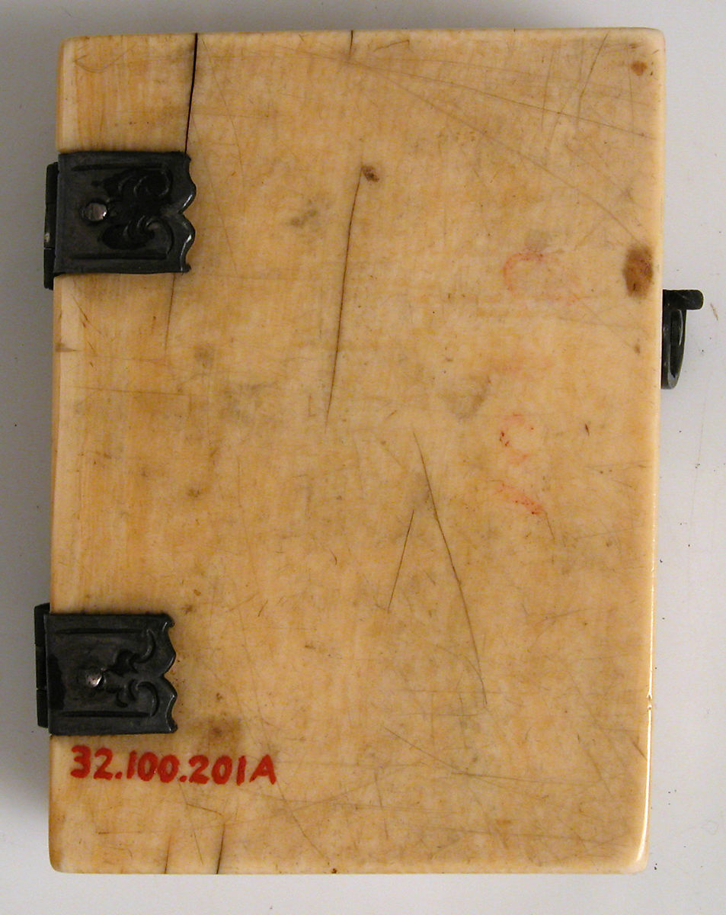
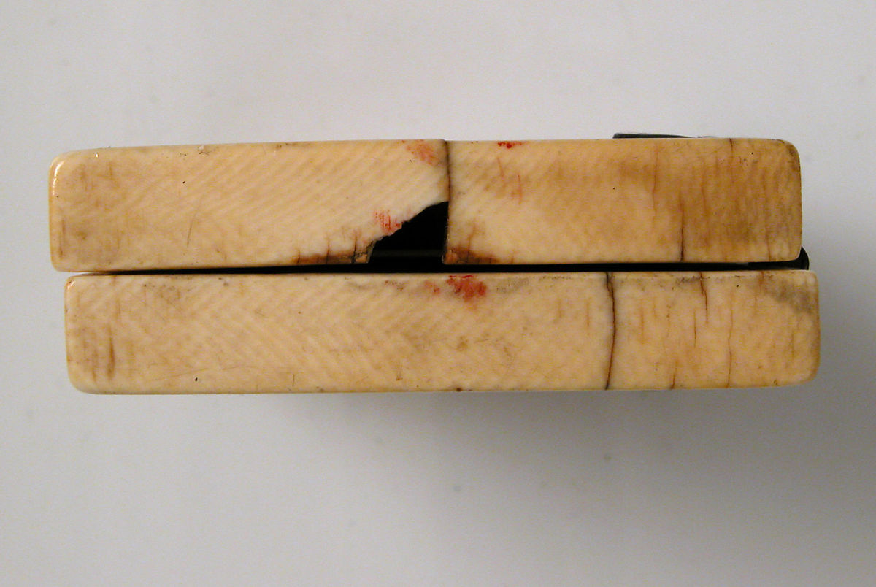
Aperto, 7.2 x 11 x 1 cm Chiuso, 7.2 x 5.2 x 1.8 cm

Slide 4
New York,
The Metropolitan Museum of Art

Slide 5
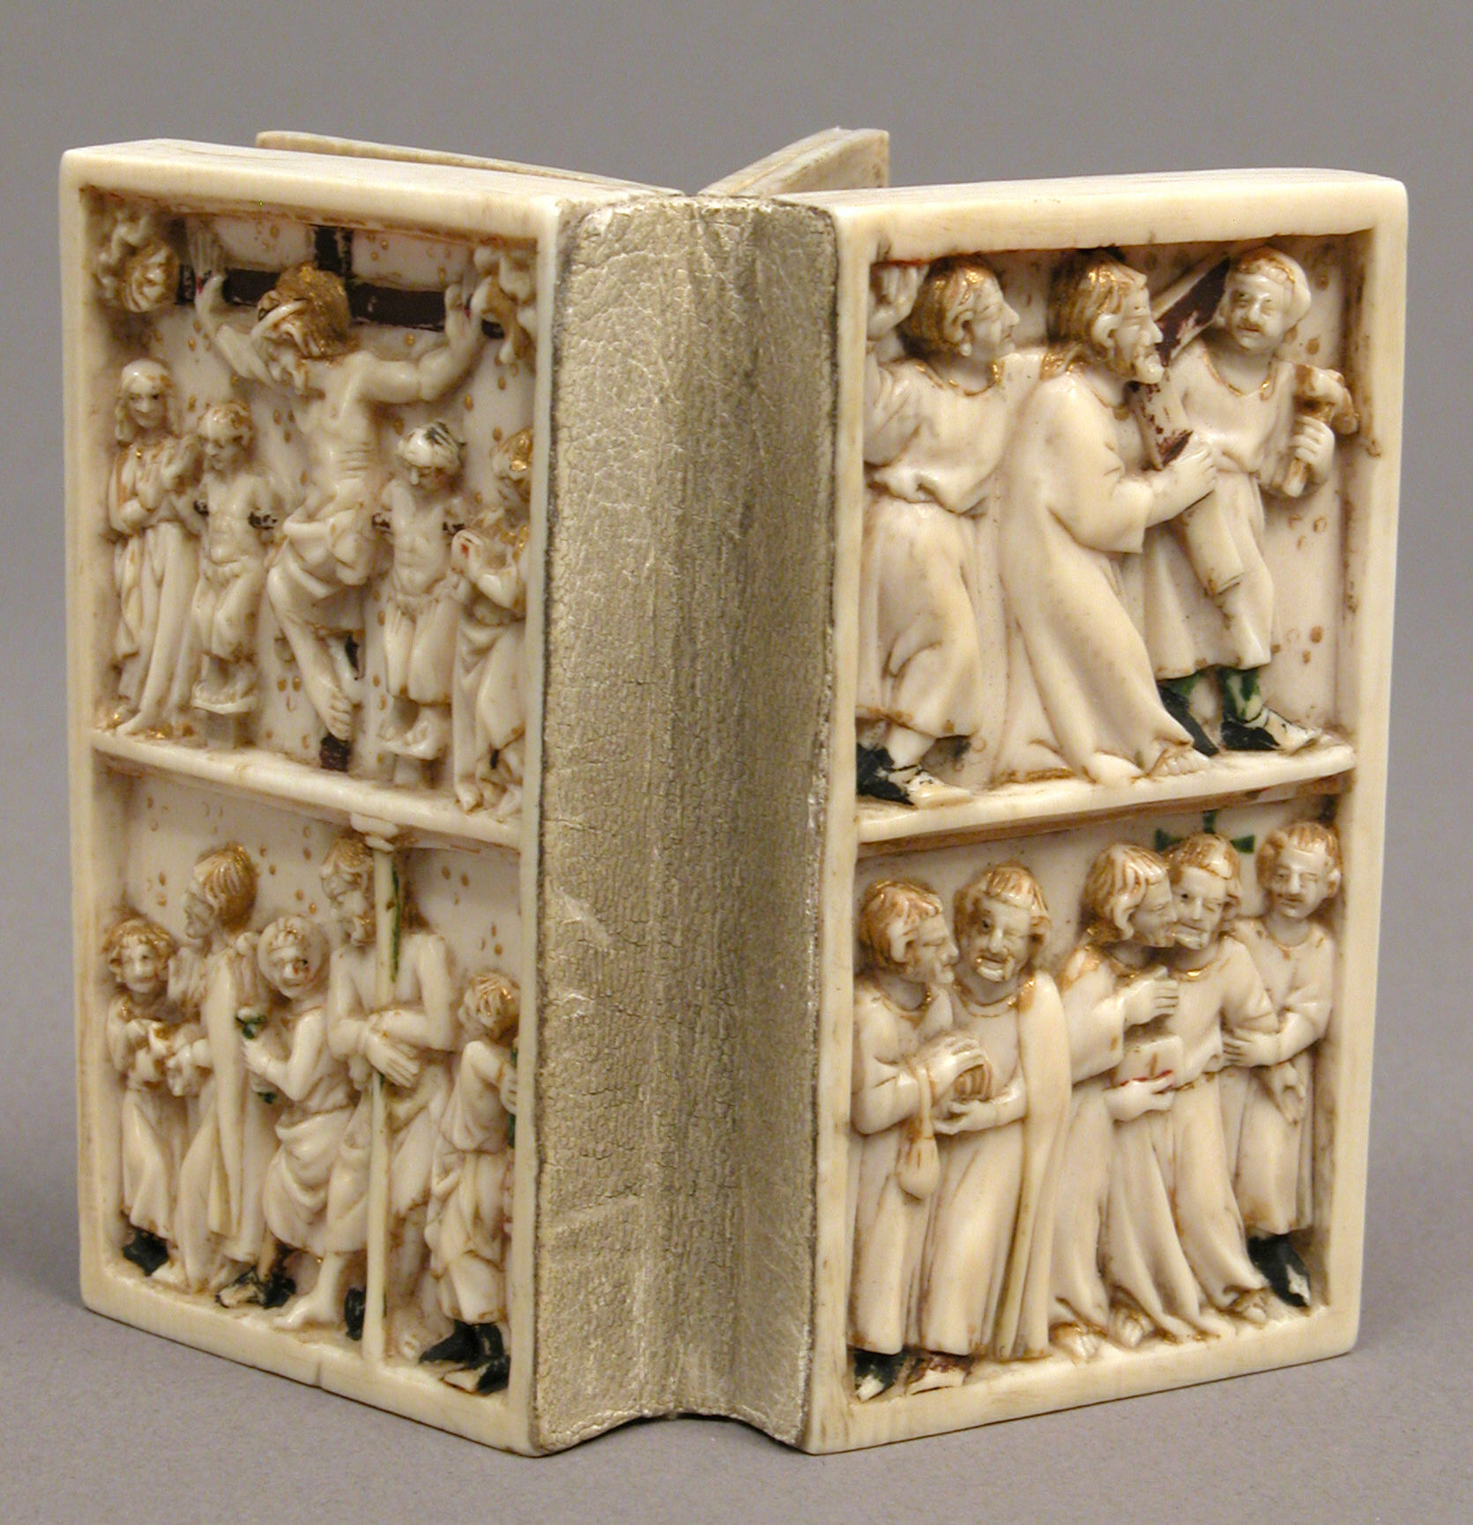
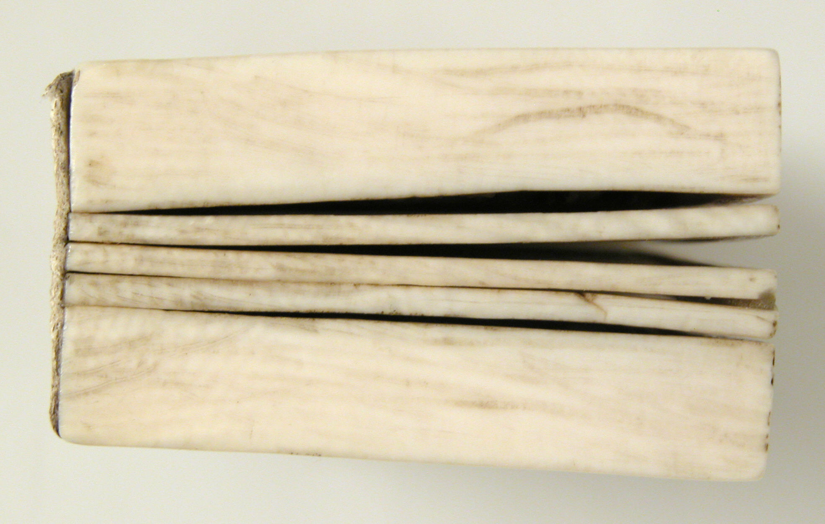
Aperto: 7.2 x 8.1 x 1.2 cm Chiuso: 7.2 x 4 x 2.2 cm

Slide 6
