Slide 1
Benzodiazepines

Slide 2
History
The first benzodiazepine (benzo) was synthesized by an Austrian scientist named Dr. Leo Sternbach in the mid 1950’s while working at Hoffman-La Roche. The new compound’s potential as a pharmaceutical was not initially recognized, however, Dr. Sternbach’s persistent research eventually uncovered it’s efficacy as a tranquilizer. In 1959, chlordiazepoxide (Librium) was introduced as the first of many benzos to come. Just four years later, in 1963, diazepam (Valium) came on the market. Clinicians quickly recognized the potential of benzos as a safer alternative to the barbiturate class of anxiolytics.

Slide 3
History
1903 Barbiturates
1957 Chlordiazepoxide synthesized
1960 Marketed as Librium
1959 Diazepam synthesized
1963 Valium launched
1978 Valium – most widely prescribed drug in the world
1980 Risk of dependence realised
Current average time from synthesis to commercial availability is 14 years
Notes:
Safer & Less Toxic than Barbs

Slide 4
Clinical Applications
Anxiolytic
GAD, PTSD, OCD, etc.
Panic Disorder
Specific Phobias
Anticonvulsant
Status epilepticus
Myoclonic epilepsy
Muscle relaxant
Sleep aid
Pre-operative anesthesia
Alcohol withdrawal
Notes:
Posttraumatic stress disorder (PTSD)

Slide 5
Structure
2-Keto Benzos
Some administered as prodrug
All have active metabolites (commonly desmethyldiazepam)
Long half-lives (most in excess of 60 hours)
3-hydroxy Benzos
No active metabolites
Not metabolized in the liver
Intermediate half-lives (most ~ 8-20 hours)
Triazolo Benzos
Additional heterocyclic ring attached at the 1 and 2 positions
Some active metabolites
Short to intermediate half-lives (anywhere from 3-14 hours)
Diazepam
1
2
3

Slide 6
2-Keto Benzos
Chlordiazepoxide (Librium)
Diazepam (Valium)
First isolated benzo
Oxidized to desmethyldiazepam in the liver
Indicated for treatment of anxiety and insomnia
Most prolific and versatile benzo
Indicated for treatment of anxiety, seizure, muscle tension, insomnia, and alcohol withdrawal

Slide 7
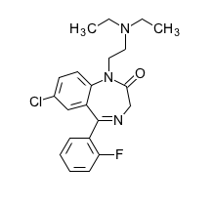
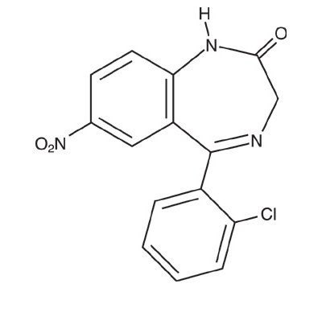
2-Keto Benzos
Flurazepam
Clonazepam
High potentcy (~ 20 times stronger per miliigram than diazepam)
Causes moderate anterograde amnesia
Indicated for treatment of anxiety, also a highly effective anticonvulsant
Longest half-life of any benzo (~ 40-250 hours)
Indicated primarily for treatment of insomnia, may also serve as an anxiolytic

Slide 8
2-Keto Benzos
The original date-rape drug, and the origin of the term “roofie”
Pharmacologically very similar to clonazepam, but possesses much stronger amnesic properties.
One of only two drugs in the U.S. for which a first possession charge is a mandatory felony. The other of the two is crack cocaine.
Flunitrazepam
Notes:
Droga da stupro perché è amnesizzante

Slide 9
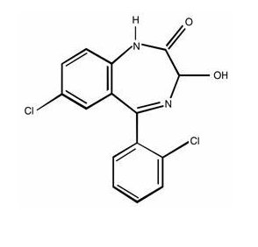
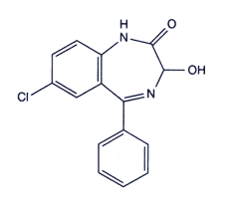
3-hydroxy Benzos
Lorazepam
Oxazepam
Indicated for treatment of anxiety, seizure, insomnia, panic disorder, and alcohol withdrawal.
Unique among benzos in it’s use as an adjunctive anti-emetic
Indicated for treatment of anxiety, insomnia, and alcohol withdrawal.
Common metabolite of many 2-keto benzos following their oxidation to desmethyldiazepam

Slide 10
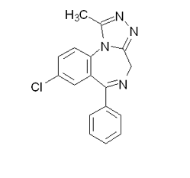
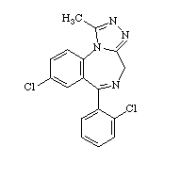
Triazolo Benzos
Alprazolam (Xanax)
Triazolam (Halcion)
First benzo approved by FDA for treatment of panic disorder.
Also used as an adjunctive treatment for depression while adjusting to SSRIs.
Very rapid onset
Very short half-life
Possesses amnesic properties similar to clonazepam
Used almost exclusively as a pre-op anesthetic

Slide 11
Benzodiazepine Pharmacology
CNS Depressant
The major action of the benzodiazepine drug class is focused in the brain
Can cross the blood brain barrier (BBB)
Easy access to the brain where the drugs exert their effect
Affects other body systems as well
Heart
Acts on different sites (receptors) of the heart
Notes:
C

Slide 12
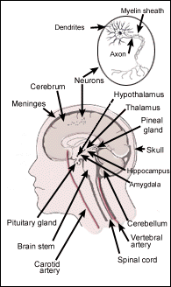
Benzodiazepine Pharmacology
Benzodiazepines act
on the GABA system in
the brain
Increase function

Slide 13
PRINCIPALI CLASSI DI RECETTORI GABA-ERGICI
RECETTORE
TIPO
AGONISTI
ANTAGONISTI
MODULATORI
GABA_{A}
Canale ionico
GABA
muscimolo
Bicucullina
Benzodiazepine
Barbiturici
β-carboline
Etanolo
A. generali etc.
GABA_{B}
Metabotropico
GABA
Baclofen
Faclofen
GABA_{C}
Canale ionico
GABA

Slide 14
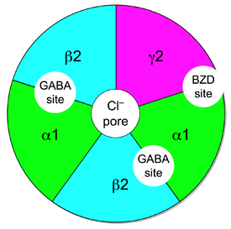
Site and Structure of Action
Site of action is the GABA_{A} receptor
Structure of GABA_{A} receptor
Comprised of 5 subunits
2 α subunits (to which GABA binds)
2 β subunits (to which barbiturates bind)
1 γ subunit (to which benzodiazepines bind)

Slide 15
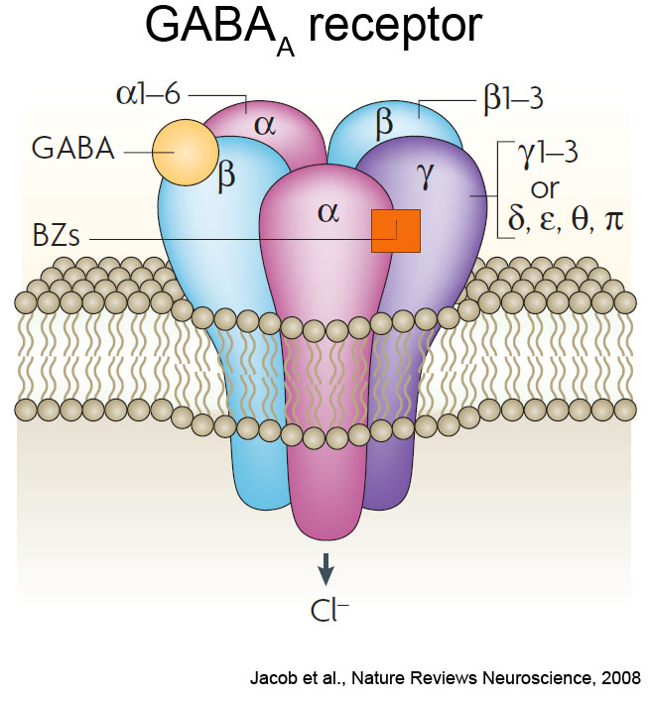
Benzodiazepine receptor of GABA_{A} is heterogeneous
13 known subunits of the GABA_{A} receptor
Benzodiazepine-sensitive:
α1, α2, α3, α5
Benzodiazepine-insensitive:
α4 and α6

Slide 17
Location(s) and mechanism of action on GABA_{A} receptor:
Appear to act at the limbic, thalamic, and hypothalamic levels of the CNS
Neuroanatomically, the amygdala, orbitofrontal cortex, and insula are associated with the production of behavioral responses to fearful stimuli and the central mediation of anxiety and panic
PET scans demonstrate increased blood flow to the amygdala concomitant with anxiety responses
Patients with panic disorders have shown a global decrease in benzodiazepine binding, largely in the orbitofrontal cortex and insula

Slide 18
Location and mechanism
Increased activity of amygdala function along with concurrent lowered GABAergic inhibition of function produces anxiogenic responses
The conclusion is that hypofunctional GABA_{A}- receptor activity may sensitize the amygdala to anxiogenic responses
It is thought that the benzodiazepines may reset the threshold of the amygdala to a more normal level of responsiveness

Slide 19
Location and mechanism
VTA has been shown as a possible site for anxiolytic actions of benzodiazepines
We know that dopamine neurons synapse are regulated by GABA_{A} Cl⁻ channels in the VTA
Flurazepam injections into the VTA have been shown to block anxious responses

Slide 20
Location and Therapeutic Index
Location of Action
Therapeutic Effect
Amygdala
Alleviate anxiety, agitation, and fear
Orbitofrontal Cortex
Insula
Mental confusion, amnesia, antiepileptic actions
Cerebral Cortex
Hippocampus
Spinal Cord
Mild muscle-relaxing effects
Cerebellum
Brain Stem
Abuse potential, and psychological dependence
Ventral Tegmental Area
Nucleus Accumbens

Slide 24
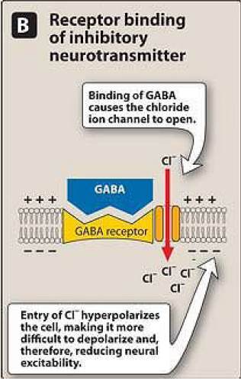

Slide 26
Barbiturates
enhance the binding of GABA to GABA_{A} receptors
Prolonging duration
Only α and β (not ϒ) subunits are required for barbiturate action
Narrow therapeutic index
in small doses, barbiturates increase reactions to painful stimuli.
Hence, they cannot be relied on to produce sedation or sleep in the presence of even moderate pain
Barbiturates can open ion channel all by themselves at higher levels
Bezodiazepines
enhance the binding of GABA to GABA_{A} receptors
increasing the frequency
Unlike barbiturates, benzodiazepines do not activate GABA_{A} receptors directly
Barbiturates increase the duration of chloride ion channel opening at the GABA_{A} receptor, whereas benzodiazepines increase the frequency of the channel opening
Notes:
In addition to this GABAergic effect, barbiturates also block AMPA and kainate receptors, subtypes of ionotropic glutamate receptor.

Slide 27
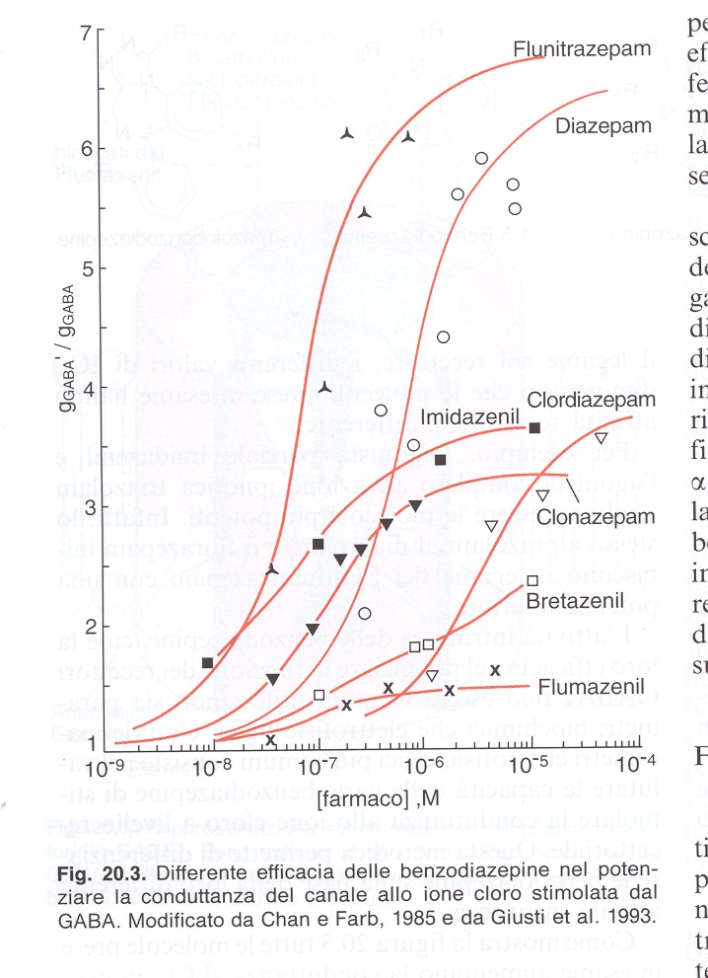

Slide 28
Dose Equivalents
Drug | Daily range mg | Equiv 5mg diazepam. | Duration (½ life)
alprazolam | 1 – 4 | 0.5 - 1 | Short/Intermediate
bromazepam | 6 – 9 | 3 – 6 | Short/Intermediate
clobazam | 30 – 80 | 10 | Intermediate
clonazepam | 4 – 8 | 0.5 | Intermediate
diazepam | 5 – 20 | 5 | Long
flunitrazepam | 0.5 – 2 | 1 – 2 | Intermediate
lorazepam | 2 – 4 | 1 | Short/Intermediate
nitrazepam | 5 – 20 | 5 – 10 | Intermediate
oxazepam | 45 – 90 | 15 – 30 | Short
temazepam | 10 – 30 | 10 - 20 | Short
triazolam | 0.125 - 0.25 | 0.25 | Short
buspirone* | 15 – 30 | - | Short
zopiclone* | 3.75 - 7.5 | - | Short
Notes:
* Non benzodiazepine

Slide 29
Short Acting: 3 - 8 hrs
Oxazepam
Temazepam
Triazolam
Buspirone*
Zopiclone*
Notes:
Non benzodiazepine

Slide 30
Intermediate Acting: 10 - 20 hours
Alprazolam
Bromazepam
Clobazam
Clonazepam
Flunitrazepam
Lorazepam
Nitrazepam

Slide 31
Long Acting 1- 3 days: Diazepam
X
X
X

Slide 32
Pharmacokinetics
Mostly oral, some available parenterally
Peak plasma concentrations are achieved in about one hour
Metabolized in liver
Through urine
Absorption
Distribution
Metabolism
Elimination
Notes:
-some benzodiazepines are metabolized to pharmacologically inactive, water-soluble products.
Others are first biotransformed to intermediate, pharmacologically active products and have to be detoxified further before excretion.

Slide 33
Pharmacokinetics
• Rapidly absorbed in the GI tract following oral administration (75% reaches plasma)
• Only approx. 20% is metabolized in first-pass metabolism
Metabolized in the liver and excreted by the kidney’s
• Peak plasma levels reached in approx. 1 hour

Slide 34
Absorbtion distribution, Metabolism and Excretion
Well absorbed when taken orally, with peak plasma concentrations achieved in approx. 1 hour
Several benzo’s (diazepam, chlordiazepoxide, chlorazepate, halazepam, prazepam, chlorazepate) are first biotransformed to pharmacologically active intermediates
These intermediates are then degraded and excreted
Thus, long-lasting benzo’s are so b/c they are first degraded to active intermediates, and both the parent drug and the intermediate are long-lasting/acting

Slide 35
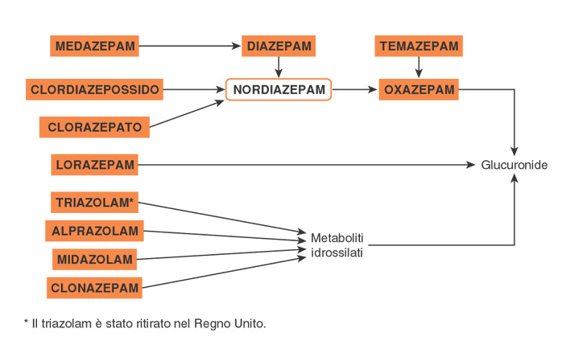

Slide 36
Short Acting and the Elderly
Short-lasting benzo’s are not converted to active intermediates; they are metabolized directly into inactive products
The elderly have a reduced ability to metabolize long-acting benzo’s (and their active metabolites)
Pharmacokinetics are not drastically altered with the short-acting benzo’s
Short to intermediate acting BDZ (oxazepam & temazepam) are safer than the other in elderly.

Slide 37
Pharmacological effects
Those compounds that bind and enhance the inhibitory actions of GABA are complete agonists:
Lorazepam, midazolam, etc.
Those compounds that bind with “less than complete agonist action” are termed partial agonists: zolpidem
Those compounds that bind and decrease the inhibitory actions of GABA are inverse agonists

Slide 38
Pharmacological effects
Those compounds that bind and have no effect on GABA inhibition are antagonists
Prevent enhancement of GABA effects, but do NOT reduce the basal conductance of Cl⁻
Prevent gating of Cl⁻ channels in spite of the presence of benzodiazepines
Flumazenil (a benzodiazepine) binds with high affinity to the GABA_{A} complex, but illicits no response
Rapidly metabolized in the liver, and therefore has a very short half-life

Slide 39
Indications
Anxiety
Short term relief (two to four weeks only) of anxiety that is severe, disabling, or causing the patient unacceptable stress.
Insomnia
Benzodiazepines should be used to treat insomnia only when it is severe, disabling or causing the patient extreme distress.
Chronic Muscle Spasm or spasticity associated with MS
Status epilepticus
Febrile Convulsions
Hypnotic (sleep inducing)
Withdrawal treatment
Panic disorder with anxiety
THE USE OF BENZODIAZEPINES FOR SHORT TERM MILD ANXIETY OR MINOR INJURY IS NOT APPROPRIATE

Slide 40
Indications | Drug
Anxiolytic | Diazepam, Alprazolam, Bromazepam, Lorazepam, Oxazepam, Buspirone*
Muscle relaxant | Diazepam
Pre-med | Diazepam, Lorazepam
Alcohol withdrawal | Diazepam, Oxazepam,
Panic disorder | Alprazolam, Clonazepam.
Anti-convulsant | Clobazam, Clonazepam, Diazepam, Lorazepam
Hypnotic | Flunitrazepam, Nitrazepam Temazepam, Zolpidem, Zopiclone*
Notes:
* = Non benzodiazepine

Slide 41
Normal
➔
ANXIOLYTIC
_________ ➔ _________________
Drowsiness/decrease reaction time
➔
HYPNOSIS
➔
Confusion, Delirium, Ataxia
➔
Surgical Anesthesia
➔ Coma
➔
DEATH

Slide 42
_{Respiratory}
_{Depression}
_{BARBS}
_{BDZs}
_{Coma/}
_{Anesthesia}
_{Ataxia}
_{RESPONSE}
_{ETOH}
_{Sedation}
_{Anticonvulsant}
_{Anxiolytic}
_{DOSE}

Slide 43
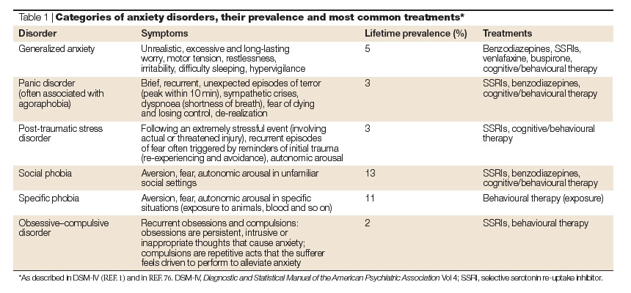
CLASSIFICAZIONE DEI DISTURBI CORRELATI AD ANSIA
Notes:
Nature Reviews Neuroscience 5, 545-552 (2004); doi:10.1038/nrn1429 THE DEVELOPMENTAL ORIGINS OF ANXIETY

Slide 44
CRITERI DIAGNOSTICI PER LA DEFINIZIONE
DI UN ATTACCO DI PANICO
Palpitazioni, o aumento della frequenza cardiaca
Sudorazione
Brividi o vampate di calore
Tremori o sussulti
Sensazione di soffocamento
Dolori al torace
Nausea o disturbi addominali
Senso di vertigine, instabilità, debolezza
Parestesie
Derealizzazione o depersonalizzazione
Paura di perdere il controllo o di impazzire
Paura di morire
SINTOMI
NEURO-
VEGETATIVI
SINTOMI
NEURO-PSICHICI

Slide 45
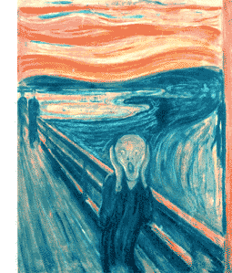
Why Do People Use Benzodiazepines?
To get away from
this!

Slide 46
Short-Term Effects (Low Doses)
Euphoria
“Being in a happy world”
Fatigue
Feeling drowsy
Shallow breathing
Not being able to take full, deep, normal breaths
Trouble coordinating your movements

Slide 47
Short-Term Effects (High Doses)
Paranoia
Having an unrealistic perception of something, someone, or some place in relationship to the world and you
Aggression
Easily agitated
Difficulty remembering
Irritability

Slide 48
Effects in Overdose
Unconsciousness
Respiratory depression
Collapse of heart and heart functions
Walking difficulty
CNS depression
Shallow breathing
Not being able to take full, deep, normal breaths

Slide 49
Long-term Effects
“Rebound effects”
Over use of these drugs can cause a reversal effect
Seizures can occur; calm and relaxed feelings dissipate
Tolerance develops, resulting in dependence
Must have more and more of the drug to feel an even minor effects
Higher risk of overdose
Withdrawal
This leads to dependence as well
No one wants to feel the unpleasant withdrawal effects, so continues use

Slide 50
Cognitive Effects
Memory impairment/Amnesia
Confusion
Sleepiness

Slide 51
Psychological Effects
Relaxation
Helps with the daily stresses of life/relieves tension
Anxiety from school and peer stresses
Drowsy
Easier to sleep/induces sleep
Distracts you from other problems going on around you and in your own life
Just a temporary fix; the problem never goes away

Slide 52
Effects of benzodiazepine
On increasing the dose sedation progresses to hypnosis and then to stupor.
But the drugs do not cause a true general anesthesia because
-awareness usually persists
-immobility sufficient to allow surgery cannot be achieved.
However at "preanesthetic" doses, there is amnesia.

Slide 53
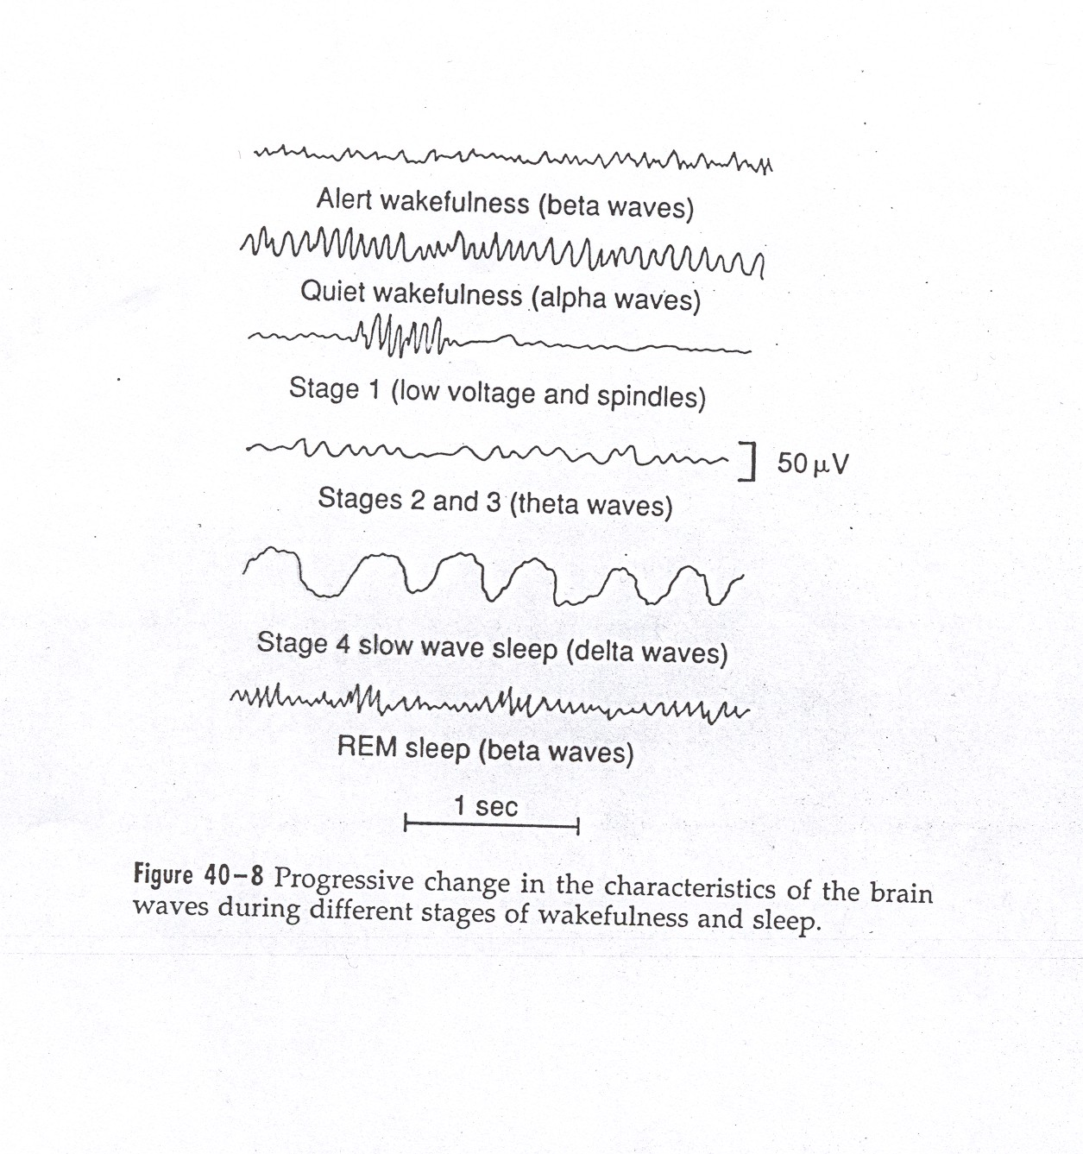
SLEEP
Notes:
Slow-wave sleep: sonno estremamente riposante, associato a diminuzione del tono vascolare periferico e di molte altre funzioni vegetative. Pressione, ritmo respiratorio e metabolismo basale diminuiscono del 10-30%. È la varietà di sonno più rappresentata. Nonostante lo SWS venga anche denominato “sonno senza sogni”, si possono verificare sogni, e a volte anche incubi, durante questa fase del sonno, ma a differenza di quanto accade per i sogni della fase REM non si ha il processo del consolidamento dei sogni nella memoria, per cui al risveglio non si ricordano.
Durante una normale notte di sonno episodi di sonno REM di durata dai 5 ai 30’ si verificano ogni circa 90’, partendo da 80 a 100’ dall’addormentamento. Il sonno REM è generalmente associato con l’attività onirica; frequenza cardiaca e respirazione diventano spesso irregolari; nonostante l’inibizione dei muscoli periferici si possono avere movimenti muscolari irregolari, specie a carico dei muscoli oculomotori; il cervello è attivato in questa fase e il suo metabolismo può aumentare fino al 20%. L’attività EEG è simile a quella dello stato di veglia, da cui il nome di sonno paradosso.
Le BDZ diminuiscono il tempo di latenza del sonno e diminuiscono il numero di risvegli, ma anche del tempo passato in fase SWS. La maggior parte delle BDZ aumenta il tempo intercorrente tra l’inizio del sonno “a fusi” e il primo episodio di sonno REM; il tempo speso in fase REM è generalmente diminuito.tuttavia, il numero di cicli di sonno REM è generalmente aumentato. (l’effetto dello zolpidem sul sonno REM è meno marcato di quello delle BDZ. IL tempo totale di sonno è generalmente aumentato, soprattutto per via dell’aumento del tempo speso nello stadio 2 (che rappresenta la frazione maggiore del sonno non-REM). Gli effetti dei barbiturici sulle fasi del sonno sono simili a quelli delle BDZ.

Slide 54
CATEGORIES OF INSOMNIA
Transient insomnia | Short-term insomnia | Long-term insomnia
Lasts <3 days ---Caused by a brief environmental or situational stressor. ---Respond to attention to sleep hygiene rules. --- Hypnotics should be used at the lowest dose and for only 2-3 nights. | 3 days to 3 weeks --- Caused by a personal stressor such as illness, grief, or job problems. ---Sleep hygiene education is the first step. ---Hypnotics may be used adjunctively for 7-10 nights. ---- Hypnotics are best used intermittently during this time, with the patient skipping a dose after 1-2 nights of good sleep. | lasted for >3 weeks ---No specific stressor may be identifiable. ---A more complete medical evaluation is necessary in these patients, but most do not need an all-night sleep study.

Slide 55
LONG-TERM INSOMNIA
Nonpharmacological treatments are important for all patients with long-term insomnia.These include
Reduced caffeine intake
Avoidance of alcohol
Adequate exercise
Relaxation training
Behavioral-modification approaches, such as sleep-restriction and stimulus-control therapies.
Nonpharmacological treatments for insomnia have been found to be particularly effective in reducing sleep-onset latency and time awake after sleep onset.

Slide 56
Effects on the (EEG) and Sleep Stages
↓ sleep latency
↓ number of awakenings
↓ time spent in stage 0, 1, 3, 4
↓ time spent in REM sleep (↑number of cycles of REM sleep)
↑ total sleep time (largely by increasing the time spent in stage 2)

Slide 57
Respiration-Hypnotic doses of benzodiazepines are without effect on respiration in normal subjects
CVS-In preanesthetic doses, all benzodiazepines decrease blood pressure and increase heart rate

Slide 58
Management of Patients after Long-Term Treatment with Hypnotic Agents
If a benzodiazepine has been used regularly for >2 weeks, it should be tapered rather than discontinued abruptly.
In some patients on hypnotics with a short t_{1/2}, it is easier to switch first to a hypnotic with a long t_{1/2} and then to taper.
The onset of withdrawal symptoms from medications with a long t_{1/2} may be delayed.
Consequently, the patient should be warned about the symptoms associated with withdrawal effects.

Slide 59
PHARMACOKINETIC CONSIDERATIONS
A short elimination t_{1/2} is desirable for hypnotics, although this carries the drawback of increased abuse liability and severity of withdrawal after drug discontinuation.
Most of the BZDs are metabolized in the liver to produce active products (thus long duration of action).
After metabolism these are conjugated and are excreted via kidney.

Slide 60
Prescribing Guidelines for the Management of Insomnia
Hypnotics that act at GABA_{A} receptors, including the benzodiazepine hypnotics and the newer agents zolpidem, zopiclone, and zaleplon, are preferred to barbiturates because they have a
Greater therapeutic index
Less toxic in overdose
Have smaller effects on sleep architecture
Less abuse potential.
Compounds with a shorter t_{1/2} are favored in patients with sleep-onset insomnia but without significant daytime anxiety who need to function at full effectiveness during the day.
These compounds also appropriate for the elderly because of a decreased risk of falls and respiratory depression.
One should be aware that early-morning awakening, rebound daytime anxiety, and amnestic episodes also may occur.
These undesirable side effects are more common at higher doses of the benzodiazepines.

Slide 61
Prescribing Guidelines for the Management of Insomnia
Benzodiazepines with longer t_{1/2}
are favored for patients
- --- who have significant daytime anxiety and
----- who may be able to tolerate next-day sedation.
However can be associated with
-next-day cognitive impairment
-delayed daytime cognitive impairment (after 2-4 weeks of treatment) as a result of drug accumulation with repeated administration.
Older agents such as barbiturates, chloral hydrate, and meprobamate have high abuse potential and are dangerous in overdose.

Slide 62
ADVERSE EFFECTS
Light-headedness
Fatigue
Increased reaction time
Motor incoordination
Impairment of mental and motor functions
Confusion
Antero-grade amnesia
Cognition appears to be affected less than motor performance.
All of these effects can greatly impair driving and other psychomotor skills, especially if combined with ethanol.
• Drowsiness, dizziness, and nausea at therapeutic doses
Severe nausea and vomiting greatly limit overdoses

Slide 63
Avoid (if possible)
Pregnancy
Lactation

Slide 64
IN PREGNANCY:
Is contraversy
Not major teratogen?
Cleft plate reported
W.D. symptoms in newborns

Slide 65
Effects on Pregnancy
Benzodiazepines (and their metabolites) can freely cross the placental barrier and accumulate in fetal circulation
Administration during the first trimester can result in fetal abnormalities
Administration in third trimester (close to the time of birth) can result in fetal dependence, or “floppy-infant syndrome”
Benzodiazepines are also excreted in the breast milk

Slide 66
Adverse Effects
Physical dependence occurs in about 1 in 3 patients.
History substance abuse > risk dependence
Increased accident risk.
Tolerance & rebound insomnia.
Alcohol & CNS depressants potentiate adverse effects.

Slide 67
Adverse effects
60y+ > vulnerability to confusion, memory impairment, over sedation (most common S/E) & falls.
Adverse mood effects: depression, emotional anaesthesia, aggression, increased suicide risk in elderly.

Slide 68
Benzodiazepines
Tolerance and Dependence
Tolerance to the sedative and euphoric effects are rapid, but lesser for anti-anxiety and antipanic effects.
*Dependence can develop even following only therapeutic dosages

Slide 69
Benzodiazepine Therapy

Slide 70
Withdrawal from Benzodiazepines
Abrupt cessation: > seizures
Withdrawal symptoms may occur between doses during continuous use (inter-dose withdrawal). Patients may think these symptoms are due to the original problem.
Withdrawal symptoms: increased anxiety, sleep disorder, aching limbs, nervousness & nausea.

Slide 71
Withdrawal from Benzodiazepines
Withdrawal experienced by 45% of patients discontinuing low dose benzodiazepines & 100% patients on high doses.
Short half life benzodiazepines are associated with more acute & intense withdrawal symptoms.
Long half life benzodiazepines - milder, more delayed withdrawal (NPS, 1999).

Slide 72
Withdrawal from benzodiazepines
Benzodiazepines should not be ceased abruptly.
Dose reduced by 10-20% per week.
Patient allowed to stabilise between each reduction.
Admission for high dose users, history of seizures or psychosis, or for more rapid withdrawal.

Slide 73
Overdose Benzodiazepines
Generally safe in overdose unless mixed with alcohol/CNS depressants.
Symptoms overdose: hypotension, respiratory depression & coma.
Treatment: Supportive
Flumazenil rarely indicated

Slide 74
Flumazenil
Flumazenil reported to reverse memory impairments and overdoses
Flumazenil also reported to improve memory and learning, thus suggesting a possible role of endogenous benzo’s in memory function
Notes:
Sonnolenza, vertigini e nausea

Slide 75
Flumazenil is a benzodiazepine Antagonist = Blocker
Flumazenil binds to GABA receptor displacing benzodizepine
Notes:
Attaches to the benzodiazepine binding site but does not facilitate action of GABA. Competes with any benzodiazepine that is present, displacing the benzodiazepine from the receptor and reversing the action of the benzodiazepine

Slide 76
FLUMAZENIL: A BENZODIAZEPINE RECEPTOR ANTAGONIST
competitively antagonism
Flumazenil antagonizes both the electrophysiological and behavioral effects of agonist and inverse-agonist benzodiazepines and β -carbolines.
Flumazenil is available only for intravenous administration.
On intravenous administration, flumazenil is eliminated almost entirely by hepatic metabolism to inactive products with a t_{1/2} of ~1 hour; the duration of clinical effects usually is only 30-60 minutes.

Slide 77
FLUMAZENIL: A BENZODIAZEPINE RECEPTOR ANTAGONIST
PRIMARY INDICATIONS FOR THE USE OF FLUMAZENIL ARE:
Management of suspected benzodiazepine overdose.
Reversal of sedative effects produced by benzodiazepines administered during either general anesthesia.
The administration of a series of small injections is preferred to a single bolus injection.
A total of 1 mg flumazenil given over 1-3 minutes usually is sufficient to abolish the effects of therapeutic doses of benzodiazepines.
Patients with suspected benzodiazepine overdose should respond adequately to a cumulative dose of 1-5 mg given over 2-10 minutes;
A lack of response to 5 mg flumazenil strongly suggests that a benzodiazepine is not the major cause of sedation.

Slide 78
IV Flumazenil
Dangerous to use if mixed overdose (e.g benzodiazepine + tricyclics, amphetamines, other pro-convulsants) - Result in uncontrolled seizure
In dependent individuals severe withdrawal
Flumazenil has a shorter half life ( one hour) than all benzodiazepines Therefore, repeat doses of flumazenil may be required to prevent recurrent symptoms of overdosage once the initial dose of flumazenil wears off.

Slide 79
Detoxification from Benzodiazepines. Why, when and how…

Slide 80
Key points
It is possible
It is worth doing
It needs the right time, the right support and the right regimen
Relapse happens but should not be a reason not to try and keep trying!

Slide 81
Not every one needs a detox…
Even with long term use mot everyone develops dependency.
More likely when
Longer durations of treatment
Higher doses
More potent benzodiazepines
Shorter-acting drugs
A history of anxiety problems
(Kan et al 2004)

Slide 82
Why detoxify
Long term use:
Affects thinking and memory
Reduces emotional responsiveness
Increased depression and anxiety
Notes:
It was as though a net curtain or veil had been lifted from their eyes: slowly, sometimes suddenly, colours became brighter, grass greener, mind clearer, fears vanished, mood lifted, and physical vigour returned.

Slide 83
Withdrawals depend on speed of reduction
Most people only experience mild withdrawal symptoms when withdrawal is slow and tapered to their needs [Ashton, 2002d].
Severe withdrawal symptoms are associated with the following [Kan et al, 2004]:
Rapid withdrawal
Prolonged use of benzodiazepines
High-dose use
Short-acting, potent benzodiazepines
People with a history of anxiety problems
Withdrawal symptoms characteristically vary in severity and type from day to day and from week to week. As some symptoms resolve, others may take their place. These symptoms gradually become less severe and less frequent with time [Ashton, 2002d].

Slide 84
What has been tried?
NO EVIDENCE for:-
Anticonvulsants
Antipsychotics – makes it worse!!
Antidepressants
Beta blockers
Buspirone
SOME evidence for propranolol
Lingford- Hughes et al 2004

Slide 85
Why is it so hard to come off?
Reducing causes increased excitation throughout the brain which causes the symptoms of withdrawal, including agitation, anxiety, and insomnia.
The number of GABA receptors is slowly restored in response to benzodiazepine cessation or dose reduction.. The rate of withdrawal of treatment needs to allow time for GABA receptors to regenerate if withdrawal symptoms are to be minimized.

Slide 86
Common problems when detoxing.
Symptoms of depression
Symptoms of anxiety
Insomnia
Worsening of pre-existing mental health problems
OCD
Panick attacks
Psychotic symptoms

Slide 87
Anxiety symptoms
Common to all anxiety
Agitation
panic attacks
agoraphobia
Insomnia
nightmares
Depression
Poor memory,
loss of concentration
Specific to withdrawal
Perceptual distortions, depersonalization
Hallucinations (visual and auditory)
Tingling and loss of sensation, formication (a feeling of ants crawling over the skin)
Sensory hypersensitivity
Muscle twitches and fasciculations
Psychotic symptoms, confusion, convulsions (rare)

Slide 88
How long do symptoms last?
Up to 15% of people develop protracted withdrawal symptoms (months or years)
Anxiety:- Gradually diminishes over 1 year
Insomnia:- Gradually diminishes over 6–2 months
Depression:- May last a few months
responds to antidepressants
Cognitive impairment:- Gradually improves, but may last for >1 year
Perceptual symptoms (e.g.tinnitus, paraesthesia, pain (usually in limbs) Gradually recedes, but may last for at least 1 year and occasionally persist indefinitely
Motor symptoms (e.g.muscle pain, weakness, tension, painful tremor, jerks) Usually gradually recede, but may last for >1 year
Gastrointestinal symptoms:-Gradually recede, but may last for at least 1 year and occassionally persist indefinitely

Slide 89
Different detoxes for different types of addiction?
Therapeutic dose dependence.
Prescribed high dose dependence
More flexibility in reduction
Recreational use of benzodiazepines
to increase the "kick" obtained from illicit drugs
alleviate the withdrawal symptoms of other drugs of abuse
Tend to be fixed withdrawal – why?

Slide 90
Suggested principles.
Where possible change to a long acting drug – usually diazepam
Avoid extra medication
Antidepressants only useful for clinical depression or panic attacks
SUPPORT.. SUPPORT.. SUPPORT!
Family, friends, helplines, addiction or GP staff

Slide 91
Why use diazepam?
Withdrawal is most easily managed from diazepam because:
Diazepam and its metabolites (desmethyldiazepam and nordiazepam) have long half-lives (between 20 hours and 200 hours), which ensures a gradual fall in blood concentrations. The blood level of its longest active metabolite for each dose falls by a half in about 8 days [Micromedex, 2006]

Slide 92
Detox regimens
Be flexible in following the schedule
For people taking 40 mg per day of diazepam or less, a typical withdrawal schedule that is tolerated by most people would be to:
Reduce by 2 mg to 4 mg every 1–2 weeks to 20 mg per day
Reduce by 1 mg to 2 mg every 1–2 weeks to 10 mg per day
Reduce by 1 mg every 1–2 weeks to 5 mg per day
Reduce by 0.5 mg to 1 mg every 1–2 weeks until completely stopped.
Total withdrawal time from diazepam 40 mg per day might be 30–60 weeks; withdrawal from diazepam 20 mg per day might take 20–40 weeks.
Stopping the last few milligrams is often seen by patients as being particularly difficult but this is usually an unfounded fear derived from long-term psychological dependence on benzodiazepines.

Slide 93
FLUMAZENIL
benzodiazepine receptor “antagonist” (high affinity, low agonist action)
attenuates withdrawal and reduces withdrawal symptoms & signs
normalizes and upregulates BZD receptors
restores GABA receptor allosteric structure and inhibits BZD induced uncoupling
reverses tolerance
reduces craving

Slide 94
Intravenous flumazenil versus oxazepam in the treatment of benzodiazepinewithdrawal: a randomized, placebo-controlled study
Gerra G et al
Addiction Biology; 7:385 -395, 2002

Slide 95
Single-blind, randomized, placebo- controlled trial
(n = 20) IV flumazenil 1mg in 500ml normal saline over 4hrs x twice daily (0900 - 1300; 1430 - 1830) for 8 days + (oxazepam 30mg,15mg, 7.5mg nocte x 3 days)
(n = 20) tapering oxazepam 105mg - 7.5mg over 8 days
(n = 10) placebo tablets and saline infusion

Slide 96
Intravenous flumazenil in the treatment of benzodiazepine dependence
reduced withdrawal symptoms & signs
reduced craving
reduced post detoxification relapse rates

Slide 97
Intravenous flumazenil in the treatment of benzodiazepine dependence
reduced post detoxification relapse rates
DAY 30
FLUMAZENIL: 40%
OXAZEPAM: 70%

Slide 98
Prescribing Recommendations
Address the cause of symptoms
Psychotherapeutic guidance required – Listen to the patient
Has the patient tendency to misuse drugs/alcohol?
Ensure dose is correct
Prescribed for as long as necessary, aiming for shortest time – but not > 4/52
Rebound anxiety, tapering dose, support
Reduction/Discontinuation – Careful medical supervision & appropriate psychological interventions

Slide 99
Before prescribing benzodiazepines
Take a full history including an alcohol and licit and illicit drug history.
Inform the patient of the side-effect profile of benzodiazepines and offer an information
leaflet.
Consider and treat, if possible, any underlying causes.
Consider referral to other services.
Consider alternative therapies.
Consider delaying prescribing until a subsequent visit
Notes:
Talk about why patient is not sleeping
Relaxation therapy.
Avoidance of stimulant drugs and beverages
Increase physical activity & mental stimulation
Explain that 8 hrs sleep not always necessary
Avoid 'catnaps' during the day.
A relaxing bath or a good book can facilitate sleep.
Yoga/ Meditation/ Exercise.
Consider alternative medication
Kalms (Valerian)
Natrasleep (Hops & Valerian)
Natracalm (Passion flower)
Rescue Remedy

Slide 100
When prescribing for the 1st time
Initiate with the lowest recommended dose, but this may need to be adjusted depending on patient’s response.
Do not prescribe for longer than 4 weeks.
Use phased dispensing where possible.
Ensure that agreements between doctor and patient are documented.
Record all details of medication prescribed and duration of treatment.
Clear, effective and speedy communication concerning benzodiazepine usage should always take place between the prescribing professionals both within and between services.

Slide 101
Benzodiazepine dependent patients or pts in receipt of continuing prescribing
Issue small quantities at a time Review regularly – monthly
Use a long acting benzodiazepine in dosages no higher than diazepam 5 mg three times daily (or equivalent)
Make patients aware of the risks of long term benzodiazepine use and document this communication.
Signed consent forms should be used where appropriate.
Encourage dependent pts to withdraw, offer them a detoxification programme at regular intervals (at least annually) and document
A significant number of requests for repeat benzodiazepine prescribing are associated with addiction problems, primarily alcohol, or in urban areas, opiate misuse. A doctor who
suspects this is the case should seek specialist advice

Slide 102
Benzodizepines, interactions
Increased Effects with
Alcohol
Analgesics (Fentanyl)
Antibacterials (Clarithromycin, Isoniazid)
Antifungals
(ketokonazole, itraconazole)
Antipsycotics
Antivirals
Muscle relaxants (baclofen)
Decreased Effects with
Antibacterial (Rifampicin)
Probenecid
Theophylline
Neoquinolone

Slide 103
Non benzodiazepines Anxiolytic: Buspirone (Buspar)
Different action to bzd.
Not a CNS depressant.
Partial agonist (stimulant) of dopaminergic & serotoninergic receptors.
No sedation, anti-convulsant or muscle relaxant properties - just anxiolytic.
Delayed action (1-2 weeks)
Effect reduced if benzodiazepine used in last 3/12

Slide 104
Comparison of benzodiazepine & buspirone
Benzodiazepine
Rapid onset
Can cause sedation
May impair performance
Additive effects with alcohol
May cause dependence & withdrawal
Pharmacokinetic change with age
Associated with falls in elderly (Keltner & Folks, 2001)
Buspirone
Delayed onset (cannot be used PRN)
Does not cause sedation
Does not impair performance
No additive effect with alcohol
Non addictive
No pharmacokinetic change with age
Does not cause falls in elderly
Expensive (Not on PBS)
Notes:
Gradual improvement in 1 to 2 weeks, maximum effect in 4 to 6 weeks

Slide 105
Presentation: Buspar
White scored
5 mg & 10 mg tabs

Slide 106
Buspirone: Agonist = Mimic
Buspirone attaches to serotonin receptor mimicking serotonin.
Notes:
Buspirone attaches to Serotonin 1A receptor and activates it mimicking serotonin action on the receptor, which results in an anti-anxiety action.
Drug mimics action of the transmitter = Agonist
Green symbolises “Go”

Slide 107
Non benzo Hypnotic: Zopiclone (Imovane)
Similar action, side effects & contraindications to benzo’s.

Slide 108
Barbiturates and Benzodiazepines

Slide 109
Introduction
Barbiturates basically replaced things like opium and brandy for MDs
Phenobarbital is still used to prevent seizures
Sternback et al discovered the benzodiazepines by brute force.
Discovered diazepam (Valium)
Rohypnol

Slide 110
Administration
Rapid effect, go with IV
Long term, oral better
Diazepam is the quickest, 30 min peak
Absorption from digestive system is GREATLY increased by taking alcohol
Superadditive
Great deal of variability

Slide 111
Distribution
More lipid soluble ones go through BB barrier more quickly
Redistributed to fat cells
Biphasic curve
Many metabolites are also psychoactive
Also cross the placental barrier too…

Slide 112
Neurophysiology
Modifies the effect of GABA
GABA lets Cl- in
Harder to fire
Positive GABA modulators
Make GABA more effective
Barbiturates can open ion channel all by themselves at higher levels

Slide 113
Effects
Barbiturates affect blood pressure, benzodiazepines do not.
Both have anti convulsant properties
Benzodiazepines are good muscle relaxants
REM effects
REM rebound
Euphoria, ‘liking’ and fatigue

Slide 114
More effects
Confusion
Decrease in visual acuity
Divided attention becomes more difficult
Reaction time
Acquisition but not recall effects
Hangover
DO NOT DRIVE

Slide 115
Even more effects
More exploration in lab animals
Huh?
Disinhibition?
Less anxiety probably
Increase FR responding, decrease FI
Timing effect?
Increase in punished behaviour
Dissociation effects

Slide 116
Tolerance
Acute tolerance develops virtually right away
Chronic tolerance seems first to develop to the depressant effects
Next to the antianxiety effects
Cross tolerance within benzodiazepines
Some cross tolerance to barbiturates and alcohol

Slide 117
Withdrawal
Barbiturates
REM Rebound
Tremors
Insomnia
Nausea
Seizures
Hallucinations

Slide 118
Withdrawal
Benzodiazepines
Agitation
Depression
Pain
DTs
REM rebound
Two stage withdrawal

Slide 119
Self-administration
Most people will NOT choose to take these
Some will, but usually if they have a history of alcohol or sedative use
If you like alcohol, you will like these!
Iatrogenic use and doctor shopping
Street use, smoothing out a speed rush and as a substitute for Heroin

Slide 120
Bad stuff
Birth defects (barbiturates for sure, maybe benzodiazepines)
Newborns go through withdrawal
Demasculanizing effects
Aggression and violence
LD shows no tolerance but ED does, so…..
OD

Slide 121
Treatment
Have to get over the withdrawal first
Detox in other words
Under a Doc’s care
12 step programs
Contracting
Tough with people using it illegally, hard to get them to admit to it etc

Slide 122
Benzodiazepine Therapy

Slide 123
Benzodiazepines key points
Should not be used in patients with liver disease, history of substance abuse, severe respiratory distress, performing hazardous tasks
Avoid during pregnancy/lactation if possible
Assess for over sedation
Cease slowly
Monitor elderly (cognition, falls)
Be aware they raise seizure threshold, and
Potentiate CNS depressants (alcohol)

Slide 124
Hypnotic key points
Advise re rebound insomnia when medications ceased
Should not be used in sleep apnoea
Avoid alcohol
Hangover effect (impairing performance)
Monitor in elderly (falls, double dosing)

Slide 125
Side Effects of Benzodiazepines
Drowsiness & Light-headedness the next day
Confusion & Ataxia (especially in the elderly)
Increase in fractures -> increase in hospitalisation
Amnesia
Dependence, Tolerance
Dysarthria (Slurred speech)
Respiratory depression (more so if taken with alcohol or other CNS depressants).decr. B.P &
Paradoxical increase in aggression
Demotivation - Inhibition of learning behaviour, academic performance
Coma
Decreased libido & erection problem are common
Notes:
demotivational
dysarthria - impaired articulatory ability resulting from defects in the peripheral motor nerves or in the speech musculature
defect of speech, speech defect, speech disorder - a disorder of oral speech

