Slide 1
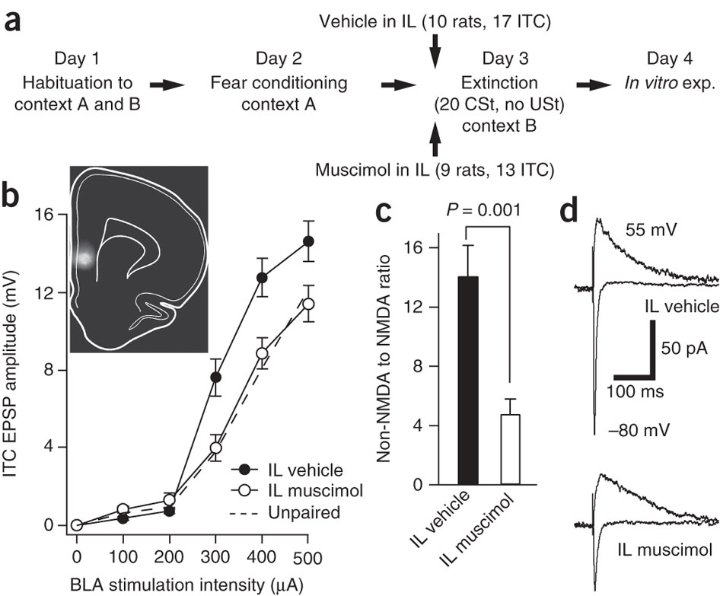
a) Experimental procedure.
(b) Intensity-dependence of BLA-evoked responses in ITC cells from the vehicle (n = 15) and muscimol (n = 11) groups (average ± s.e.m.). Dashed line indicates data from unpaired group Inset, extent of fluorophore-conjugated muscimol diffusion in the infralimbic cortex.
LA
Extintion
Acquisition
BLA
CEA
Fear
ITC
mPFC

Slide 2
Relapse (spontaneous retrieval of fear memory, reinstatement, renewal)
Since extintion does not erase the original fear memory, the CS has an ambiguous valence, it could be fear eliciting or not, depending on:
the level of activation of the US representation during non reinforced trials,
the decreases in attention, which can influence conditioned performance during extinction,
contexts.
La risposta emotiva può perciò riapparire a causa del recupero spontaneo, della ripresentazione dello SI o del rinnovo (se lo SC è presentato in un contesto differente da quello dell’estinzione).

Slide 3
After extinction, contextual information has a critical function in determining whether the original fear memory or the new extinction memory should control fear expression.
Evidence suggests that hippocampal projections to the vmPFC and the amygdala mediate the context-dependent expression of extinction (Fanselow, 2000; Ji and Maren, 2005).

Slide 4
Furthermore, inactivation of the hippocampus before extinction learning impairs extinction recall on the subsequent day (Corcoran et al, 2005), suggesting that the hippocampus regulates fear expression both outside and within the extinction context.
One suggestion is that the hippocampus controls the context-specific retrieval of extinction through projections to the vmPFC (Corcoran and Quirk, 2007).
Another possibility is that the hippocampus gates fear expression directly through projections to LA.

Slide 5
Although clarification of the precise circuitry requires further investigation, there is strong evidence that the hippocampus, through communication with the vmPFC and the amygdala, regulates the contextual modulation of fear expression during extinction retrieval.

Slide 6
Ruolo della neurogenesi ippocampale nell’espressione di comportamenti ansiosi e nel pattern separation
Ipotesi sul ruolo della neurogenesi ippocampale:
Formazione di cluster temporali di memorie (retrieval episodico) (Aimone e Gage)
Separazione di contesti diversi (Sahai et al., 2011)
Meno neurogenesi, più generalizzazione (Fear Conditioning in contesto A, test in contesto B, mancanza di discriminazione)

Slide 7
Ippocampo ventrale e dorsale: ruoli diversi
Ippocampo dorsale cognition of context;
ippocampo ventrale connesso con il sistema limbico, espressione dell’ ansietà (blocco con HRh dei neuroni dell’ippocampo ventrale, animali esplorano i bracci aperti dell’EPM)

