Slide 1
BREXIT AND THE NETHERLANDS
International Trade

Slide 2
INTRODUCTION
Who are we?
Industrial Engineering and Management
Commercial Economics
Duration
Brexit and The Netherlands

Slide 3
CONTENT
Information about The Netherlands
The Netherlands and The United Kingdom
Consequenses Brexit
Brexit for Dutch Companies
Conclusion
Brexit and The Netherlands

Slide 4
Information about the Netherlands
Gfg
m
 | Total population: | 17 million
 | Population density: | 488 people per km2
 | Capital city: | Amsterdam
 | Government: | The Hague
 | Official languages: GDP: | Dutch 826,2 Billion euro
Brexit and The Netherlands

Slide 5
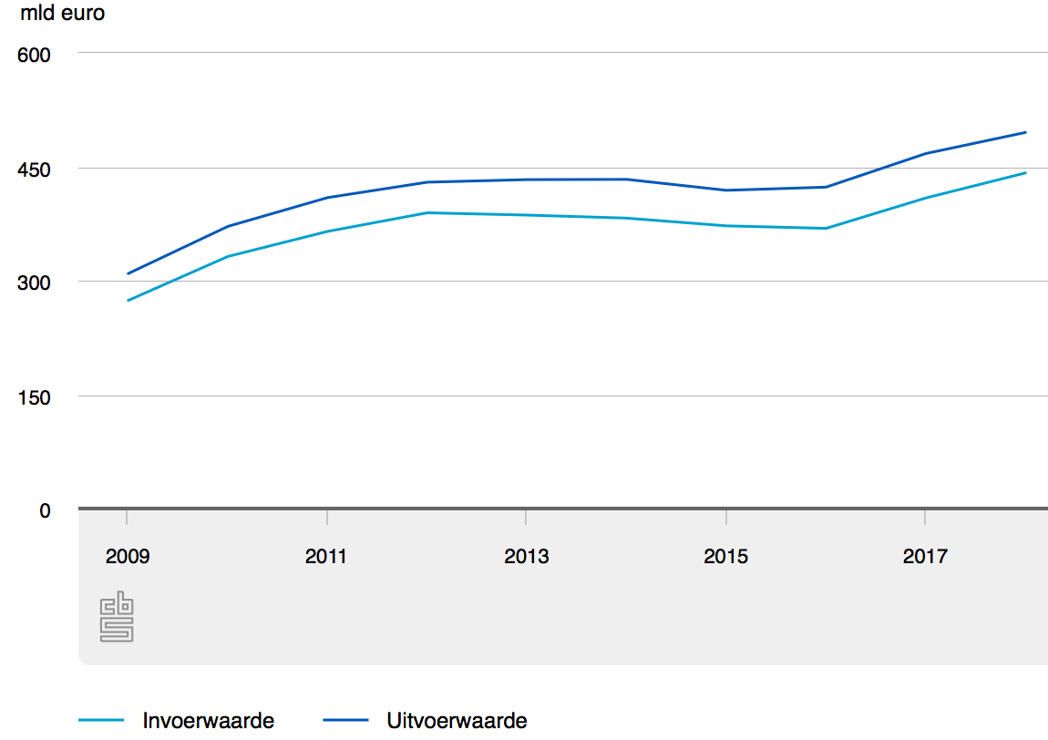
Information about The Netherlands
International trade in products (CBS, 2018)
Import +8%
Export +6%
Importvalue
Exportvalue
Brexit and The Netherlands

Slide 6
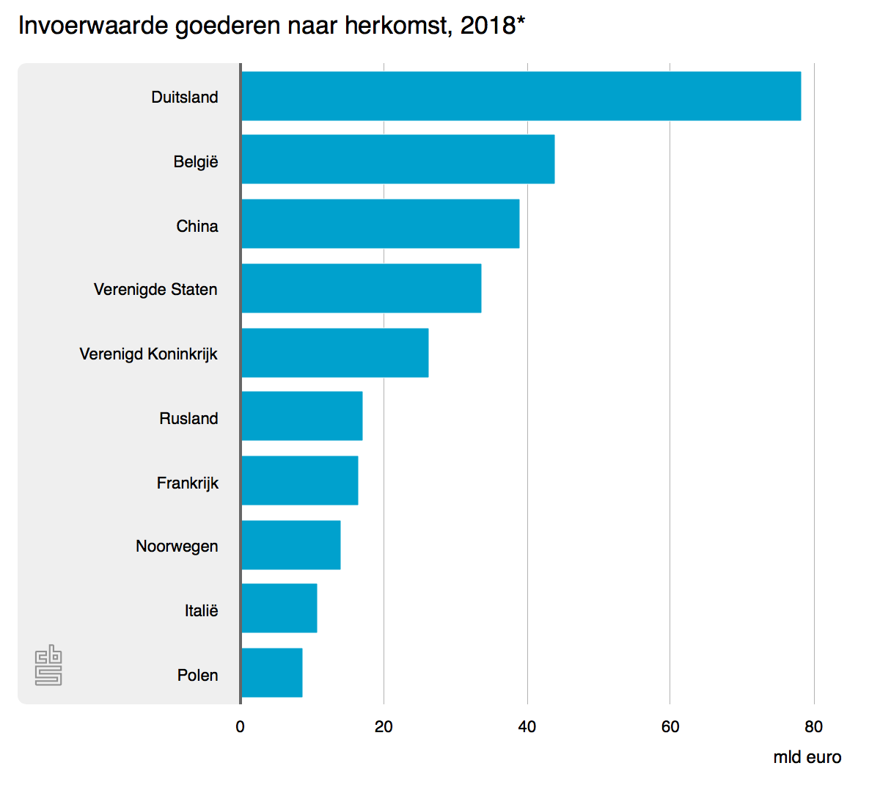
Import Value of products
Import value products by origin (CBS, 2018)
Germany
Belgium
China
USA
UK
Russia
France
Norway
Italy
Poland
Brexit and The Netherlands

Slide 7
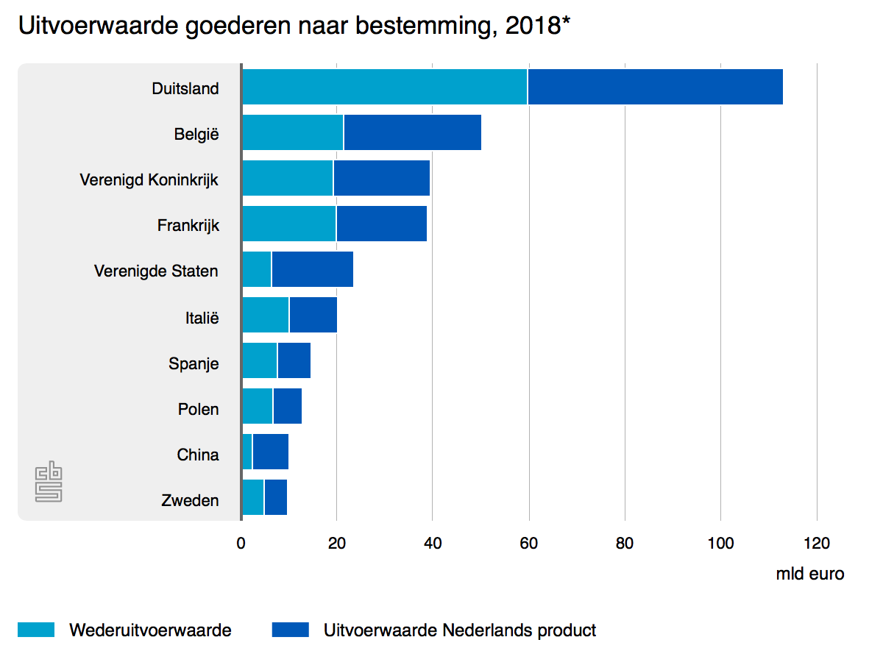
Export Value of products
Export value products by origin (CBS, 2018)
Germany
Belgium
UK
France
USA
Italy
Spain
Poland
China
Sweden
Brexit and The Netherlands

Slide 8
Trading Partners for services
32% of international trade in services (CBS, 2018)
Input (Billion)
Output (Billion)
Brexit and The Netherlands

Slide 9
Illegal trade
Production (EMCDDA, 2016) Trafficking (EMCDDA)
Hard to measure
€19 billion
Biggest port of Europe
25–50 % of the cocaine
Brexit and The Netherlands

Slide 10
Port of Rotterdam
Import of 4.499.591 containers
Export of 4.136.191 containers
Brexit and The Netherlands

Slide 11
Brexit Monster
Government campaign
Annoyingly across your workplace and stops you getting any work done.
The consequences of the Brexit for companies.
Why?
“Have you checked what consequences the Brexit has for you or your company? Make sure the Brexit doesn’t get – or lie – in your way.”
Brexit and The Netherlands

Slide 12
The Netherlands and The United Kingdom
Attractive to trade
Good connections on a personal level and the level of freight traffic
Export | Year
€39.700.000.000 | 2018
Import | Year
€26.400.000.000 | 2018
Brexit and The Netherlands

Slide 13
The Netherlands and The United Kingdom
Most important export goods | Worth
Telecommunications devices | €3.500.000.000
Medical and pharmaceutical products | €2.400.000.000
Office machines | €2.200.000.000
Vegetables and fruit | €2.000.000.000
Most important import goods | Worth
Medical and pharmaceutical products | €1.600.000.000
Vehicles for road transport | €1.100.000.000
Organic chemicals | €940.000.000
Various manufactured goods | €840.000.000
Brexit and The Netherlands

Slide 14
The Netherlands and The United Kingdom
Rise in investments
Shrinking investments
Brexit and The Netherlands

Slide 15
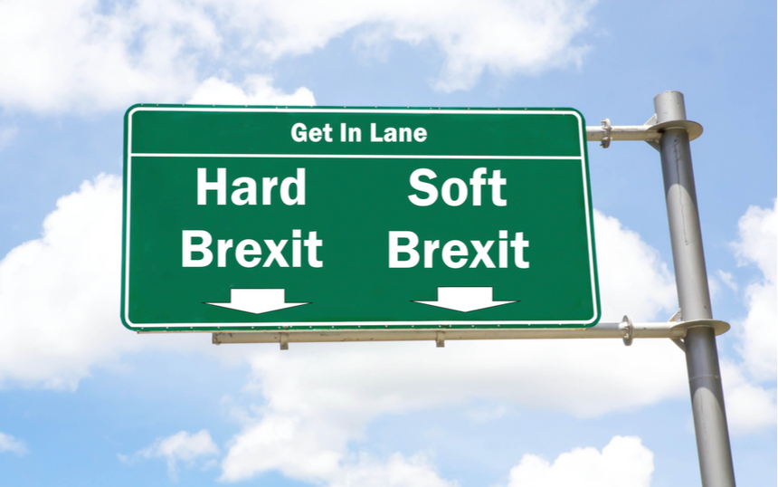
Consequentes Brexit for the Netherlands

Slide 16
Soft Brexit
Free movement of goods and people
Trades agreements remain in force
Outstanding bill of 40 billion euros (CPB)
Unlikely due to immigration policy

Slide 17
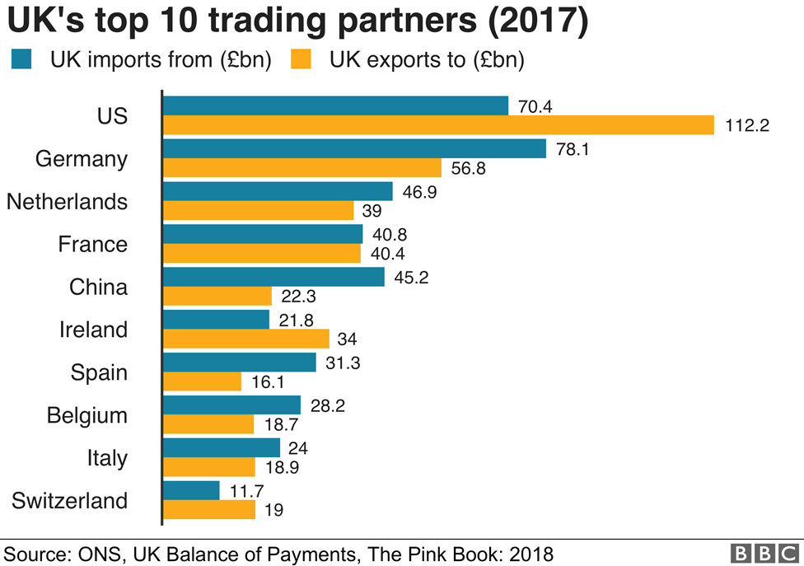
Hard Brexit
Hard loss for the Netherlands
World Trade Organization (WTO)
Higher rates import and export
Products can be 30% more expensive (CPB, 2019)
Fishing industry

Slide 18
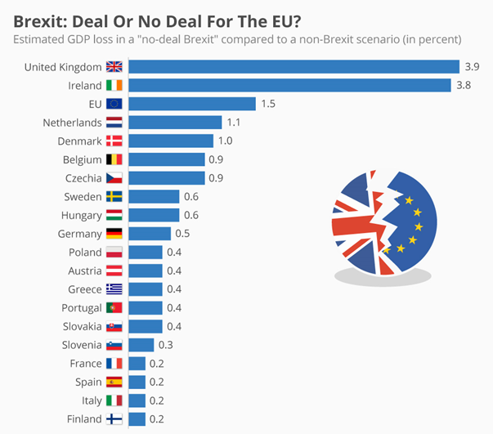
No deal
All agreements will lapse
1.1 GDP loss, 10 billion dollars (CPB, 2019)
The bill of 40 billion euros will lapse
Dutch coverment has to pay 1,6 billion euros (CPB, 2019)
Border control processes and Logistics and transport (Central Goverment of the Netherlands, 2018)
(Oxford Economics, 2018)

Slide 19
Dutch Companies
Export / Import
Employees from UK or NL
Keeping stock / New office
Special inspections
EU Trade Agreement
Pound vs Euro
Data storing (Chamber of Commerce, 2019)
Port of Rotterdam (Chamber of Commerce, 2019)

Slide 20
Conclusion
Consequences
Impact
Preperation
Brexit and The Netherlands

Slide 21
Thank you for your time!
Brexit and The Netherlands

