Slide 1
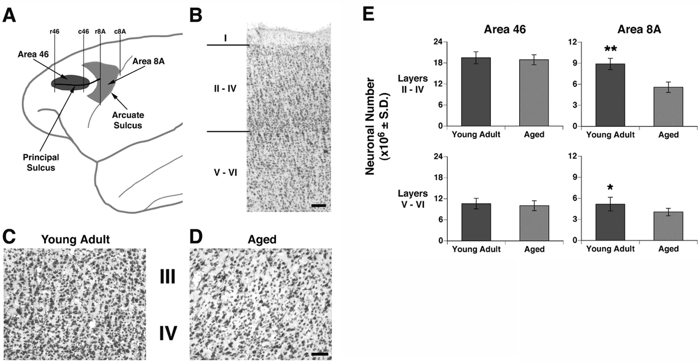
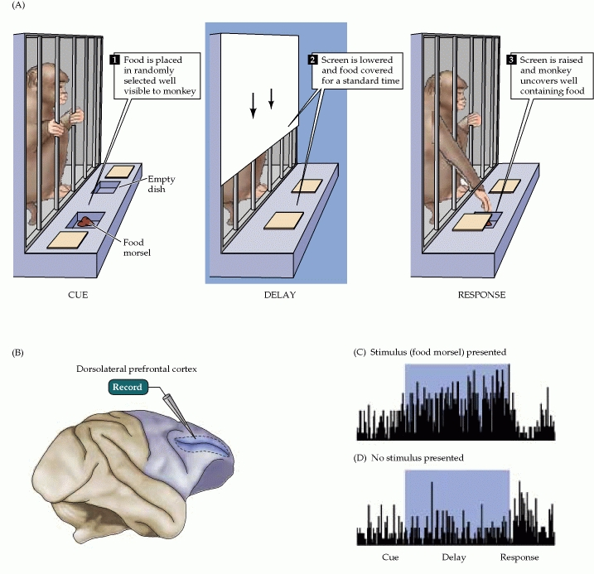
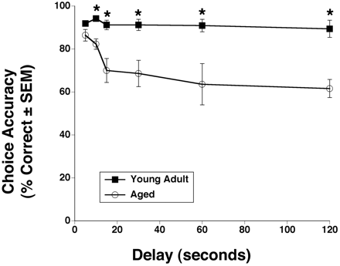
One exception: Memory Impairment in Aged Primates Is Associated with Focal Death of Cortical Neurons and Atrophy of Subcortical Neurons
Also cholinergic input to area 8A is reduced in aged monkeys
Smith et al., 2004

Slide 2
At the level of neuronal morphology, investigations on dendritic branching and spine density suggest that age associated alterations are also region-specific: morphology of prefrontal cortex neurons seems to be more vulnerable to the effects of aging than that of hippocampal neurons (see Burke and Barnes, 2006).

Slide 3
Thus, normal aging is accompanied by differential and often subtle changes in gray and white matter, with different regions and even different subregions being differentially affected by normal and pathological aging; this is evident, for instance, at the level of the hippocampus (see Small et al., 2011 for a review).
Very different is of course the situation in presence of age associated neurodegenerative diseases leading to dementia, such as Alzheimer’s disease (AD).

Slide 4
In summary, advancing age is accompanied by a pattern of differential brain changes that are observed in both cross-sectional and longitudinal investigations (see Raz and Rodriguez, 2006 for a review).
Overall, there is age related cortical thinning and shrinkage of some neural structures and there is loss of subcortical neurons in the diffuse projecting systems (dopaminergic, cholinergic).
There are disproportionate declines in the prefrontal cortex, moderate declines in temporal cortex and only mild declines in occipital regions.

Slide 5
As far as neural plasticity is concerned, normal aging causes evident changes at multiple levels:
in addition to the reduction in synaptic density, which by itself could affect synaptic plasticity by making it more difficult to attain the sufficient amount of cooperatively active synapses necessary to induce synaptic efficacy changes, and to changes in Ca2+ conductances and homeostasis, aging alters forms of synaptic plasticity related to declarative memory processes such as hippocampal LTP.
Hippocampal LTP is altered in aged animals at the level of both induction and maintenance, with maintenance most severely affected (see Burke and Barnes 2006 for review).

Slide 6
Most basic neuronal properties remain rather constant with age both in the hippocampus and in the PFC
Aged animals do have alterations in the mechanisms of plasticity that contribute to cognitive functions.
LTP decline and spatial memory decline (Barnes maze) correlate
Burke and Barnes, 2006

Slide 7
Even in normal aging there are subtle changes in the biological processes that underlie memory, and in the relationship between how good an animal’s memory is and how functional their synapses are.
But the real message in these experiments is that old animals can and do learn.
None of the older animals exhibited what could be considered behaviorally to be “dementia”, nor were their biological mechanisms that allow memory traces to be laid down completely dysfunctional.

