Slide 1
Legame con PTSD: eccessiva generalizzazione è un evento maladattivo, un singolo reminder del contesto originale può provocare il richiamo dell’intero contesto traumatico anche in un contesto “sicuro”
B
A
Menta
Contesto del condizionamento
Menta
Contesto sicuro

Slide 2
Research examining extinction learning in humans has been largely consistent with the findings from rodent studies.
Initial fMRI studies of extinction learning in humans reported an increase in amygdala activation during early extinction after the shift in the CS–US contingency (LaBar et al, 1998; Gottfried and Dolan, 2004; Knight et al, 2004; Phelps et al, 2004).
Amygdala activation decreased as extinction progressed and remained low during extinction

Slide 3
The magnitude of the decrease in amygdala activation during extinction learning correlated with the degree of participants’ extinction retrieval (Phelps et al, 2004).
These findings further support a function for the amygdala in extinction learning and confirm that amygdala activity is reduced during extinction retrieval.

Slide 4
The first fMRI study examining both extinction learning and subsequent retrieval in humans supported the function of the vmPFC in extinction retrieval (Phelps et al, 2004).
Fear conditioning fMRI studies have typically reported decreases in the blood oxygen level-dependent (BOLD) signal in the vmPFC below the resting baseline when the CS
is presented during fear acquisition (Gottfried and Dolan, 2004; Phelps et al, 2004).
BOLD signal in this region increases toward baseline during initial extinction learning, and increases further during extinction retrieval (Phelps et al, 2004). Subsequent studies have also observed increased vmPFC activation during extinction retrieval (Kalisch et al, 2006; Milad et al, 2007).

Slide 5
The degree of increase in activity in the vmPFC as well as the thickness of the cortex in this region are correlated with the degree of extinction success during recall (Milad et al, 2005, 2007).

Slide 6
fMRI studies examining the context-dependent recall of extinction in humans point to an important function for the hippocampus (Kalisch et al, 2006; Milad et al, 2007).
In such studies, context is manipulated through changes in the background color or the visual scene in which the CS is presented.
Extinction learning takes place only in one of the
contexts, allowing activation correlated with context dependent retrieval to be examined.
Increased hippocampal activation was observed during extinction retrieval (Kalisch et al, 2006; Milad et al, 2007).

Slide 7
Activation in the hippocampus was positively correlated with vmPFC activation, providing further support for the notion that the hippocampus may mediate context-dependent extinction recall through connections with the vmPFC.
Finally, confirming the function of the hippocampus in contextual reinstatement, a human lesion study found that contextual reinstatement of the CR was impaired in individuals with hippocampal lesions (LaBar and Phelps, 2005), similar to the findings observed in rodents (Wilson et al, 1995).

Slide 8
Consistent with studies in animal models, extinction learning in humans seems therefore to depend on the integrated functioning of a neural circuit that includes the amygdala, the vmPFC, and the hippocampus.
This convergent evidence across species suggests that the neural mechanisms supporting fear extinction are highly phylogenetically conserved.
Hippocampus, amygdala and mPFC are often disfunctional in PTSD

Slide 9
Extinction-based therapies have been widely explored as potential avenues of treatment for anxiety disorders (Barlow, 2002; Garakani et al, 2006).
Posttraumatic stress disorder (PTSD), in which patients display spontaneous or cue induced re-experiencing of a traumatic event, may result from failure to consolidate and retrieve extinction learning (see Rauch et al, 2006 for a review).

Slide 10
Consistent with this theory, PTSD patients exhibit deficits in extinction retention (Orr et al, 2000), along with reduced vmPFC and hippocampal volume and activity and increased amygdala activity (Gilbertson et al, 2002; Bremner, 2006; Liberzon and Martis, 2006; Shin et al, 2006).

Slide 11
L’esperire eventi traumatici e paurosi può determinare nell’uomo l’insorgenza di un disturbo d’ansia, la cui cura è ostacolata dal riaffiorare delle memorie a valenza negativa legate all’evento.
Alcuni disturbi, come il disturbo post traumatico da stress (PTSD), sono associati ad un deficit di estinzione (Milad et al., 2009).

Slide 12
Individuals with PTSD typically show exaggerated amygdala and diminished hippocampal activation relative to controls.
The dACC has emerged as another brain region that appears hyperactive in PTSD.
Most studies have shown that vmPFC is hypoactive in this disorder, but a few have reported hyperactivity

Slide 13
The objective of the Milad study was to examine the neurobiological basis of deficient extinction recall in PTSD with a focus on the above-mentioned brain regions.
While in a 3T fMRI scanner, PTSD and trauma-exposed, non-PTSD control (TENC) subjects underwent a two-day Pavlovian fear conditioning and extinction procedure previously used
in healthy and PTSD subjects.
Skin conductance response (SCR), a commonly used measure in human fear studies served as the dependent measure of
conditioned responding.

Slide 14
On day 1, subjects underwent fear conditioning to two pictures of
differently colored lamps, followed by extinction for one of them.
Day 2 tested recall of the extinction that had been learned the previous day by contrasting responses to the previously
extinguished and unextinguished stimuli.

Slide 15
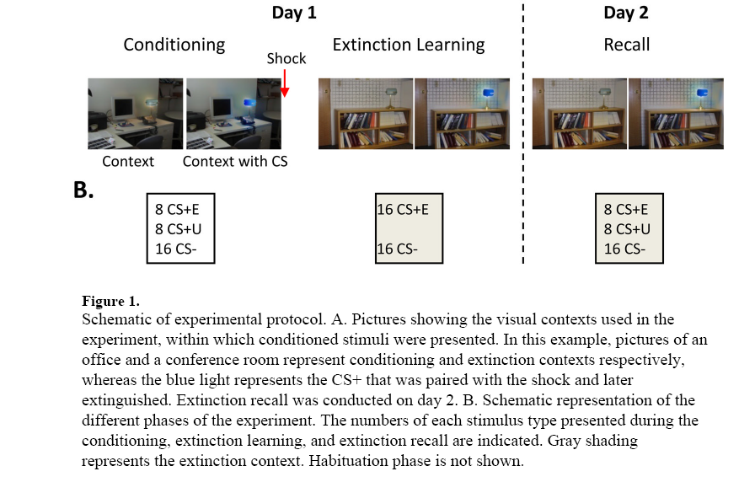
A total of 19 PTSD patients and 20 trauma-exposed non-PTSD control (TENC) subjects were recruited from the community.

