Slide 1
Altri esempi dell’uso dei modelli animali nello studio delle malattie del neurosviluppo
Il disordine da deficienza di CDKL5
La sindrome da deficienza di creatina

Slide 2
The CDKL5 disorder (formerly The Hanefeld variant of Rett syndrome)
Described by Markolf Hanefeld, 1984
Associated with cyclin-dependent kinase-like 5 (CDKL5) gene mutation
that is located on the X chromosome
Characterized by seizures in the first months of life with subsequent development of RTT features
No regression after period of normal development as in classic RTT
Altered development of cognitive and motor function
Stereotypies
Severe hypotonia
Autonomic dysfunctions
Severe deficits in visual processing, sideways glance
and abnormal eye tracking
Incidence estimated at 0.21/100,000 live births (Hector et al. 2017)
Notes:
Dire la sigla del gene

Slide 3
What is CDKL5?
It is a serine-threonine kinase, highly conserved among vertebrates, pathogenic missense mutations in patients clearly cluster within the amino(N)-terminal kinase domain of CDKL5, suggesting that perturbed kinase function likely underlies the pathophysiology of the disorder
It is highly expressed in the brain, and in particular in the forebrain with an increase in expression during early postnatal life, it is present both in nucleus and cytoplasm and it is enriched in synaptic structures (post-synaptic density, dendritic spines)

Slide 4
A SYNAPTIC DISEASE
CDKL5 Peak expression during synaptogenesis
Synaptic interactors
Alterations in excitatory and inhibitory puncta
Dendritic spines are unstable
Notes:
To understand whether this anatomical abnormalities result in a defective functional processing, we analyzed in vivo the function of cortical sensory circuits by mean of intrinsic signal optical imaging
Focalizzare l’attenzione sul fatto che è una synaptic disease!!!!
Interattori postsinaptici
Alterazioni di sinapsi (puncta) che turnover spine
Anche solo scritte
Quindi problema funzionale e non degenerativo, quindi tecnica funzionale

Slide 5
Are these deficits present in vivo?
What aspects of spine dynamics are affected?
Are there differences during lifespan?
Can these deficits be reversed?

Slide 6
TWO-PHOTON IMAGING ALLOWS STUDIES OF INDIVIDUAL SPINES IN A MOUSE MODEL OF CDKL5 DISORDER
PYRAMIDAL NEURONS
- In vivo
- Same dendrite over time
- Gain and loss

Slide 7
Impairment of Long-Term Spine Survival in Cdkl5^{−/y} Mice
P50 P80 P50 P80
Excessive loss of spines
Della Sala, Putignano et al Biological Psychiatry 2015

Slide 8
PI3K
How can we try to prevent this synaptic deficits?
Akt
mTOR
IGF1 can activate the Akt-mTOR pathway which is downregulated in CDKL5 KO mice
S6Ks
P
P
S235-6
S6
S240-4
Protein synthesis

Slide 9
IMAGING IN VIVO IGF-1 STRUCTURAL SYNAPTIC PHARMACOLOGY
NO TREATMENT
The advantage gained with the treatment is not lost

Slide 10
To use sensory processing
to reveal abnormalities in
synaptic integration
Notes:
Domanda
Can we use sensory processing to monitor the abnormal synaptic integration of cdkl5 defective circuits?

Slide 11
Biomarkers:
Indicators of biological or pathological processes and response to drug intervention. They can be biofluids evaluated with molecular or biochemical techniques; tissue analysis; functional measures (eg EEG, fMRI)
Good biomarkers:
Great sensitivity, specificity, accuracy, high predictive value, quantitative
Safe and easy to measure
Cheap to assess
CDKL5 has established synaptic actions: Functional biomarker

Slide 12
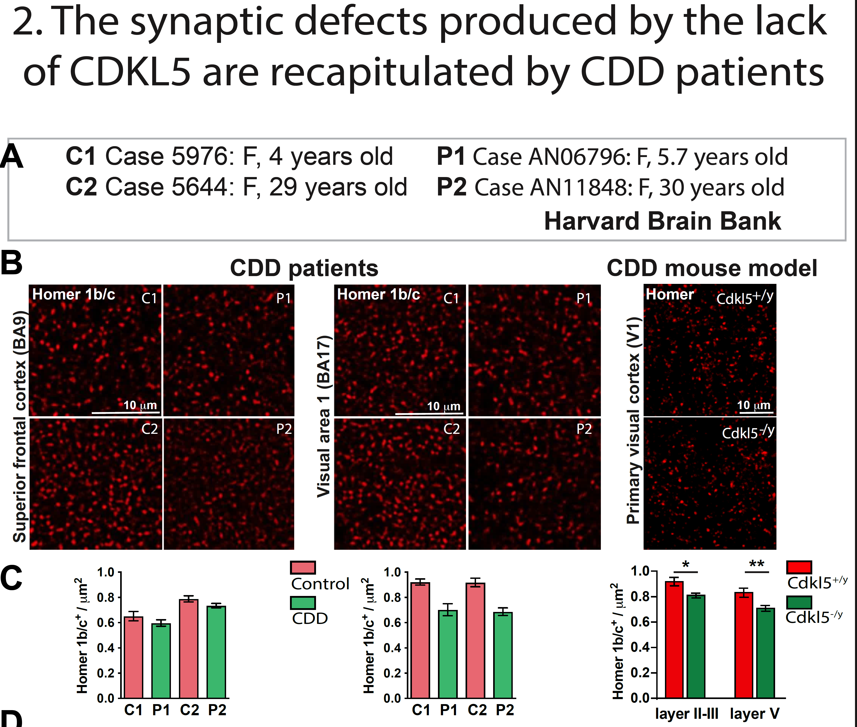
Similar data for PSD-95

Slide 13
To use visual processing
to reveal abnormalities in
synaptic integration
Notes:
Domanda
Can we use sensory processing to monitor the abnormal synaptic integration of cdkl5 defective circuits?

Slide 14
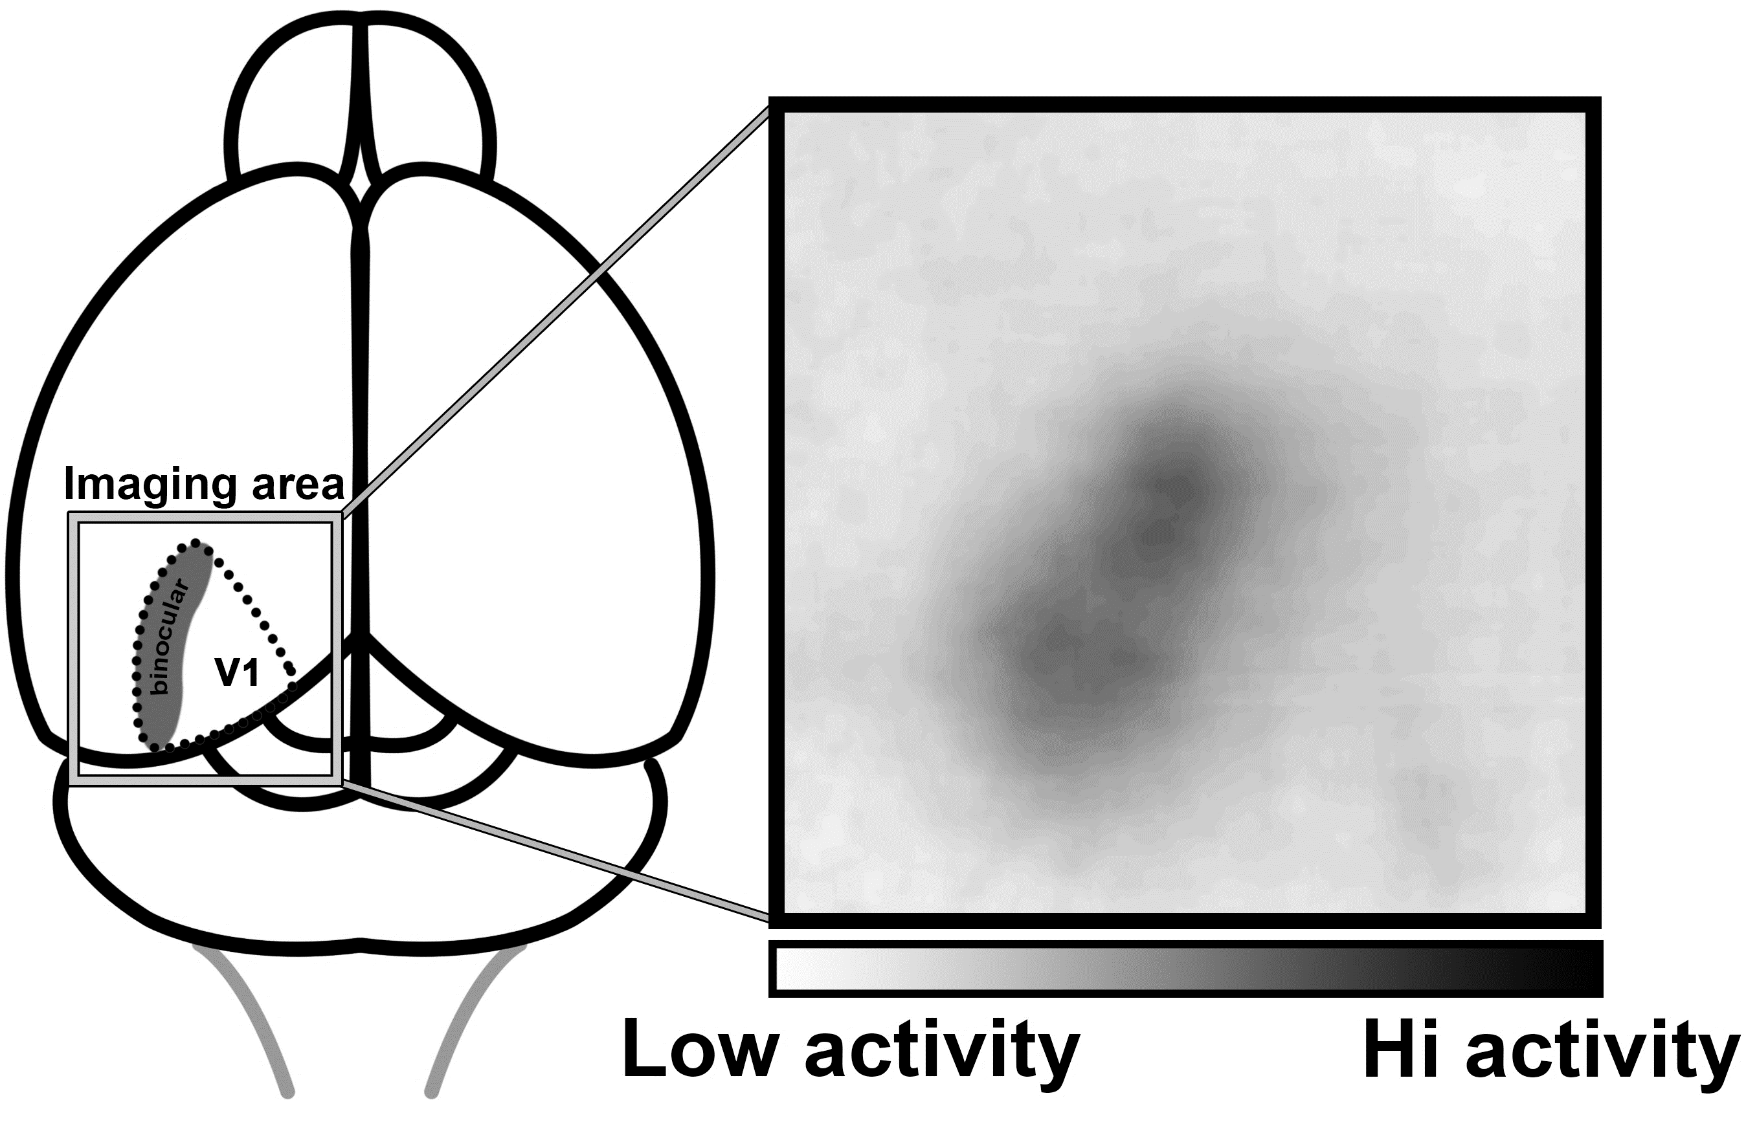
INTRINSIC OPTICAL SIGNAL (IOS) IMAGING

Slide 15
REDUCED AMPLITUDE OF IOS VISUAL RESPONSES
Mazziotti R.*, Lupori L.*et al. 2017

Slide 16
SLIGHTLY IMPAIRED VISUAL FUNCTION
Mazziotti R.†, Lupori L. † et al. 2017
Notes:
Sincewe measured longitudinally many parameters, we checked whether there could be a correlation between early sings of the disease and late perceptive deficits
I deficit solo LIEVI, ma d’altra parte anche nei bambini, ma non vuol dire che il processing corticale sia perfetto. Non vogliamo misurare la vista ai topi, ma misurare il processing sinaptico a livello di microcircuito.

Slide 17
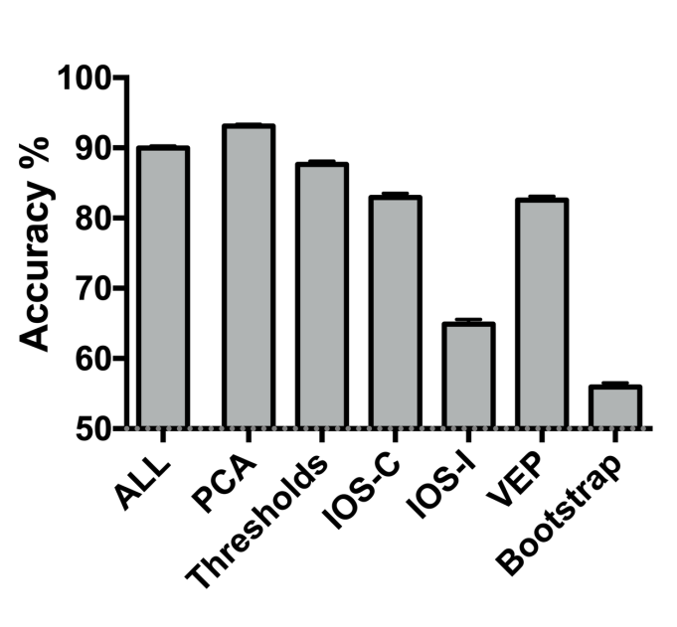
VISUAL RESPONSES ARE A ROBUST BIOMARKER
Early deficits predict late deficits
Mazziotti R.†, Lupori L. † et al. 2017

Slide 18
The visual biomarker
Allows for longitudinal studies
Readily translatable to humans
Highly quantitative nature
Predictive of behavioral impairments?
Depending on a defined brain structure?
Responsive to treatment?

Slide 19
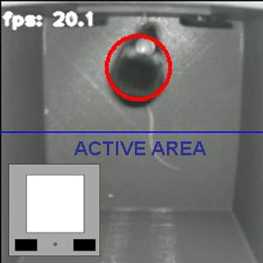
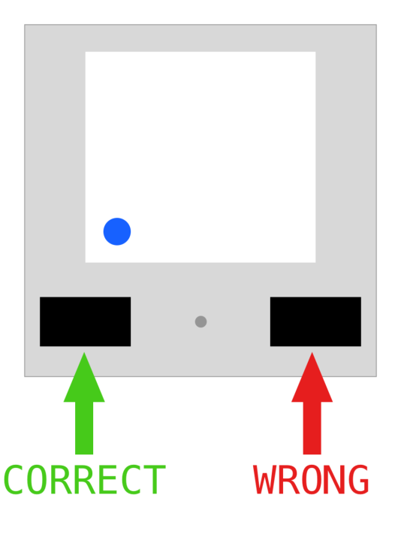
OPERANT CONDITIONING SETUP
Giulia Sagona
Raffaele Mazziotti

Slide 20
Impulsive behavior in CDKL5 mutants

Slide 21
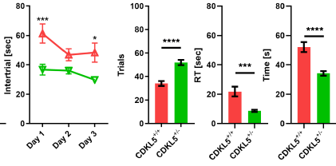
The phenotype is present also in female mutants

Slide 22
Prolonging the «No go» period impairs solving the task

Slide 23
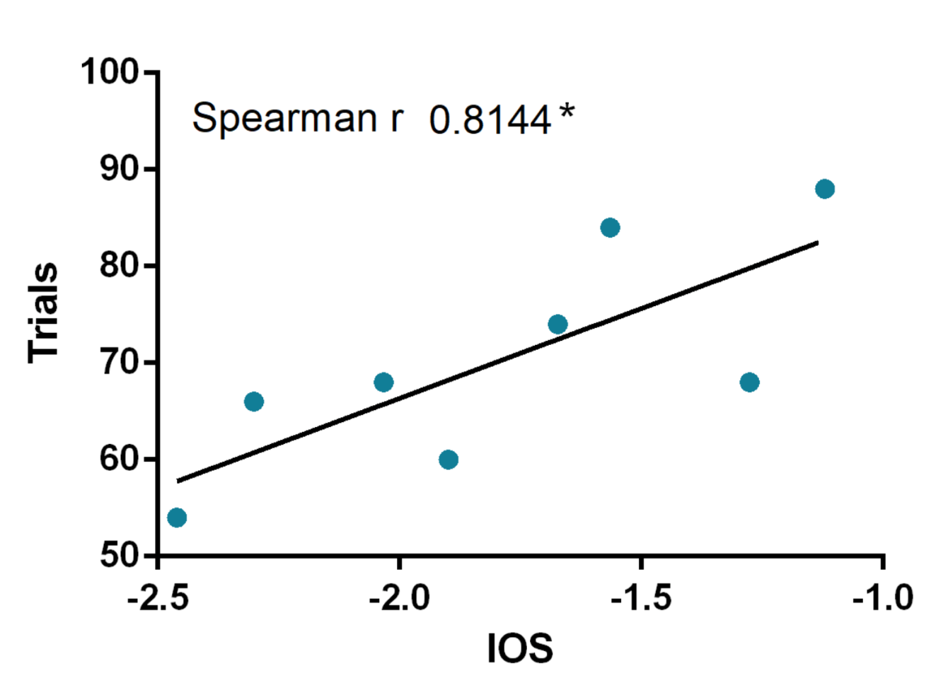
Behavioral deficit is correlated with the visual biomarker
KO mice only
Behavioral alteration
Visual response impairment

Slide 24
The visual biomarker
Allows for longitudinal studies
Readily translatable to humans
Highly quantitative nature
Predictive of behavioral impairments? YES
Depending on a defined brain structure?
Responsive to treatment?

Slide 25
The visual biomarker
Allows for longitudinal studies
Readily translatable to humans
Highly quantitative nature
Predictive of behavioral impairments? YES
Depending on a defined brain structure?
Responsive to treatment?

Slide 26
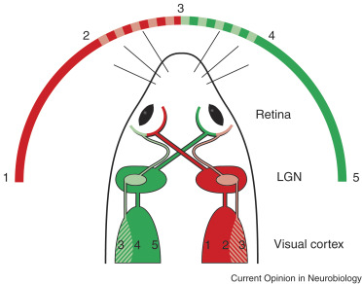
THE VISUAL SYSTEM

Slide 27
NORMAL RETINAL MORPHOLOGY
Antonia Stefanov
Elena Putignano
Debora Napoli
Enrica Strettoi
Synaptotagmin
CalbindinD
CtBP2/RIBEYE
PKCα
Connexin36
Müller glial cells
Lupori et al. 2019

Slide 28
SPINE AND SYNAPTIC ABNORMALITIES IN dLGN and V1
Claudia Fuchs
Dendritic spines
PSD-95
Lupori et al. 2019

Slide 29
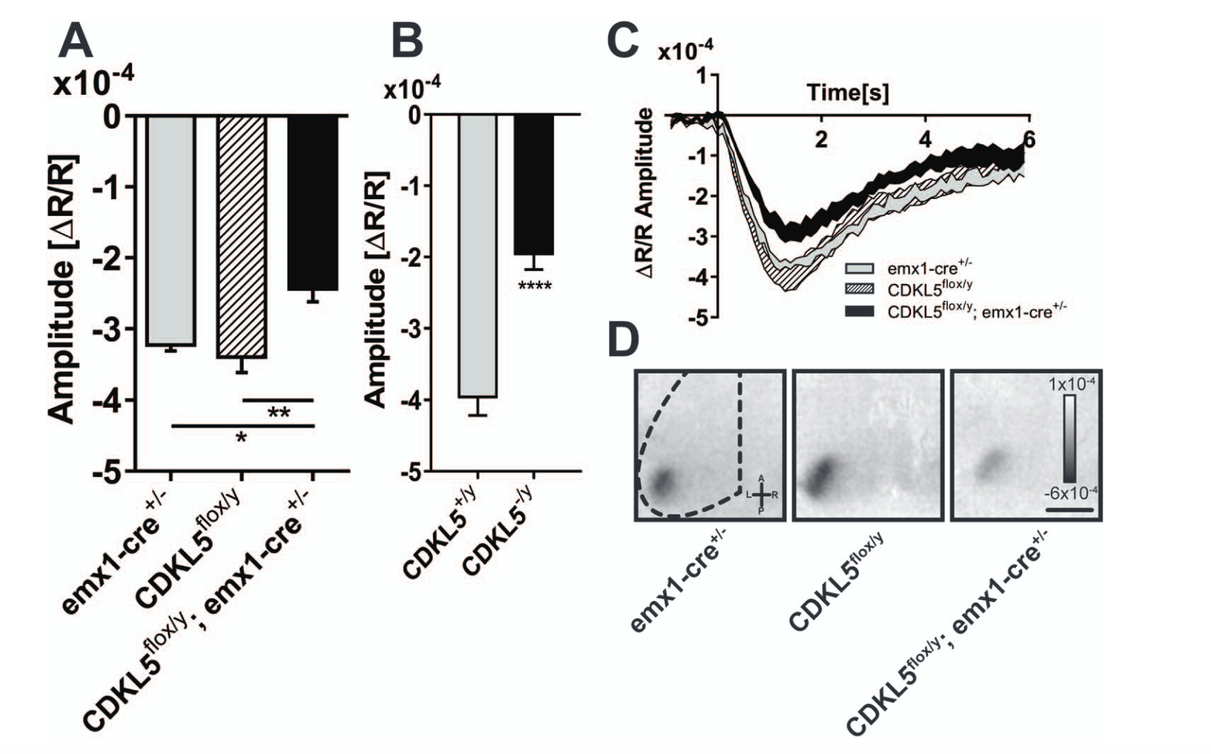
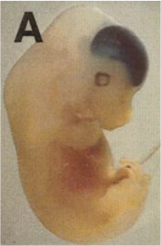
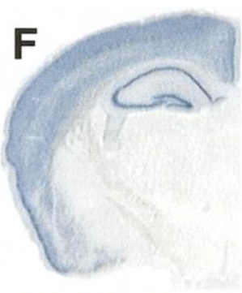
RESPONSE DEFICIT IN ABSENCE OF CORTICAL CDKL5
Emx1-CRE driver line
Lupori et al. – under review

Slide 30
The visual biomarker
Allows for longitudinal studies
Readily translatable to humans
Highly quantitative nature
Predictive of behavioral impairments? YES
Depending on a defined brain structure? YES
Responsive to treatment?

Slide 31
The visual biomarker
Allows for longitudinal studies
Readily translatable to humans
Highly quantitative nature
Predictive of behavioral impairments? YES
Depending on a defined brain structure? YES
Responsive to treatment?

Slide 32
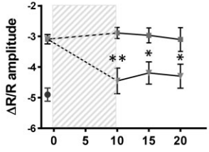
PROTEIN BASED THERAPY
Prof. Elisabetta Ciani
Claudia Fuchs
Trazzi et al. – 2018
Notes:
Valorizzare longitudinalità del biomarker
Valorizzare che ci sono spine nei soliti animali
Il biomarker rileva cambiamenti di behavior e spine, biomarker è biomarker, correlato con severità dei sintomi. Biomarker diverso da genotipo

Slide 33
The visual biomarker
Allows for longitudinal studies
Readily translatable to humans
Highly quantitative nature
Predictive of behavioral impairments? YES
Depending on a defined brain structure? YES
Responsive to treatment? YES

Slide 34
Nel modello CDKL5 abbiamo potuto comprendere molti dei possibili usi di un modello animale di malattia:
Comprensione delle basi molecolari (conoscenza degli interattori)
Conoscenza di meccanismi cellulari alterati (sinapsi e spine dendritiche)
Possibilità di recupero
Idee per studi di biomarcatori nell’uomo

