Slide 1
Estinzione e adolescenza: la scarsa efficacia dell’estinzione in adolescenza è un punto singolare nella traiettoria di sviluppo degli effetti dell’estinzione

Slide 2
During threat extinction training, the CS is presented without the aversive outcome, which results in reduced amygdala responses to the CS over time, with the mPFC playing a critical role.
Research with rodents and humans has shown distinctive developmental profiles of blunted threat extinction recall in adolescents, relative to children and adults.

Slide 3
For example, adolescents continue to show signs of defensive responding to previously learned threat cues (freezing in rodents and elevated skin conductance in humans), suggesting an age-specific relative dysregulation of the process that updates threat associations as safe.
Immunohistochemical evidence points to reduced synaptic plasticity in areas of the mPFC after extinction recall in adolescent rodents.
Direct evidence regarding the neural circuitry underlying blunted threat extinction learning in adolescent humans is limited.

Slide 4
Developmental alterations in amygdala-prefrontal cortical interactions are thought to be responsible for threat extinction differences seen in adolescence.
Amygdala-prefrontal functional connectivity changes with age at rest and during the processing of affective information.

Slide 5
Amygdala and mPFC undergo substantial structural change during development: the amygdala shows linear increases in grey matter across late childhood and adolescence, while the mPFC is characterised by quadratic changes, with substantial grey matter growth across childhood followed by grey matter pruning across adolescence.
Uncinate fasciculus, a white matter tract that connects amygdala and mPFC, undergoes protracted growth across adolescence and into early adulthood.

Slide 6
In the Morriss et al., (2019) study the Authors examined:
age-dependent changes in recruitment of the amygdala and mPFC during threat extinction learning, and
age-dependent relationship between structure and function in the amygdala and mPFC.
Methods: event-related functional magnetic resonance imaging (fMRI) of a cued threat conditioning paradigm, where an aversive sound served as an unconditioned stimulus and visual shapes as conditioned stimuli

Slide 7
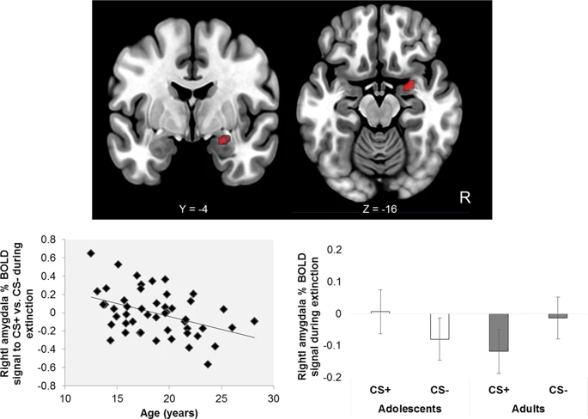
Amigdala
Right amygdala activation to CS+ > CS− × decreasing age. Bottom left panel: Younger age is significantly associated with greater right amygdala activation to the CS+ vs. CS− across the threat extinction phase. Bottom right panel: Right amygdala activation to CS+ and CS− during extinction displayed by groupings of adolescents and adults R = right.

Slide 8
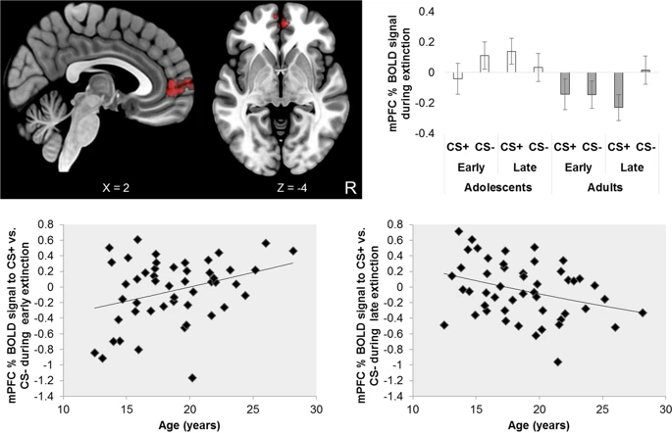
mPFC
Top left panel: mPFC activation to CS+ > CS− early − CS+ > CS− late × increasing age. Bottom left and right panels: Older age is significantly associated with greater mPFC activity to the CS+ vs. CS− during early threat extinction, whilst younger age is significantly associated with greater mPFC activity to the CS+ vs. CS− during late threat extinction. R = right.

Slide 9
Younger age was associated with exaggerated amygdala responses to learned threat vs. safety cues during threat extinction learning.
In addition, younger age was associated with reduced mPFC activity during early extinction learning.
The relationship between age and delayed recruitment of the mPFC was mediated by the structural integrity of the uncinate fasciculus, a white matter tract connecting the amygdala and mPFC.

