Slide 1
E&D International Trade Lecture 15
Giorgia Giovannetti
Professor of Economics, University of Firenze
E-mail: giorgia.giovannetti@unifi.it
Notes:
1

Slide 2
Proposal of change
International Trade, September 16th- December 8th
1 | 16/9 |  | Introduction: The main issues
2 | 19/9 |  | Introduction, 2 detailed presentation of the course
3 | 23/9 |  | Introduction, 3; Measuring globalization
4 | 26/9 |  | Measuring Globalization, (VA) and overview of models
5 | 30/9 |  | Overview trade models (Bernard et al 2007; 2011)
6 | 3/10 |  | Gravity model
7 | 7/10 |  | Gravity, Melitz intro
8 | 10/10 |  | Melitz
9 | 14/10 |  | Trade models: Ricardo
10 | 17/10 |  | Trade models: Ricardo and H-O
11 | 21/10 |  | Trade models: H-O,2, Leontieff
12 | 24/10 |  | H-O, end, Trade and Imperfect competition, 1
13 | 28/10 |  | Trade and imperfect competition, end
14 | 31/10 |  | Mid term Hysteresis, Heterogeneous firms
15 | 4/11 | Brexit UK, G, I , F1 | Hysteresis, Heterogeneous firms
16 | 7/11 | Brexit F2, S, S2, P | The Melitz model
17 | 11/11 |  | Networks of tradeFDI/migrants/ MIDTERM
18 | 14/11 |  | INAUGURAL LECTURE/OTTAVIANO
19 | 18/11 | GVC 1-3 | FDI and Multinationals Offshoring/trade in tasks
20 | 21/11 | Trade and w. 2 Prod 2 | Trade policy
21 | 25/11 |  | Trade policy- trade wars/ FDI and Multinationals: OLI
22 | 28/11 |  | China and India/ new th. FDI Offshoring/trade in tasks,
23 | 2/12 | N n th. networks, migration | Granularity and aggregate shocks
24 | 5/12 |  | Final test

Slide 3
Brexit UK | S. Geyerhofer (Bachelor) ,M. Möllnitz (Master), R. Stofanakova (Bachelor), F. Canjels (Bachelor) | 30 | 4 Erasmus | 4/11
Germany | Nina Kunzmann , Victoria Pörings, Caro Preuß | 20 | 3 Erasmus | 4/11
Italy | J. C. Cuenca Serrano, D. Lopez Laguardia, M. Jimenez Nieto M. van Nuland Azuaga. | 20 | 4 Erasmus | 4/11
Spain | A. Simón Díaz, B. Ramón Cienfuegos-Jovellanos, L Porto Vergara C Manea Surubaru. | 20 | 4 Erasmus | 4/11
France | F Yskout, L, Scheldewaert, J. Puelings, M. Dobblelaere | 30 | 4 Erasmus | 7/11
Netherland | Martijn van Rijnsoever, Thijs Kamp, Sander Liesting and Youri Buskens | 20 | 4 Erasmus | 7/11
Ireland | Frederique Bosveld, Anastasia Weiz, Gina Kuhlmann and Isabelle Schrage | 20 | 4 Erasmus | 7/11
Poland | A Tereshchenko ( Erasmus, Master degree), Viktoriia Kovryha ( Erasmus, Master) | 20 | 2 Erasmus | 7/11
Portugal | J. Rujas, I. Romero, Pedro Ardiaca, Sergio Ledesma | 20 | 4 Erasmus | 18/11
GVCs 1 | Kevin Mahekpreet Cheema, Moritz Pfeffer, S. Munoz , Keno-Leon Hartman | 20 | 4 Erasmus | 18/11
GVC 2 | S. Czernatowicz, MSC, F Fasel, MSC, A Burkard, BSC,A Gschwind, | 20 | 4 Erasmus | 18/11 ????
GVC 3 | Leonardo Rosini, Michele Fontani e Sharon di Cocco | 20 | 3 | 18/11
Productivity | J Hauer C Barroso Raya, V Martin Ortega, J A Alonso Perez | 20 | 4 | 21/11
 | M Chlechowitz; A Conde//C. Veneau A. Bouchonnier., C. Savelli | 15 | 2 | 21/11
Trade and wages | Salazar E. Vania, Mejia, Isaza V., Maach Fatima Zohra S | 20 | 4 | 21/11
 | Carlo Poggi, -Iacopo Maria Taddei ,Andrea Cioli, Shafiga | 20 | 4 | 21/11
New Trade Th. | C.Moretti, F. Ciapini, Francesco Vadalà, Giovanni Cappellini | 30 | 4 ECO | 2/12
Network | Niccolò Toccafondi, Dario Gori e Simone Senesi | 30 | 3 ECO | 2/12
Migration and FDI | Elisa del Sordo, Selma Sbai e Matteo Zorzenon | 20 | 3 | 2/12

Slide 4
Students’ presentations

Slide 5
Inter-industry and Intra-industry Trade
Gains from inter-industry trade reflect comparative advantage.
Gains from intra-industry trade reflect economies of scale (lower costs) and wider consumer choices.
The monopolistic competition model does not predict in which country firms locate, but a comparative advantage in producing the differentiated good will likely cause a country to export more of that good than it imports.

Slide 6
Inter-industry and Intra-industry Trade (cont.)
The relative importance of intra-industry trade depends on how similar countries are.
Countries with similar relative amounts of factors of production are predicted to have intra-industry trade.
Countries with different relative amounts of factors of production are predicted to have inter-industry trade.
Unlike inter-industry trade in the Heckscher-Ohlin model, income distribution effects are not predicted to occur with intra-industry trade.

Slide 7
Inter-industry and Intra-industry Trade (cont.)
About 25% of world trade is intra-industry trade according to standard industrial classifications.
But some industries have more intra-industry trade than others: those industries requiring relatively large amounts of skilled labor, technology, and physical capital exhibit intra-industry trade for the U.S.
Countries with similar relative amounts of skilled labor, technology, and physical capital engage in a large amount of intra-industry trade with the U.S.

Slide 8
Empirical Applications of Monopolistic Competition and Trade
The idea that free trade expands the range of products available to customers is not new—Ricardo mentions it.
The ability to model the effects of trade under a monopolistically competitive model is new (Developed by Helpman, Krugman, and Lancaster.)
Research used to shed light on free trade agreements, which guarantee free trade among a group of countries.
Use NAFTA to illustrate gains and costs
Gains and Adjustment Costs for Canada
Studies (1960s) predicted substantial gains from free trade with the U.S. Firms would expand their scale of operations to service the larger market and lower their costs. Studies by Harris (mid-80s) influenced Canadian policy makers to proceed with the free trade agreement with the U.S.

Slide 9
What Happened with liberalized Trade?
Trefler, data from 1988–1996 to estimate effects of the Canada-U.S. Free Trade Agreement. Main findings: Short-run adjustment costs of 100,000 jobs, or 5% of manufacturing employment. Some industries that had very large tariff cuts saw employment fall by as much as 12% Over time, these job losses were more than made up for by creation of new jobs elsewhere in manufacturing. There were no long run job losses due to NAFTA.
In the long run, large positive effects on productivity: 15% over eight years in industries most affected by tariff cuts—compound growth of 1.9%/year; 6% for manufacturing overall—compound growth of 0.7%/year; difference of 1.2%/year is an estimate of how free trade with the U.S. affected the Canadian industries over and above the impact on other industries; Rise of 3% in real earnings over this period.

Slide 10
Empirical Results
Gains and Adjustment Costs for Mexico:
Joining NAFTA was a way to ensure the permanence of the reforms already underway; Under NAFTA, Mexican tariffs on U.S. goods declined from an average of 14% in 1990 to 1% in 2001; In addition, U.S. tariffs on Mexican imports fell as well.
Maquiladora: productivity rose 45% from 1994 to 2003—compound growth rate of 4.1%/year.
Non-maquiladora, productivity rose overall by 25%—compound growth rate of 2.5%/year.
The difference, 1.6%/year, is an estimate of the impact of NAFTA on the productivity of maquiladora plants over and above the increase in productivity that occurred in the rest of Mexico.
Notes:
Figure 6.8 (a) Labor Productivity and Wages in Mexico Panel (a) shows labor productivity for workers in the maquiladora Mexican manufacturing plants and for workers in non-maquiladora plants in the rest of Mexico.
Source: Gary C. Hufbauer and Jeffrey J. Schott, 2005, NAFTA Revisited: Achievements and Challenges, Washington, D.C.: Peterson Institute for International Economics, p. 45.

Slide 11
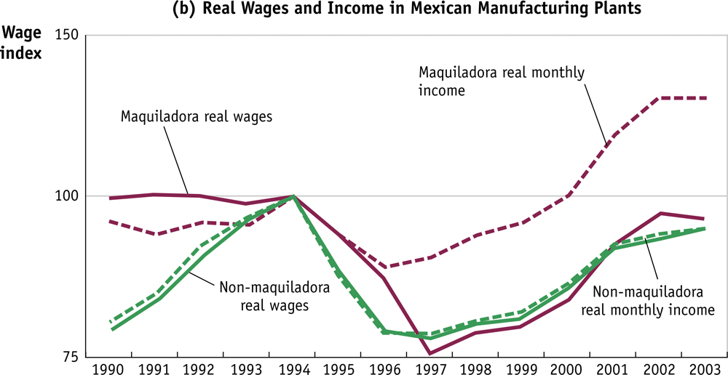
Empirical Results
Real better
Start rising again
More affected
From 1994 to 1997, fall of over 20% in real wages in both sectors, despite increase in productivity. Not predicted by the monopolistic competition model. Shortly after joining NAFTA,
Mexico suffered a financial crisis that led to a large devaluation of the peso. This makes it
expensive for Mexico to import goods. Therefore, the Mexican consumer price index also
Increased leading to a fall in real wages.
Notes:
Figure 6.8 (b) Labor Productivity and Wages in Mexico Panel (b) shows wages and monthly income for workers in maquiladora and non-maquiladora plants. Productivity and real monthly income grew faster in the maquiladora plants because of increased trade with the United States.
Source: Gary C. Hufbauer and Jeffrey J. Schott, 2005, NAFTA Revisited: Achievements and Challenges, Washington, D.C.: Peterson Institute for International Economics, p. 45.

Slide 12
Adjustment Costs in Mexico
When Mexico joined NAFTA, agricultural sector expected to fare worst (competition from the U.S). Tariff reductions in agriculture phased in over 15 years. Evidence: the corn farmers did not suffer as much as was feared.
The poorest farmers consume the corn they grow, rather than sell it & Mexican government able to use subsidies to offset the reduction in income for other corn farmers.
Total production of corn in Mexico rose; for maquiladora plants, employment grew rapidly to a peak of 1.29 million in 2000; then, sector entered a downturn.
The U.S. entered a recession decreasing demand for Mexican exports; China was competing exporting goods similar to those sold by Mexico; The Mexican peso became over-valued, making it difficult to export abroad; Employment in the maquiladora sector fell after 2000 to 1.1 million in 2003.

Slide 13
Adjustment Costs in Mexico & US
Mexico: The maquiladora sector faces increasing international competition; hence, the volatility of its output and employment increases. Volatility = cost of international trade for displaced workers.
Gains and Adjustment Costs for the U.S.
Studies on the effects of NAFTA on the U.S. have not estimated its effects on the productivity of U.S. firms. It would be hard to identify the impact since Mexico and Canada are only two of many trading partners. Researchers have estimated expansion of import varieties available to consumers.
For U.S. we will compare the long-run gains to consumers due to expanded product varieties with the short-run adjustment costs from exiting firms and unemployment.

Slide 14
Gains and Losses for US
Expansion of Variety to the U.S; To understand how NAFTA affected the range of products available in U.S., lets look at imports from Mexico (1990 and 2001).
Table below shows the % of all products imported to the U.S. in a particular industry that are from Mexico.This does not take into account the amount that Mexico sells of each product, just the number of different types of products Mexico sells to the U.S. compared to the total the U.S. imports from all countries.
From 1990–2000, the range of agricultural products that Mexico exported to the U.S. expanded from 42% to 51%.
Export variety grew at a faster rate in the wood and paper industry, petroleum and plastics, and electronics.
Other areas where there had already been a lot of trade, such as machinery and transport, slower growth in export variety.

Slide 15
Mexico’s Export Variety to the United States
The increase in the variety of products imported to the U.S. under NAFTA
is a source of gains to U.S. consumers. According to one estimate, the total
number of product varieties imported into the U.S. from 1972–2001 has
increased four times. That expansion in import variety has had the same effect
as a reduction in import prices of 1.2% per year.
Notes:
Table 6.3 Mexico’s Export Variety to the United States, 1990–2001 (Percent) This table shows the extent of variety in Mexican exports to the United States, by industry. From 1990 to 2001, export variety grew in every industry, as U.S. tariffs were reduced due to NAFTA. All figures are percentages.
Source: Robert Feenstra and Hiau Looi Kee, 2007, “Trade Liberalization and Export Variety: A Comparison of Mexico and China,” The World Economy, 30(1), 5–21.

Slide 16
Gain & losses for US
Using the 1.2% equivalent reduction in import prices for Mexico found for all countries, we can estimate $ gains. Using an average $90 billion in U.S. imports per year and the 1.2% reduction in prices to U.S. consumers, $90(1.2%) = $1.1 billion per year in savings to consumers. These consumer savings are permanent and increase over time as export varieties grow. In 2003 (10th year of NAFTA) consumers would gain $11 billion as compared to 1994.
Losses: come as firms exit the market (import competition) and workers are temporarily unemployed. One way to measure this loss is to look at claims under the U.S. Trade Adjustment Assistance (TAA) provisions. Offers assistance to workers in manufacturing who lose their jobs due to import competition. From 1994–2002, about 525,000 workers ( 58,000 a year) lost their jobs and were certified as adversely affected by trade under the NAFTA-TAA program.

Slide 17
Gain and losses, US
Probably the most accurate estimate of the temporary unemployment caused by NAFTA. Compare this number to overall job displacement in the U.S. over the same time period. Annual number of workers displaced (manufacturing): 4 million or 444,000 workers per year.
The NAFTA layoffs of 58,000 workers were about 13% of total displacement—a substantial amount.
Another way to measure effects is to compare the loss in wages from the displaced workers to the consumer gains. HP: about 2/3 of workers laid off in manufacturing are re-employed within three years; Suppose the average length of unemployment for laid off workers is 3 years; Average yearly earnings for manufacturing workers was $31,000 in 2000 so each displaced worker lost $93,000 in wages, Total losses were $5.4 billion.

Slide 18
Gain & losses
These private costs of $5.4 billion are nearly equal to the average welfare gains of $5.5 billion.
However, gains continue to grow over time and job loss was only temporary. Adjustment costs due to job losses fall.
In 2002 the NAFTA-TAA program was consolidated into the general TAA program, so there is no further data specific to NAFTA.
Still limitations in addressing the needs of workers laid off due to trade competition.

Slide 19
Gain and losses: Summary of NAFTA
The monopolistic competition model indicates two sources of gains from trade. The rise in productivity (due to expanded output by surviving firms) leads to (i) lower prices; (ii) More varieties of products for consumers
For Mexico and Canada, long-run gains measured by improvement in productivity for exporters as compared to other manufacturing firms. For the U.S.: long-run gains using the expansion of varieties from Mexico, and the equivalent drop in price faced by U.S. consumers.
For Canada and the U.S., long-run gains considerably exceed the short-run costs. In Mexico the gains have not been reflected in the growth of real wages for production workers.
The real earnings for higher-income workers in the maquiladora sector have risen and have been the principal beneficiaries of NAFTA so far.

Slide 20
Empirical Applications of Monopolistic Competition and Trade
Intra-Industry Trade
Under monopolistic competition, countries will specialize in producing different varieties of a differentiated good and will trade those varieties back and forth.
This common trade pattern is called intra-industry trade.
The index of intra-industry trade tells us what proportion of trade in each product involves both imports and exports.

Slide 21
The Gravity Equation
Trade between countries is similar to the force of gravity between objects: objects with larger mass or close together have greater gravitational pull between them.
The gravity equation states that countries with larger GDPs or close to each other will have more trade between them. Newton’s Universal Law of Gravitation
Suppose you have two objects with masses, M₁ and M₂ and are located distance d apart.
The force of gravity between these two masses is:
F_{g} = G[M₁M₂/d²]
G is the constant that tells the magnitude of the relationship.
The larger the objects are or the closer they are, the greater the force of gravity between them.

Slide 22
KEY TERMS
K e y T e r m
differentiated goods
imperfect competition
monopolistic competition
increasing returns to scale
intra-industry trade
gravity equation
free-trade agreements
regional trade agreement
duopoly
marginal revenue
marginal cost
monopoly profits
Trade Adjustment Assistance (TAA)
index of intra-industry trade
border effects
tariffs
quotas

Slide 23
Stylized facts: firms are heterogenous
Standard deviations of log sales
Exporters are a minority and are different from non exporters

Slide 24
Definition: Trade costs
The sum total of all of the costs that impede trade from origin to destination. This includes:
Tariffs and non-tariff barriers (quotas etc).
Transportation costs.
Administrative hurdles.
Corruption.
Contractual frictions.
The need to secure trade finance (working capital while goods in transit).
NB: There is no reason that these ‘trade costs’ occur only on international trade

Slide 25
Trade costs, 2
They enter many modern models of trade, so empirical implementations of these models need an empirical metric for trade costs.
There are clear features of the international trade data that seem hard (but not impossible) to square with a frictionless world.
As famously argued by Obstfeld and Rogoff (Brookings, 2000), trade costs may explain ‘the six big puzzles of international macro’. (we do not deal with these…)
Trade costs clearly matter for welfare calculations.
Trade costs could be endogenous and driven by the market structure of the trading sector; this would affect the distribution of gains from trade. (A monopolist on transportation could extract all of the gains from trade.)

Slide 26
Relevance of trade costs
Arguments in favor:
Trade falls very dramatically with distance.
Clearly haircuts are not very tradable but a song on iTunes is. Everything else is in between.
Contractual frictions of sale at a distance seem potentially severe.
One often hears the argument that a fundamental problem in developing countries is their ‘sclerotic infrastructure’ (ie ports, roads, etc).
Arguments against:
Inter- and intra-national shipping rates aren’t that high: in March 2010 (even at relatively high gas prices) a California-Boston refrigerated truck journey cost around $5, 000. Fill this with grapes and they will sell at retail for around $100, 000.
Tariffs are not that big (nowadays).
Repeated games and reputations/brand names get around any high stakes contractual issues.
Surprisingly little hard evidence has been brought to bear on these issues.

Slide 27
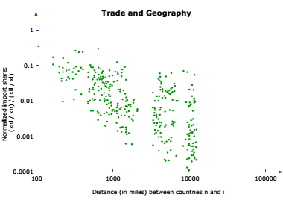
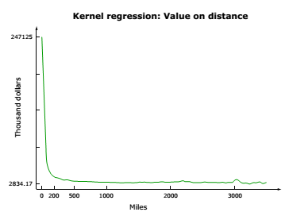
Trade falls with distance

Slide 28
Direct measure: airshipping prices falling

Slide 29
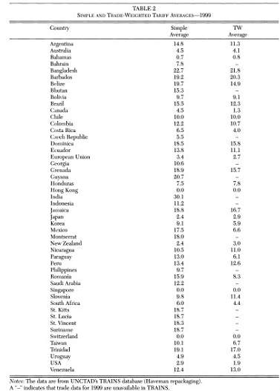
Direct measure, tariffs

Slide 30
Direct measure, Djankov, Freund and Pham (ReStat, 2010)
Also data on doing business etc etc

Slide 31
Measuring costs, end
Descriptive statistics can only get us so far. No one ever writes down the full extent of costs of trading and doing business afar. For example, in the realm of transportation-related trade costs: the full transportation-related cost is not just the freight rate (which Hummels (2007) presents evidence on) but also the time cost of goods in transit, etc.
The most commonly-employed method (by far) for measuring the full extent of trade costs is the gravity equation.
This is a particular way of inferring trade costs from trade flows.
Implicitly, we are comparing the amount of trade we see in the real world to the amount we’d expect to see in a frictionless world; the ‘difference’—under this logic—is trade costs.
Gravity models put a lot of structure on the model in order to (very transparently and easily) back out trade costs as a residual
Trade costs can be estimated as residuals and with the determinant approach. We look at determinants

