Slide 1
Diplomatic correspondence: English and Italian news dissemination in context
Historical pragmatics
Understanding:
Contents (and presentation)
Layout (of diplomatic correspondence)
Register

Slide 2
Reporting England’s inglorious defeat at the Battle of Leghorn 1653: newsletters, pamphlets, avvisi and secret correspondence
Nicholas Brownlees

Slide 3
Leghorn

Slide 4
ELBA

Slide 5
Battle of Livorno 1653 (Johannes Lingelbach)

Slide 6
English reporting of Battle of Leghorn
Weekly London weekly pamphlet reporting the battle
London pamphlets written by Appleton and Badiley to defend their honour and reputation

Slide 7
English reporting of Battle of Leghorn
Weekly English newsletters sent by England’s envoy in Leghorn, Charles Longland, to the English government
Occasional Italian avvisi forwarded by Longland to English government
London pamphlets written by Appleton and Badiley to defend their honour and reputation
Weekly London weekly pamphlet reporting the battle

Slide 8
Transmission of news
Newsletters
Pamphlets
Avvisi
Top secret correspondence

Slide 9
Transmission of news
Newsletters
Pamphlets
Avvisi
Top secret correspondence

Slide 10
A Remonstrance: Henry Appleton

Slide 11
Badiley’s Answer to Remonstrance

Slide 12
Mercurius Politicus

Slide 13
Reporting battle of Leghorn in newsbook Mercurius Politicus (1) (Ch. 8 Language of periodical news…)
30 Sept.–7 Oct. 1652 (122) From Legorn September 13 stilo novo | 7 Oct.–14 Oct. 1652 (123) From Amsterdam, Octob. 11. stilo novo | 14 Oct.–21 Oct. 1652 (124) From Amsterdam, October. 18. 1652. stilo novo
4–11 Nov. 1652 (127) - From Legorn, October 8 - From Legorn of the 18 of October, stilo novo - From Amsterdam November 15: stilo novo. | 11–18 Nov. 1652 (128) From Rotterdam, November 15 stilo novo. | 25 Nov.–2 Dec. 1652 (130) From Legorn, Novem. 1
2–9 Dec. 1652 (131) By an Express from Legorn of the 29 of Novemb. it is certified, That […] | 30 Dec. 1652– 6 Jan. 1653 (135) - From the English at Portolongone, Decem. 18. Stilo novo - From aboard the Phenix-Frigot, before Naples, November 30. | 13 Jan.–20 Jan. 1653 (136) [sic] - From aboard the Leopard in Legorn Mole, December 24 - From aboard the States ship the Bonaventure in Legorn Mole, December 24.

Slide 14
Reporting battle of Leghorn in newsbook Mercurius Politicus (2)
Most of the thirty-five separate news items regarding Leghorn comes from the conflict zone itself, with the rest of the news originating from different parts of Europe. The reader is, thus, given a wide range of viewpoints and information, but the various news reports, dispatches, and simple news flashes are hardly ever linked up to either what has been written in the previous numbers of Politicus or indeed in the very same number.

Slide 15
Reporting battle of Leghorn in newsbook Mercurius Politicus (3)
The newsbook is providing a different angle of the same event, but given that a month has passed between the publication of the first news story and the second would readers have realized on the basis of their reading of Politicus alone that the news referred to the same event?
It is not possible to know the answer, but what is clear is that no editorial information is offered to orient the reader towards that understanding. Likewise, the reader is given no explicit information as to the identity of the addressee (the ‘you’) in the second report (“I informed you of the cruelty that the Dutch exercised”).
In the modern press the reader would be acquainted with such information, in Politicus it was not considered essential. Newsbook readers at that time were accustomed to receiving news reports in different forms and from multiple unidentified sources.
In the unfolding drama of the Leghorn crisis the readers of Politicus were presented with many such texts.

Slide 16
Reporting battle of Leghorn in newsbook Mercurius Politicus (4)
“therfore, you must take things as they come represented in parcells from severall hands; which being added to what was published in the last, you may by collecting all together, have a sight (in some measure) of the late successe and Victory. In the first place, take this following.”

Slide 17
The Daily Courant, 1702
And for an Assurance that he {the editor} will not, under Pretence of having Private Intelligence, impose any Additions of feign'd Circumstances to an Action, but give his Extracts fairly and Impartially; at the beginning of each Article he will quote the Foreign Paper from whence 'tis taken, that the Publick, seeing from what Country a piece of News comes with the Allowance of that Government, may be better able to Judge of the Credibility and Fairness of the Relation: Nor will he take upon him to give any Comments or Conjectures of his own, but will relate only Matter of Fact; supposing other People to have Sense enough to make Reflections for themselves.
Notes:
The Daily Courant was the first English daily
Professional news writer or compiler of news: In early modern period news sources are unreliable,
ALSO news writer’s low status, sceptical readers.
Not wanting to interpret
The editor presents the news without comment.
News writers write news without comment.
Emphasis on factuality.
Handing responsibility to news reader to interpret
Writer not trying to assume authority/responsibility for the interpretation of news

Slide 18
Reporter, Correspondent/ Interpreter?
The Quiet American
“Besides I have never thought of myself as a correspondent, I am just a reporter, I offer no point of view, I take no action, I don’t get involved, I just report what I see …even an opinion is a form of action”
Notes:
2002 Film
Michael Caine’s viewpoint fits in very closely with early modern news writers.
And this form of news presentation, hard news, is still clearly found.
In the film Michael Caine is a journalist reporting the Vietnam War between the French and free Vietnam forces in the fifties.
What contextual reasons are there for him to maintain the same form of news reporting?
Is there government censorship, are there unreliable sources, is there something else in this present-day form of news presentation?
Various reasons for hard news and some of them clearly relate to the socio-historical context in which news is produced.
IndoChina War 1946-1954.

Slide 19
English reporting of Battle of Leghorn
Weekly London weekly pamphlet reporting the battle
London pamphlets written by Appleton and Badiley to defend their honour and reputation
Weekly English newsletters sent by England’s envoy in Leghorn, Charles Longland, to the English government
(some of which wee published in Mercurius Politicus)
Occasional Italian avvisi forwarded by Longland to English government

Slide 20
English newsletters sent by English envoy in Leghorn
Charles Longland

Slide 21
John Thurloe

Slide 22
Longland as spy master
His Letters speak of need to find “good spies”

Slide 23
Ferdinando II de’ Medici Grand Duke of Tuscany

Slide 24
British History Online
http://www.british-history.ac.uk/Default.aspx
A Collection of the State Papers of John Thurloe

Slide 25
Diplomatic correspondence important source for news (1)
Right Honourable,
Here are still in this Port 6 Dutch Men of War, 5 of which departed this morning towards the East, to look after the Tripoly men, who have lately fought with a Dutch Merchant man richly laden from Smyrna, who fought two dayes, and by good hap shot down the Turks main-mast, and so got into Messina, whither it is said these 5 ships are gone to convey her hither. Since our Nation hath been outed of the Turky trade, the Dutch and French send twice as many ships thither as formerly; so if the Parliament should think fit to send a squadron of 20 sail into the Streights, your Honours may see what a good purchase they may be for your Frigots (sufficient no doubt to maintain the fleet:) many other advantages of great importance might redound to our State by keeping a powerful fleet in these Seas, as well as in relation to France, Spain, and Barbary, as to the free trade of our own Nation; all which I humbly commend unto your Honours consideration.
(Mercurius Politicus, 29 September–6 October 1653)

Slide 26
Diplomatic correspondence important source for news (2)
Chas. Longland to the Admiralty Committee. There are 6 Dutch ships in this port, although 5 departed this morning towards the east to look after the Tripoli men-of-war, who lately fought with a Dutch merchantman richly laden from Smyrna; she fought 2 days, and by good hap shot down the Turk's mainmast, and so got into Messina, and these 5 ships are gone to convoy her hither.
Since our nation has been ousted of the Turkey trade, the Dutch and French send twice as many ships thither as formerly, so that if the Parliament should think fit to send a good squadron of 20 sail into these seas, you may see what good purchases there will be for your frigates, and sufficient no doubt to maintain the fleet. Many other advantages of great import might rebound to our State by keeping a powerful fleet in these seas, as well in relation to France, Spain, and Barbary, as the free trade of our own nation.
(Calendar of State Papers Domestic: Interregnum, 1653-4, Sept. 5. Leghorn)

Slide 27
Diplomatic correspondence important source for news (3)
Charles Longland letter
Report in Mercurius Politicus
There are 6 Dutch ships in this port, although 5 departed this morning towards the east to look after the Tripoli men-of-war, who lately fought with a Dutch merchantman richly laden from Smyrna; she fought 2 days, and by good hap shot down the Turk's mainmast, and so got into Messina, and these 5 ships are gone to convoy her hither.
Here are still in this Port 6 Dutch Men of War, 5 of which departed this morning towards the East, to look after the Tripoly men, who have lately fought with a Dutch Merchant man richly laden from Smyrna, who fought two dayes, and by good hap shot down the Turks main-mast, and so got into Messina, whither it is said these 5 ships are gone to convey her hither.

Slide 28
Charles Longland’s need for news: News as commodity
‘It would ad much to my credit here, as I am the state's servant, to hav frequent and good advys of al such passages at hom at the first hand: the governor and other officers wil ask me, if such and such things be so; wherunto I can say nothing but what is common upon the exchange, which if it once prov true tis six tymes the contrary: 'tis in your power to remedy this, and enable me to keep a better correspondency with the great duk's officers’ (A collection of the State Papers of John Thurloe, 1: 1638-1653 (1742), URL: http://www.british-history.ac.uk.).

Slide 29
Charles Longland
“you have the Catastrophe of this Squadron who was destined to ruine, for they omitted many a better opportunity to go out of the mold, but wold not make use of any till they wer driven out, this is a sad story to give you the relation of”

Slide 30
Amerigo Salvetti (1572-1657)
Alessandro Antelminelli adottò il nome Salvetti in seguito al suo coinvolgimento in una cospirazione filo-fiorentina nel 1596 a danno della sua città natale, Lucca
Residente dal 1618
Successo
Nozze
Notes:
Il ruolo dei diplomatici italiani e inglesi di quellli anni, che parte favevan loro nella scacchiera politica anglo-toscana
Gli anni ‘20 del ‘600
Amerigo salvetti era un diplomatico e un informatore di enorme volore e abilità
Salvetti aveva una enorme familiarità con l’establishment socio-politico inglese
Ciò che emerge dalla corrispondenza è un diplomatico che ha esperienza,
conosce alcuni membri importanti del governo inglese e che promuove la causa del Granducato con determinazione e successo
Era sempre nel mirino delle autorità lucchesi che diverse volte hanno cercato di assassinarlo sia in Italia che all’estero
I rapporti tra la Toscana e l’Inghilterra si facevano sempre più fitti
Eventuale perdono del Salvetti
Una donna di 20 anni si sposa con un uomo di 63 soltanto per la sua bellezza fisica?
Soltanto per labellezza fisica di un uomo di 63 anni

Slide 31
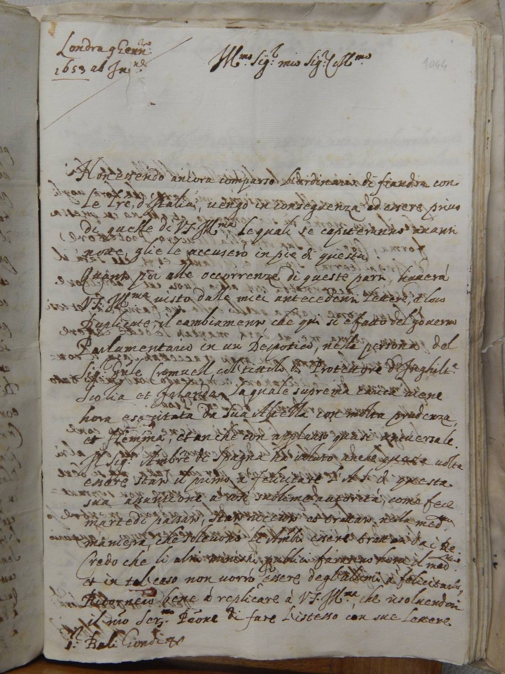

Slide 32
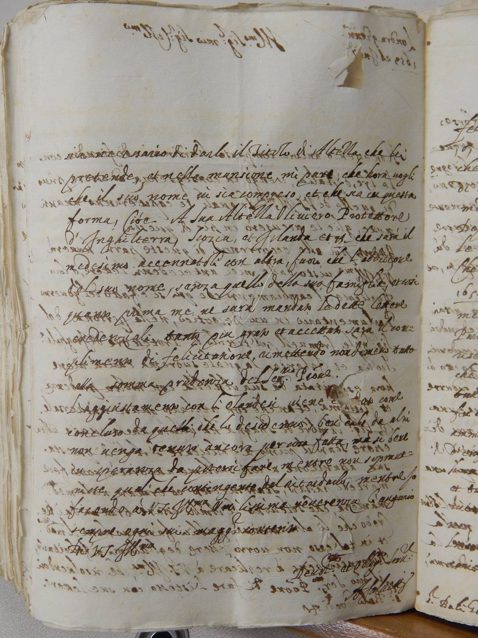

Slide 33
Lettere di Amerigo Salvetti
Archivio di Stato, Firenze
Archivio Mediceo del Principato

Slide 34
British Library trascrizione in italiano standardizzato (fine Ottocento)
Notes:
L’unico principe italiano che mantenne una rappresentanza diplomatica italiana in Ighilterra durante tutti gli anni della Guerra Civile e gli anni 50 del regime repubblicano era il granduca di Toscana.
Amerigo salvetti era un diplomatico e un informatore di enorme volore e abilità
I rapporti tra la Toscana e l’Inghilterra si facevano sempre più fitti
Eventuale perdono del Salvetti
Il matrimonio imparentò il Salvetti con il conte di Bolingbroke. Salvetti aveva una enorme familiarità con l’establishment politco-economico inglese
Mercante fiorention Francesco Terriesi
Il balì Giambaptista Gondi

Slide 35
Postal service
Ordinario
Corriere espresso
Corriere Trottolino

Slide 36
Post Coach

Slide 37
Ciphered news in Italian newsletters sent by Tuscan ‘residente’ in London
Ricevo in questo punto un’Biglietto da
un’amico che mi accenna essersi
nel parlamento
ultimam.te disputato 13146705

Slide 38
Dual purpose
‘the writers regarded these [diplomatic ] letters as critically important, not for the affairs of state, but for their own fortunes and future careers’
Fitzmaurice (2006)

Slide 39
Translation
‘The particulars whereof [the affair] have beene represented to the Parlament by your letters of the 7th and 9th of December last, and more at large, by the worthy Amerigo Salvetti your Resident here, And they are so sensible of the honour of your Highnesse concerned therein, That they have given Order […]’
‘le particolarità di tutto essendo state rappresentate al Parlamento dalle lettere di V.A. de’ 7 et 9 di dicembre, et più particolarmente et amplamente dal degno Amerigo Salvetti suo residente qui, che ci ha resi tanto sensitivi del honore dell’A.V. che habbiamo subito dato ordine […]’. (29/1/1653)

Slide 40
Diplomatic correspondence can also be examined for intercultural aspects (1)
In 1703 Sir Lambert Blackwell, envoy to the Grand Duchy of Tuscany explains “how one does business in Italy”
Notes:
In questa lettera del 1703 Blackwell sta spiegando perché, quando scrive in italiano al Granduca e ad altri politici e diplomatici toscani,
usa i titoli di cortesia che per ufficiali inglesi di Londra sembrano troppo ossequiosi ed esagerati.
Il diplomatico inglese si difende dicendo che questo è il modo in cui la corrispondenza e la comunicazione si svolgono in Italia

Slide 41
Doing business in Italy….
“which the Italians tearme doing businesse with soft words and hard arguments”
(Sir Lambert Blackwell, 1703)
…. Unlike the English Secretary of State who does not understand or accept the need for elaborate and exceesively honorific address terms

Slide 42
Francesco Terriesi, Agente per il Gran Ducato di Toscana (1670-1691)
…...
È un gran tempo che il Signor Bernardo Howard mi tormenta accio che supplichi l.ill.ma sua, a suo nome di mandarli un poco del suo olio da stomaco e del suo balsamo apopletico, e che ora non mi lascia più vivere, non ammettendo più le mie scuse sopra la difficoltà del farlo venire, per che afferma che vuole S.A.S. farlo andare a Parigi e che da Parigi ne prenderà esso la cura.

Slide 43
Con tale arrivo mi ha tornato a fare una dimanda il Signor Neville che mi haveva fatto di gia’ piu’ volte, cioe’, se S.A.S. m’haveva con essa mandato una cassetta di galanterie, che S.A. gli ha fatto sperare per una sua nipote. Gl’Inglesi sono come i bambini; dalli quali conviene guardarsi di promettere cosa alcuna perché mai se le scordano, ne vi lasciano vivere, sin ‘a tanto che non se li e’ data.
(13 January 1690)
Perché gli inglesi sono così?
Notes:
Ho chiesto a mia moglie

Slide 44
Protestantism
The Bible and the word of God
Give importance to the word

Slide 45
Lecture notes, pp. 52-55
Sir Lambert Blackwell 1703 correspondence

