Slide 1
The impact of the Brexit on spain
Beatriz Ramón
Catalina manea
Andrea simón
Laura Porto

Slide 2
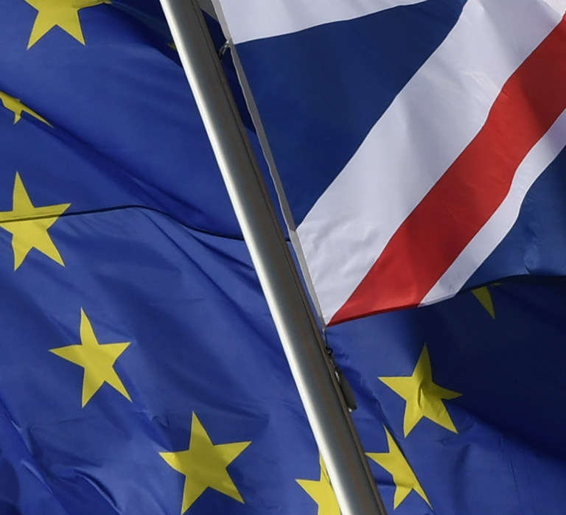
The impact of the brexit in spain
Introduction
Our country, Spain
Geographical, political and population aspects
Economic indicators
Impact on Migration and Tourism
Migration and Tourism between the UK and Spain
Consequences of the Brexit on Migration and Tourism
Impact on Trade and Investment
Is there any social impact?

Slide 3
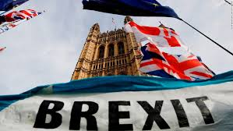
1. Introduction
CONTROVERSIAL?
CRISIS 2008
European Economic Community since 1973
Diverse
+ Cohesive

Slide 4
The impact of the brexit in spain
Introduction
Our country, Spain
Geographical, political and population aspects
Economic indicators
Impact on Migration and Tourism
Migration and Tourism between the UK and Spain
Consequences of the Brexit on Migration and Tourism
Impact on Trade and Investment
Is there any social impact?

Slide 5
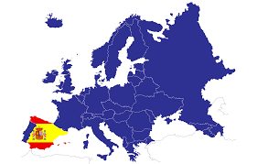
2. Our country, spain
Kingdom of Spain
1st January 1986
parliamentary democracy and constitutional monarchy
17 autonomous communities and 2 autonomous cities

Slide 6
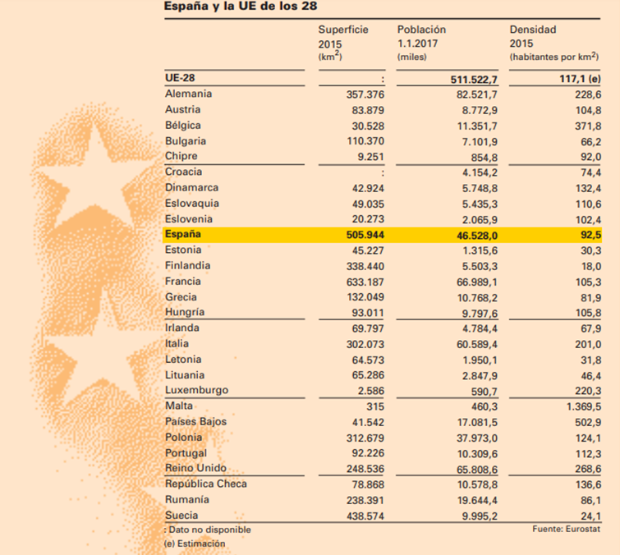
Extension
Population
Density

Slide 7
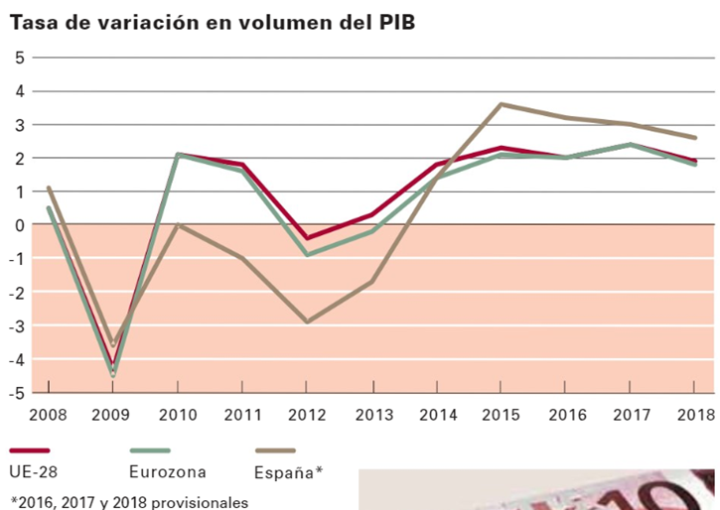
“Rate of variation in GDP volume”
The GDP _{per capita} of Spain in 2018 was about 25.730€, 760€, higher than in 2017 that was about 24.970€.
The value of gross domestic product at current prices in 2018 was about 1.208.248 million of euros and that means a nominal variation rate of 3,6%. In terms of volume, the variation is of 2,6% compared to 2017. Five years of sustained GDP growth.

Slide 8
Purchasing Power Parity, 2017
GDP at market prices, 2018
15th

Slide 9
The impact of the brexit in spain
Introduction
Our country, Spain
Geographical, political and population aspects
Economic indicators
Impact on Migration and Tourism
Migration and Tourism between the UK and Spain
Consequences of the Brexit on Migration and Tourism
Impact on Trade and Investment
Is there any social impact?

Slide 10
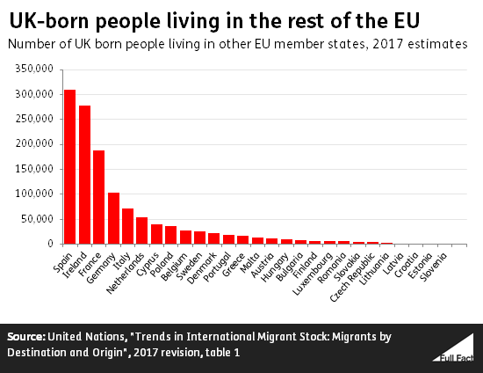
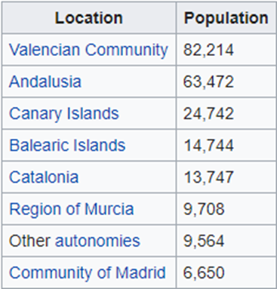
3. MIGRATION AND TOURISM BETWEEN THE UK AND SPAIN
MIGRATION

Slide 11
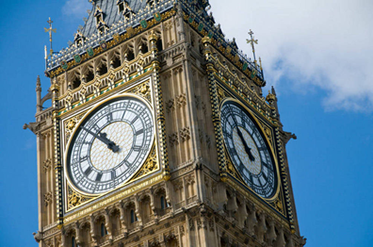
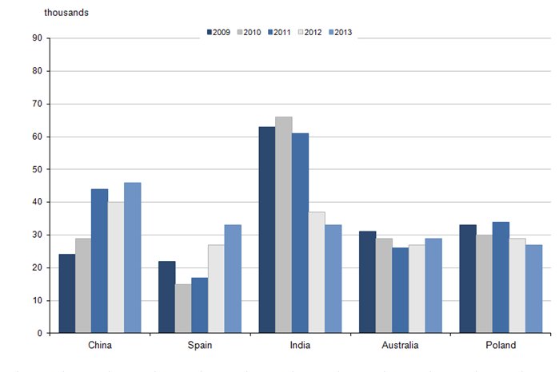
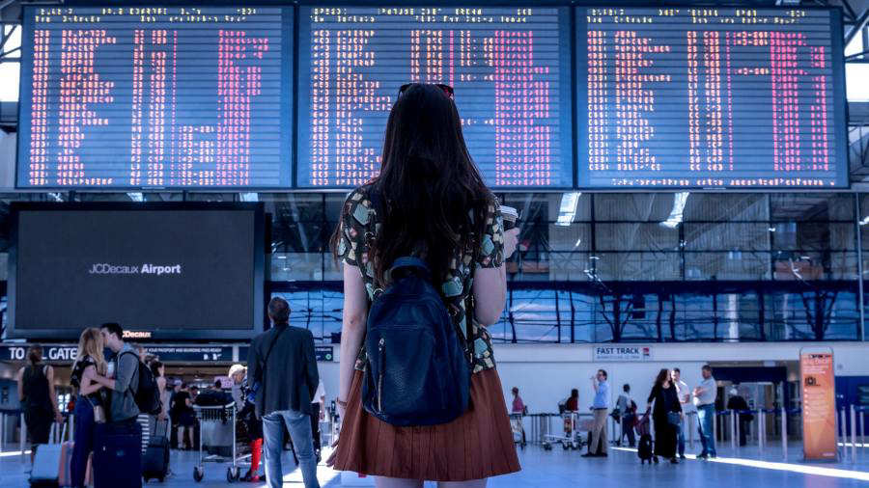

Slide 12
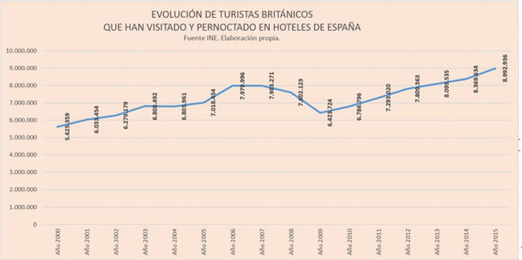
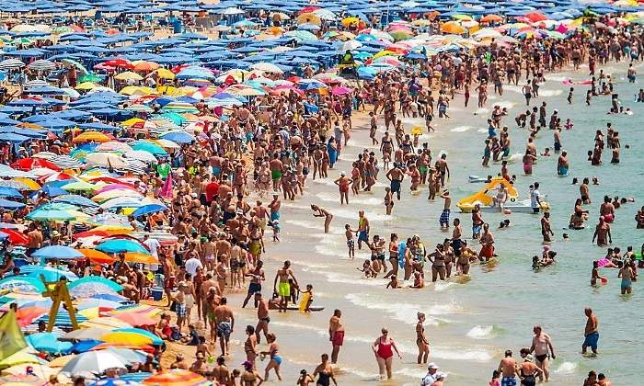
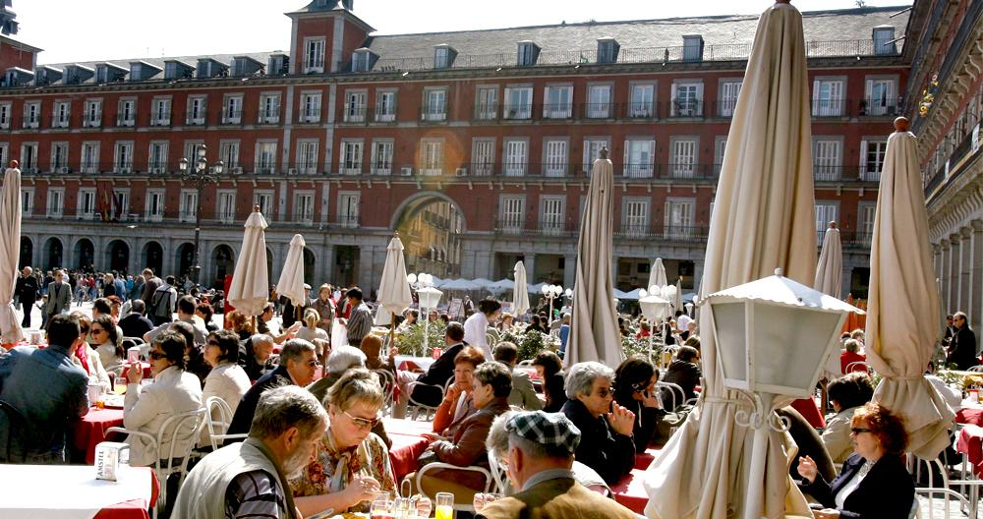
TOURISM

Slide 13
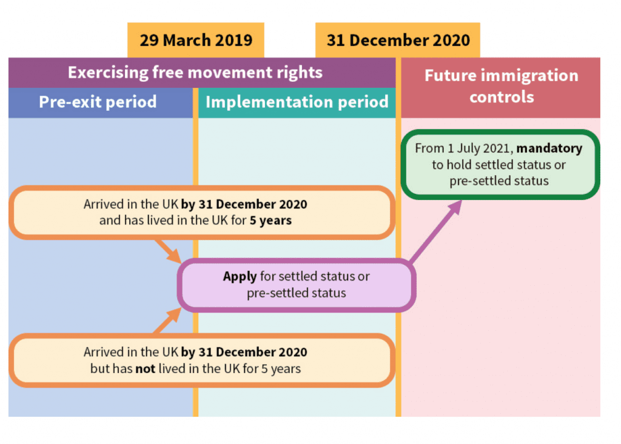
BREXIT CONSEQUENCES
BRITISH LIVING IN SPAIN
SPANISH LIVING IN THE UK

Slide 14
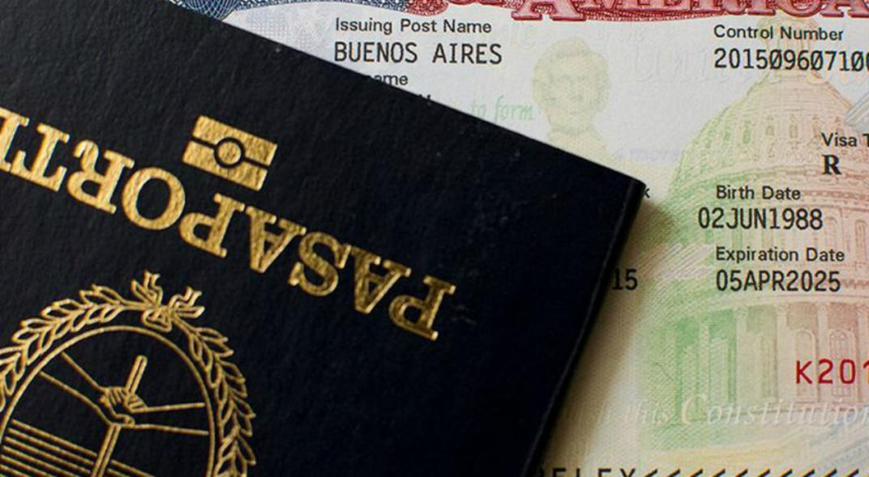
ON TOURISM

Slide 15
The impact of the brexit in spain
Introduction
Our country, Spain
Geographical, political and population aspects
Economic indicators
Impact on Migration and Tourism
Migration and Tourism between the UK and Spain
Consequences of the Brexit on Migration and Tourism
Impact on Trade and Investment
Is there any social impact?

Slide 16
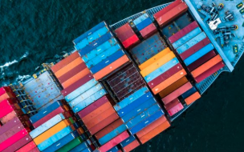
Globalisation
Increase their participation on the global value chains

Slide 17
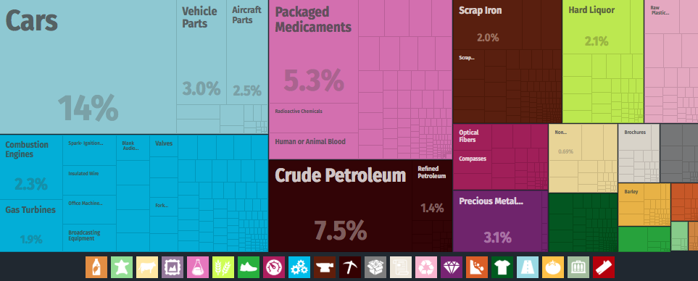
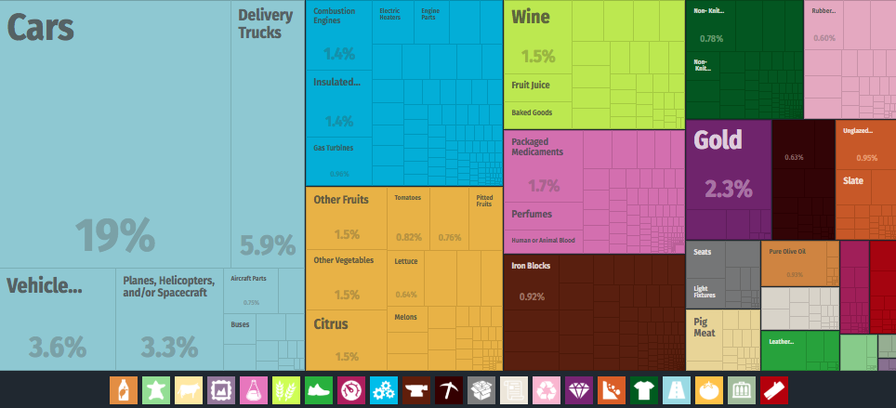
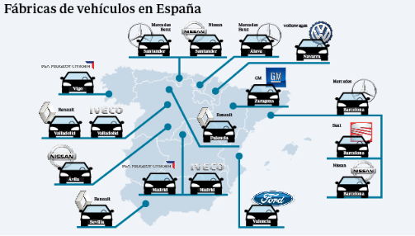
Exports?
Imports?
Our 5th trading partner!!
And measured in terms
of added value?
weight in terms of added value < in gross terms

Slide 18
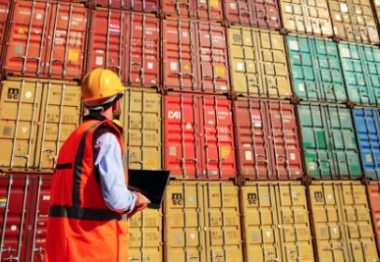
And what about firms…?
Effects?

Slide 19
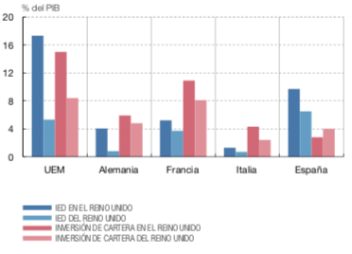

Slide 20
The impact of the brexit in spain
Introduction
Our country, Spain
Geographical, political and population aspects
Economic indicators
Impact on Migration and Tourism
Migration and Tourism between the UK and Spain
Consequences of the Brexit on Migration and Tourism
Impact on Trade and Investment
Is there any social impact?

Slide 21
Is there any social impact?
EDUCATION
MEDIA INDUSTRY

Slide 22
BREXIT AND SPANISH REAL ESTATE MARKET
BUYERS OF HOUSES BY NATIONALITY
NUMBER OF PURCHASED HOUSES

Slide 23
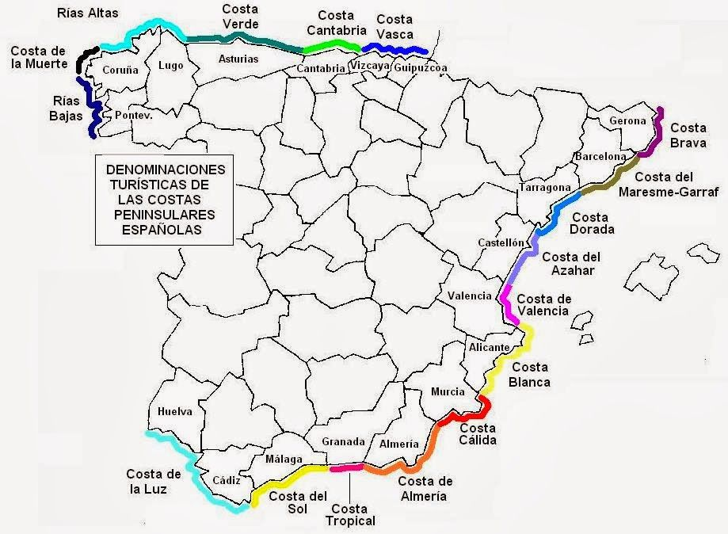
PRICE FALL

Slide 24
GIBRALTAR

Slide 25
Is there any similarity between brexit and catalan independence?

