Slide 1
PSPPI
Progetto e Sviluppo di
Prodotti e Processi Industriali
“Design, Modelling, Simulation, Implementation, Testing and Validation of Advanced and Innovative Mechatronics System for Road Electric Vehicle’s Performances Improvement”
Candidate: Tommaso Favilli
tommaso.favilli@unifi.it
Relatore: Prof. Marco Pierini
Co-Relatori: Prof. Luca Pugi, Ing. Lorenzo Berzi
Accademic Year: 2019-2020
Firenze, 13 Ottobre 2020
Notes:
Good morning to everyone, I’ll introduce myself: I’m Tommaso Favilli, a PhD student belonging to the Department of Industrial Engineering of Florence, PSPPI curriculum. My research activities concern the “Design, Modelling, Simulation, Implementation, Testing and Validation of Advanced and Innovative Mechatronics System for Road Electric Vehicle’s Performances Improvement”.

Slide 2
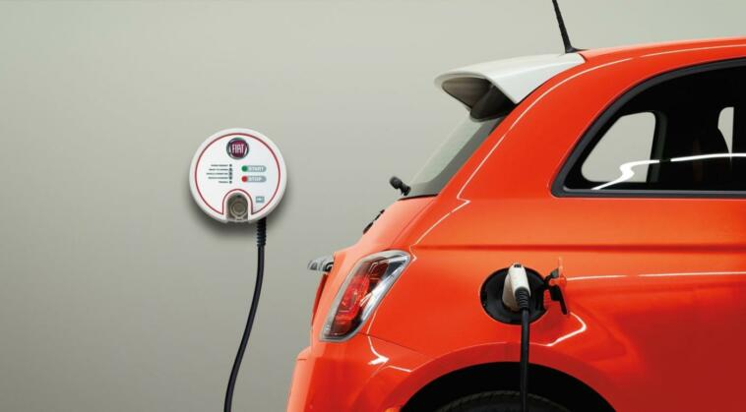
Design, Modelling, Simulation, Implementation, Testing and Validation of Advanced and Innovative Mechatronics System for Road Electric Vehicle’s Performances Improvement
Firenze, 13 Settembre 2020
Index
Introduction
State-of-Arts
Research Approach
Performed Activities
Future Developments
Notes:
The presentation is organized as follows:
A brief introduction;
A state of art review;
The research approach followed for my work;
The performed activities;
Finally, future developments.

Slide 3
Design, Modelling, Simulation, Implementation, Testing and Validation of Advanced and Innovative Mechatronics System for Road Electric Vehicle’s Performances Improvement
Firenze, 13 Settembre 2020
Introduction
Challenges and Opportunities
Intent of the research: Challenges
Improve Electric Vehicle’s performances
Proposed solutions: Tools and Means
Development of advanced mechatronics systems through model-based approach
Ensure portability and flexibility of the solutions
Proposal of a systematic assessment methodology
Optimization of control strategy and multi-DOF allocation problems
Notes:
The main intent of my research concern the improvements of Electric Vehicle’s performances, while ensuring portability and flexibility properties of the proposed solutions, in order to be easily adapted and integrated for different e-powertrain architectures.
To reach this goal and accomplish the challenge I am currently working on the development of advanced mechatronic systems and control algorithm using a model-based approach. Those systems are devoted to the optimization of specific control strategy and multi Degree Of Freedom allocation problems.
A systematic methodology to evaluate the improvements is proposed as well, which is able to assess the achieved enhancements for several aspects.

Slide 4


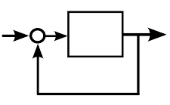
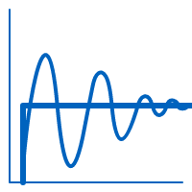
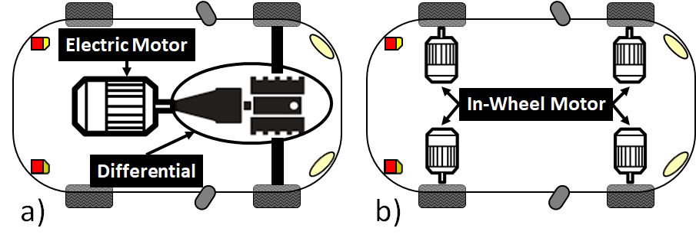




Design, Modelling, Simulation, Implementation, Testing and Validation of Advanced and Innovative Mechatronics System for Road Electric Vehicle’s Performances Improvement
Firenze, 13 Settembre 2020
Introduction
How can the EV’s performances be improved?
Research Question
Open Problem:
EV’s Solutions
H2
Hybrid
Battery
Fuel Cell
SuperCap
FWD
4WD
Energy Storage System
Powertrain layout
Feasibility
Man-hour and economical cost
Technological trend
Required performances
Control strategies
Notes:
My research is aimed at answering a fundamental question:
How can the EV’s performances be improved?
electric vehicles are an established industrial reality and an academic growing topic. However, a wide range of different vehicle solutions have been taken into consideration respect to powertrain architecture, storage system, control strategies. This constitutes a major open problem. Indeed, what is not well defined is which layout is the most feasible and suitable, considering the man-hour and economical cost, the industrial process trend and the required performances, tailored for the specific application.

Slide 5
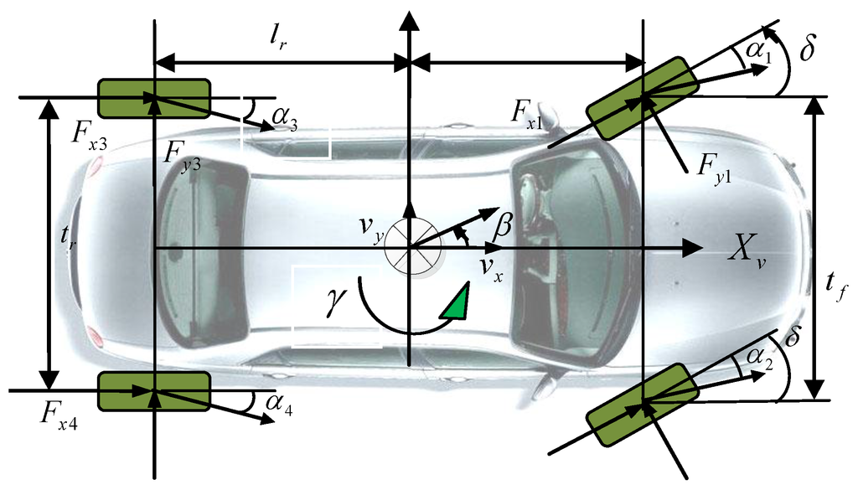
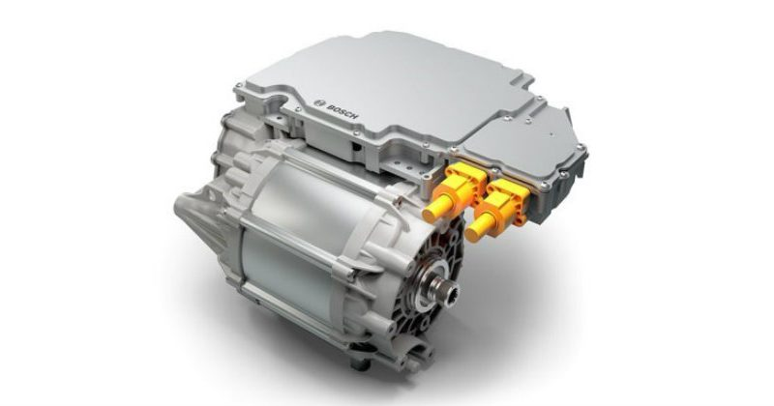
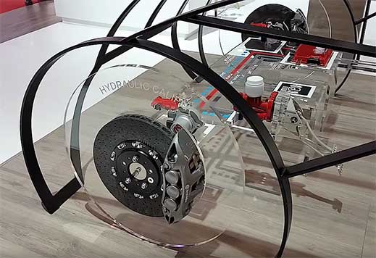
Design, Modelling, Simulation, Implementation, Testing and Validation of Advanced and Innovative Mechatronics System for Road Electric Vehicle’s Performances Improvement
Firenze, 13 Settembre 2020
State-of-Arts
State-of-Arts Investigation
Literature Review
Vehicle Dynamics
Electric Powertrain
By-Wire System
[1]G. Genta and L. Morello - The Automotive Chassis (2009)
[2] T. D. Gillespie - Fundamentals of Vehicle Dynamics (1992)
[3]M. Guiggiani, - The science of vehicle dynamics: handling, braking, and ride of road and race cars(2014)
[4]Emadi A. - Power Electronics and Motor Drives in Electric, Hybrid Electric, and Plug-In Hybrid Electric Vehicles (2008)
[5]de Santiago J. - Electrical Motor Drivelines in Commercial All-Electric Vehicles A Review (2012)
[6]Krishnan R. - Electric Motor Drives Modeling, Analysis, and Control
[7]Yu L. - Review of Brake-by-Wire System used in Modern Passenger Car (2016)
[8]Frede D., Khodabakhshian M. - A state-of-Art Survey on Vehicular Mechatrononics Focusing in By-Wire System (2010)
Notes:
During the first year I concentrate my effort in a deep State-of-Arts investigation, concerning various topics in the electric automotive field:
Vehicle dynamics and his interaction with the other safety-related on-board subsystem, for example EBD, ABS and ESP;
Electric powertrain, starting from the analysis of the traction architecture, high and low-level control strategies and power management;
Finally, by-wire technologies, which consent a better integration within mechatronics systems, such longitudinal and lateral stability controller.

Slide 6
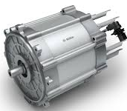
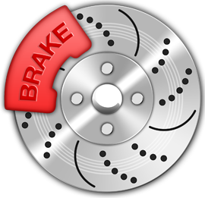
Design, Modelling, Simulation, Implementation, Testing and Validation of Advanced and Innovative Mechatronics System for Road Electric Vehicle’s Performances Improvement
Firenze, 13 Settembre 2020
State-of-Arts
How can the EV’s performances be improved?
Research Questions
State-of-Arts Investigation
Optimization of Electric Power Management Strategy
Can an Optimized Electric Torque Allocation Technique Improve the Performances of Electric Vehicles?
Can the Hydraulic Brake be Completely
Removed in Electric Vehicle?
Notes:
What arises is that, among the different possibilities, one feasible solution to improve the EV performances can be the optimization of the electric power management strategy, using by-wire technologies.
Additional information can be acquired by asking ourselves a pair of sub-questions, useful for the main purpose of my PhD activities:
Can an optimized electric torque vectoring technique improve the performances of electric vehicles?
Can the hydraulic brake be completely removed from an electric vehicle?

Slide 7



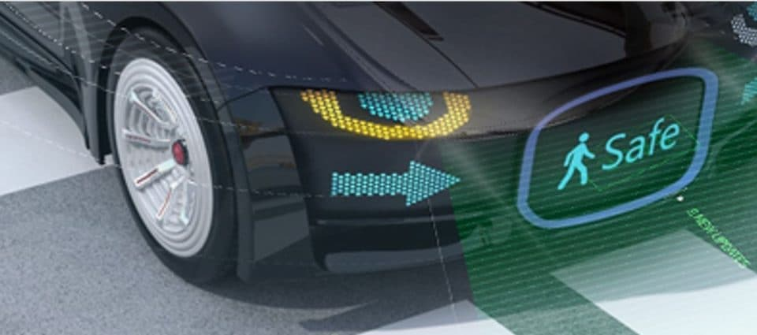
Design, Modelling, Simulation, Implementation, Testing and Validation of Advanced and Innovative Mechatronics System for Road Electric Vehicle’s Performances Improvement
Firenze, 13 Settembre 2020
State-of-Arts
Can an Optimized Electric Torque Allocation Technique Improve the Performances of Electric Vehicles?
Yes,
it can!
Research Sub-Questions
Energetic
Stability
Safety/Reliability
Increased Vehicle Efficiency
Increased Vehicle Autonomy
[9],[10],[11]
Increased Longitudinal Stability
Increased Lateral Stability
[10],[11],[12]
Over-actuated Braking System
Advanced Braking Control Strategy
Reduced CO2 and Particle Emission
[12],[13],[14],[15]
[9] Qiu C. - New evaluation methodology of regenerative braking contribution to energy efficiency improvement of electric vehicles (2016)
[10] Rauh J., Ammon D. - System dynamics of electrified vehicles - Some facts, thoughts, and challenges (2011)
[11] Boerboom M. - Electric Vehicle Blended Braking maximizing energy recovery while maintaining vehicle stability and maneuverability (2012)
[12] Oleksowicz S. A. - Regenerative braking strategies vehicle safety and stability control systems critical use case proposals (2013)
[13] Novak M. - Comparison of exhaust emission on the basis of Real Driving Emissions measurements and simulations (2017)
[14] Hesse D. - Investigation of the Potentials of Regenerative Brake Systems towards the Reduction of Brake Particle Emissions (2019)
[15]T. Grigoratos and G. Martini, ‘Brake wear particle emissions: a review’, Environ Sci Pollut Res, vol. 22, no. 4, pp. 2491–2504, Feb. 2015.
Notes:
Referring to the first sub-question, the available literature confirm this consideration. The performances improvements involve several aspects:
From an energetic point of view, is found an increase in the vehicle’s efficiency and autonomy, due to regenerative braking and the possibility to implement advanced energy management policies.
From a stability perspective instead, an increased longitudinal and lateral stability are verified, due to a faster bandwidth response and adoption of specific controlling techniques.
For what concern the safety/reliability performances, the availability of multi braking device make appear the vehicle over-actuated, with consequent reliability advantages, due to redundancy of brake plant. Also, the possibility to implement advanced braking strategy improve the functional safety aspect of the system. Finally, a reduction of CO2 and pads particle emission is desirable.

Slide 8

Design, Modelling, Simulation, Implementation, Testing and Validation of Advanced and Innovative Mechatronics System for Road Electric Vehicle’s Performances Improvement
Firenze, 13 Settembre 2020
State-of-Arts
Can the Hydraulic Brake be Completely
Removed in Electric Vehicle?
No, it can’t!
Research Sub-Questions
Ideal Motor Characteristic
Performances Derating
Torque [Nm]
Power [W]
Traction
Speed [rad/s]
SOC_up
SOC [%]
SOC_dw
Braking
Motor Overloading
Motor Oversizing
[4],[5],[6],[16]
Battery SOC
Battery SOH
Battery Overheating
[4],[5],[6]
[4] Emadi A. - Power Electronics and Motor Drives in Electric, Hybrid Electric, and Plug-In Hybrid Electric Vehicles (2008)
[5] de Santiago J. - Electrical Motor Drivelines in Commercial All-Electric Vehicles A Review (2012)
[6] Krishnan R. - Electric Motor Drives Modeling, Analysis, and Control
[16] Ahn J. K., Jung K. H. - Analysis Of a Regenerative Braking System For Hybrid Electric Vehicle Using An Electro-Mechanical Brake (2008)
Notes:
Even to this second question the investigated literature answer: No, is not possible remove hydraulic brake from an EV in a short-term scenario. This is because the electric braking can be unavailable in several conditions, not assuring the provision of the minimum braking performances required for this application. There are 2 main reasons:
The electric motor must be controlled in order to reproduce the ideal traction/braking characteristic, so the available torque is speed-dependent. Otherwise, we encounter motor overload problems or in the necessity of oversize the latter.
The motor performances can be subject of derating to avoid undesired situations, such the over-charge or the under-discharge of the battery, accelerated ageing, overheating.

Slide 9
Design, Modelling, Simulation, Implementation, Testing and Validation of Advanced and Innovative Mechatronics System for Road Electric Vehicle’s Performances Improvement
Firenze, 13 Settembre 2020
State-of-Arts
How can the EV’s performances be improved?
Research Questions
State-of-Arts Investigation
Optimization of Electric Power Management Strategy
Regenerative Brake
Friction Brake
Optimized Brake Blending
Notes:
Keeping in mind the research question and the correlated sub-questions, we can summarize saying that optimized electric power management strategy can improve the vehicle performances and that the presence of the hydraulic brake is essential to assure the achievement of minimum braking performances.
To merge this acquired competences I decide to mainly focus on an interesting topic concerning the optimization of EV’s which adopts by-wire technologies: The brake blending strategy. Typically implemented through a CU, this algorithm has to regulate and optimize how regenerative and conventional braking efforts are coordinated and applied together to the driven wheels.

Slide 10
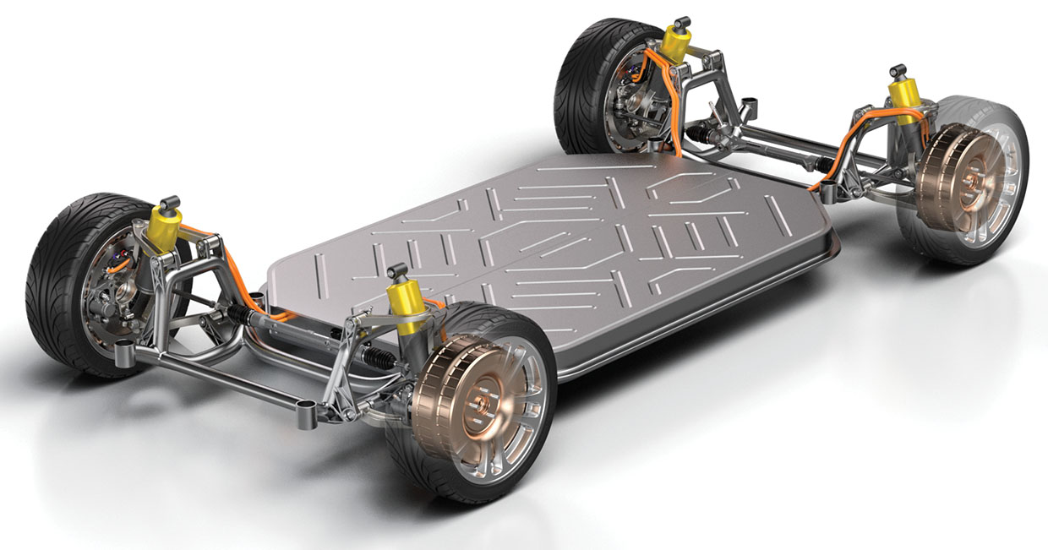
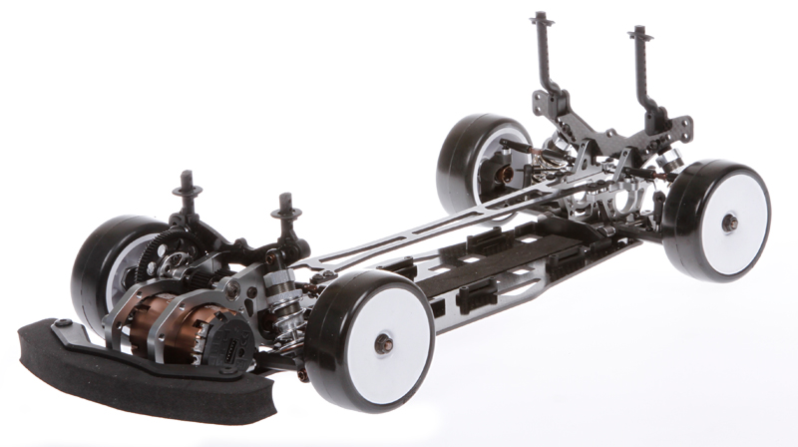
Design, Modelling, Simulation, Implementation, Testing and Validation of Advanced and Innovative Mechatronics System for Road Electric Vehicle’s Performances Improvement
Firenze, 13 Settembre 2020
Research Approach
Simulation Activities
Front-Wheel Motor Driven
In-Wheel Motor Driven
Energetic
Stability
Safety/Reliability
Notes:
The assessment of achievable energetic, stability and safety improvement is done trough simulation activities during my second PhD year, using complex models of different EV use cases and supposing several powertrain architectures, in order to comparatively evaluate the results.
So proposed model-based approach concern the execution simulation campaigns, supposing Electric vehicle equipped with by-wire system Technology.
Energetic and stability performances are established making the vehicle replicate reference driving cycle and specific manoeuvres; while for safety/reliability point of view, performances are evaluated in accordance with related standards.

Slide 11

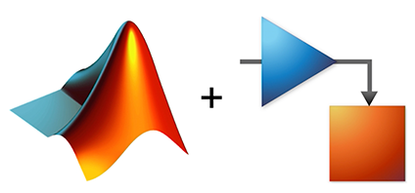

Design, Modelling, Simulation, Implementation, Testing and Validation of Advanced and Innovative Mechatronics System for Road Electric Vehicle’s Performances Improvement
Firenze, 13 Settembre 2020
Research Approach
How can the EV’s performances be improved?
Open Problem
Open Problem:
EV’s Solutions
Developed Models
Scalable
Abstract
Parametrized
Modulate
Flexible
RT Capable
MATLAB Simulink®
Model-based Methods and Tools
Simcenter Amesim ™
Co-Simulation
Notes:
To overcome the open problem of defining a specific Vehicle Use Case and ensure maximum portability of developed mechatronics systems and control algorithms, some solutions have been proposed.
Considering the complex interaction arising due to the coupling of systems belonging to heterogeneous engineering fields, all the proposed model must respect some important features, in order to be validated trough simulation activities: scalability, abstraction, parameterization, modularity, flexibility and Real-Time capability. For doing this I use some model-based methods and tools.

Slide 12
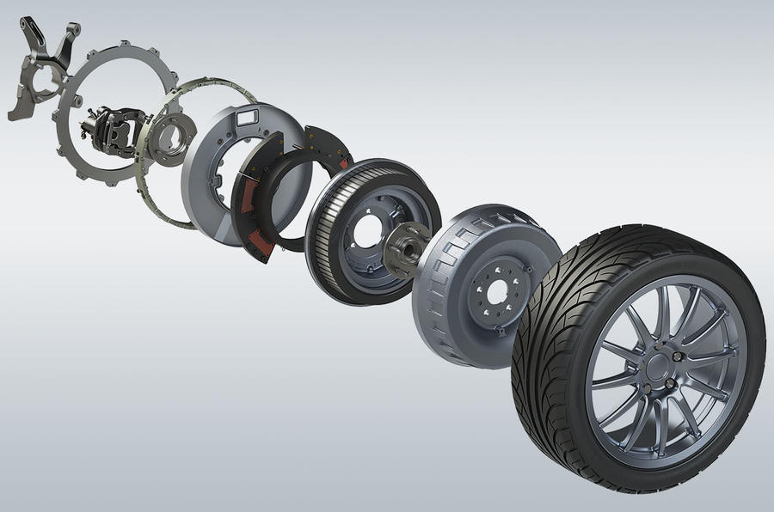





Design, Modelling, Simulation, Implementation, Testing and Validation of Advanced and Innovative Mechatronics System for Road Electric Vehicle’s Performances Improvement
Firenze, 13 Settembre 2020
Research Approach
How can the EV’s performances be improved?
Open Problem
Open Problem:
EV’s Solutions
High power density
Easy and precise control
Fast bandwidth response
Torque vectoring techniques
In-Wheel Motor
Four quadrant modes
[17] R. de Castro, M. Tanelli, R. E. Araújo, and S. M. Savaresi, ‘Minimum-time manoeuvring in electric vehicles with four wheel-individual-motors (2014)
Notes:
Also, the developed system has been firstly applied supposing alternative in Wheel Motors vehicle architectures, in order to ensure a higher level of abstraction. The technological features of modern electric Hub motors offer to designers a wide range of functionalities that are very innovative respect to constraints affecting conventional solutions.
A high power density;
An easy and precise torque and speed control;
A Fast bandwidth response;
The possibility to apply advanced torque vectoring techniques, controlling independently the effort produced on each wheel;
and the availability of four-quadrant operational mode, which consents the application of regenerative braking.
Nevertless, this kind of motors present some disadvantages, such Higher unsprung masses and major exposure to environment and impact

Slide 13
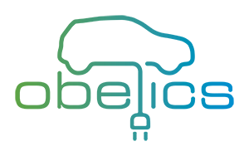
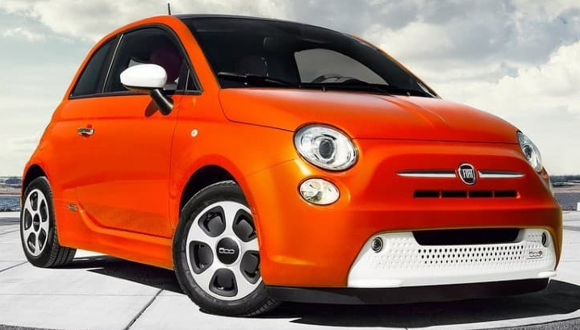
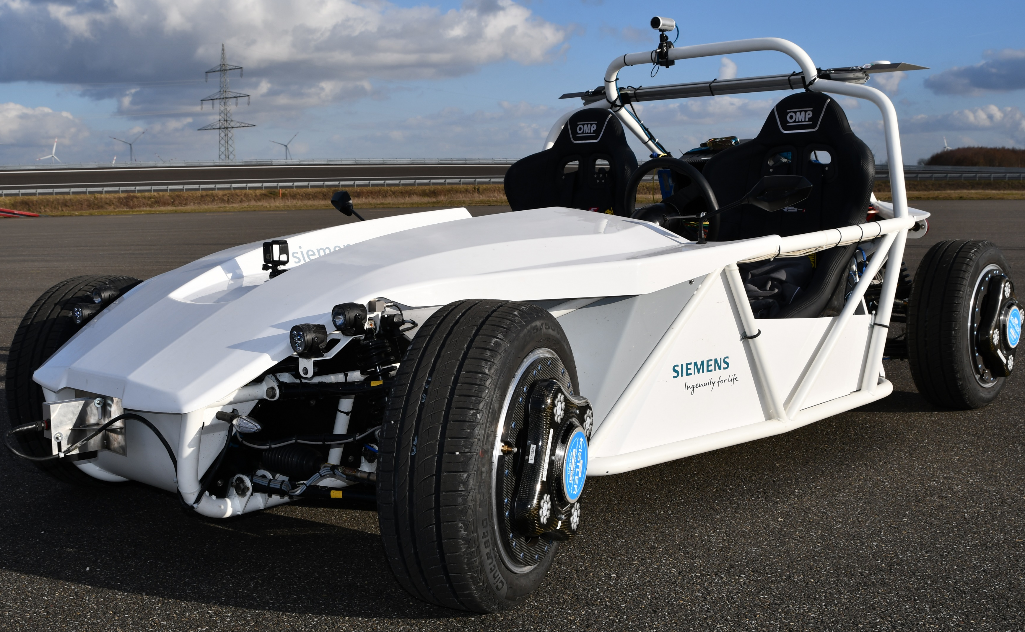
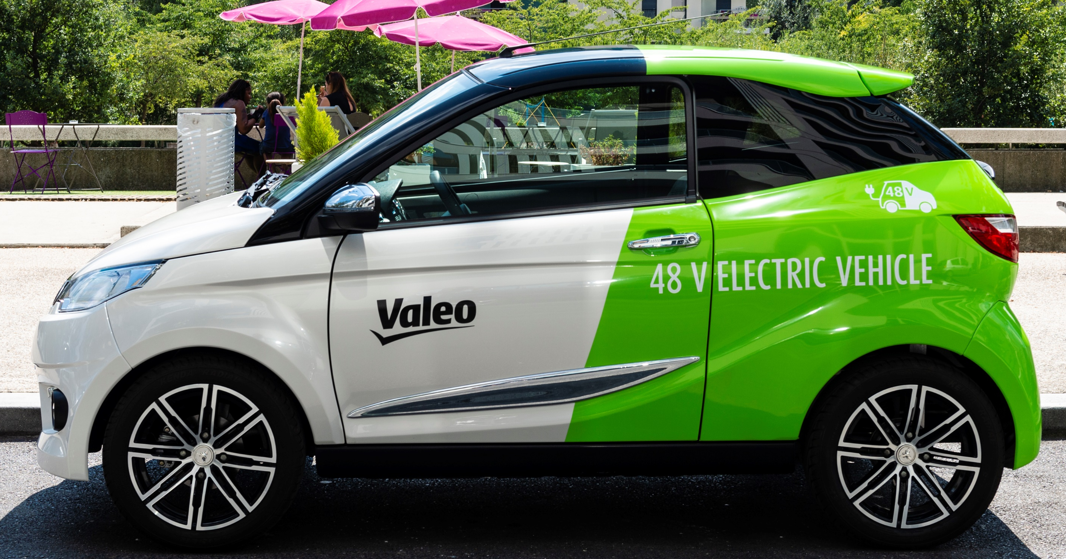



Design, Modelling, Simulation, Implementation, Testing and Validation of Advanced and Innovative Mechatronics System for Road Electric Vehicle’s Performances Improvement
Firenze, 13 Settembre 2020
Performed Activities
Benchmark Vehicle Use Cases
FIAT 500e
SimRod Kyburz
48V Valeo Concept
Variable | Value
Mass | 1320 [kg]
Front Track | 1407 [mm]
Rear Track | 1397 [mm]
Front Wheelbase | 989 [mm]
Rear Wheelbase | 1311 [mm]
E-Motor Power | 85 [kW]
Battery Cap | 64 [kWh]
Variable | Value
Mass | 848 [kg]
Front Track | 1420 [mm]
Rear Track | 1425 [mm]
Front Wheelbase | 1249 [mm]
Rear Wheelbase | 1101 [mm]
E-Motor Power | 20 [kW]
Battery Cap | 12 [kWh]
Variable | Value
Mass | 1094 [kg]
Front Track | 1295 [mm]
Rear Track | 1295 [mm]
Front Wheelbase | 915 [mm]
Rear Wheelbase | 1055 [mm]
E-Motor Power | 60 [kW]
Battery Cap | 42,5 [kWh]
Notes:
In particular, three vehicles use cases are investigated, in collaboration with the OBELICS project partners: the FIAT 500e (a fully electric front-wheel-drive vehicle), the SimRod Kyburz (a rear-wheel-drive e-vehicle, developed by a Swiss automotive company and modified by Siemens Leuven Research laboratory), a concept Low Voltage 4WD Battery Electric Vehicle with IWM (proposed by Valeo Company).

Slide 14




Design, Modelling, Simulation, Implementation, Testing and Validation of Advanced and Innovative Mechatronics System for Road Electric Vehicle’s Performances Improvement
Firenze, 13 Settembre 2020
Performed Activities
Brake Blending Controller
Energetic
UC: Fiat 500e
[18,19]
Brake Demand
Drive Cycle | Traction Layout | Recovered vs. Consumed Energy | Pad Wear Reduction
NEDC | 2x4 (A) | 0,258 | About 60%
 | 4x4 (B) | 0,427 | About 99%
WLTP | 2x4 (A) | 0,287 | About 68%
 | 4x4 (B) | 0,454 | About 99%
FTP75 | 2x4 (A) | 0,393 | About 66%
 | 4x4 (B) | 0,601 | About 99%
Brake Blending Controller
Torque [Nm]
Traction
I°
IV°
Speed [rad/s]
Cases | Cons. Energy [kJ] | Reg. Energy [kJ] | Reg. Energy [%] | SOC_{f} [%]
No Reg. brake | 1582.1 | 0 | 0 % | 41,2 %
2x4 Reg. Brake | 1356.6 | 225.5 | 14.3 % | 43,9 %
4x4 Reg. Brake | 1306.3 | 275.8 | 17.4 % | 44,5 %
Braking
Regenerative Brake
Friction
Brake
[P3] Application of Regenerative Braking on Electric Vehicles (2019)
[P4] Brake Blending Strategy on Electric Vehicle Co-simulation between MATLAB Simulink® and Simcenter Amesim™ (2019)
Notes:
Energetic performances of the optimized brake blending controller are established making the vehicle replicate reference driving cycles. This torque allocation strategy intends to completely exploit the regenerative brake while ensuring the provision of minimum braking performance in every operative scenario.
As expected, a four in-wheel motors powertrain is absolutely desirable in terms of regenerated energy and brake pad wear, allowing maximum energy recover, if compared to conventional solutions.
The strategy appears to be efficient and reliable, since address to the electric motor the maximum available braking torque, leaving to the hydraulic system the burden to compensate electric torque unavailability. Also, the algorithm proved to be flexible, since it was possible to use the same controller for all the investigated vehicle configurations.

Slide 15

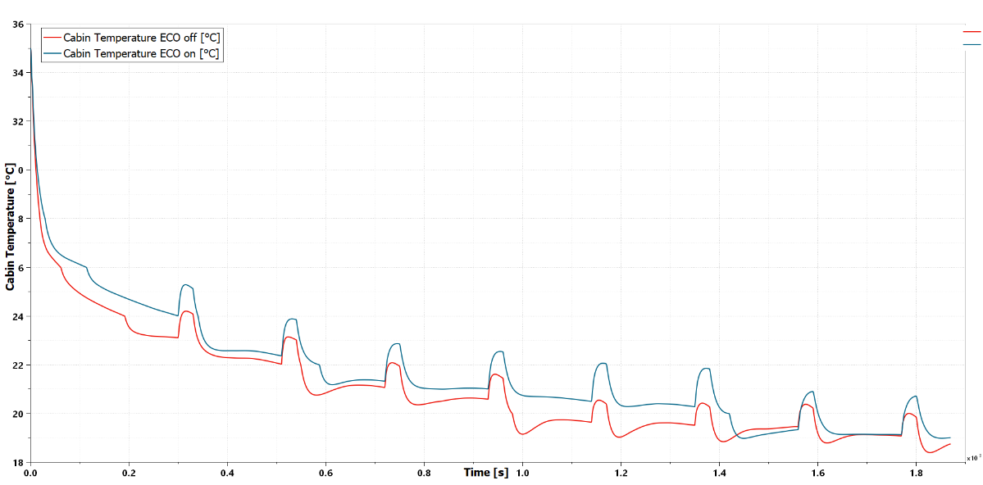
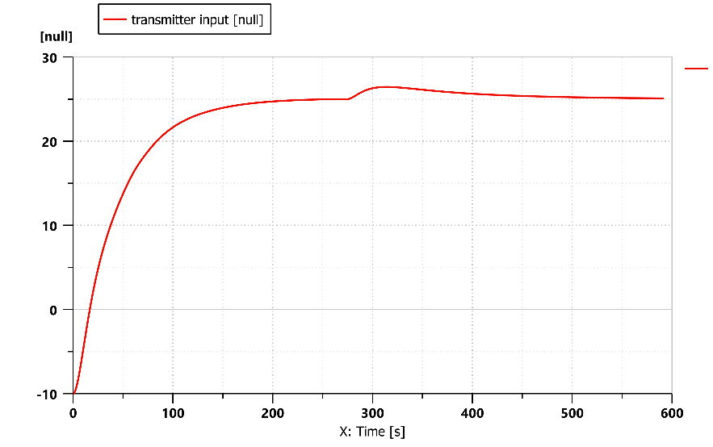
Design, Modelling, Simulation, Implementation, Testing and Validation of Advanced and Innovative Mechatronics System for Road Electric Vehicle’s Performances Improvement
Firenze, 13 Settembre 2020
Firenze, 13 Settembre 2020
Performed Activities
Auxiliary Power Management System
Energetic
UC: Fiat 500e
UC: Valeo
[20,21]
Heating
Cooling
Cabin Temperature
Cabin Temperature
PID-gain Intervention
Dead-zone intervention
Efficiency Improvement [%]
Ext.Temperature | Urban (430 s) | Extraurban (1045 s) | Highway (3330 s)
35°C (AC ON) | 5.16 % | 1.13 % | 0.26 %
10°C (AC ON) | 8.67 % | 4.04 % | 1.74 %
-10°C (AC ON) | 6.87 % | 2.92 % | 1.85 %
[P8] Smart Energy Management of Auxiliary Load for Electric Vehicles (2020)
[P11] 48V Electric Vehicle Powertrain Optimal Model-based Design Methodology (2020)
Notes:
Considering the relevant amount of energy required for cabin temperature regulation, a smart auxiliary power management system has been developed to increase vehicle efficiency. In particular, this control methodology can reduce thermal regulation system power demand, when limit conditions occur, e.g. low SOC or when traction system requires intensive power. In those scenarios, the so-called ECO mode will trigger. Acting on PID gain and admitted temperature dead zone, the auxiliary power management system can reduce the energy demanded by Heater and HVAC sub-components, both during heating and cooling phases. Increased drive range and efficiency improvement are achieved while ensuring acceptable levels of comfort for the users by exploiting cabin thermal inertia.

Slide 16

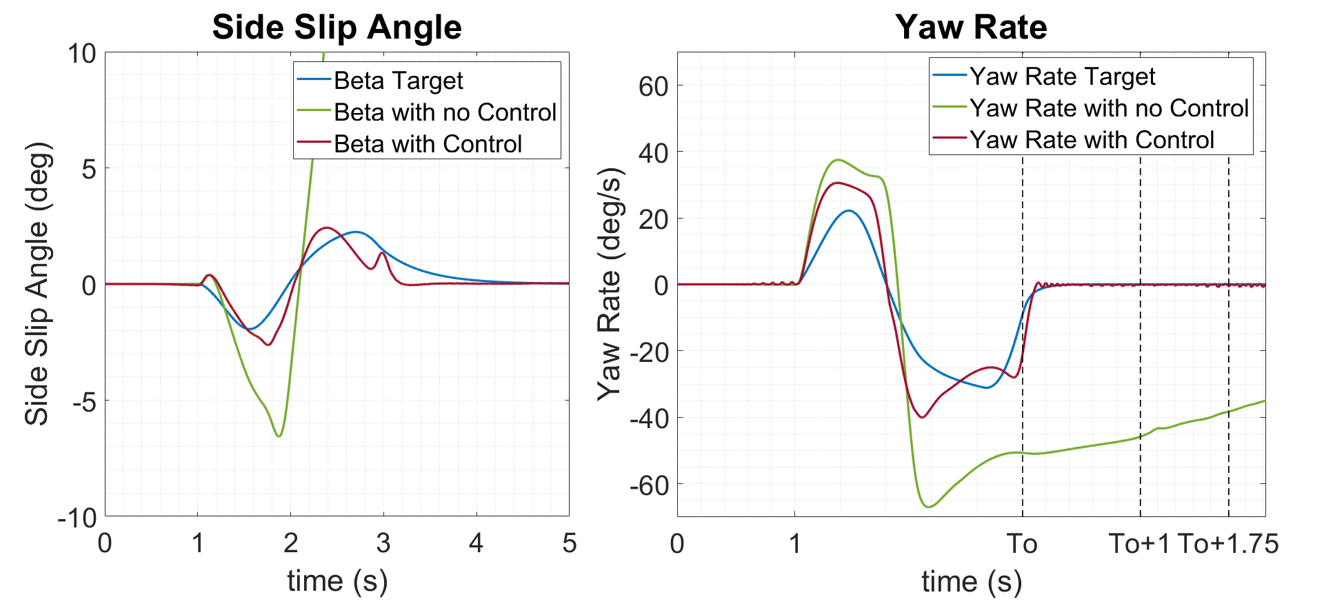
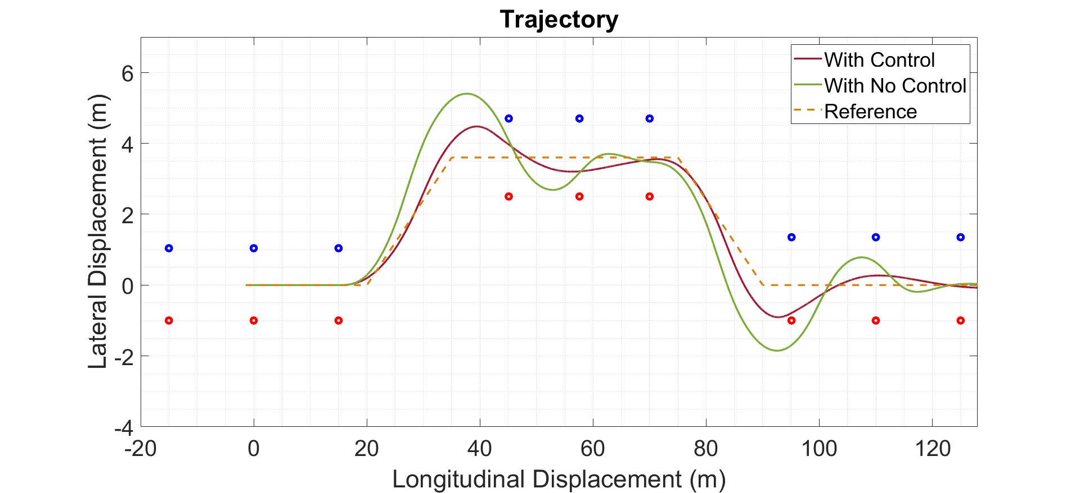
Design, Modelling, Simulation, Implementation, Testing and Validation of Advanced and Innovative Mechatronics System for Road Electric Vehicle’s Performances Improvement
Firenze, 13 Settembre 2020
Performed Activities
Moore-Penrose Pseudoinverse ESP
Stability
UC: Fiat 500e
[18,22,23,24,25]
Friction | ESC | Max Vx (km/h) | RMSE
1 | ON | 50 | 0.52
 | OFF | 40 | 0.78
0.7 | ON | 40 | 0.40
 | OFF | 30 | 0.53
0.5 | ON | 30 | 0.11
 | OFF | 30 | 0.28
[P2] Brake blending and optimal torque allocation strategies for innovative electric powertrains
[P7] ESC on In-Wheel Motors Driven Electric Vehicle: Handling and Stability Performances Assessment
[P12] Brake blending and torque vectoring of road electric vehicles: A flexible approach based on smart torque allocation
[P9] LQR State Estimator Coupled with Moore-PenrosePseudoinverse H∞ESC Strategy: In-WheelMotors driven Electric Vehicle co-simulation
Notes:
For the stability performances point of view, assuming that longitudinal efforts can be modulated separately on each wheel, is proposed and tested on reference manoeuvres, an ESP™ algorithm. This solution performs an advanced torque-vectoring technique, which resolves a multi-DOF constrained allocation problems by dispatching traction and braking torques, to let the vehicle follow as close as possible target sideslip angle and yaw moment.
This activity, performed in collaboration with another PhD student, couple an LQR State Estimator with Moore-Penrose Pseudoinverse ESC Strategy. Applied to an In-Wheel Motors driven Electric Vehicle, prove to be efficient and reliable, actually increasing the maximum speed at which the double lane change manoeuvre can be correctly executed, if compared with conventional vehicle solution. Also, increased longitudinal performances are achieved thanks to the presence of an ABS controller, integrated with optimized Electronic Braking Distribution controller, developed for Brake by wire systems.

Slide 17

Design, Modelling, Simulation, Implementation, Testing and Validation of Advanced and Innovative Mechatronics System for Road Electric Vehicle’s Performances Improvement
Firenze, 13 Settembre 2020
Performed Activities
Fuzzy Brake Blending Controller
Reliability/Safety
UC: Fiat 500e
[26]
NEDC Initial Condition: Tbatt=60°C; σ=2
Layout | Fuzzy BB | SOCf [%] | Ereg/Econs [%] | Cycle impact[%]
FWD | ON | 79,7 | 8,14 | 6,42
 | OFF | 80,1 | 16,23 | 6,90
4WD | ON | 79,9 | 10,85 | 6,57
 | OFF | 80,5 | 21,71 | 7,22
σ=1.5
σ=1
σ=2
NEDC Initial Condition: Tbatt=20°C; σ=1
Layout | Fuzzy BB | SOCf [%] | Ereg/Econs [%] | Cycle impact[%]
FWD | ON | 80,1 | 16,24 | 3,24
 | OFF | 80,2 | 16,28 | 3,45
4WD | ON | 80,5 | 21,72 | 3,40
 | OFF | 80,5 | 21,76 | 3,61
Severity Factor:
$$σ=\frac{{Ah}_{nom}}{\int_{0}^{t_{EOL}}{\left|i(t)\right|dt}}$$
[P6] Regenerative Fuzzy Brake Blending Strategy on Benchmark Electric Vehicle: the FIAT 500e
Notes:
Another version of the brake blending controller has been developed, using a probabilistic approach based on Fuzzy logic, to account both model-based and non-model-based aspects of the e-powertrain. Proposed controller aims at the coordination of the blending strategy, to guarantee an increased battery’s reliability and lifespan while ensuring the maximum energy recover by the electric braking.
To quantify the ageing effects, we consider the severity factor sigma, an indicator of the battery degradation respect to the nominal condition.
Results highlight how the proposed fuzzy controller could increase battery reliability and lifespan, selecting more conservative power constraints when limit conditions occur. However, the adopted solution reduces the overall energy which could be recovered from electric braking in those scenarios. So this strategy attempts to find an optimal comprise between energy regeneration and battery preservation.

Slide 18
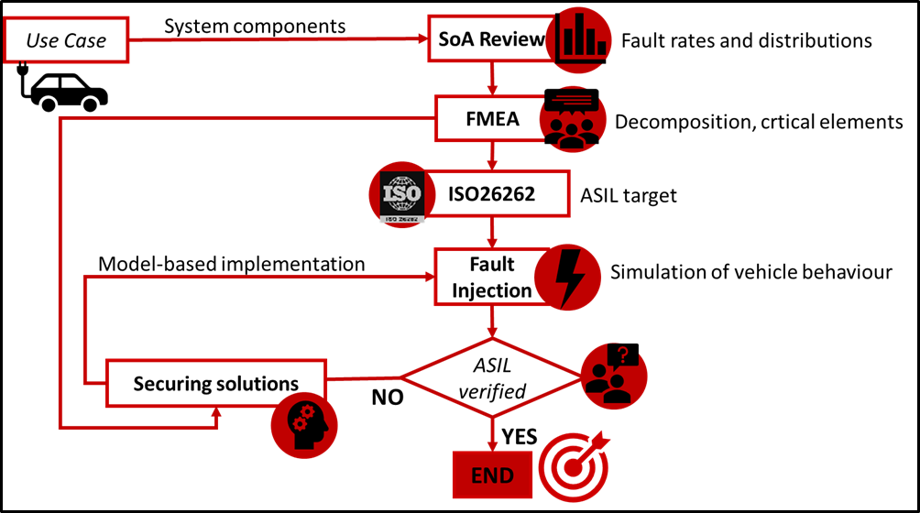


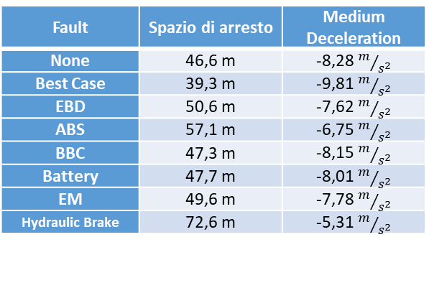
Design, Modelling, Simulation, Implementation, Testing and Validation of Advanced and Innovative Mechatronics System for Road Electric Vehicle’s Performances Improvement
Firenze, 13 Settembre 2020
Performed Activities
ISO 26262
Reliability/Safety
UC: Valeo
[27]
Fault | Spazio di arresto | Medium Deceleration
None | 46,6 m | -8,28 $m/{s^{2}}$
Best Case | 39,3 m | -9,81 $m/{s^{2}}$
EBD | 50,6 m | -7,62 $m/{s^{2}}$
ABS | 57,1 m | -6,75 $m/{s^{2}}$
BBC | 47,3 m | -8,15 $m/{s^{2}}$
Battery | 47,7 m | -8,01 $m/{s^{2}}$
EM | 49,6 m | -7,78 $m/{s^{2}}$
Hydraulic Brake | 72,6 m | -5,31 $m/{s^{2}}$
ASIL target | Random Hardware Failure [1/h] | ABS Failure [1/h]
C | <10⁻⁷ | <10⁻¹²
[P10] Functional safety and reliability for innovative vehicle braking system and integration with electric traction units (2020)
Notes:
A tool for the functional safety assessment of a target Brake-By-Wire system has been investigated. To reduce the development time while increasing system reliability and the a priori knowledge about its safety requirements, is proposed a systematic approach, in accordance with ISO 26262 standard, based on Virtual FMEA and multi-level Fault Injection techniques. Plant modification and securing strategy as been presented and implemented in a vehicle model, evaluating their performances in simulation environments, in order to meet target Automotive Safety Integrity Level.
Applied to the reference vehicle system, allow to verify the effectiveness of proposed securing solution, making vehicle fulfil standard specifications, for straight line deceleration manoeuvres.

Slide 19
Design, Modelling, Simulation, Implementation, Testing and Validation of Advanced and Innovative Mechatronics System for Road Electric Vehicle’s Performances Improvement
Firenze, 13 Settembre 2020
Future Developments
Today
Gantt Chart
 | First Year |  |  |  |  |  |  |  |  |  |  |  | Second Year |  |  |  |  |  |  |  |  |  |  |  | Third Year
UCs EV Data and Specs Exchange
Model Developments
Multi-level control strategy
Reliability Assessment (ISO26262)
Computational Optimization
Hardware in the Loop (Internship)
Post-processing Data and Thesis
1°
Y
E
A
R
 | First Year |  |  |  |  |  |  |  |  |  |  |  | Second Year |  |  |  |  |  |  |  |  |  |  |  | Third Year
UCs EV Data and Specs Exchange
Model Developments
Multi-level control strategy
Reliability Assessment (ISO26262)
Computational Optimization
Hardware in the Loop (Internship)
Post-processing Data and Thesis
2°
Y
E
A
R
Today
Notes:
Respect to the last year proposed Gantt chart, some modification occurs. The model development task is not yet finished, as well as reliability assessment activities, related to ISO26262. Multi level control strategy and computational optimization tasks are in time. Post-processing and thesis task is yet started, but, due to the global pandemic situation, I was unable to carry out my internship period. This activity must shift in the last year of my PhD activity.

Slide 20
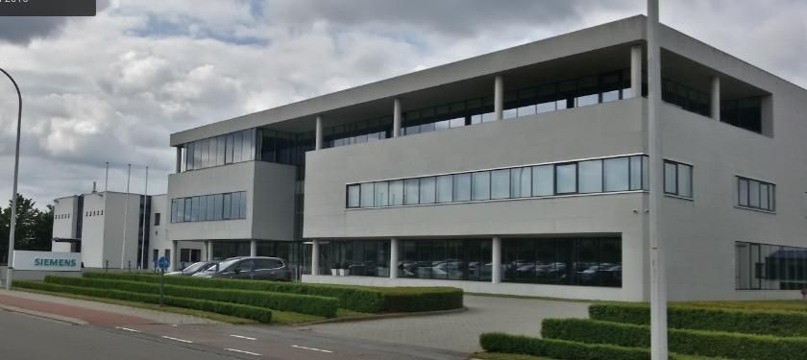
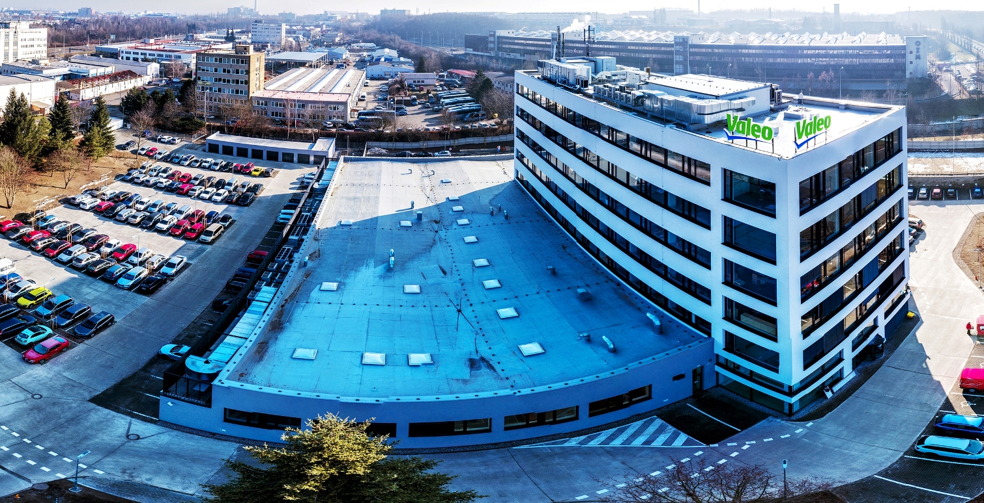
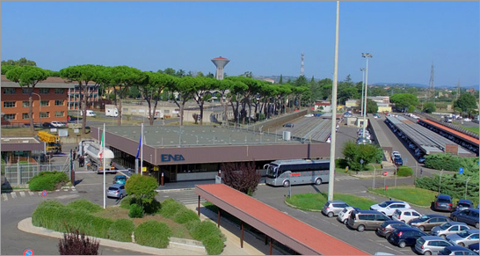

Design, Modelling, Simulation, Implementation, Testing and Validation of Advanced and Innovative Mechatronics System for Road Electric Vehicle’s Performances Improvement
Firenze, 13 Settembre 2020
Future Developments
Siemens R&D Centre (Belgium, Leuven)
Valeo (France, Paris)
ENEA (Roma, Casaccia)
Internship Period
Notes:
For the last year, I got in contact with ENEA and DICEA for a joint project with DIEF. This activity should be useful to apply acquired competencies on a prototypes of electric public transport vehicles that ENEA is developing within the research centre in Casaccia (Roma).
This allows me to perform experimental activities on the national territory, hoping in future the situations will allow me taking advantage of the numerous international connections that I have been able to set up during OBELICS Project.
A possible destination could be the Siemens laboratories of Leuven. The UC electric vehicle lends itself well for the implementation of the developed control solutions and assessment activities.
The proposed four IWM ESP strategy should be implemented in a vehicle with this traction architecture. Valeo (France, Paris) is proposing a vehicle with four independent traction wheels, so this could be also a possible destination for the internship.
Obviously, if international internship could not be possible due to the current pandemic situation, even the ENEA laboratories of Roma could be a feasible destination for hosting my activities.

Slide 21

PSPPI
Progetto e Sviluppo di
Prodotti e Processi Industriali
“Design, Modelling, Simulation, Implementation, Testing and Validation of Advanced and Innovative Mechatronics System for Road Electric Vehicle’s Performances Improvement”
Candidate: Tommaso Favilli
tommaso.favilli@unifi.it
Relatore: Prof. Marco Pierini
Co-Relatori: Prof. Luca Pugi, Ing. Lorenzo Berzi
Thank you for the attention!
Accademic Year: 2019-2020
Firenze, 13 Ottobre 2020

Slide 22
Design, Modelling, Simulation, Implementation, Testing and Validation of Advanced and Innovative Mechatronics System for Road Electric Vehicle’s Performances Improvement
Firenze, 13 Settembre 2020
Papers and Articles
Congressi internazionali:
[P1] Berzi L., Favilli T., Locorotondo E., Pierini M., Pugi L. (2019) Real-Time Models of Automotive Mechatronics Systems: Verifications on “Toy Models”. In: Carbone G., Gasparetto A. (eds) Advances in Italian Mechanism Science. IFToMM ITALY 2018. Mechanisms and Machine Science, vol 68. Springer, Cham
[P2] Pugi L., Favilli T., Berzi L., Locorotondo E., Pierini M. (2019) Brake Blending and Optimal Torque Allocation Strategies for Innovative Electric Powertrains. In: Saponara S., De Gloria A. (eds) Applications in Electronics Pervading Industry, Environment and Society. ApplePies 2018. Lecture Notes in Electrical Engineering, vol 573. Springer, Cham
[P3] L. Pugi, T. Favilli, L. Berzi, E. Locorotondo and M. Pierini, "Application of Regenerative Braking on Electric Vehicles," 2019 IEEE International Conference on Environment and Electrical Engineering and 2019 IEEE Industrial and Commercial Power Systems Europe (EEEIC / I&CPS Europe), Genova, Italy, 2019, pp. 1-6.
DOI: 10.1109/EEEIC.2019.8783318
[P4] Berzi L., Favilli T., Pugi L., Pierini M., "Brake Blending Strategy on Electric Vehicle, Co-simulation Between MATLAB Simulink® and Simcenter Amesim™”, °2019 IEEE 5th International Forum on Research and Technologies for Society and Industry (RTSI 2019) Proceedings, Firenze, Italy, 2019, pp. 308-313.
[P5] T. D’hondt et al., ‘Modeling and Identification of an Electric Vehicle Braking System: Thermal and Tribology Phenomena Assessment’, Apr. 2020, pp. 2020-01–1094, DOI: 10.4271/2020-01-1094.
[P6] T. Favilli, L. Pugi, L. Berzi, M. Pierini, and N. Tobia, ‘Regenerative Fuzzy Brake Blending Strategy on Benchmark Electric Vehicle: the FIAT 500e’, in 2020 IEEE International Conference on Environment and Electrical Engineering and 2020 IEEE Industrial and Commercial Power Systems Europe (EEEIC / I&CPS Europe), Madrid, Spain, Jun. 2020, pp. 1–6, DOI: 10.1109/EEEIC/ICPSEurope49358.2020.9160584.
[P7] M. Montani et al., ‘ESC on In-Wheel Motors Driven Electric Vehicle: Handling and Stability Performances Assessment’, in 2020 IEEE International Conference on Environment and Electrical Engineering and 2020 IEEE Industrial and Commercial Power Systems Europe (EEEIC / I&CPS Europe), Madrid, Spain, Jun. 2020, pp. 1–6, DOI: 10.1109/EEEIC/ICPSEurope49358.2020.9160768.
[P8] L. Berzi et al., ‘Smart Energy Management of Auxiliary Load for Electric Vehicles’, in 2020 IEEE International Conference on Environment and Electrical Engineering and 2020 IEEE Industrial and Commercial Power Systems Europe (EEEIC / I&CPS Europe), Madrid, Spain, Jun. 2020, pp. 1–6, DOI: 10.1109/EEEIC/ICPSEurope49358.2020.9160762.
[P9] Favilli T., Montani M., Berzi L., Capitani R, Pierini M., Pugi L., Annicchiarico C., ‘LQR State Estimator Coupled with Moore-Penrose Pseudoinverse H∞ESC Strategy: In-Wheel Motors driven Electric Vehicle co-simulation’, in IEEE Transactions on Industry Applications (TIA) [UNDER REVIEW]
[P10] Favilli T., Delogu M., Pugi L., Berzi L., ‘Functional safety and reliability for innovative vehicle braking system and integration with electric traction units’, in IOP Conference Series [UNDER REVIEW]
[P11] 48V Electric Vehicle Powertrain Optimal Model-based Design Methodology (2020) [UNDER REVIEW]
Riviste internazionali con referee:
[P12] L. Pugi, T. Favilli, L. Berzi, E. Locorotondo, and M. Pierini, ‘Brake blending and torque vectoring of road electric vehicles: a flexible approach based on smart torque allocation’, IJEHV, vol. 12, no. 2, p. 87, 2020, DOI: 10.1504/IJEHV.2020.106339.

