Slide 1
1st Year Presentation - 07/10/2020
Development of uncertainty quantification-based methodologies for robust design and optimization of high temperature components of turbomachines
Candidate:
Alberto Amerini
Tutor: Coordinatore:
Prof. Bruno Facchini Prof. Giampaolo Manfrida
Co-Tutor:
Dott. Ing. Antonio Andreini
Dottorato in Ingegneria Industriale - Ciclo XXXV - Energetica e Tecnologie Industriali ed Ambientali Innovative

Slide 2
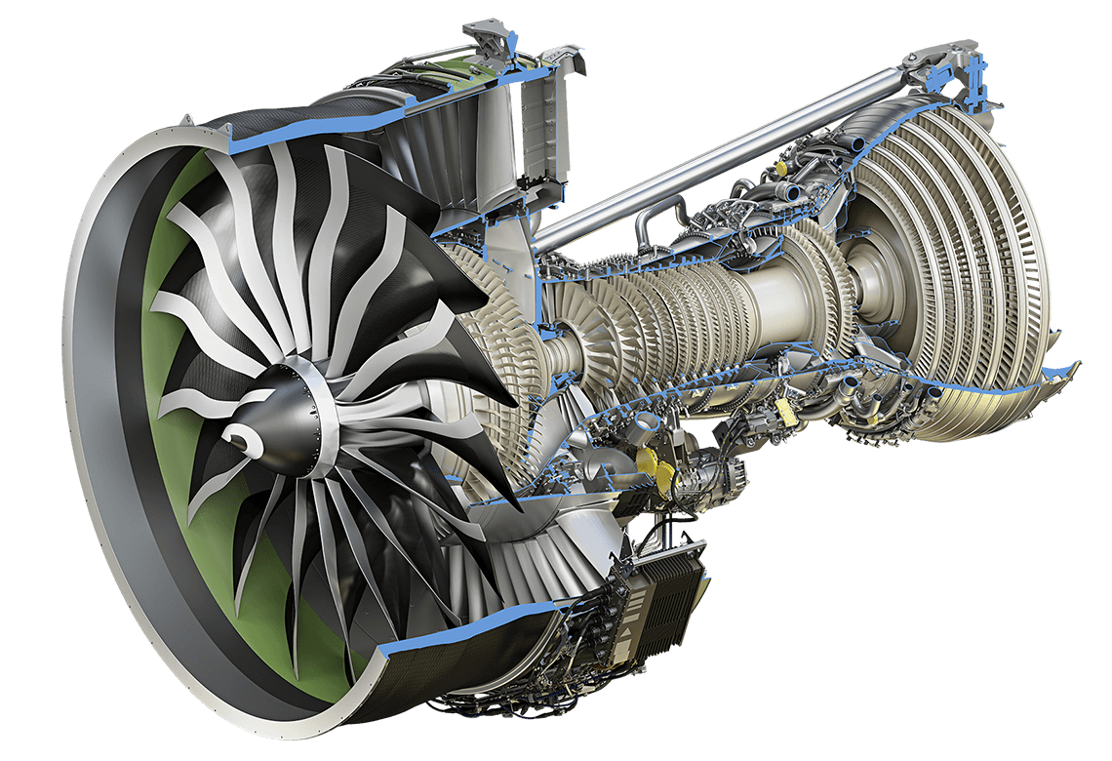
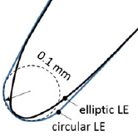


Uncertainty in turbomachinery
Numerical simulations in the turbomachinery area are often a deterministic exercise
Sand & Ice erosion:
  Clearence up to $65\%$
  Tip chord reduced up to $10\%$
  Pressure rise reduction $\sim 10\%$
  [A. Ghenaiet 2005]
Combustor & HPT
  Geometric tolerance
  Boundary condition
  [C. Stimpson 2017]
Compressor blade
  A $0.02mm$ LE variation can produce a $30\%$ increase of pressure loss
  [A.P. Wheeler 2009]
  [R.S. Bunker 2009]

Slide 3
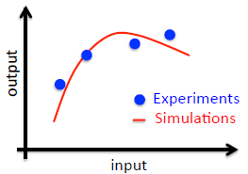
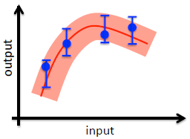
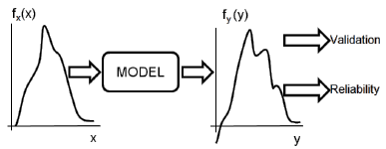
Uncertainty Quantification
A set of methodologies that allow to quantify the propagation of uncertainty within numerical codes
Deterministic Approach
Probabilistic Approach
UQ
The objective is the estimation of the PDF of the output quantities

Slide 4
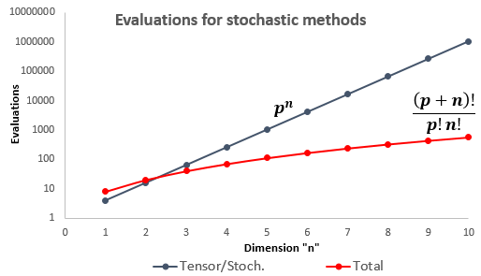
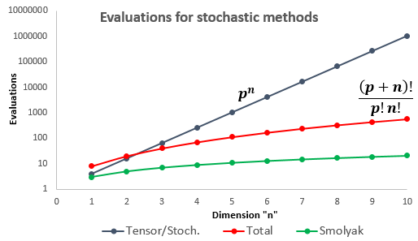
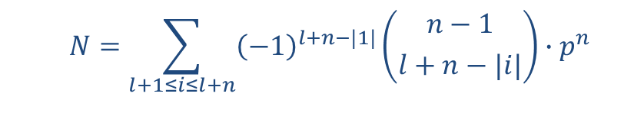
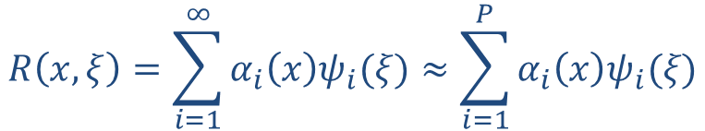
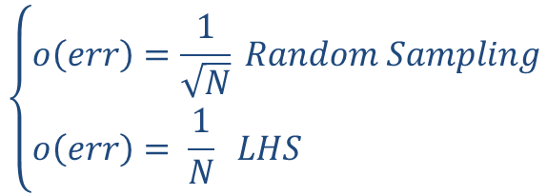

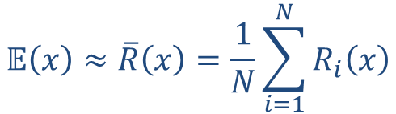
Methodologies
$$𝔼\left(x\right)≈\overline{R}\left(x\right)=\frac{1}{N}\sum_{i=1}^{N}{R_{i}\left(x\right)}$$
Monte Carlo
$$\left\{\begin{aligned}o\left(err\right)=\frac{1}{\sqrt{N}} Random Sampling \\ o\left(err\right)= \frac{1}{N} LHS \end{aligned}\right.$$
$\overline{R}(x)⟶𝔼\left(x\right)$ , for $N⟶∞$
Stochastic Methods
Polynomial coefficients
  Polynomial chaos
    Total order
    Tensor quadrature (Gauss grid)
  Stochastic collocation
  Smolyak grid
$$R\left(x,ξ\right)=\sum_{i=1}^{∞}{α_{i}\left(x\right)ψ_{i}(ξ)≈\sum_{i=1}^{P}{α_{i}\left(x\right)ψ_{i}(ξ)}}$$
Polynomial basis functions
  $$N=\sum_{l+1≤i≤l+n}{{\left(−1\right)}^{l+n−|1|}\left({n−1 \atop l+n−|i|}\right)∙p^{n}}$$
  Curse of dimensionality

Slide 5


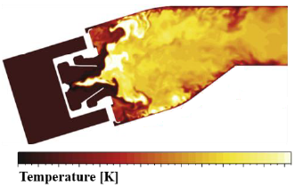


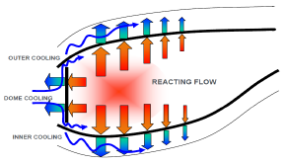
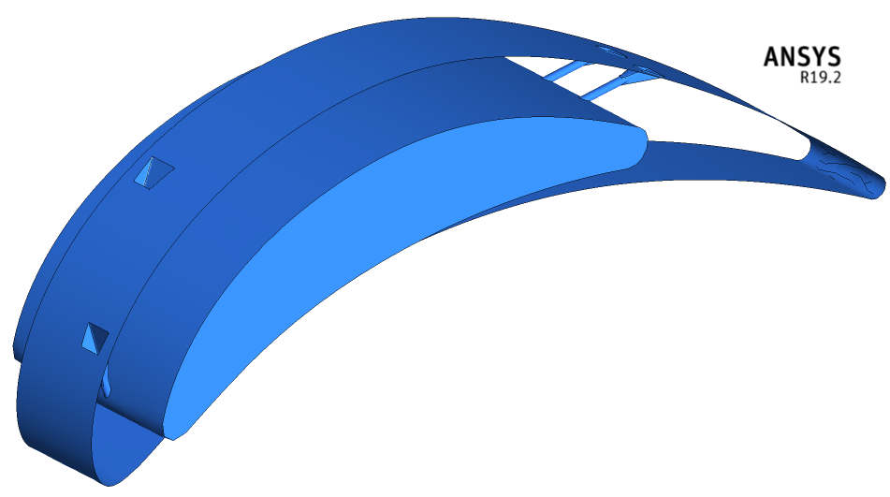
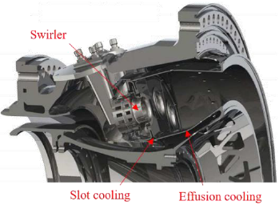
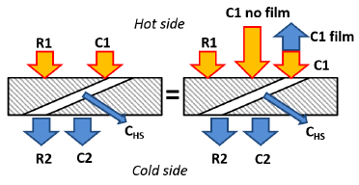

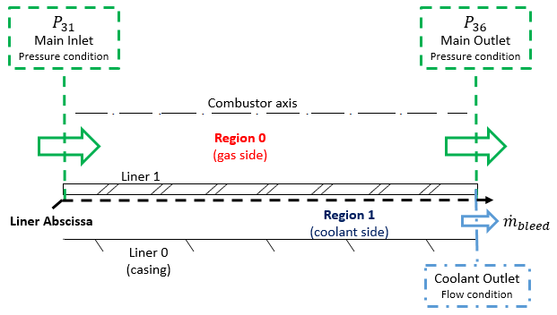

Objectives and test case
Validation of UQ methods with DAKOTA
1D application $⟶$ Therm1D
3D application $⟶$ Film cooling performance
Test case

Slide 6
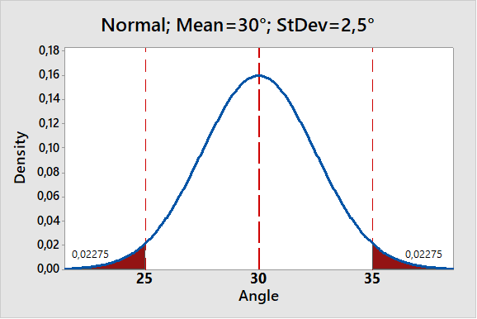
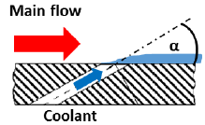
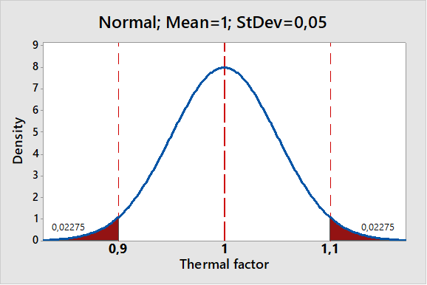
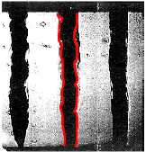
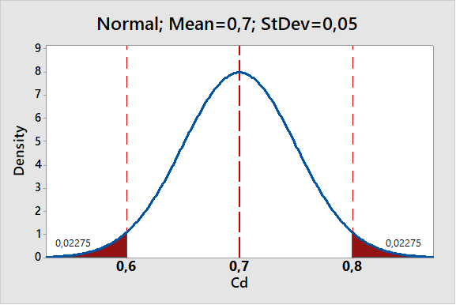
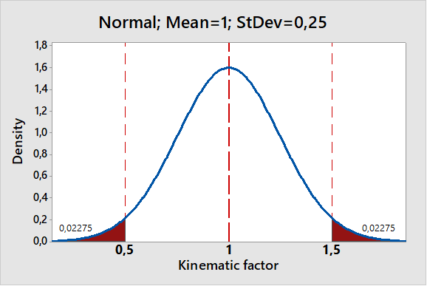




Uncertain variables
Different types of analyses have been conducted
HTC tuning factor analysis
  $HTC_{cold}$
  $HTC_{hs}$
  $HTC_{hot}$
Overall analysis
  7 variables
  Smolyak grid validation
  Sensitivity analysis
Geometric analysis
  Angle
  Cd
Buondary conditions analysis
  ${BC}_{1}→$Thermal quantities
    $T_{gas}, T_{rad},FAR$
  ${BC}_{2}$ $→$Kinematic quantities
    $v,ρv$
 |  | Geo | HTC | BC | Overall
Monte Carlo |  | 10-100-1000 | 1000 | 1000 | 50-100-250-500-1000
Tensor/Stoch ord. 1 |  | 4 | 8 | 4 | 128
Tensor/Stoch ord. 2 |  | 9
Tensor/Stoch ord. 3 |  | 16
Tot ord.2 | c.r.=1 | 6
 | c.r.=2 | 12 | 20 | 12 | 72
Tot ord.3 | c.r.=1 | 10
 | c.r.=2 | 20
Tot ord.4 | c.r.=2 | 30
Smolyak level 1 |  |  |  |  | 15
Smolyak level 2 |  |  |  |  | 128
Smolyak level 3 |  |  |  |  | 807
$$HTC_{hot}$$
$$HTC_{cold}$$
$$H{TC}_{hs}$$

Slide 7


Interface script
An interface has been developed to allow DAKOTA to interact with Therm1D
A script has been written to process the output data
Python
Post process
DAKOTA
Output File
DAKOTA
Input File
Yes
Sampling
No
DAKOTA
Results
File
$N_{i}=N_{Tot}$
Interface
Run
dprepro.py
Run
Read_Tw.py
Therm-1D
Therm-1D
Input File
Therm-1D
Output File

Slide 8
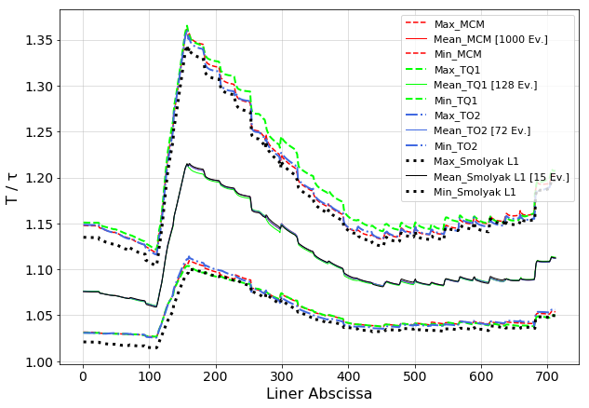
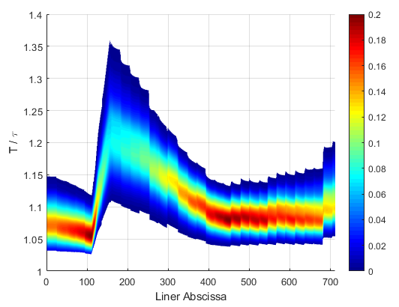
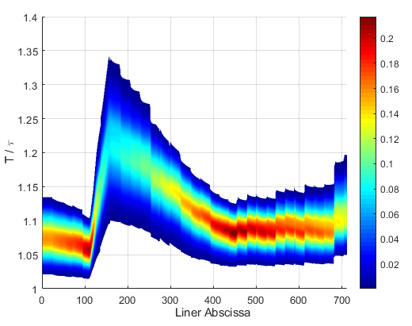
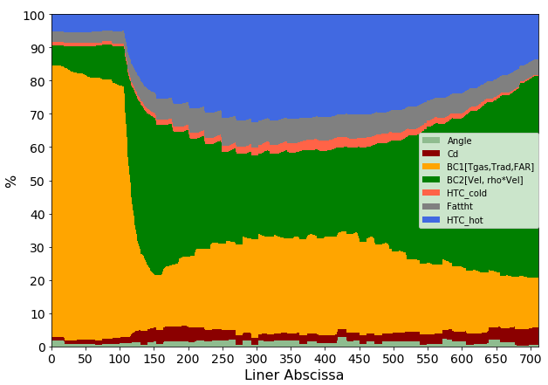
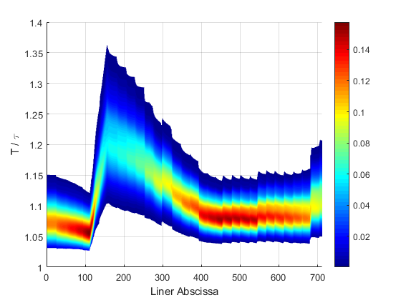
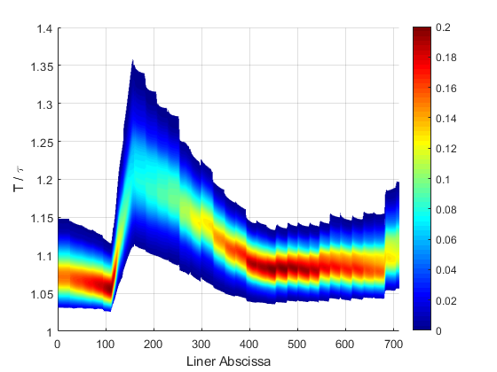
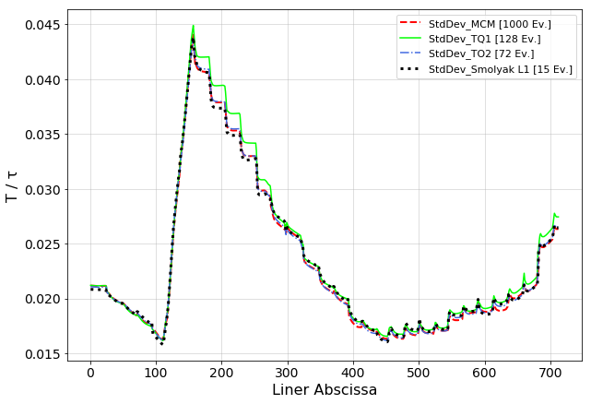


Results – Smolyak grid
Sensitivity analysis
$$S_{i}=\frac{Var\left[E(Y|x_{i})\right] }{Var(Y)}⇒\sum_{i=1}^{n}{S_{i}=1}$$
Maximum variability of 60%
MC
SG
TQ
TO
Three variables have the greatest influence: $BC_{1}$,$BC_{2}$ and $HTC_{hot}$
Greater impact due to thermal quantities
The output is dominated by the kinematic quantities

Slide 9
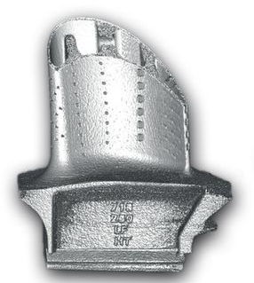
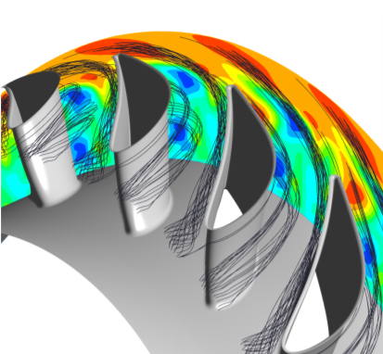
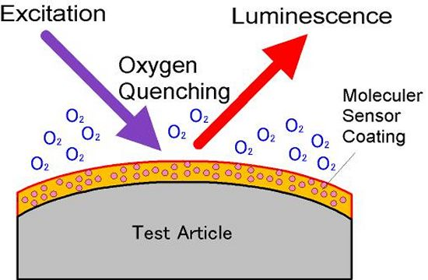
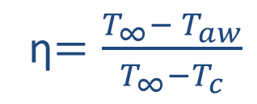
Objectives and test case
Validation of UQ methods with DAKOTA
1D application $⟶$ Therm1D
3D application $⟶$ Film cooling performance
EDM
Numerical support for validation of experimental data
Uncertainty quantification analysis on a high fidelity CFD model
Show how geometric parameters affect the heat transfer
Additive Manufacturing
High temperatures reduce the integrity
of turbine structural components.
Film cooling
Adiabatic Effectiveness
Heat transfer measure:
Infrared thermography
ƞ$=\frac{T_{∞}− T_{aw}}{T_{∞}−T_{c}}$
Heat-mass anology:
PSP
(Pressure Sensitive Paint)

Slide 10
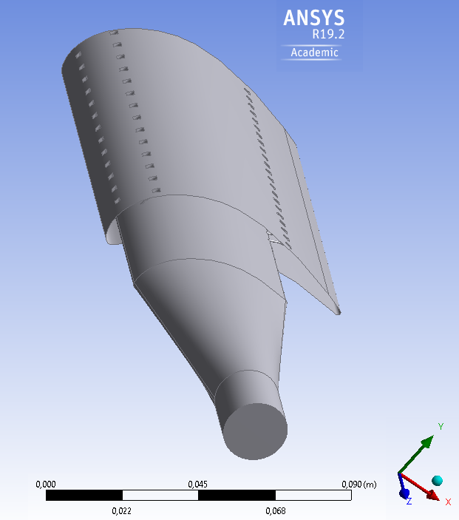

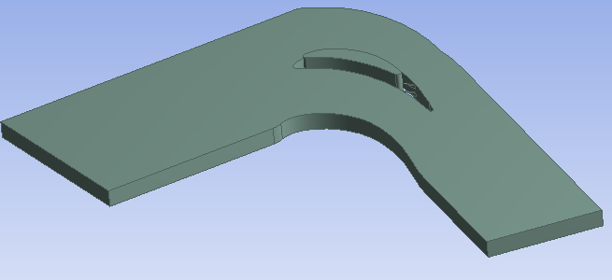
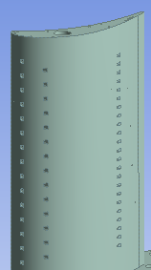
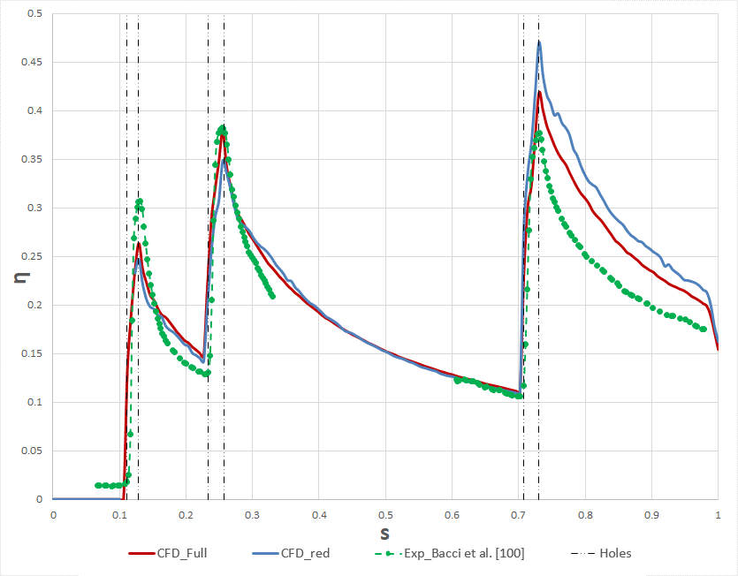


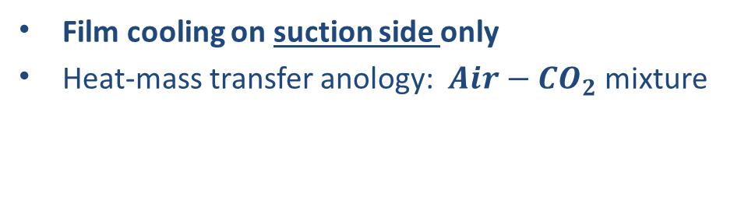
Methodology – numerical setup
REDUCED GEOMETRY
Mesh
Full 3D | Reduced
20.5M | 3M
FULL 3D
Film cooling on suction side only
Heat-mass transfer anology: $Air−{CO}_{2}$ mixture
RANS Approach
Turbolence model: k-ω SST
Second order discretization
${BC}_{s}$: imposed pressure
Periodicity
${CO}_{2 }out$let

Slide 11


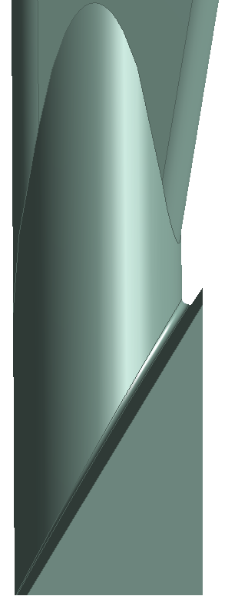
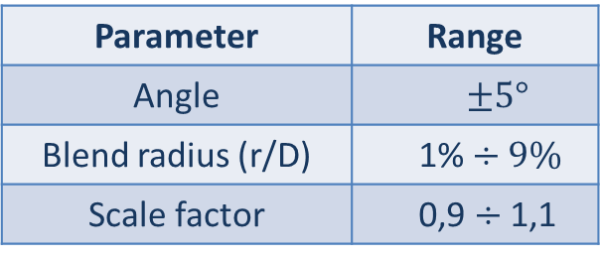
Methodology - Geometry
Uncertain variables: angle, fillet radius and scale factor
Outputs: effectiveness on SS, BR and Cd
UQ analysis with tensor quadrature methology
  8 simulation needed
Parametric CAD to modify:
Angle of the hole
Blend radius
Hole scale
Methodology:
Geometry
Parameters
Mesh
Numerical Setup
Uncertainty
Quantification
Parameter | Range
Angle | $$±5°$$
Blend radius (r/D) | 1% $÷9\%$
Scale factor | 0,9 $÷$ 1,1
{
Normal distribution
(1.)
(2.)
(3.)

Slide 12
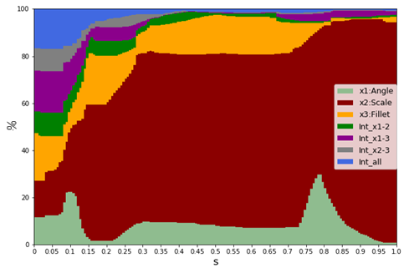
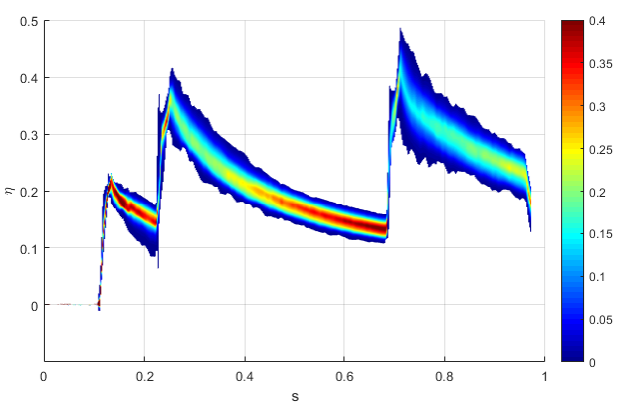





Results - Adiabatic Effectiveness
UQ analysis8 simulations required
  PCE method
GAUSS GRID
 | DP0 | DP7
ANGLE | -2,1991$°$ | 2,1991°
BLEND RADIUS | 1,9445E-5 m | 4,055E-5 m
SCALE FACTOR | 0,956 | 1,044
PDF
$$η$$
Uncertainty 
DP0
η
DP7
Uncertainty 
s

Slide 13











Results - Blowing Ratio & Cd
$BR=\frac{ρ_{c}v_{c}}{ρ_{∞}v_{∞}}$
  Simulation without film cooling$→$ isentropic mach number
  Isentropic relations and perfect gases law $→$ $ρ_{∞},v_{∞}$
$C_{d}=\frac{\dot{m}}{P_{0,c}{\left(\frac{P_{∞}}{P_{0,c}}\right)}^{\frac{γ+1}{2γ}}\sqrt{\frac{2γ}{\left(γ−1\right)RT_{0,c} }\left({\left(\frac{P_{0,c}}{P_{∞}}\right)}^{\frac{γ−1}{γ}}−1\right)}\frac{π}{4}D^{2} }$

Slide 14
Conclusions & Publications
DAKOTA has proved functional for 1D and 3D applications performed
Stochastic methods are efficient compared to Monte Carlo method
Sensitivity analysis determines the impact of uncertainties on the outputs through quantitative indices
Future works
  Apply UQ methods to other test cases
  Use DAKOTA for robust design and optimization applications
  Development of a standard procedure to use the results of the UQ analysis to update the design project
National conferences
  Gamannossi, A., Amerini, A., Poggiali, M., Elmi, C. A., Mazzei, L., & Andreini, A. (2019, December). Uncertainty quantification of an aeronautical combustor using a 1-D approach. ATI 2019 In AIP Conference Proceedings (Vol. 2191, No. 1, p. 020083). AIP Publishing LLC.
  Poggiali, M., Gamannossi, A., Langone, L., & Amerini, A. (2019, December). Civil aero-engine performance prediction using a low-order code and uncertainty quantification estimation. ATI 2019. In AIP Conference Proceedings (Vol. 2191, No. 1, p. 020130). AIP Publishing LLC.
International conferences
  Gamannossi, A., Amerini, A., Poggiali, M., Elmi, C. A., Mazzei, L., & Andreini, A. “Application of uncertainty quantification methods to the prediction of effusion cooled combustor liner temperature”. ASME Turbo Expo 2020 Turbomachinery Technical Conference and Exposition GT2020 September 2020
International journals
  Gamannossi, A., Amerini, A., Mazzei, L., Bacci, T., Poggiali, M., & Andreini, A. (2020). Uncertainty Quantification of Film Cooling Performance of an Industrial Gas Turbine Vane. Entropy, 22(1), 16.

Slide 15
1st Year Presentation - 07/10/2020
Development of uncertainty quantification-based methodologies for robust design and optimization of high temperature components of turbomachines
Candidate:
Alberto Amerini
Tutor: Coordinatore:
Prof. Bruno Facchini Prof. Giampaolo Manfrida
Co-Tutor:
Dott. Ing. Antonio Andreini
Dottorato in Ingegneria Industriale - Ciclo XXXV - Energetica e Tecnologie Industriali ed Ambientali Innovative

