Slide 1
C14-SCAR
Technology transfer
of a new methodology
for radiocarbon measurement
Candidate:
Carcione Federico
Tutor:
Prof. Bruno Facchini
Co-tutor:
Dott. Saverio Bartalini
07/10/2020

Slide 2
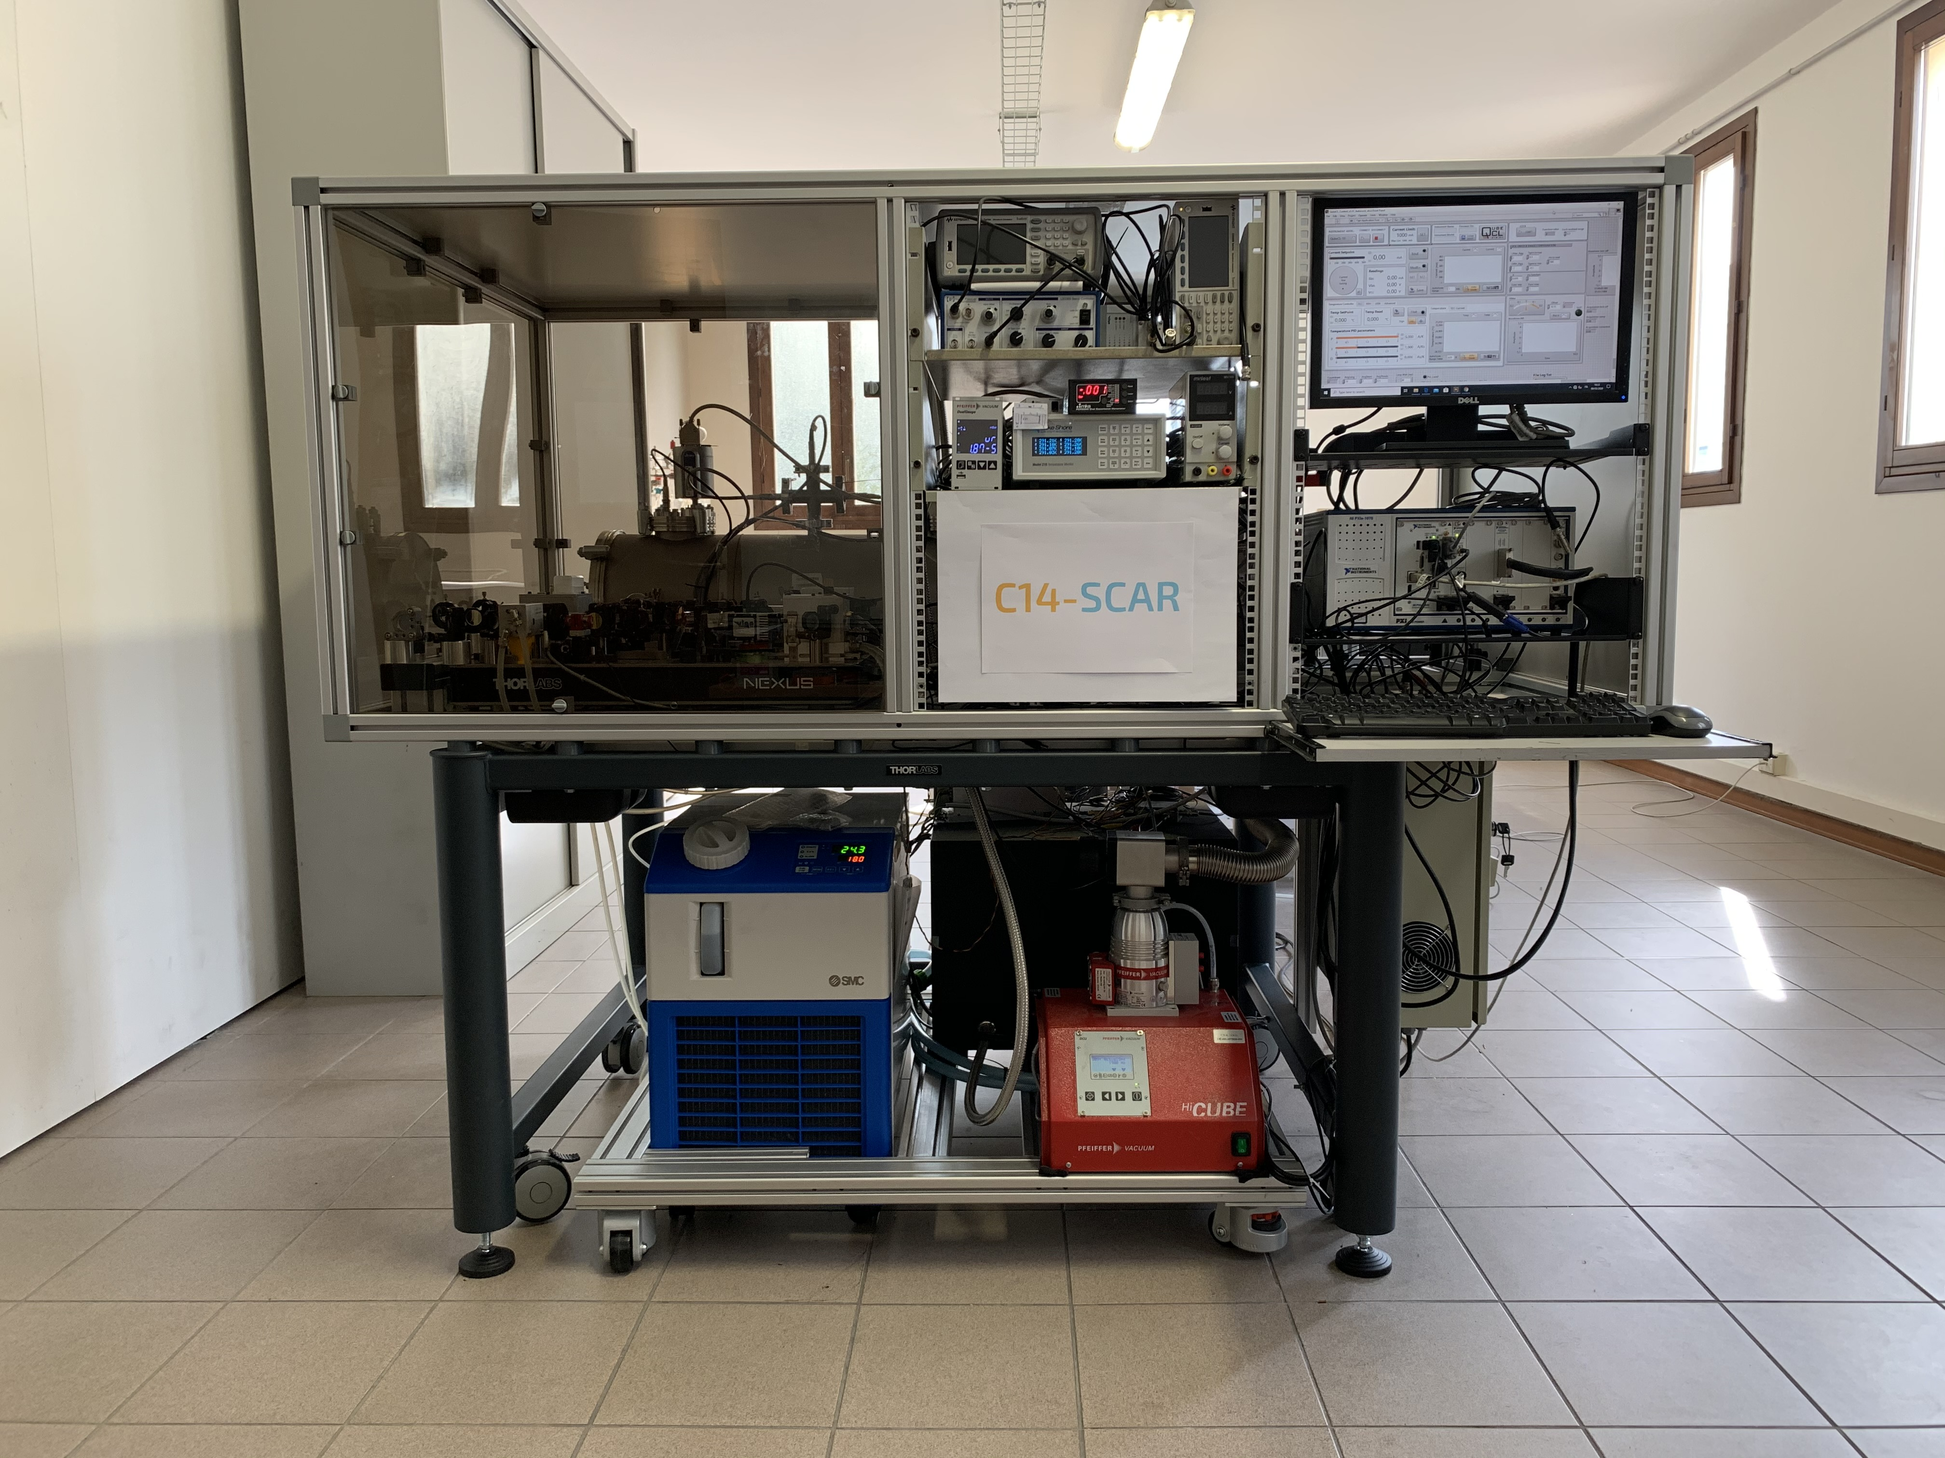
C14-SCAR
07/10/2020
Overview on first year of PhD
STATE OF THE ART
Basic optics;
Basic Infrared spectroscopy.
C14-SCAR: Saturated absorption Cavity Ringdown
GOALS
Technology transfer of a new method for radiocarbon detection;
Engineering the C14-SCAR prototype (TRL 4);
Performance tests;
Identifying repeatable and standardizable procedures.

Slide 3
C14-SCAR
07/10/2020
Radiocarbon (¹⁴C) and its applications
14C is a carbon isotope that is present in nature with a very low concentration (1 atom every 1,000 billion) and the half-life is 5,700 years.
It is produced:
by nature (cosmic rays in the stratosphere);
by human interventions (nuclear tests).
This isotope can be exploited in a variety of applications:
Biomedical use;
Radiocarbon dating;
Monitoring of the environmental pollution due to fossil C0₂;
Measurement of radiocarbon radioactivity in nuclear waste repositories;
Measurement of the bio/fossil fraction in fuel blends.

Slide 4
C14-SCAR
07/10/2020
Biofuel and C14-SCAR
In recent years, reducing CO2 emissions has become an urgent aim in several sectors, e.g. transport. One of the possible ways to achieve the goal of reducing these emissions relies on biofuels.
In next years, the possibility for manufacturers and certifying agencies to have at their disposal a relatively cheap and transportable instrument able to measure the 14C amount in fuels will become extremely important.
The measurement of the 14C isotope concentration in fact allows a simple method for certifying if the fuel under analysis has biological origin.
C14-SCAR is a perfect example of the concept of technology transfer: starting from the laboratory prototype (TRL 4), the ppqSense team is working to obtain a validated technology in an operational environment (TRL 9).
At that point this new methodology will be competitive with the main technology presently used for radiocarbon analysis: Accelerator Mass Spectrometry (AMS)

Slide 5
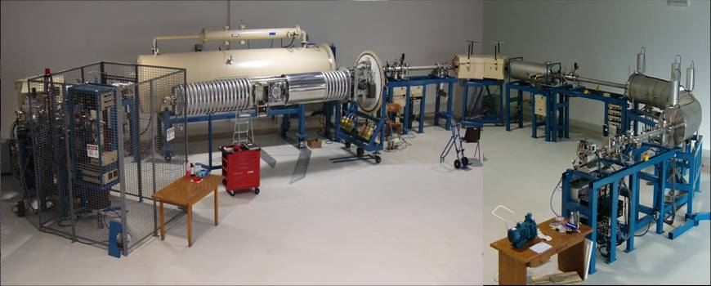
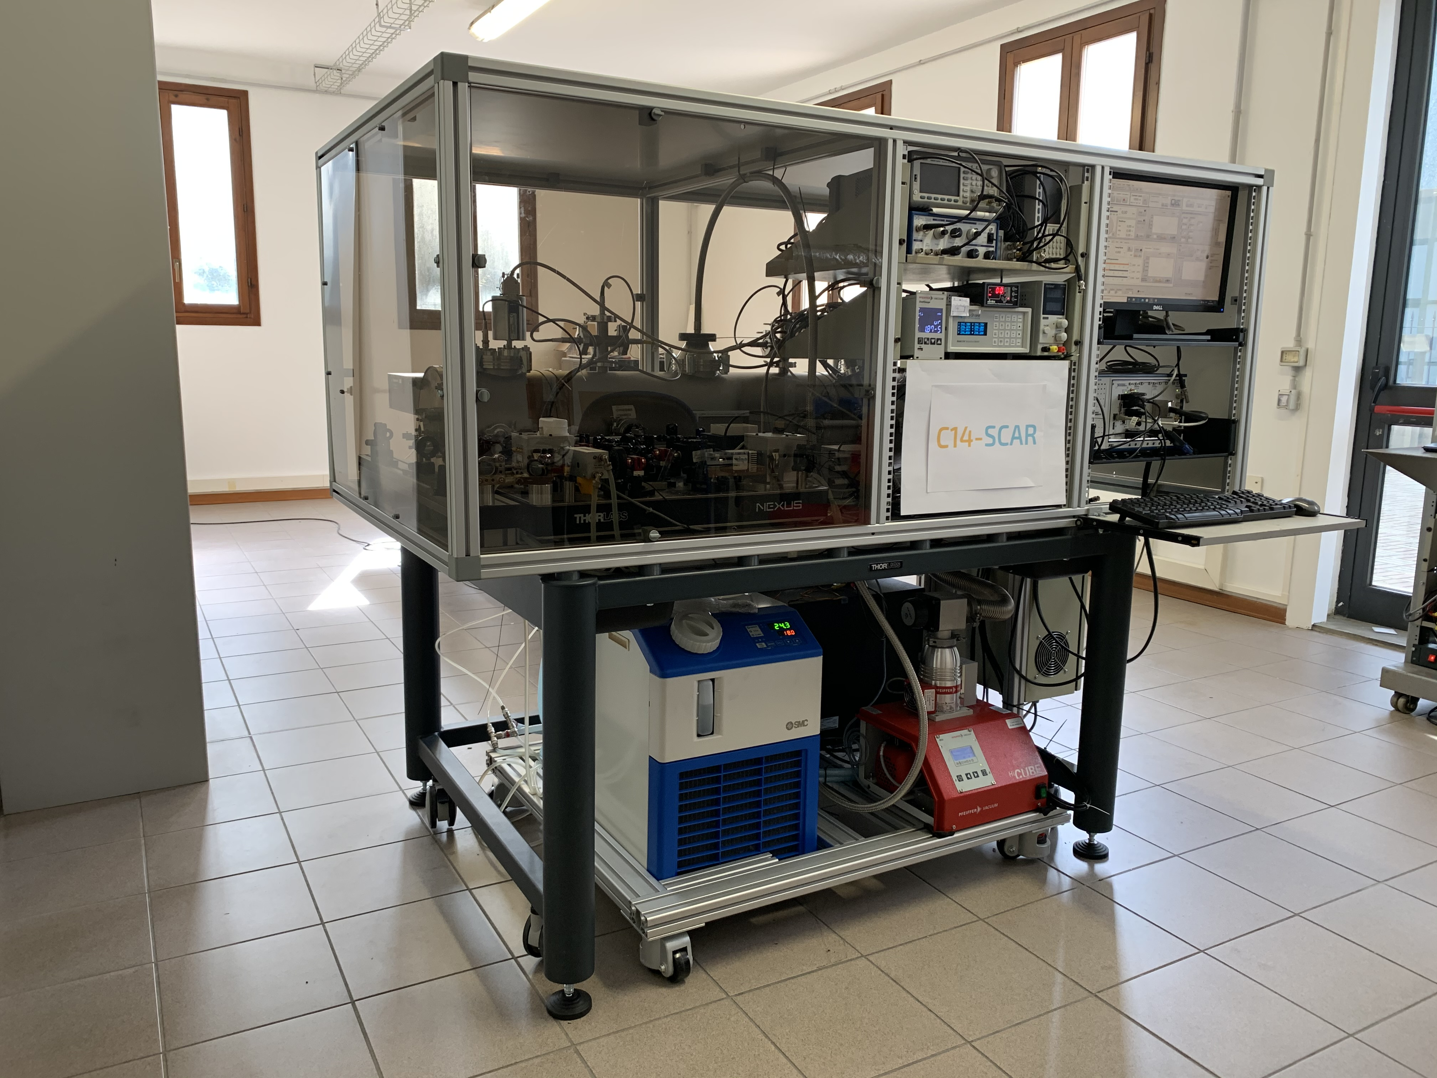
C14-SCAR
07/10/2020
C14-SCAR vs AMS
 | AMS | SCAR
¹⁴C detection method | ¹⁴C ion count | absorbed photons
C mass (mg) | <1 | ~6
Sample material | C+Fe | CO₂
Measurement repeatability | No | Yes
Background and/or Interferences | ¹³CH ¹²CH₂ | ¹³CO₂ (T>170 K) N₂O (>0.3 ppb) O₃ (>10 ppm)
Measurement time (h) | ~1 | ~2
Precision for modern samples (pMC) | ~0.2 | ~0.5
Limiting factor | Poisson statistics | α_{min}
Footprint (m²) | 7 - 200 | ~2
Cost (k€) | 700 - 5 000 | ~600
Accelerator Mass Spectrometry
Saturated absorption Cavity Ringdown

Slide 6
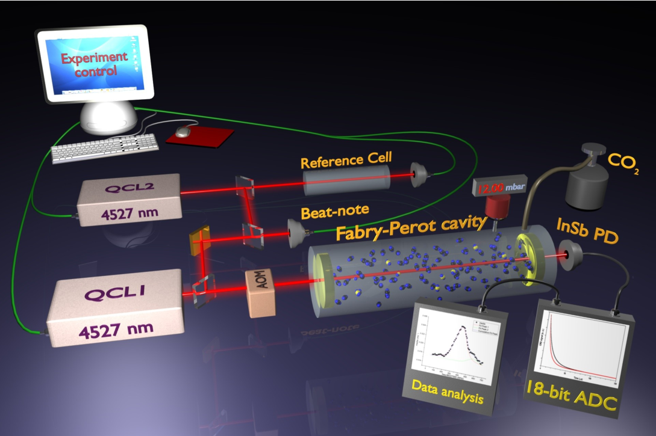
C14-SCAR
07/10/2020
C14-SCAR schematics

Slide 7
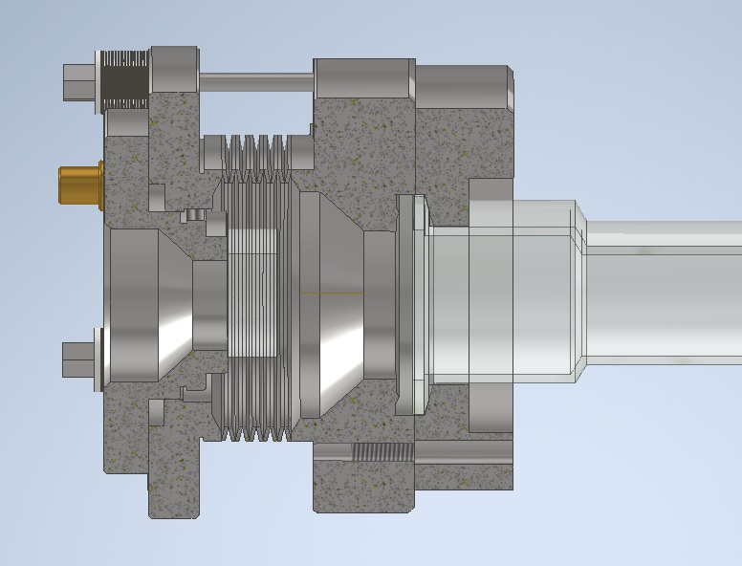
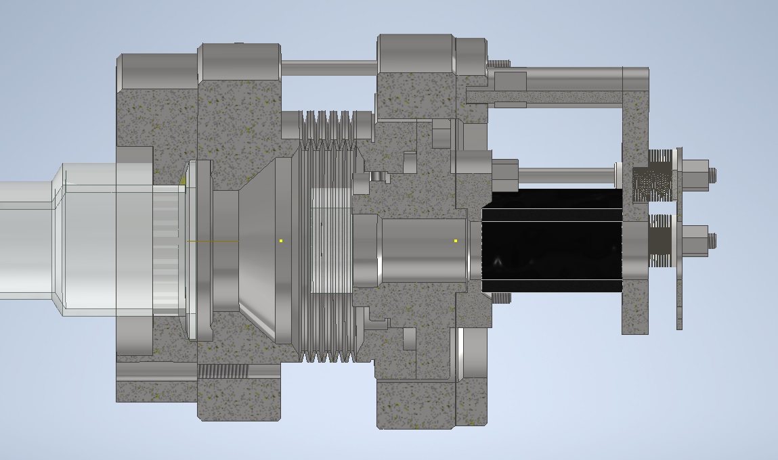
C14-SCAR
07/10/2020
Internal cavity
Section view of the internal cavity
10 µm
Left side internal cavity section
Right side internal cavity section

Slide 8

C14-SCAR
07/10/2020
Performance tests and standardizable procedures
Checking the proper behaviour of new mechanical solutions,
such as glues or energized o-rings;
Reaching good vacuum levels in the internal cavity;
Checking the proper behaviour of the system at temperature T=170 K;
Checking the correct vacuum sealing of mirrors at 170 K;
Ensuring the purely axial movement of the piezoelectric actuator.
These tests then became operational, repeatable procedures for the assembly of the instrument.

Slide 9
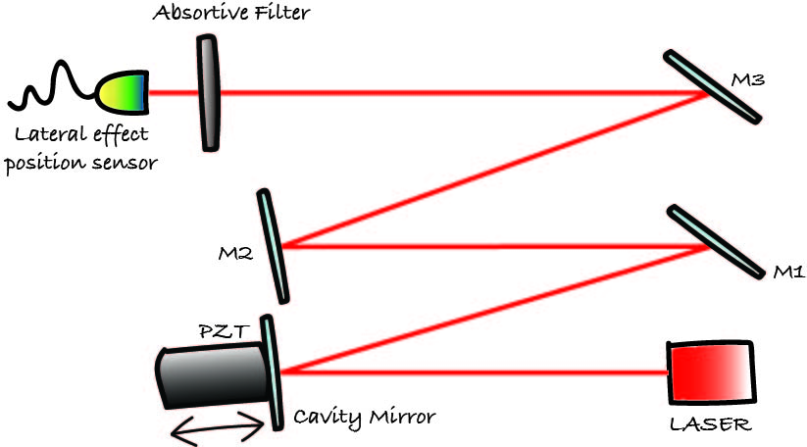
C14-SCAR
07/10/2020
Example: testing the piezoelectric actuator
I prepared the optical setup for the measure and then I find the optimal compression for Piezoelectric actuator.
Optical setup

Slide 10
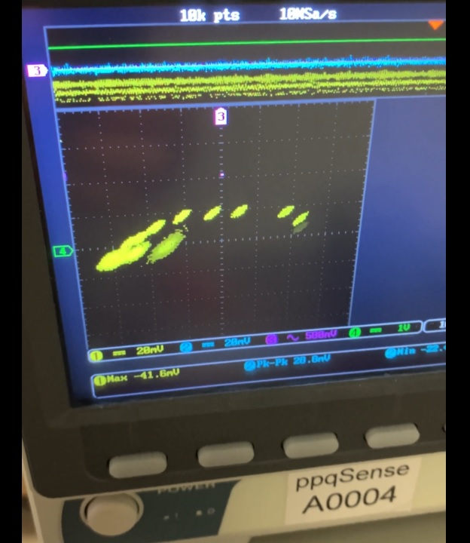
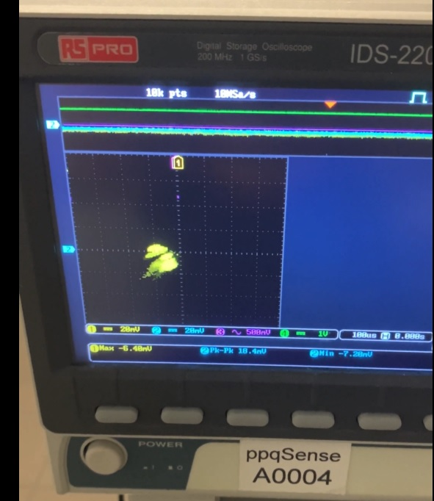
C14-SCAR
07/10/2020
Example: testing the piezoelectric actuator
X and Y position of a reflected laser beam aligned to a "Lateral Effect Position Sensor". The output is displayed using an oscilloscope (20 mV scale, a square is 25 µm).
Piezoelectric not properly compressed
Correctly compressed piezoelectric

Slide 11
C14-SCAR
07/10/2020
Objectives for the second year of PhD
Further engineering the C14-SCAR instrument;
Acquiring more expertise and knowledge about biofuels;
Making an expertise in optics;
Publishing results in scientific journals;
Identifying other operating procedures that can ensure the quality of the entire device, with the aim of making them standard and repeatable.

Slide 12
Titolo presentazione
arial bold 8 pt
07/10/2020
Thanks for your attention

