Slide 1
Passage of year presentation Reconstruction and Analysis of the Energy Demand of a Healthcare Facility
Department: Industrial Engineering
Ph.D Cycle: XXXV
Candidate: Marco Zini
(DT30464)
Tutors: Ing. Alessandro Bianchini
Prof. Ing. Carlo Carcasci
Prof. Ing. Giampaolo Manfrida

Slide 2
Introduction
The energy demand in healthcare facilities is at a large extent constant during the day and throughout the year
Due to specific constraints
Service continuity
Indoor air quality
It is difficult to define reference characteristics for the energy demand
It is strongly connected with the specific activities/services carried out within each structure
Aim of the study:
Reconstruct and analyse the energy demand of the Healthcare Facility
Provide a simplified representation of the healthcare facility energy demand
Develop a BEM model prototype in energy plus environment based on the preceding analyses

Slide 3
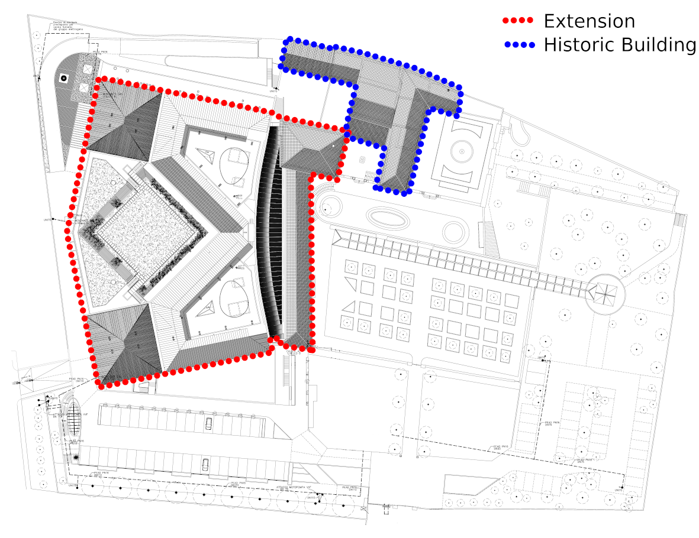
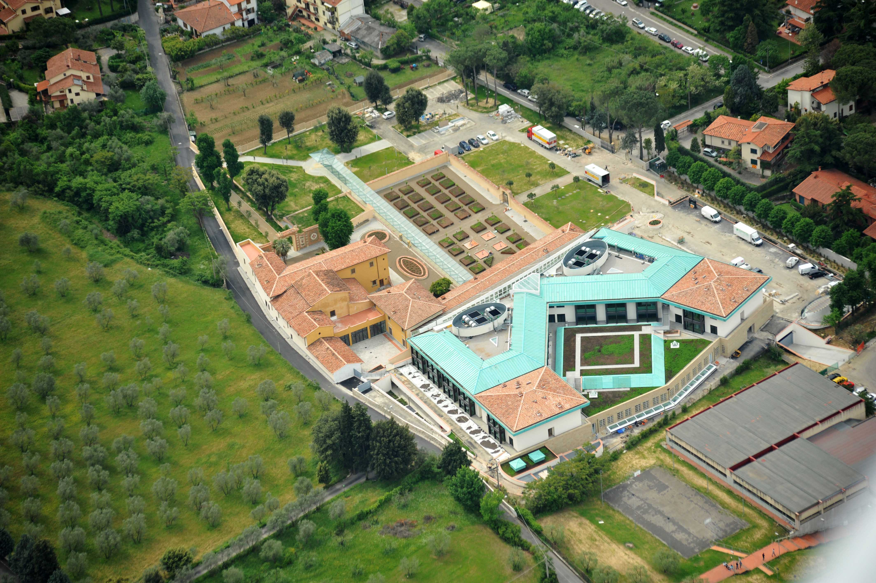
Healthcare Facility Overview
Building characteristics
Total Surface: 12'000 m²
Historic Building
Majority of the offices
Extension Area
Healthcare core activities
Technical Systems
Thermal Power Plant
Hot water generators (x4, Q_{tot}= 2800 kW_{th})
Steam generators (x3, Q_{tot} = 600 kW_{th})
Water Cooling System
Refrigerators (x3, W_{el} = 960 kW_{el})
Evaporative Towers (x6)
Air Handling System
27 Units for Building Extension
2 Units for the Historic Building

Slide 4
Monthly Consumption - Electric and Thermal Energy
Electric Energy consumptions
July → +50% of the February energy demand
Massive cooling and ventilation requirements
Thermal Energy consumptions
Heating
Domestic Hot Water

Slide 5
Monthly averaged daily Power Loads - 2019 VS. 2020
Weekdays
T_{mean} (°C) | February | March | April | May | June | July | August
2019 | 9.68 | 11.66 | 14.02 | 15.63 | 25.35 | 27.21 | 26.88
2020 | 9.50 | 9.24 | 13.46 | 19.00 | 21.38 | 25.56 | 25.54

Slide 6
Correlation Analysis

Slide 7
Correlation Analysis - Healthcare Facility Parameters
Time
Month of the year, (Month)
Represented through a sinusoidal function $− f\left(m\right)=\sin\left(m∙\frac{2π}{12}\right) ,$ with m = 1, … , 12
Hour of the day, (Time)
Represented through a sinusoidal function $− f\left(t\right)=\sin\left(t∙\frac{2π}{24}\right) ,$ with t = 1, … , 24
Day typology, (Day Typ)
Time slot, (Timeslot)
Climate
External Temperature, (T)
Relative Humidity, (RH)
Healthcare activities
Staff in Service, (Staff Srv)
Core Activities, (core act)
Global parameter composed by the number of exams performed during a specific time step

Slide 8
Correlation Analysis - Pearson's correlation coefficients
W
Month
Time
Day
Typ
Time
T
RH
Staff
Srv
Core
Act
slot
W
1.00
Month
0.29
1.00
Time
-
0.21
0.00
1.00
Day
Typ
-
0.26
-
0.05
0.00
1.00
Timeslot
-
0.53
-
0.02
0.37
0.41
1.00
T
0.78
0.21
-
0.27
-
0.02
-
0.25
1.00
RH
-
0.14
-
0.12
0.14
0.06
0.14
-
0.17
1.00
Staff
Srv
0.32
-
0.22
-
0.17
-
0.71
-
0.55
0.12
-
0.13
1.00
Core
Act
0.15
0.00
0.00
0.26
0.07
0.28
-
0.01
-
0.12
1.00

Slide 9
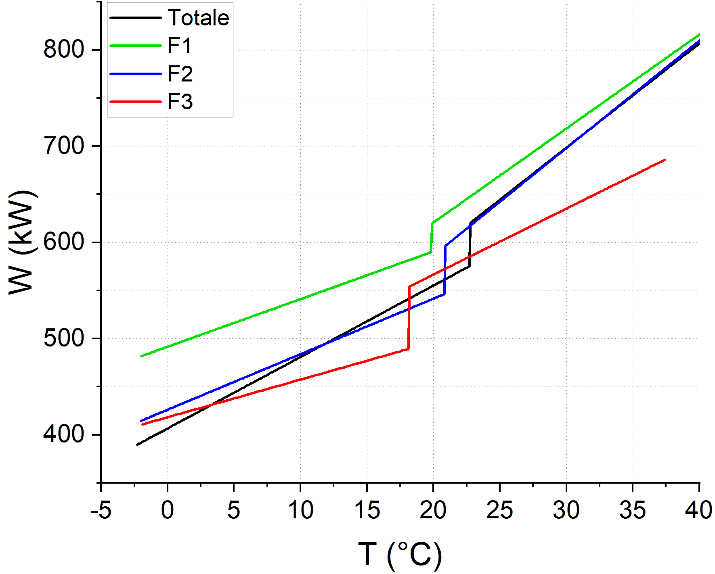
Correlation Analysis - Polynomial regression (Linear)
$$W_{el}=a+b∙T$$
 | T_{lim} [°C] | ΔW [kW] | R² T < T_{lim} | R² T > T_{lim}
F1 | 19.80 | 29.05 | 0.20 | 0.37
F2 | 20.81 | 49.18 | 0.25 | 0.23
F3 | 18.10 | 64.38 | 0.18 | 0.21
Totale | 22.71 | 44.28 | 0.33 | 0.27

Slide 10
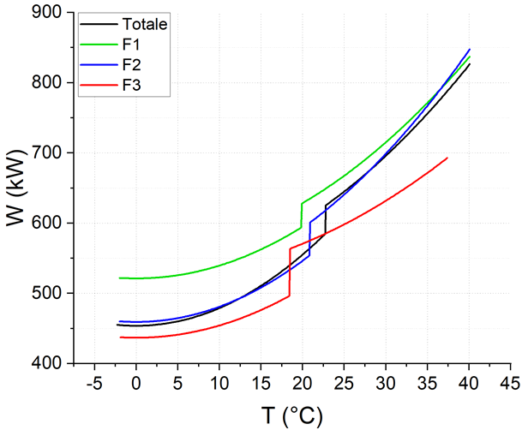
Correlation Analysis - Polynomial regression (Quadratic)
$$W_{el}=a+b∙T^{2}$$
 | T_{lim} [°C] | ΔW [kW] | R² T < T_{lim} | R² T > T_{lim}
F1 | 19.80 | 33.77 | 0.21 | 0.36
F2 | 20.81 | 46.55 | 0.29 | 0.24
F3 | 18.44 | 66.87 | 0.21 | 0.17
Totale | 22.71 | 40.27 | 0.36 | 0.27

Slide 11
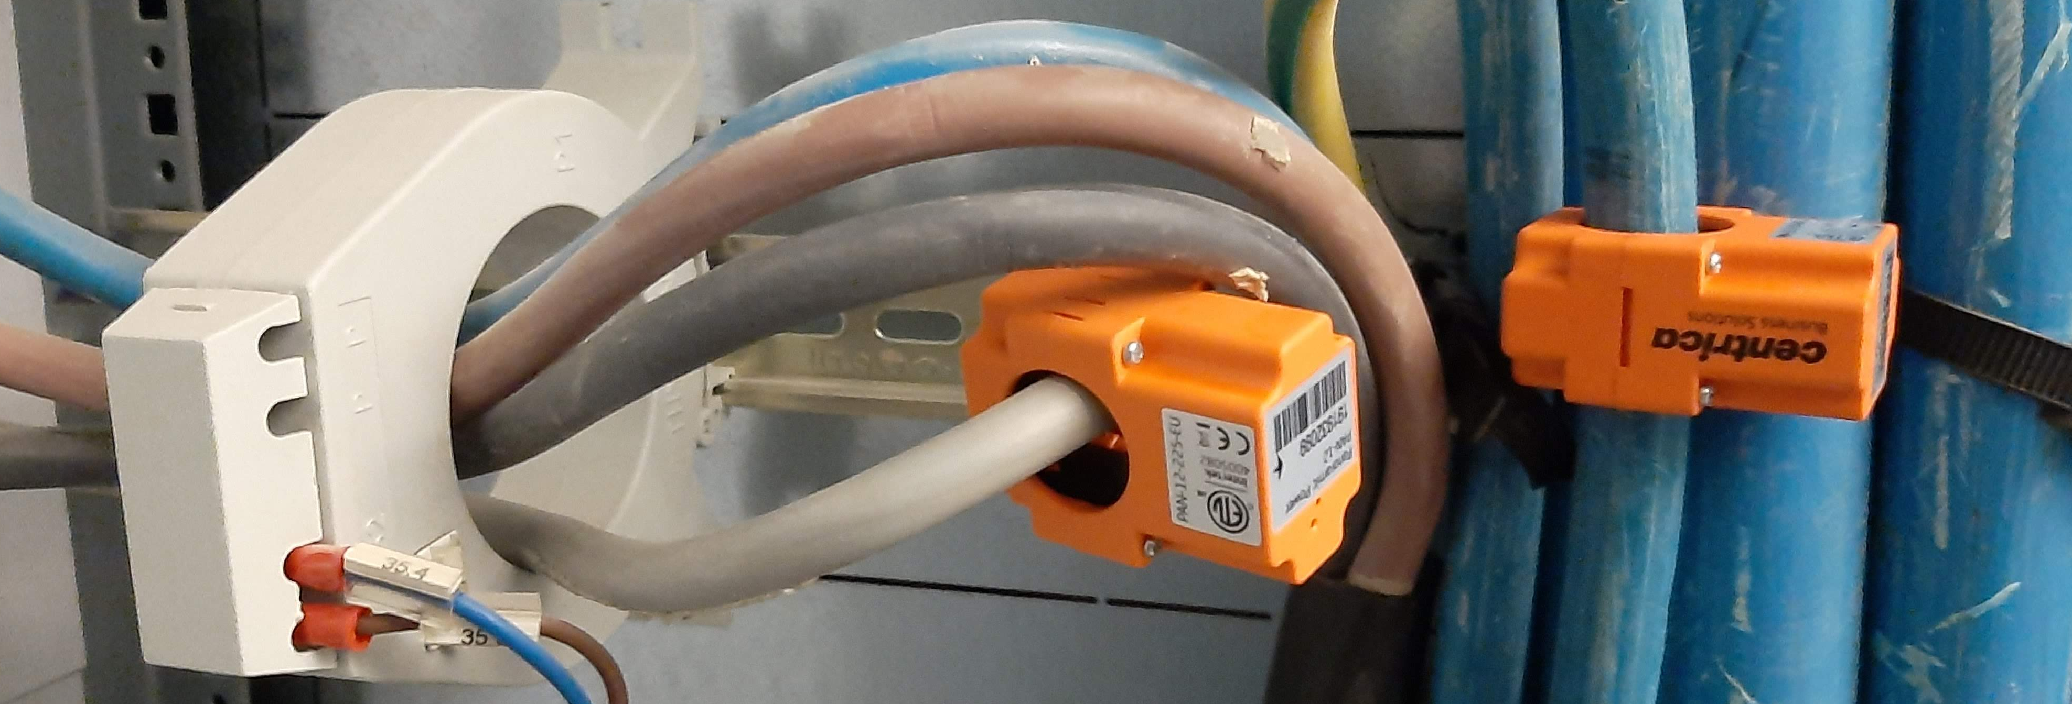
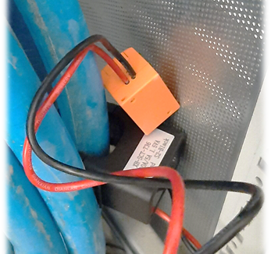
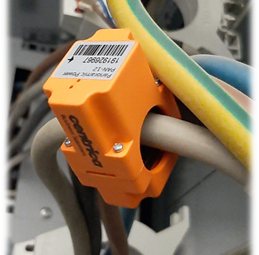
Monitoring System Electric Energy
The electrical cabinet is divided in:
Normal Section
21 lines powered by electricity grid
Preferential section
63 lines
Can be powered by a generator installed within the structure

Slide 12
Monitoring System - Data Analysis
Analyzed Period
Start: February 12th 2020
End: August 31th 2020
Electric Power Demand
Total Power demand, W_{tot}
Refrigerators, Refrig.
Air Handling Units, AHU
Pumps
Departments, Dep.
UPS
Time related parameters
Month of the year, Month
Hour of the day, Time
TIme slot (F1-F2-F3)
Climate parameter
External Temperature, T

Slide 13
Monitoring System - Data Analysis
Month
Represented through a sinusoidal function
$f\left(m\right)=\sin\left(m∙\frac{2π}{12}\right) ,$ with m = 1, … , 12
Strong correlation with Electric power demand related to Refrigeration and Air Handling
Strong correlation with External Temperature
Time
Weak correlation with all the selected parameters
due to the behaviour of the daily power demand, which tents to remain constant within each time slot
$f\left(t\right)=\sin\left(t∙\frac{2π}{24}\right) ,$ with t = 1, … , 24
Time slot
High correlation with
Departments and UPS
Intermediate correlation with
global electric power demand
Air Handling Units power demand
External Temperature (T)
Strong correlation with Electric power demand and Month parameters
 | W_{tot} | Refrig. | AHU | Pumps | Dep. | UPS | Month | Time | Time slot | T
W_{tot} | -
Refrig. | 0.97 | -
AHU | 0.80 | 0.68 | -
Pumps | 0.82 | 0.82 | 0.63 | -
Dep. | 0.44 | 0.25 | 0.49 | 0.13 | -
UPS | 0.24 | 0.09 | 0.28 | -0.20 | 0.76 | -
Month | -0.79 | -0.86 | -0.46 | -0.88 | -0.01 | 0.23 | -
Time | -0.16 | -0.15 | -0.13 | -0.05 | -0.12 | -0.23 | 0.00 | -
Time slot | -0.43 | -0.26 | -0.49 | -0.09 | -0.82 | -0.78 | 0.00 | 0.33 | -
T | 0.83 | 0.83 | 0.64 | 0.80 | 0.22 | 0.03 | -0.77 | -0.38 | -0.26 | -

Slide 14
Monitoring System - Data Analysis
External Temperature resume also the Month influence on absorbed power
Time slot result to be a better choice in comparison to the Time parameter
Refrigeration and air conditioning systems (Refrig. , AHU, Pumps)
strong influence on the electric energy demand behaviour (W_{tot})
strongly influenced by the External Temperature (T)
scarce dependency on time slot parameter (Time slot)
Departments and UPSs
Strong dependency on time slot
influenced by the healthcare activities
weak influence on the total electric power demand
 | W_{tot} | Refrig. | AHU | Pumps | Dep. | UPS | Time slot | T
W_{tot} | -
Refrig. | 0.97 | -
AHU | 0.80 | 0.68 | -
Pumps | 0.82 | 0.82 | 0.63 | -
Dep. | 0.44 | 0.25 | 0.49 | 0.13 | -
UPS | 0.24 | 0.09 | 0.28 | -0.20 | 0.76 | -
Time slot | -0.43 | -0.26 | -0.49 | -0.09 | -0.82 | -0.78 | -
T | 0.83 | 0.83 | 0.64 | 0.80 | 0.22 | 0.03 | -0.26 | -

Slide 15
Building Energy Modelling
Preliminary model developed in Energy Plus

Slide 16
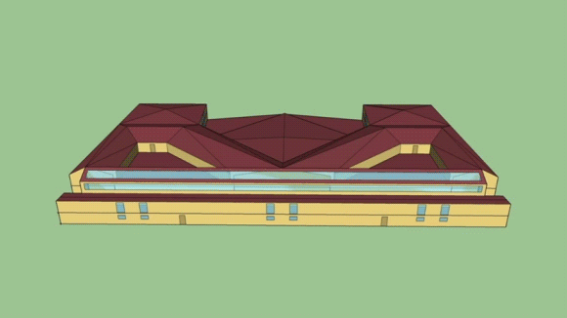
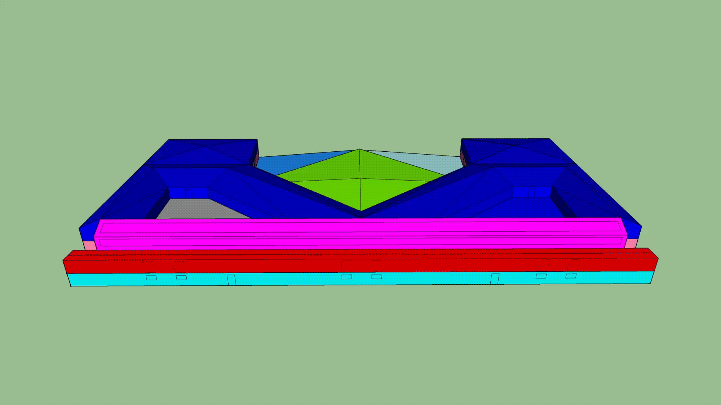
Building Energy Modeling - Energy Plus
A preliminary model of the Healthcare Facility has been realized in the Energy Plus Environment

Slide 17
Building Energy Modeling - Energy Plus
Electric Energy
Thermal Energy

Slide 18
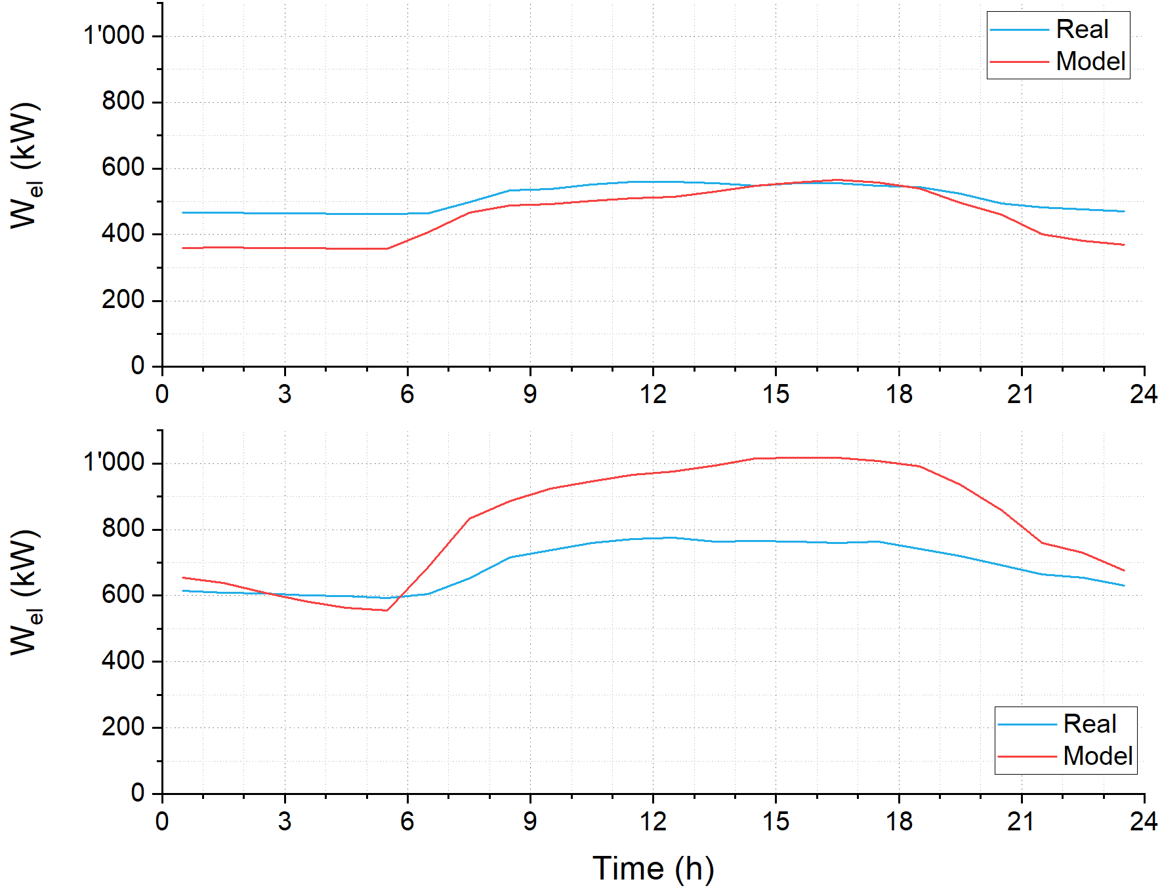
Building Energy Modeling - Energy Plus
Typical winter weekday
Typical summer weekday

Slide 19
Conclusions
It has been perform the analysis of the healthcare energy demand
The main Energy Driver is the External Temperature
Internal activity parameters seems to have lesser influence on electric energy demand
It has been provided a simplified representation of the healthcare energy requirements
More detailed study has been carried out on the monitoring system measures
More than 50% of global yearly electric energy consumption is related to HVAC Systems
A preliminary model has been realized in Energy Plus environment
Qualitative representation of the healthcare energy needs
Next Steps:
Improvement of the existing Energy Plus model
Application of AI algorithms on the available data
development of a numerical tool in order to predict the healthcare electric energy demand

Slide 20
Publications
Journal:
Balduzzi F., Zini M., Ferrara G., Bianchini A., 2019, "Development of a CFD methodology to reproduce the effects of macro turbulence on wind turbines and its applications to the particular case of a VAWT", Journal of Engineering for Gas Turbines and Power 141, 2019.
Balduzzi F., Zini M., Carbò Molina A., Bartoli G., De Troyer T., Runacres M. C., Ferrara G., Bianchini A., "Understanding the Aerodynamic Behavior and Energy Conversion of Small Darrieus Vertical Axis Wind Turbines in Turbulent Flows", Energies 2020, 13, 2936, 2020.
Conferences:
Bianchini A., Carcasci C., Manfrida G., Zini M., "Reconstruction and Analisys of the Energy Demand of a Healthcare Facility in Italy", 75° Congresso Nazionale ATI, 2020.
Future works:
Detailed analysis of the energy demand of a building through dedicated monitoring systems: The particular case of a healthcare facility in Italy
Application of AI algorithm to predict building energy demand
Building Energy Modelling of a healthcare facility in Italy
Numerical investigation on trigeneration system behaviour and related emissions

Slide 21
Passage of year presentation Reconstruction and Analysis of the Energy Demand of a Healthcare Facility
Department: Industrial Engineering
Ph.D Cycle: XXXV
Candidate: Marco Zini (DT30464)
Tutors: Ing. Alessandro Bianchini
Prof. Ing. Carlo Carcasci
Prof. Ing. Giampaolo Manfrida

Slide 22
Backup Slides Passage of year presentation
Department: Industrial Engineering
Ph.D Cycle: XXXV
Candidate: Marco Zini (DT30464)
Tutors: Ing. Alessandro Bianchini
Prof. Ing. Carlo Carcasci
Prof. Ing. Giampaolo Manfrida

Slide 23
Monthly Consumption - Water

Slide 24
Total Electric Power Measured data VS. Linear Function

Slide 25
Total Electric Power Measured data VS. Quadratic Function

Slide 26
Instantaneous Electric Power Demand - 2019 VS. 2020

