Slide 1
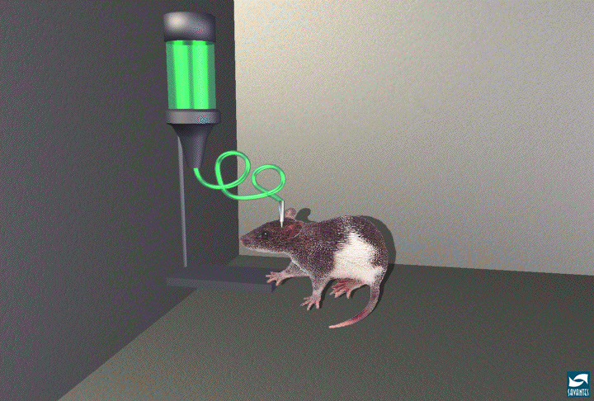
reward system
mm
Premendo la leva, il ratto si auto-somministra minuscole scariche elettriche che attivano una specifica area di cervello
(“rinforzo positivo”)

Slide 2
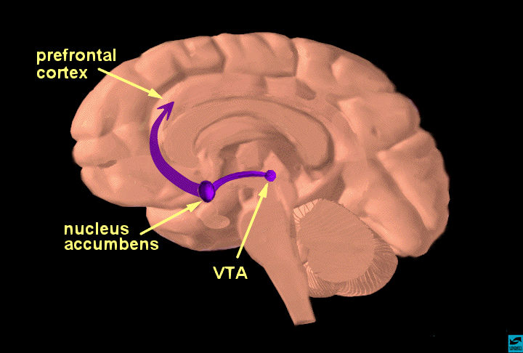
il circuito della “ricompensa”
Notes:
Slide 11: The reward pathway Tell your audience that this is a view of the brain cut down the middle. An important part of the reward pathway is shown and the major structures are highlighted: the ventral tegmental area (VTA), the nucleus accumbens and the prefrontal cortex. The VTA is connected to both the nucleus accumbens and the prefrontal cortex via this pathway and it sends information to these structures via its neurons. The neurons of the VTA contain the neurotransmitter dopamine which is released in the nucleus accumbens and in the prefrontal cortex (point to each of these structures). Reiterate that this pathway is activated by a rewarding stimulus. [Note: the pathway shown here is not the only pathway activated by rewards, other structures are involved too, but only this part of the pathway is shown for simplicity.]

Slide 3
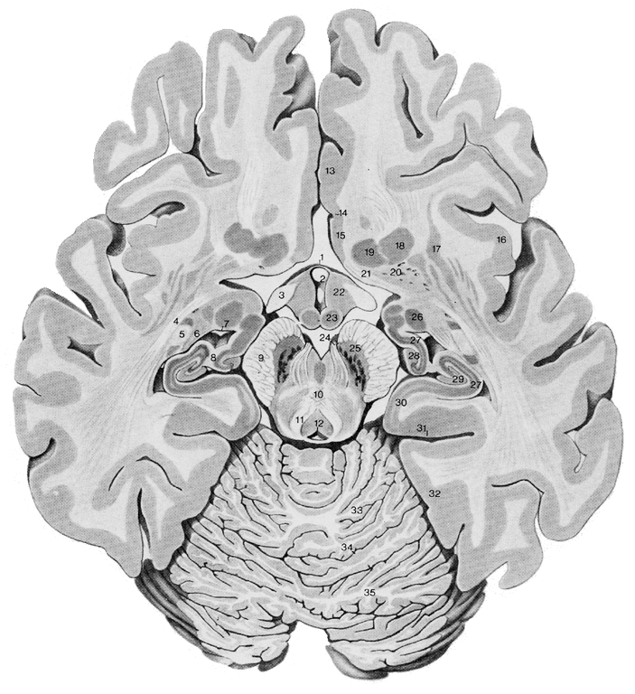
human accumbens & VTA
Nucleus Accumbens (NAc) & Ventral Tegmental Area (VTA)

Slide 4
sistema dopaminergico
putamen
nucleo caudato
nucleo accumbens
area tegmentale ventrale
sostanza nera

Slide 5
il circuito della “ricompensa”
Neurone dopaminergico
alla corteccia frontale
accumbens
VTA
Notes:
parleremo di questo, ma per parlare di questo dobbiamo avvicinarci...

Slide 6
oggi sappiamo che la stimolazione provoca un aumento della quantità di dopamina rilasciata dai neuroni dell’area VTA nell’accumbens
Notes:
Slide 11: The reward pathway Tell your audience that this is a view of the brain cut down the middle. An important part of the reward pathway is shown and the major structures are highlighted: the ventral tegmental area (VTA), the nucleus accumbens and the prefrontal cortex. The VTA is connected to both the nucleus accumbens and the prefrontal cortex via this pathway and it sends information to these structures via its neurons. The neurons of the VTA contain the neurotransmitter dopamine which is released in the nucleus accumbens and in the prefrontal cortex (point to each of these structures). Reiterate that this pathway is activated by a rewarding stimulus. [Note: the pathway shown here is not the only pathway activated by rewards, other structures are involved too, but only this part of the pathway is shown for simplicity.]

Slide 7
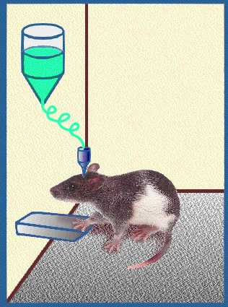
Autosomministrazione di dopamina
Il ratto si autosomministrerà dopamina...
Ma solo se questa viene iniettata in VTA o accumbens
Non si ottiene lo stesso effetto con altri neurotrasmettitori
mm
Notes:
Slide 8: Reward: drug self-administration Introduce the concept of positive reinforcement or reward. Explain that rats will press a bar to get an injection of cocaine or heroin (self-administration - shown on the left). The rat keeps pressing to get more cocaine or heroin because the drugs make the rat feel so good. This is called positive reinforcement, or reward. Natural rewards include food, water and sex - each is required to maintain survival of our species. Animals and people will continue to exhibit a behavior that is rewarding - and they will cease that behavior when the reward is no longer present. Explain that there is actually a part of the brain that is activated by natural rewards and by artificial rewards such as addictive drugs. This part of the brain is called the reward system.
Neuroscientists have been able to pinpoint the exact parts of the brain involved, with the help of the rats. Point to the cartoon on the right and explain that rats will also self-administer addictive drugs directly into their brains -but only into a specific area of the reward system. If the injection needle is moved less than a millimeter away from this crucial area, the rat won't press the lever for more drug. So based on information from working with the rats, scientists have drawn a map of the brain, and located the structures and pathways that are activated when an addictive drug is taken voluntarily. Tell the students that you will show them this "map".

Slide 8
L’importanza della dopamina
In seguito all’autostimolazione, una maggiore quantità di dopamina viene rilasciata nel circuito
Se il rilascio di dopamina viene impedito (o con un farmaco o lesionando il circuito) il ratto non preme la barra
Dunque ora conosciamo (alcune delle) strutture anatomiche e le sostanze chimiche implicate nel sistema della ricompensa
Notes:
The importance of the neurotransmitter dopamine has been determined in these experiments because scientists can measure an increased release of dopamine in the reward pathway after the rat receives the reward. And, if the dopamine release is prevented (either with a drug or by destroying the pathway), the rat won't press the bar for the electrical jolt. So with the help of the rats, scientists figured out the specific brain areas as well as the neurochemicals involved in the reward pathway.

Slide 9
Studi nell’animale e nell’uomo hanno mostrato che la ricompensa aumenta il rilascio di dopamina nel nucleo accumbens, aumentando l’attività del medesimo (da Olds e Milner, anni ’50, alle neuroimmagini).
Ricompense “innate” o "naturali"
Cibo
Acqua
Riparo
Caldo
Compagno

Slide 10
Ricompensa endogena ed esogena. Le motivazioni fisiologiche attivano comportamenti che sono naturalmente fonte di piacere e il loro oggetto (per es., cibo, calore, sesso) agisce come ‘ricompensa naturale’ per il soggetto, ossia ha un ‘valore naturale’.
Per es., le ricompense naturali stimolano il rilascio di una maggiore quantità di dopammina nel nucleus accumbens; ottenere un aumento di rilascio di dopammina (ricompensa endogena) può motivare l’animale a mettere in atto un determinato comportamento, esattamente come se la ricompensa del comportamento fosse il cibo.
L’esperienza modifica le risposte dell’SRE. Stimoli associati a una ricompensa naturale come il cibo in protocolli di condizionamento operante acquisiscono le stesse proprietà di stimolare il rilascio di dopammina. È come se la motivazione a procurarsi la ricompensa esogena, il cibo, si trasferisse allo stimolo, che acquista quindi valore in grado di motivare il soggetto.

