Slide 1
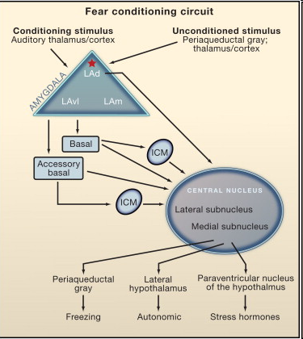
Convergence of the auditory-conditioned stimulus and nociceptive unconditioned stimulus in the amygdala is essential for fear conditioning.
Convergence of conditioned and unconditioned stimuli occurs in lateral nucleus of the amygdala (LA), especially in the dorsal subnucleus (LAd), leading to synaptic plasticity in LA.
Plasticity may also occur in the central nucleus (CE) and in the auditory thalamus.
LA connects with CE directly and indirectly by way of connections in the basal (B), accessory basal (AB), and intercalated cell masses (ICM).
CE connects with hypothalamic and brainstem areas that control the expression of conditioned fear responses, including freezing and autonomic (ANS) and hormonal responses.
LeDoux, 2011

Slide 2
In a Hebbian model of fear conditioning, strong depolarization of LA pyramidal cells evoked by the aversive unconditioned stimulus leads to strengthening of coactive conditioned stimulus inputs onto the same neurons (remember inception of false memories, Tonegawa’s paper 2014).
Existing data support the idea that LA associative plasticity and fear memory formation are triggered by unconditioned stimulus-induced activation of LA neurons.
Thus, unconditioned stimulus-evoked depolarization is necessary for the enhancement of conditioned stimulus-elicited neural responses in LA after conditioned-unconditioned stimuli pairing (Rosenkranz and Grace, 2002), and pairing a conditioned stimulus with direct depolarization of LA pyramidal neurons as an unconditioned stimulus supports fear conditioning (Johansen et al., 2010).

Slide 3
Though there is evidence that Hebbian plasticity in LA may not entirely explain fear conditioning, it is clear that synaptic plasticity at conditioned stimulus input pathways to the LA does occur with fear conditioning.
Supporting this, in vivo studies demonstrate an enhancement of auditory stimulus-evoked responses in LA neurons after fear conditioning.

Slide 4
Il condizionamento alla paura comporta variazioni della trasmissione sinaptica fra i neuroni nell’amigdala
Potenziali d’azione/sec

Slide 5
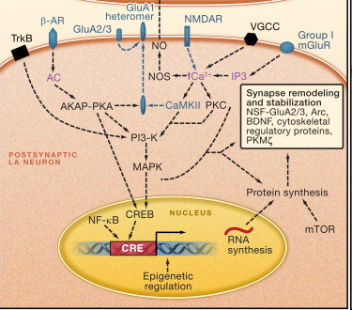
Working Model of Molecular Processes in the amygdala Mediating Acquisition and Consolidation of Fear Memories
All dotted lines denote hypothetical pathways. Molecules and processes in blue are known to be involved in the acquisition of fear conditioning.
Molecules and process in black are known to be involved specifically in the consolidation or maintenance of fear conditioning.
Purple labels denote molecules or elements whose role is not established for fear conditioning but are part of an established intracellular signaling pathway.
Abbreviations: AC, adenyl cyclase; AKAP, A-kinase anchoring protein; Arc, activity-regulated cytoskeletal-associated protein; β-AR, β-adrenergic receptor; BDNF, brain-derived neurotrophic factor; Ca2+, calcium; CaMKII, Ca2+/calmodulin (Cam)-dependent protein kinase II; CREB, cAMP response element (CRE) binding protein; GluA1, glutamate AMPA receptor subunit 1; GluA2/3, glutamate AMPA receptor subunit 2 and 3 heteromer; IP3, inositol 1,4,5-triphosphate; MAPK, mitogen-activated protein kinase; mGluR, metabotropic glutamate receptor; mTOR, mammalian target of rapamycin; NF-kB, nuclear factor κ light-chain enhancer of activated B cells; NMDAR, N-methyl-d-aspartate glutamate receptor; NO, nitric oxide; NOS, nitric oxide synthase; PI3-K, phosphatidylinositol-3 kinase; PKA, protein kinase A; PKC, protein kinase C; PKG, cGMP-dependent protein kinase; PKMζ, protein kinase M ζ; TrkB, tyrosine kinase B; VGCC, voltage-gated calcium channel.

Slide 6
L’apprendimento di risposte di paura condizionata coinvolge quindi cambiamenti duraturi dell’efficacia sinaptica di tipo potenziamento a lungo termine (LTP) nel nucleo laterale.
L’ipotesi è che l’attività evocata nel nucleo laterale dalla presentazione dello stimolo condizionato, quando appaiata con l’attività evocata dallo stimolo incondizionato, provochi un potenziamento della risposta allo stimolo condizionato (proprietà associativa di LTP).

Slide 7
Monoamine Neuromodulatory-Dependent Mechanisms Involved in Fear Learning
Though Hebbian plasticity may indeed occur during learning, it does not fully explain learning — especially learning in highly charged emotional situations.
It is generally thought that monoamine transmitters such as norepinepherine (NE) and dopamine (DA) that are released in emotional situations regulate glutamatergic transmission and Hebbian plasticity (for review, see [Bailey et al., 2000] and [McGaugh, 2000] , and Tully and Bolshakov, 2010).
The modulation of Hebbian plasticity (homosynaptic plasticity) by neuromodulators (such as monoamines) or plasticity that is independent of the specific pre-postsynaptic activity is called heterosynaptic plasticity.

Slide 8
Hebbian plasticity: what happens at a synapse affects whether it will be strengthened or not (homosynaptic plasticity).
Eterosynaptic plasticity: plasticity at a synapse is affected by what happens (or happened) at other synapses.
Indeed, in a variety of model systems, it has been shown that monoamines modulate plasticity underlying memory formation (Carew et al., 1984] and [Bailey et al., 2000] , and Glanzman, 2010 for review).
Neuromodulators also contribute to fear conditioning.

Slide 9
Tono noradrenergico nell’amigdala alto:
maggior probabilità che si inneschi e consolidi un potenziamento delle risposte dell’amigdala allo stimolo condizionato appaiato allo stimolo incondizionato.
Tono noradrenergico basso: si verifica l’opposto.
A quale stato comportamentale corrisponde un tono noradrenergico alto?

