Slide 1
The present findings suggest a new technique to target specific fear memories and prevent the return of fear after extinction training.
Using two recovery assays, the authors demonstrated that extinction conducted during the reconsolidation window of an old fear memory prevented the spontaneous recovery or the reinstatement of fear responses, an effect that was maintained a year later.
Moreover, this manipulation selectively affected only the reactivated conditioned stimulus while leaving fear memory to the other non-reactivated conditioned stimulus intact.

Slide 2
The current results also suggest that timing may have a more important role in the control of fear than previously appreciated. Standard extinction training, without previous memory reactivation, also triggers the fear memory.
Given this, one might expect mere extinction training to have similar effects. That is, the first trial of extinction might serve as the reminder cue triggering the reconsolidation cascade, which is immediately followed by extinction. However, there is abundant evidence that during standard extinction training the non-reinforced presentations of the fear-eliciting cue induce new inhibitory learning, which competes for expression with the initial fear learning, resulting in the recovery of fear responses in some.
Schiller et al findings indicate that the timing of extinction relative to the reactivation of the memory can capitalize on reconsolidation mechanisms.

Slide 3
Two factors may be important determinants in this process:
the timing of extinction training relative to retrieval,
and/or the chunking of the conditioned stimulus presentations during extinction relative to reactivation (that is, the fact that they are massed relative to the single retrieval trial during the reconsolidation phase).
Further studies are required to disentangle these possibilities.

Slide 4
The present study proposes that invasive techniques are not necessary to reduce conditioned fear responses.
Using a more natural intervention that captures the adaptive purpose of reconsolidation allows a safe and easily implemented way to prevent the return of fear.
Let us discuss this

Slide 5
Proc Natl Acad Sci U S A. 2013 Nov 25.
Extinction during reconsolidation of threat memory diminishes prefrontal cortex involvement.
Schiller D, Kanen JW, Ledoux JE, Monfils MH, Phelps EA.
Abstract
Controlling learned defensive responses through extinction does not alter the threat memory itself, but rather regulates its expression via inhibitory influence of the prefrontal cortex (PFC) over amygdala.
Individual differences in amygdala-PFC circuitry function have been linked to trait anxiety and posttraumatic stress disorder.
This finding suggests that exposure-based techniques may actually be least effective in those who suffer from anxiety disorders.

Slide 6
A theoretical advantage of techniques influencing reconsolidation of threat memories is that the threat representation is altered, potentially diminishing reliance on this PFC circuitry, resulting in a more persistent reduction of defensive reactions.
Schiller, Phelps and LeDoux hypothesized that timing extinction to coincide with threat memory reconsolidation would prevent the return of defensive reactions and diminish PFC involvement.

Slide 7
Two conditioned stimuli (CS) were paired with shock and the third was not.
A day later, one stimulus (reminded CS+) but not the other (nonreminded CS+) was presented 10 min before extinction to reactivate the threat memory, followed by extinction training for all CSs.
The recovery of the threat memory was tested 24 h later.
Extinction of the nonreminded CS+ (i.e., standard extinction) engaged the PFC, as previously shown, but extinction of the reminded CS+ (i.e., extinction during reconsolidation) did not.
Moreover, only the nonreminded CS+ memory recovered on day 3.

Slide 8
These results suggest that extinction during reconsolidation prevents the return of defensive reactions and diminishes PFC involvement.
Reducing the necessity of the PFC-amygdala circuitry to control defensive reactions may help overcome a primary obstacle in the long-term efficacy of current treatments for anxiety disorders

Slide 9
Klucken et al., 2016

Slide 10
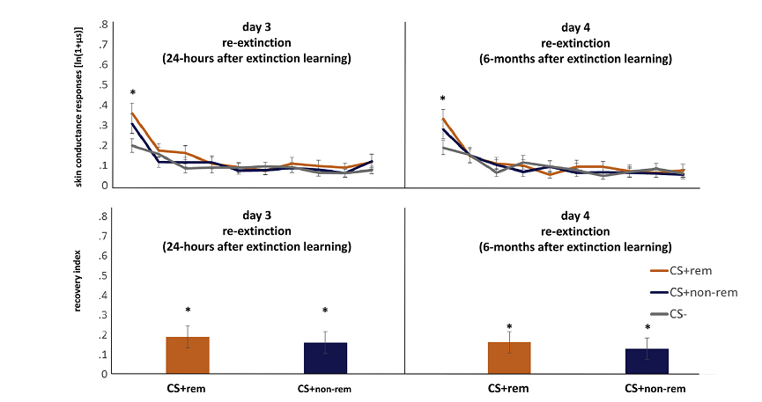

Slide 11
Regarding BOLD-responses, no significant differences between CS+rem and CS+non-rem were found in region of interest (ROI)-analyses (amygdala, ventromedial prefrontal cortex) during extinction learning and both re-extinction sessions.

Slide 12
The present results do not argue against the phenomenon of blocking the return of fear in general. Various animal and human studies found successful blocking of the return of fear (Agren, 2014; Johnson & Casey, 2015; Kindt et al., 2009; Liu et al., 2014; Nader et al., 2000; Schiller et al., 2010, 2013).
Nevertheless, the unexpected (null) results may support the view that the reported effects may exist in specific constellations only and may require specific parameters, which are not entirely clear to date (Agren, 2014; Golkar et al., 2012).
For instance, Schiller and colleagues also reported data of subjects without successfully blocked return of fear (Schiller et al., 2013).
Therefore, future studies may help to give more insight into the impact and boundaries and the opportunity for blocking the return of fear more efficiently.

