Slide 2
Prepositions

Slide 3
When a friend recently asked me what I, as a non-native speaker of English, considered the most difficult aspect of the English language, I answered, without hesitation: "The prepositions." This statement of mine has been confirmed by the countless texts, written by non-native authors, that I've had the opportunity to revise, both for our translation company and for this on-line publication. The wrong use of prepositions is by far the most common mistake these authors make.
Gabe Bokor, Translation Journal (2011)

Slide 4
Problems
Cross-linguistic
Internal to English
Paedogogic

Slide 5
Different prepositions with similar noun complements
English | Italian | German
I read it in the paper. | L’ho letto sul giornale. | Ich habe es in der Zeitung gelesen.
It depends on the weather. | Dipende dal tempo. | Es hängt vom Wetter ab.

Slide 6
Particles in verbal groups
English | Italian | German
I’m looking for a book. | Cerco un libro. | Ich suche ein Buch.
The game is over. | La partita è finita. | Das Spiel ist aus.

Slide 7
Grammar / function words = semantically empty
Focus on grammatical (i.e. syntactic properties)
Preposition obligatory or optional?
The meeting is on Saturday.
The meeting is next Saturday.
Noun complement obligatory or optional?
Sally came out of the house.
Sally came out.
Noun complement preceded by determiner or not?
Ms Wilkinson is at school.
Ms Wilkinson is at the school.

Slide 8
Variation between BrE and AmE
in Oak Street
at university
on Oak Street
at the university

Slide 9
Similar phrases, different meanings
in time vs on time
Different phrases, similar meanings
by chance vs at random

Slide 10
Some far more common as particles
out | 97.3%
up | 87.4%
down | 79.2%
back | 77.4%
Data from M. Davies, Frequency Dictionary

Slide 11
Resources
Textbooks
Dictionaries
Reference grammars

Slide 12
Collins Cobuild: 43 meanings for entry on
Macmillan: 33 + 9 submeanings
1. touching a surface or an object
2. at a particular time
3. supported by a part of your body
4. in a particular place
5. in a list
6. hitting against sth
7. wearing sth
8. looking at sb/sth
[…]

Slide 13
Oxford Guide to English Grammar Unit 27 Prepositions
Introduction to prepositions
Prepositions of place
Prepositions of time
Prepositions with other meanings
Idiomatic phrases with prepositions

Slide 14
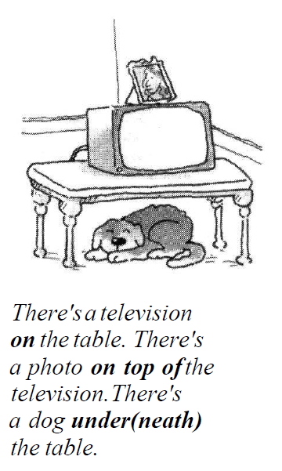

Slide 15
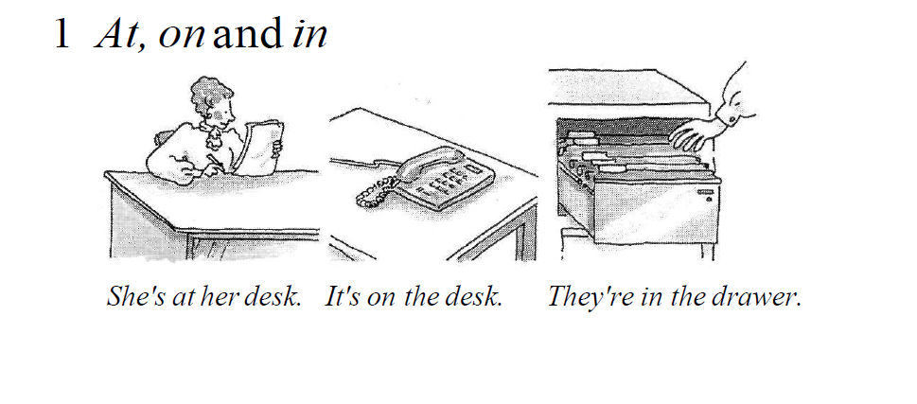
at one-dimensional on two-dimensional in three-dimensional

Slide 16
Two main criteria of classification
Space vs time
Dimension

Slide 17
Temporal and spatial senses of prepositions
Activity
All the children danced in a circle around Mary.
The hammock was suspended between two sturdy trees.
A police helicopter hovered over the stadium.
Drop by my house before 7 p.m.
They laid carpet throughout the apartment.

Slide 18
Complete the following prepositional phrases with expressions of time
Activity
around _______________
between ________________
over _______________
by ______________
thoughout _______________

Slide 19
More on spatial meanings of prepositions

Slide 20
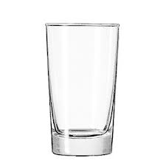
Categorizing objects by dimension: at, on, or in?
Activity

Slide 21
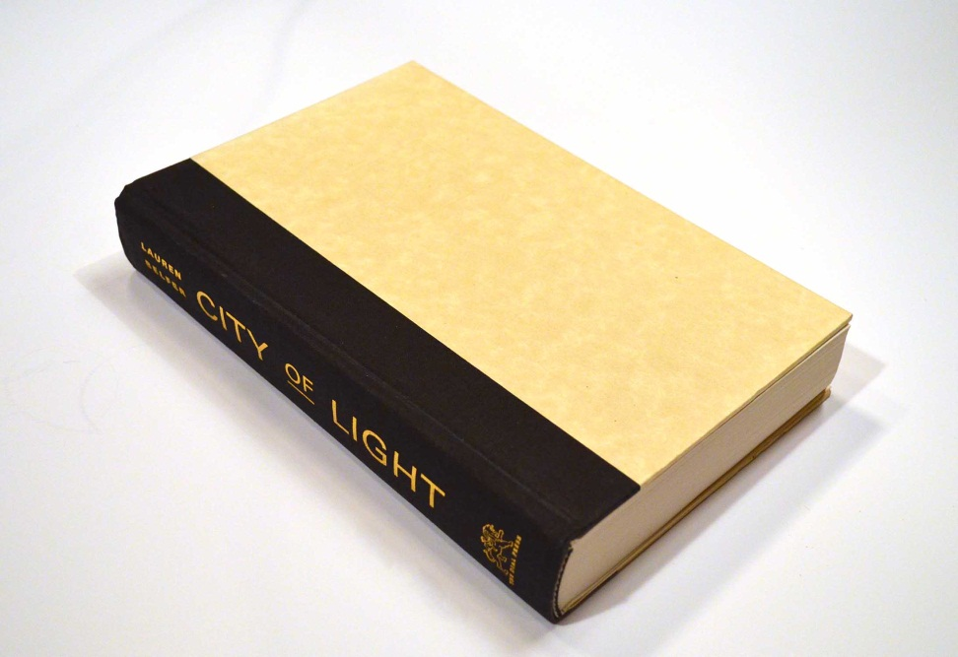

Slide 22
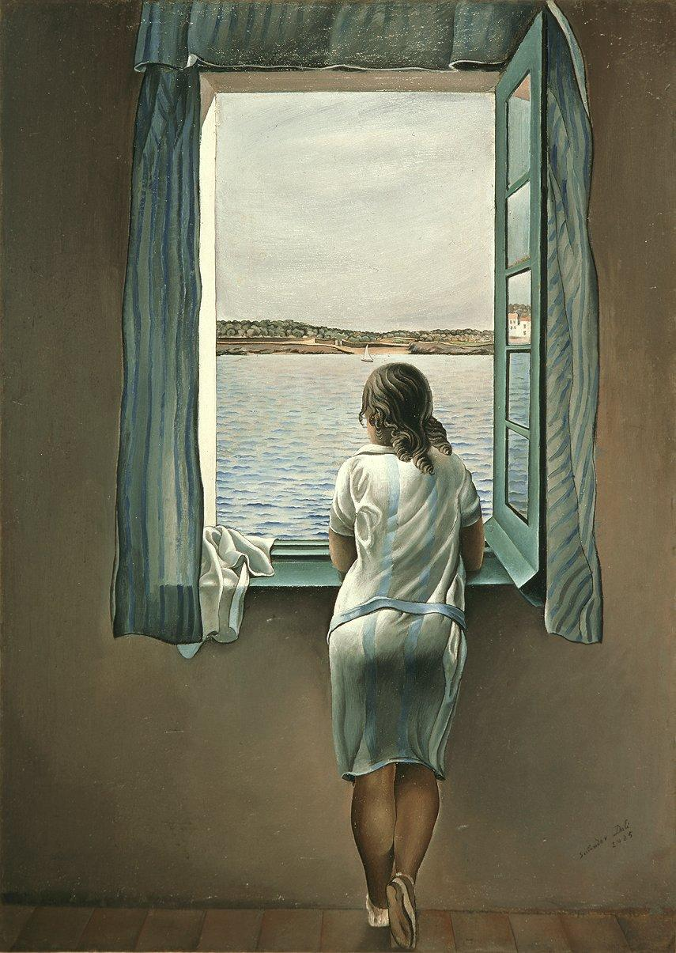
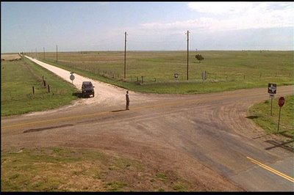

Slide 23
An object or a group of objects (a scene) can be construed as one-, two-, or three-dimensional depending on our cognitive interests.

Slide 24
The objects that constitute a scene do not appear to us to be equal in importance.
Typically, we focus on certain objects which stand out against a background of other less important ones.
We focus on smaller, often more mobile objects.

Slide 25
We use prepositions to express the asymmetrical relationship between the objects we focus our attention on and the «background» of the scene.
The same scene can be interpreted, or construed, in different ways, and these different construals are expressed through our choice of prepositions.

Slide 26
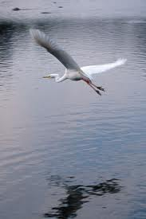
The lake is below the bird.
The bird is flying above the water.

Slide 27
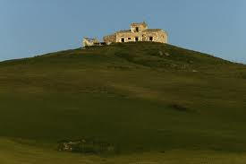
The hill is under the house.
The house is on the hill.

Slide 28
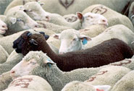
There are white sheep surrounding a black sheep.
The black sheep is surrounded by white sheep.

Slide 29
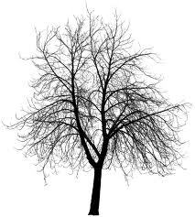
The silhouette captures the relationship between object
and background, also known as figure and ground.

Slide 30
The pencil is on the book

Slide 31
The lightswitch is on the wall

Slide 32
The mosquito is on the ceiling

Slide 33
Put the pencil on the book.

Slide 34
Basic meaning of on: ‘contact’ & ‘support’
Rotation generates different configurations.
Static location may be result of movement.

Slide 35
Activity
Make a simple drawing for each of the following scenes.
Dorothy sat down on the floor.
Toto hid under the bed.
Aunt Em opened the trap door in the floor.
She was halfway across the room.
Aunt Em came to the door.

Slide 36
References
Bokor, Gabe. Review of S. Lindstromberg, English Prepositions Explained, Translation Journal, 15:1 (2011).
Collins Cobuild English Dictionary for Advanced Learners (2001).
Davies, Mark & Dee Gardem. A Frequency Dictionary of Contemporary American English (Routledge, 2010).
Eastwood, Michael. Oxford Guide to English Grammar (1996).
Macmillan English Dictionary for Advanced Learners (2007).

Slide 38
There are many idiomatic phrases beginning with a preposition. Most of them are without a/an or the. Here are some examples.
I drive about ten thousand miles a year, on average.
Did you go there on holiday or on business?
Mr Jones is on leave this week. He’ll be in the office next Monday.
There are so many different computers on the market.
I saw it on television.
I heard it on the radio.

