Slide 1



  Cultura della ricerca e pedagogia
  Prospettive epistemologiche
Methodology of the Research
Vanna Boffo
Grounded Thery
Mortari L., Cultura della ricerca e pedagogia. Prospettive epistemologiche, Carocci, Roma, 2012.

Slide 2

Methodology
Ecological Paradigm or naturalistic enquiry (Mortari, Bronfrenbrenner)
Epistemology: general standards (parameters) to reach a reliable knowledge (naturalistic epistemology)
Philosophy of the Research: direction of the sense of the research work (phenomenological, critical, hermeneutical)
Methods of the Research: the processes of collecting and data analysis (grounded theory, narrative inquiry, phenomenological inquiry)
Strategy of the Research: the path to guide the inquiry process (case-study, action-research, ethnomethodology)
Technique of Inquiry: tools for the date collecting (observation, interview, analysis of the conversation, collections of self narrative analysis, autobiographical data)

Slide 3
4 – Research methods
      * Methodology and Methods
      * Relation Theory-Method
      - Inductive process VS Deductive process
      * 3 types of Method
      a) Grounded Theory
      b) Phenomenological-eidetic method
      c) Narrative Inquiry

Slide 4
4 – Research methods
      a) Grounded Theory
      «The Grounded Theory is a general method for comparative
      ana lysis […] and a set of procedures able to generate
      (sistematically) a theory founded [grounded] on data» (Tarozzi, 2008, p. 10)
      - General method
      - Sistematically
      - Generate a theory
      - Grounded
      Tarozzi M., Che cos’è la Grounded Theory, Carocci, Roma, 2008.
University of Florence 2015

Slide 5
4 – Research methods
      a) Grounded Theory
      * Inductive construction of the Theory
      - Identifying the area of investigation
      - Focus on the research problem
      - Data collection technique
      - Data analysis (Open Coding)
      - Elaborate core category
University of Florence 2015

Slide 6
      Grounded Theory
Finalità | Euristica | Ermeneutica
Progetto | Misurazione Oggetti, Nomotetico | Comprensione Soggetti
Metodo | Sperimentale/Ricognitivo | Etnografico/Sul Campo
Osservatore | Esterno | Autoriflessivo
Strumenti/Tecniche | Inchieste, Esperimenti | Osservazioni, Interviste Aperte
Analisi Dati | Deduzione | Induzione
Dati | Fatti | Significati
University of Florence 2015

Slide 7
      Grounded Theory
      When is it necessary or adapt a qualitative research?
Per esplorare un’area poco conosciuta o è necessario un nuovo sguardo
Per dare senso a situazioni complesse
Per comprendere i significati che i partecipanti attribuiscono a una situazione
Per costruire una teoria
Per comprendere i fenomeni in profondità
(Tarozzi, 2011)
University of Florence 2015

Slide 8
      Grounded Theory
Un metodo generale di analisi comparativa (...) e un insieme di procedure capaci di generare [sistematicamente] una teoria fondata sui dati.
(Glaser & Strauss, 1967)
Un approccio sistematico, induttivo e comparativo per condurre ricerche allo scopo di costruire una teoria (o “conceptual frameworks”).
(Charmaz, 2006)
Una specifica metodologia sviluppata da Glaser & Strauss allo scopo di costruire una teoria sui dati.
(Corbin & Strauss, 2008)
Un termine-ombrello che ricomprende svariati e differenti varianti, accenti e direzioni oltre a modi di pensare ai dati. Quindi una costellazione di metodi
(Charmaz, 2009)
University of Florence 2015

Slide 9
      Grounded Theory
      Characteristics
Esplorare un processo
Theoretical sampling, o campionamento teorico
Simultaneità della raccolta e analisi dei dati
Usare il metodo della costante comparazione a ogni livello di analisi
Costruire una codifica a partire dai dati
Concettualizzazione. Non descrizione
Produzione di memo e di diagrammi
Analisi della letteratura alla fine
University of Florence 2015

Slide 10
      Grounded Theory
      Characteristics
      Tre caratteristiche interrelate di una teoria grounded
      Aderente
      Ha presa
      Rilevante
      Funzionante
University of Florence 2015

Slide 11
      Grounded Theory
      Characteristics
BARNEY GLASER
 Columbia university
 Paul Lazarsfeld
 Positivismo
 Ricerca quantitativa
 Rigore analitico
ANSELM STRAUSS
Chicago school
Herbert Blumer, G.H.Mead
Pragmatismo e interazionismosimbolico
Fieldresearch
Attenzione ai significati e alle azioni
University of Florence 2015

Slide 12
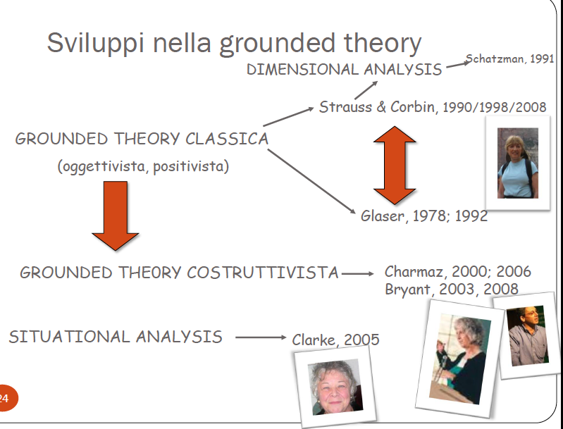
University of Florence 2015

Slide 13
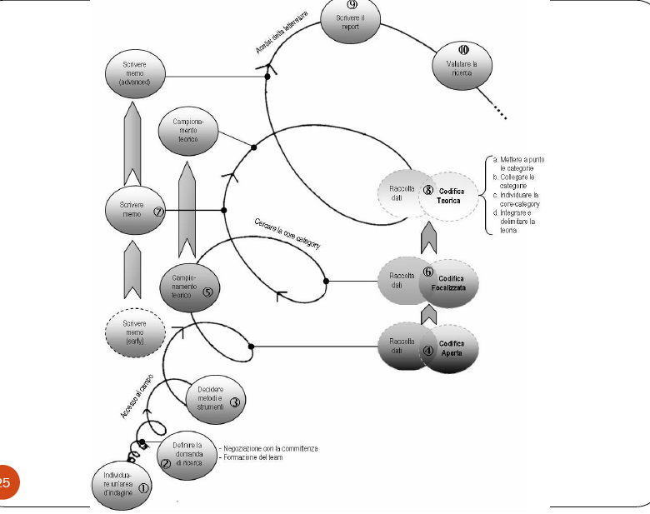
University of Florence 2015

Slide 14
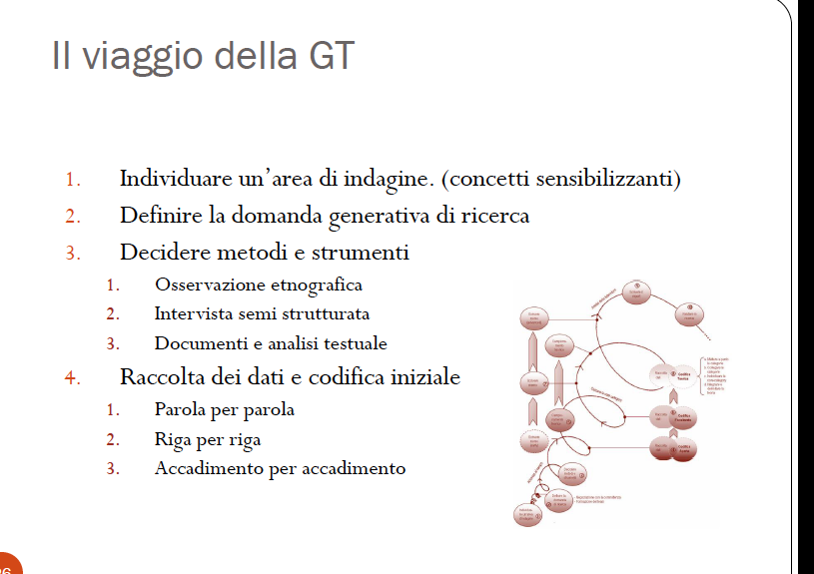
University of Florence 2015

Slide 15
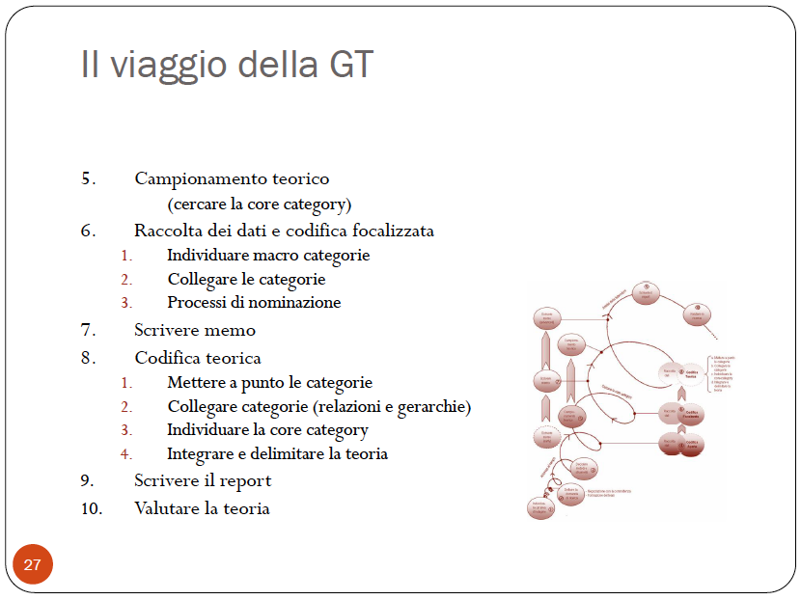
University of Florence 2015

Slide 16
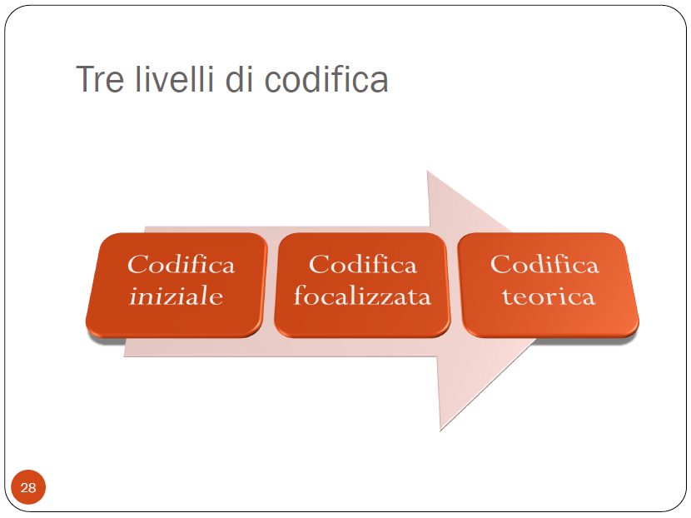
University of Florence 2015

Slide 17
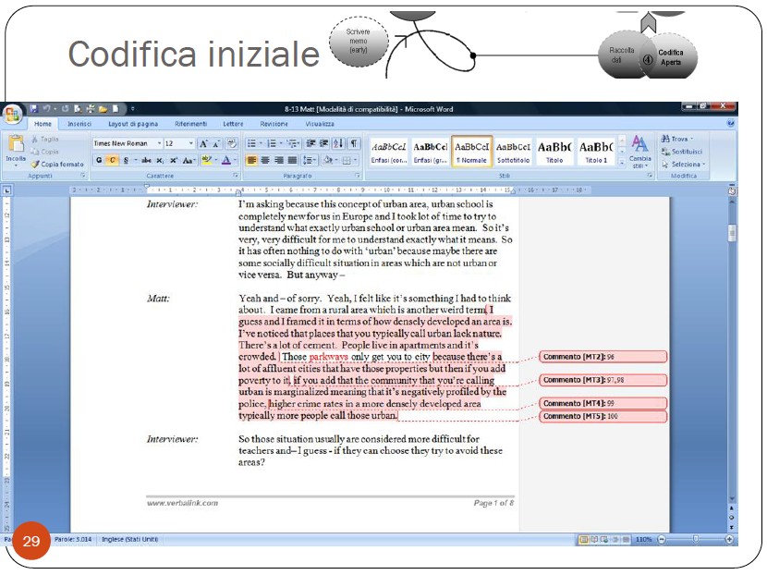
University of Florence 2015

Slide 18
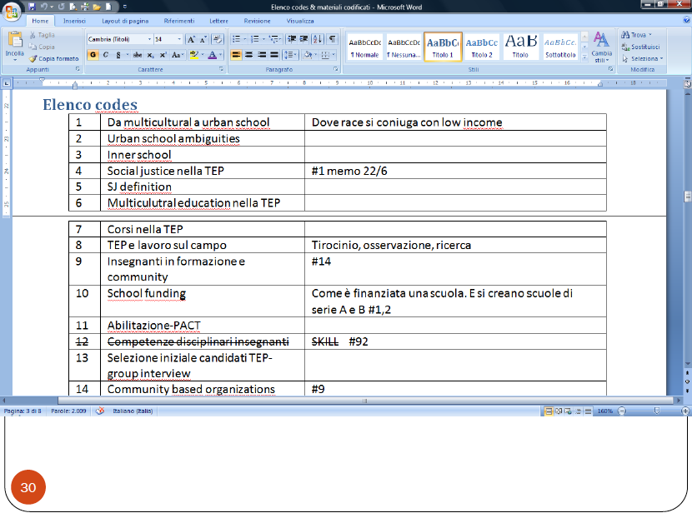
University of Florence 2015

Slide 19
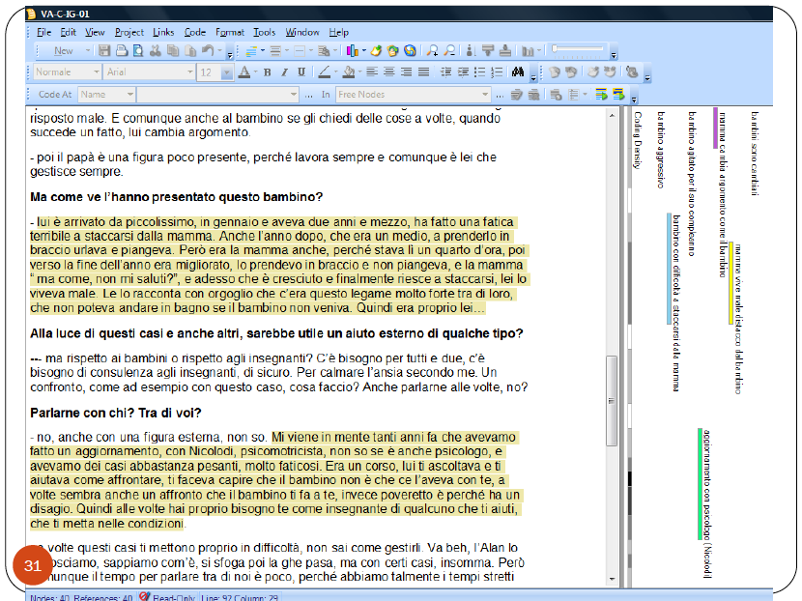
University of Florence 2015

Slide 20
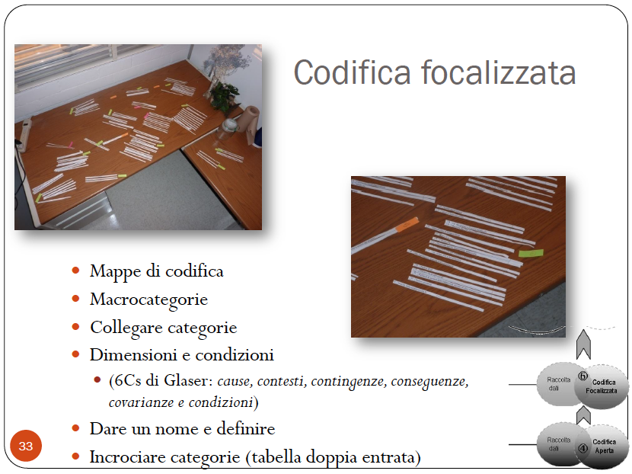
University of Florence 2015

Slide 21
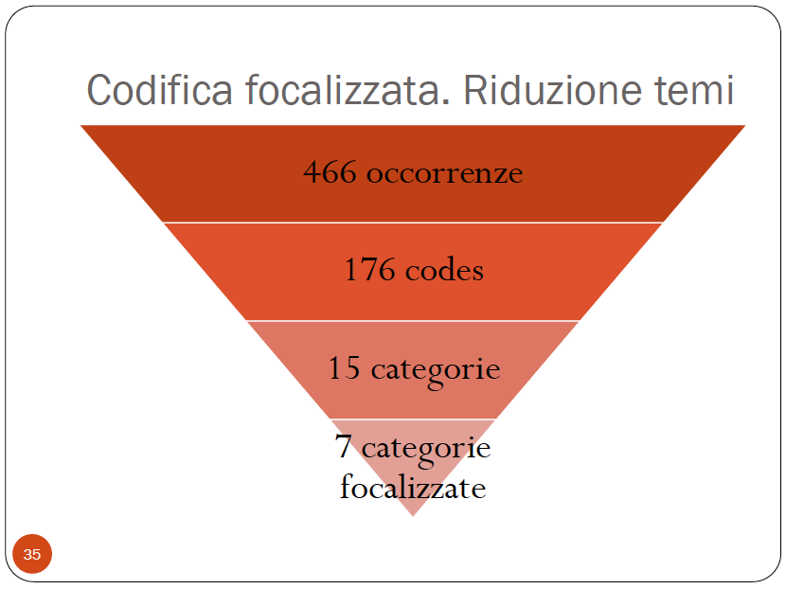
University of Florence 2015

Slide 22
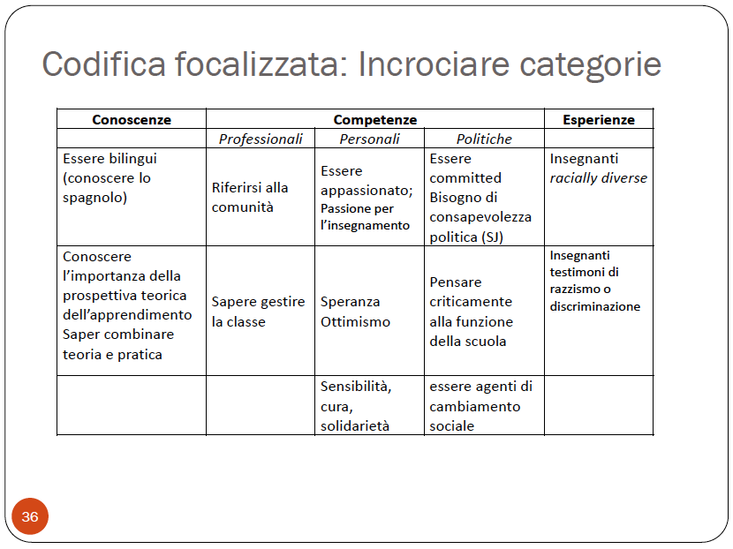
University of Florence 2015

Slide 23
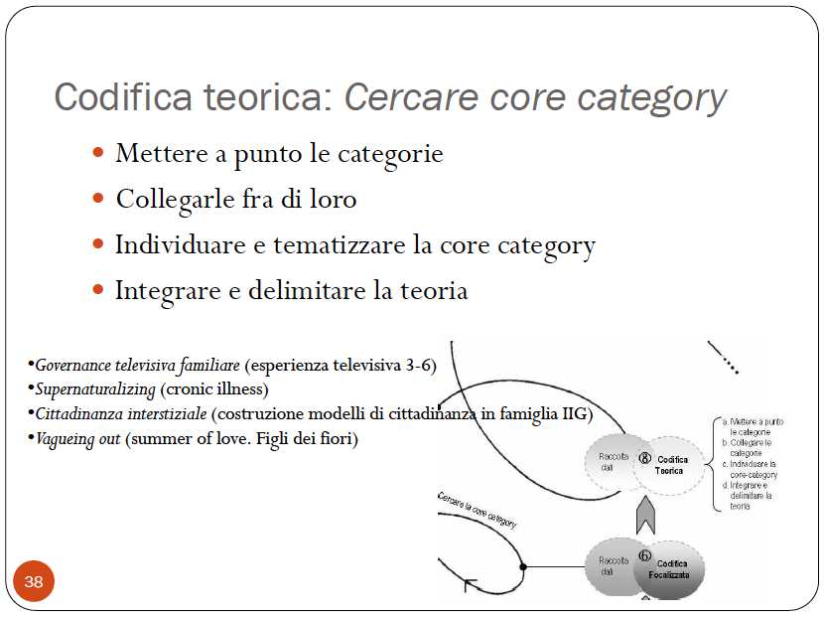
University of Florence 2015

Slide 24
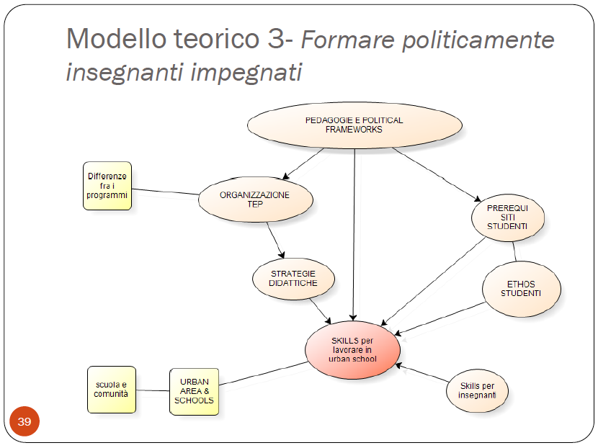
University of Florence 2015

Slide 25
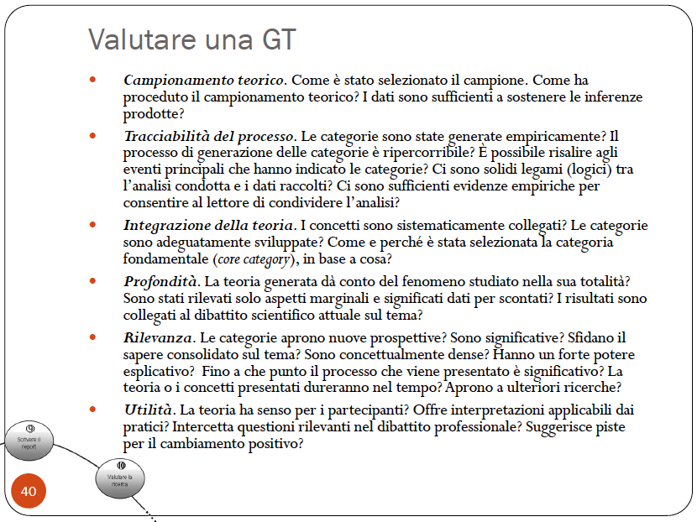
University of Florence 2015

Slide 26
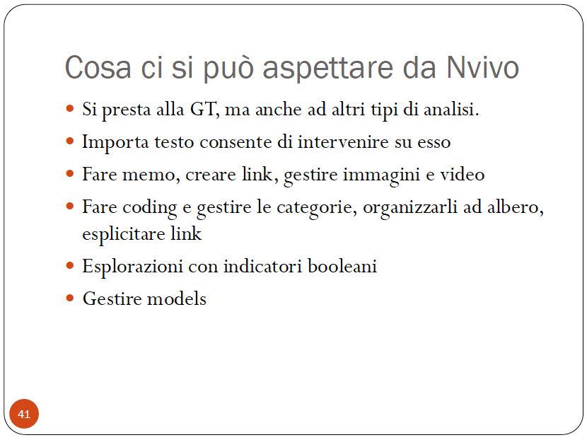
University of Florence 2015

Slide 27
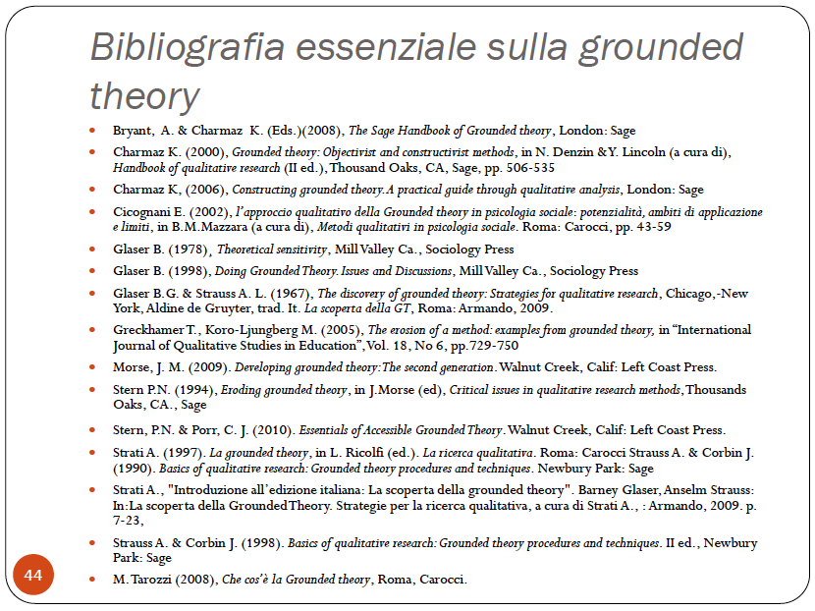
University of Florence 2015

Slide 28
4 – Research methods
      b) Phenomenological-eidetic method
      * Psychological origins and nursing research application
      * Meaning of the lived experience, as well as it is perceived
      * Structural analysis of the essence of experience
      * The researcher is looking for the «essential invariant
      structures (essence)» (Mortari 2012, p. 170)
University of Florence 2015

Slide 29
4 – Research methods
      b) Phenomenological-eidetic method
      * Phases of eidetic method:
      - Identify the phenomenon to be investigated
      - Identify participants who experienced it
      - Intensieve interview
      - Epoché
      * Process of data analysis:
      - Orizonalization
      - Clusters of meanings
      - General description
University of Florence 2015

Slide 30
4 – Research methods
      c) Narrative Inquiry
      * Text approach:
      1. Entering the text
      2. Sense-making
      3. Confirming
      4. Presenting the account
      - Fidelity
      - Betweenness
      * The importance of narrative inquiry in the research
University of Florence 2015

Slide 31
4 – Research methods
      c) Narrative Inquiry
      * Narrate experience
      → key concept in pedagogy (Dewey)
      * Narrating gives substance to experience
      - Gather meanings
      - Reach non-explicit contents of consciousness
University of Florence 2015

Slide 32
4 – Research methods
      Blending methods… (Mortari 2012, p. 193)
      - Method is not narrow, but flexible
      - Blend phenomenological-eidetic and grounded methods
      - Why it is epistemologically correct...
      - Sequential Actions & Longitudinal Actions
University of Florence 2015

Slide 33
4 – Research methods
      a) Sequential Actions
      - Read descriptions
      - Find meaningful units
      - Elaborate a synthetic description
      - Assign a conceptual Label
      - Build up a network of meanings
      - Cross-analysis of descriptions and core meanings
      - Write an intense and general description
University of Florence 2015

Slide 34
4 – Research methods
      a) Longitudinal Actions
      - Comparative dialogue with other researchers on the label
      - Buy off pre-insights
      - Continuous check on the descriptions
      - Write memos and reflections
      * Write a Research Report based on evidences
University of Florence 2015

