Slide 1
The Language of the blues:
A Journey through (a stretch of) African American History and Culture

Slide 2
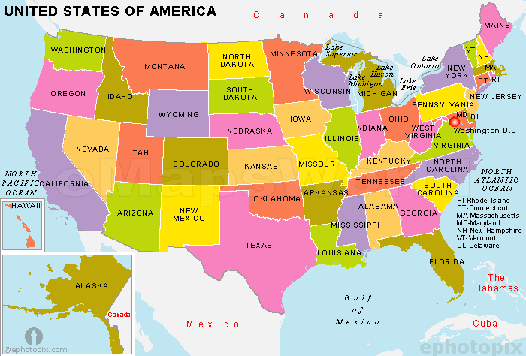

Slide 3
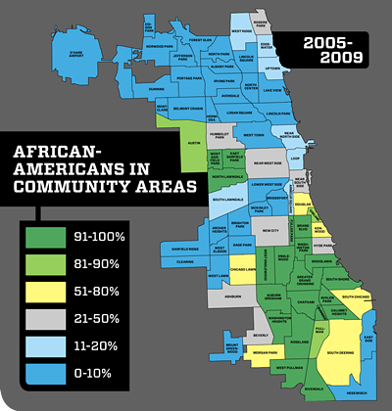

Slide 4
“It has become impossible for me to deny the reality of discrimination, harassment, even violence that people of color and women continue to experience in modern-day America from a power structure that remains for the most part in the hands of straight, white males. People like me, in other words.”
Max Boot, “2017 Was the Year I Learned About My White Privilege,” Foreign Policy 27 Dec 2017.
Michael Tomasky “The Worst of the Worst” The New York Review of Books 22 Feb 2018.

Slide 5
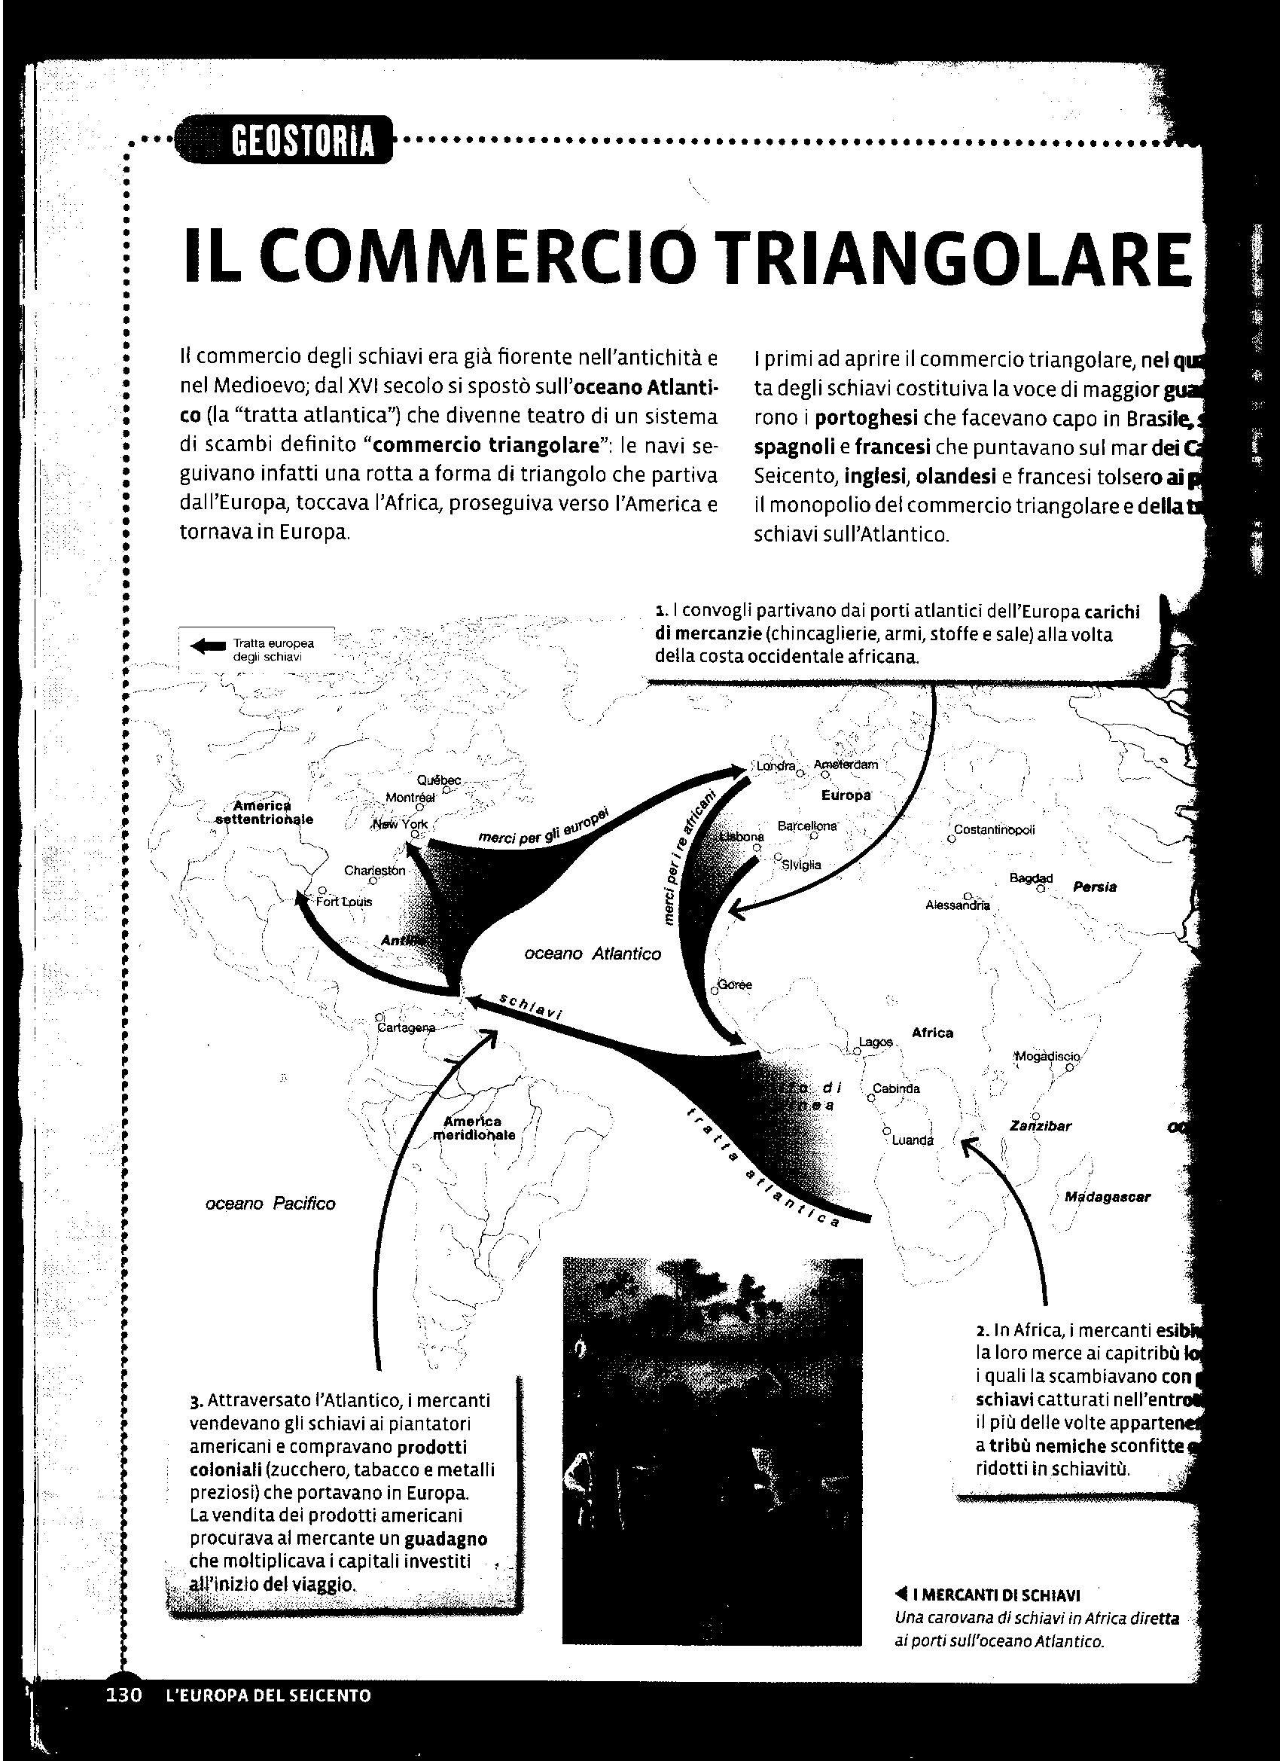

Slide 6
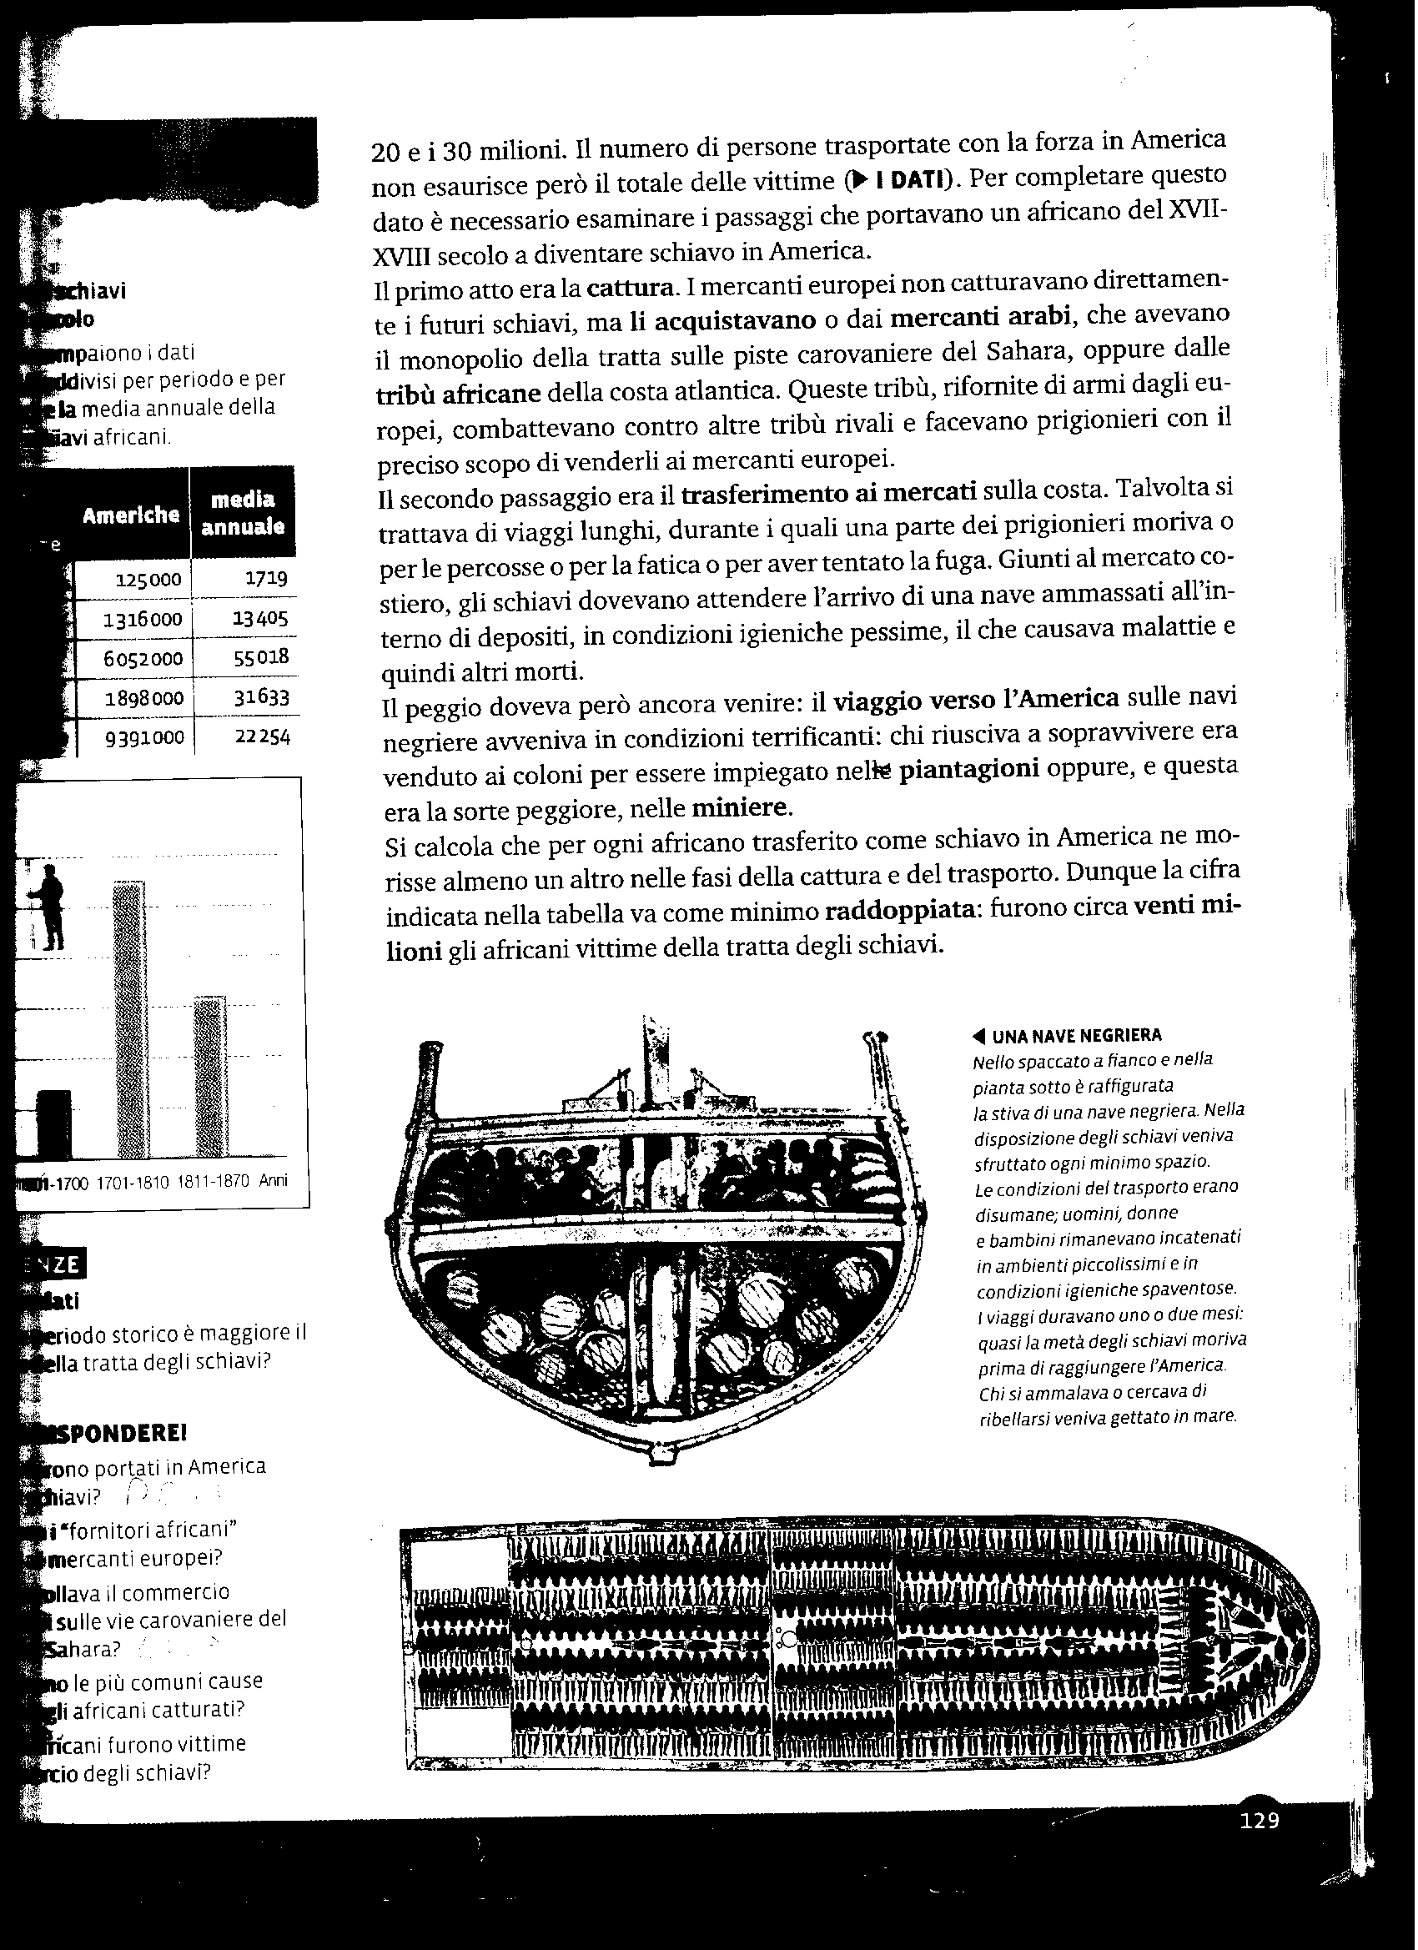

Slide 7
Nearly half of colonial New Englanders’ wealth came from sugar grown by West Indian slaves.
Between 1600 and 1800 one million Europeans migrated to British America. In the same period 2.5 million Africans were carried there by force.
Jill Lepore, These Truths: A History of the United States (2018)

Slide 8
By 1850, enslaved Americans, who were listed in their owners' inventory ledgers alongside cattle and farm equipment, were worth $1.3bn or one-fifth of the nation's wealth. When the first shot of the Civil War was fired at Fort Sumter in April 1861, the value of that human collateral exceeded $3bn and was worth more than the nation’s banks, railroads, mills and factories combined. Now numbering four million souls, they were, as Ta-Nehisi Coates has written, America's "greatest financial asset".
A'Lelia Bundles, “Know your history: Understanding racism in the US” Al Jazeera 15 Aug 2015

Slide 9
Tuckahoe Plantation Museum (Virginia)

Slide 10
Whitney Plantation Museum (Louisiana)

Slide 11
Black families in the US (1930)
2,803,756
South
2,193,357
North
610,399
Rural
1,408,188
Urban
785,189
Farm
ca. 950,000
Nonfarm
ca. 450,000
Cotton plantations
ca. 550,000
Small farms
ca. 400,000
Jeff Todd Titon, Early Downhome Blues (Univ. Ill,, 1977)

Slide 12
The state penitentiary system at Parchman is simply a cotton plantation using convicts as labor. The warden is not a penologist, but an experienced plantation manager. His annual report to the legislature is not of salvaged lives; it is a profit and loss statement, with the accent on the profit …
New York Post, Jan. 9, 1957, cited in A. Lomax liner notes to Negro Prison Songs, Tradition Records, n.d.

Slide 13
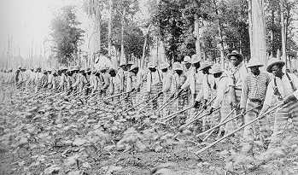

Slide 14
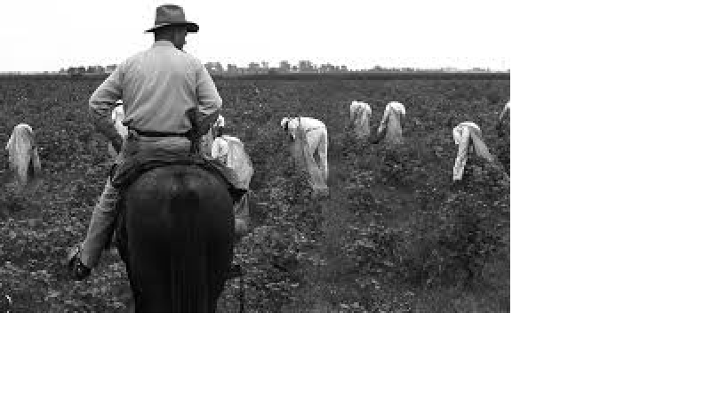

Slide 15
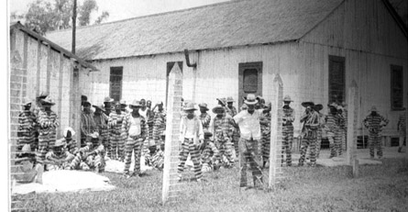

Slide 16
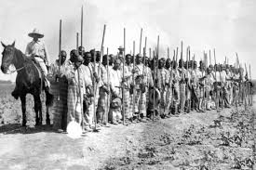

Slide 18
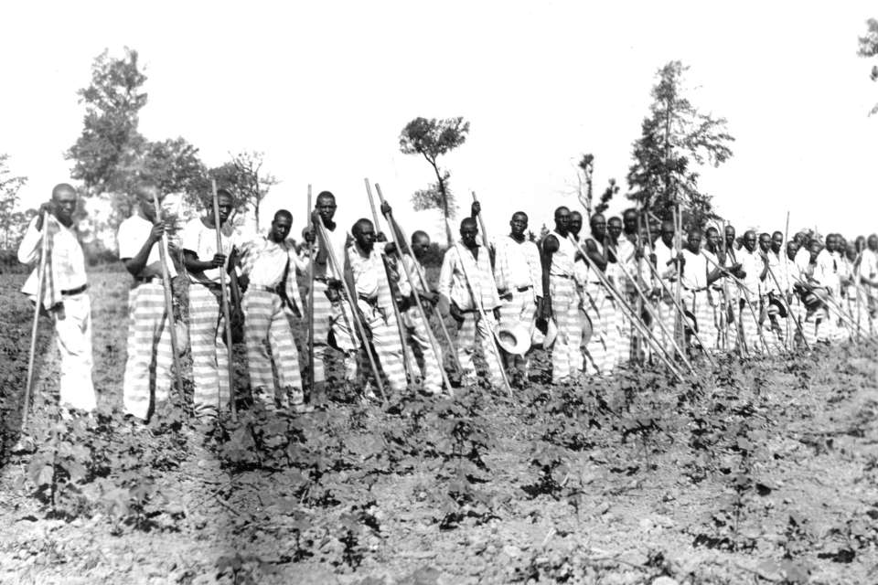

Slide 19
I began this book because I stumbled across a great story. In the summer of 1933 John Lomax, an Old South patrician in a bowler hat, wielded a 350-pound “portable” recording machine into the back of his Ford and took his starry-eyed seventeen-year-old son Alan on a driving trip through the South, stopping at all-black maximum security prisons to ask hardened convicts if they knew any good songs. At each prison they set up their equipment and recorded the convicts’ singing on twelve-inch aluminium disks, which they later deposited at the Library of Congress in Washington. This story struck me as so strange and improbable that I wanted to tell it.
B. Filene, Romancing the Folk, 2000, p. 1.

Slide 20
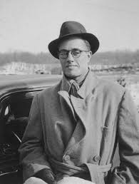

Slide 21
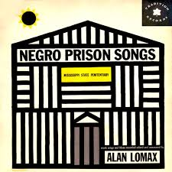

Slide 22
Be my woman gal I'll Be your Man (x3) Everydays Sunday dollar in your hand In your hand lordy, in your hand Everydays Sunday dollar in your hand Stick to the promise girl that You made me (x3) Won't got married til' uh I go free I go free lordy, I go free Won't got married til' uh I go free Whoa Rosie, hold on gal (x2) *When She walks she reel and Rocks behind (x2) Aint that enough to worry, convicts mind (x2) Whoa Rosie, hold on gal (x2)

