Slide 1
The influence of Brexit on Ireland
Isabelle Schrage, Anastasia Weiz, Frederique Bosveld, Gina Kuhlmann

Slide 2
Content
History of Ireland
Economy of Ireland: A timeline
Brief update on Brexit
Impact on Business
Social impacts
Future prospects
Questions

Slide 3
ireland

Slide 4
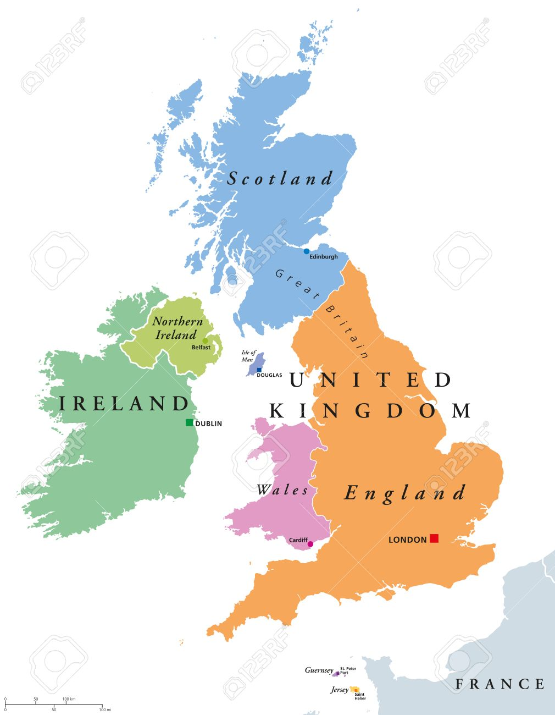

Slide 5
History of Ireland
600-150 BC Celtic tribes (language), Normans
Mid-20th century & onwards: continuation of the falling until the 1960s
Approximately last 50 years: increasing birth rate
Failed 1916 Easter Monday Uprising → independence UK in 1921.

Slide 6
Economy of Ireland: Timeline
1973: European Community
1999: Euro-Zone currency union
1995-2007: Celtic Tiger
2008-2011: World’s economic crisis → consequences
2009: Draconian budgets
2010: World largest budget deficit (32.4%); $92 billion loan package
2011: Austerity measures to meet deficit targets of the EU-IMF bailout program
2014: Fiscally neutral budget; attracting multinationals
2017-2019: Growth supported by a strong export sector
Present: Risks

Slide 7
Brexit fresh-up

Slide 8
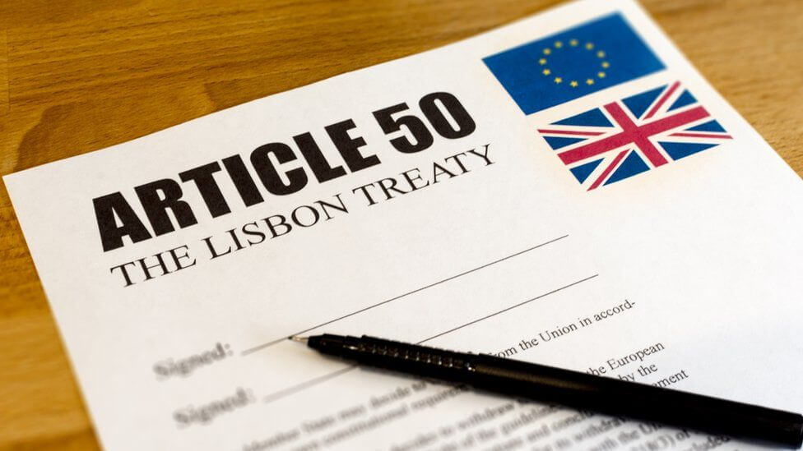
Brexit
British Exit of the European Union
First member State to withdraw from the EU
Referendum was held 23. June 2016
Prime Minister Theresa May started exit process → resignation
New Withdrawal Agreement from Prime Minister Boris Johnson
→ BACKSTOP

Slide 9
Backstop
legal guarantee to avoid a hard border
EU proposed Northern Ireland alone remaining in the customs union
Theresa May: agreed Backstop involving whole UK
→ preventing UK doing its own trade deals
Boris Johnson: “Backstop is anti-democratic”
→ Alternative plan: single regulatory zone in Irish Sea

Slide 10
Social impact

Slide 11
Job losses in agriculture and food-industry
Border between Ireland and Northern-Ireland
Irish people living in England

Slide 12
Impact on Trade

Slide 13
https://dbei.gov.ie/en/Publications/Publication-files/Ireland-and-the-Impacts-of-Brexit.pdf
measured to the Non-Brexit Baseline in 2030

Slide 14
October 2019

Slide 15
Impact on business

Slide 16
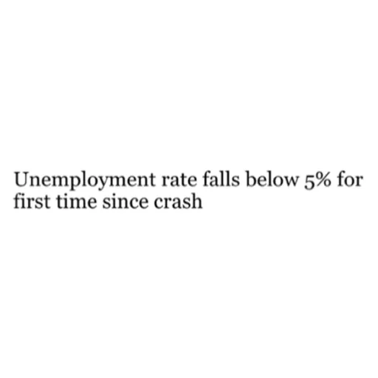
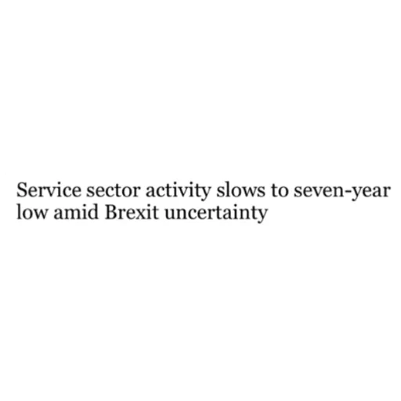
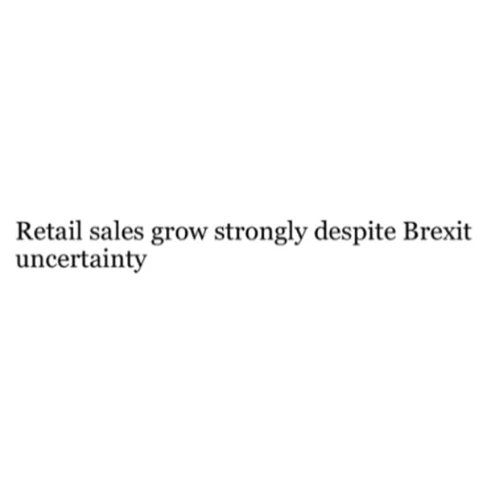
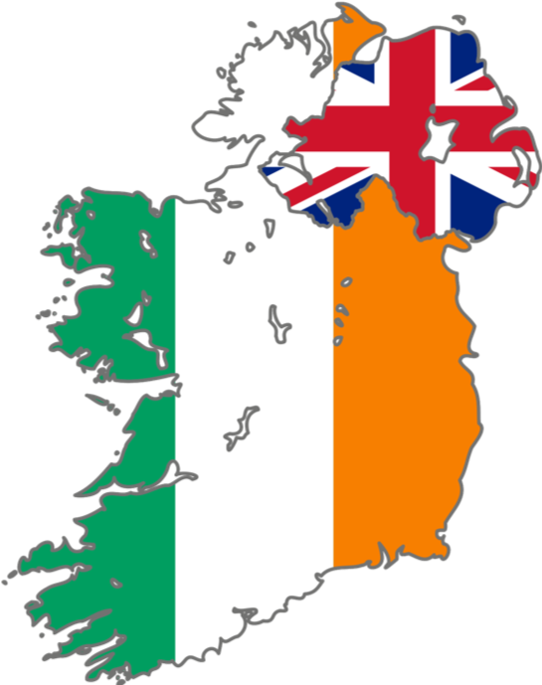
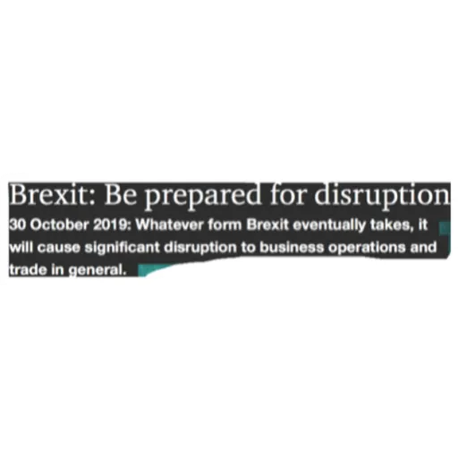
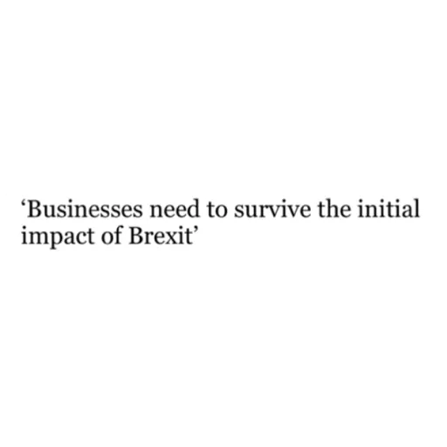
Impact on Business
Irish Times, 05.11.19
Irish Times, 05.11.19
Irish Times, 29.10.19
pwc Ireland, 30.10.19
Irish Times, 20.09.19
Irish Times, 29.10.19

Slide 17
Future prospects

Slide 18
Future prospects
No-Deal Brexit
Export/Import
The economic impact is negative

Slide 19
Conclusion

Slide 21
Sources
https://www.bbc.com/news/uk-politics-32810887
https://dbei.gov.ie/en/Publications/Publication-files/Ireland-and-the-Impacts-of-Brexit.pdf
https://www.irishtimes.com
https://www.irelandbeforeyoudie.com/
https://www.cnbc.com/world/?region=world
https://www.grantthornton.ie/insights/blogs/brexit/brexit-impact-on-the-irish-corporate-landscape/

Slide 22
Take home Question:
Do you think it’s likely that Ireland will face a new crisis due to Brexit?

