Slide 1
Aesthetic Experience and Empirical Aesthetics
Enric Munar
University of the Balearic Islands

Slide 2
What is an “aesthetic experience”?
Historically
Evolutionary
Cognitive perspective
“Aesthetics” with capital A
“aesthetics” with a lower case a

Slide 3
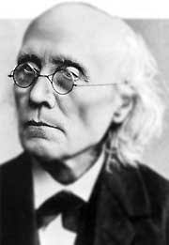
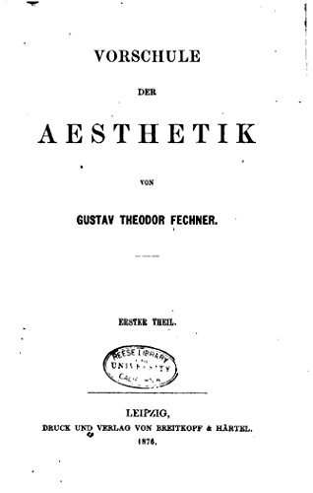
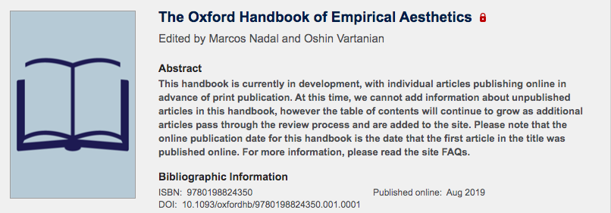
G. T. Fechner
In 1876, Vorschule der Aesthetik (Pre-school of Aesthetics).
An “empirical aesthetics from below”
“Experimental Aesthetics”

Slide 4
Individual Experience
Report
Aesthetic Threshold

Slide 5
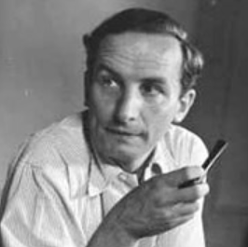
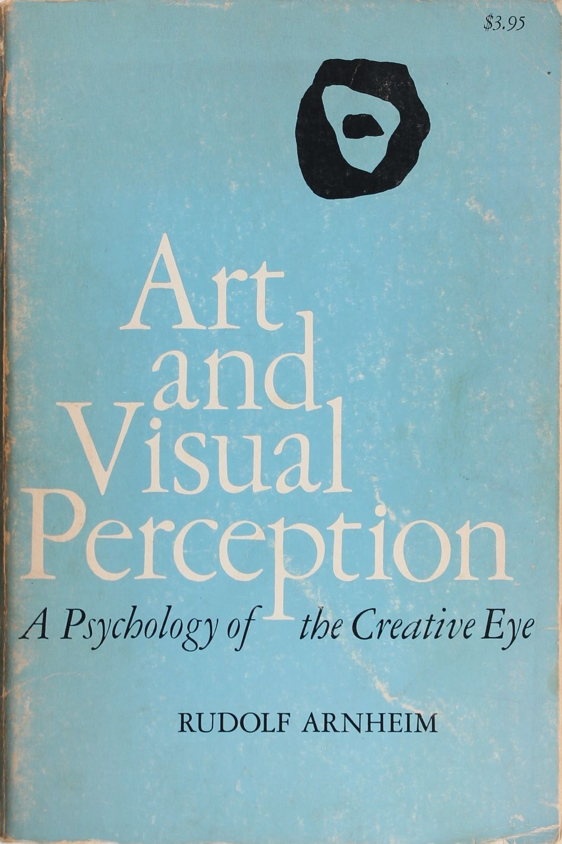
Gestalt
Rudolf Arnheim.
1954
Art and Visual Perception

Slide 6
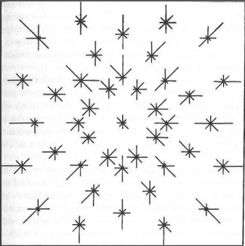
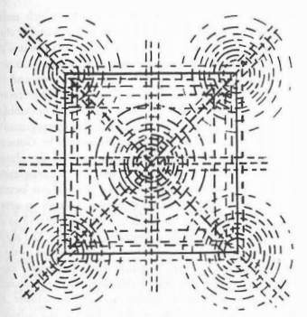
Gestalt

Slide 7
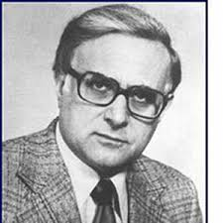
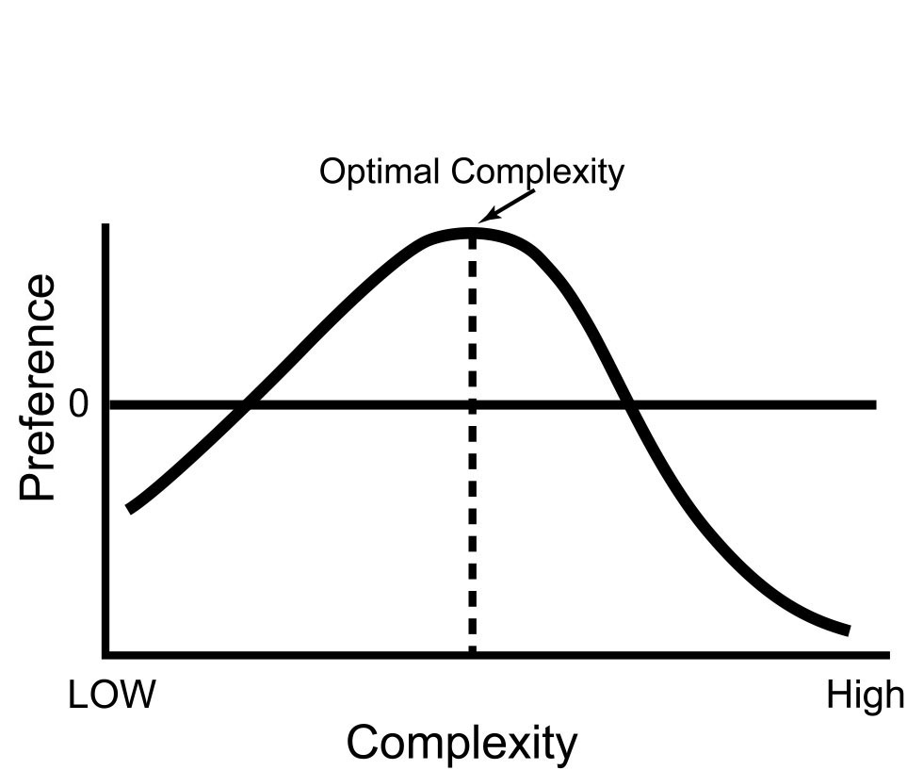
Daniel Berlyne
Aesthetics and Psychobiology (1971)
Psychobiological approach
Importance of Arousal

Slide 8
Nowadays
Empirical Aesthetics
Psychology of Art
Neuroaesthetics
Psychology of Aesthetics
Experimental Aesthetics

Slide 9
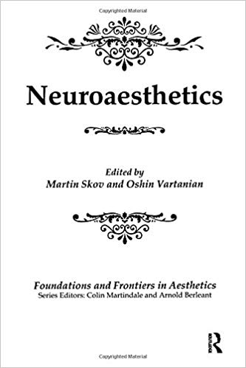
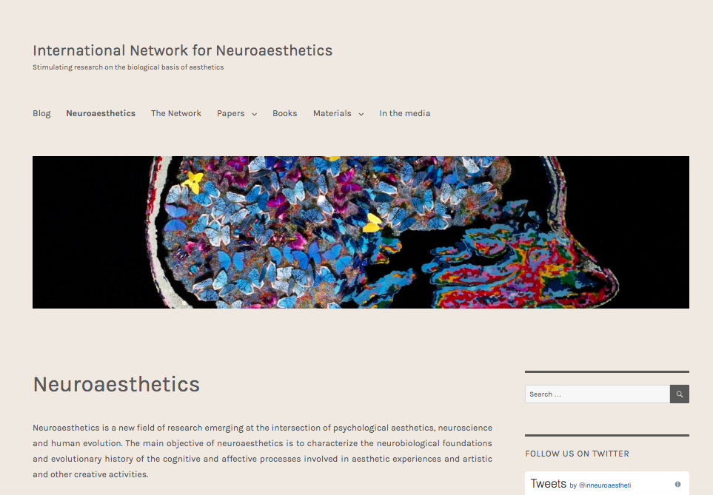
Neuroaesthetics
2002
Focused on the neurobiological correlates of aesthetic experience and creativity.
International Network for Neuroaesthetics

Slide 10
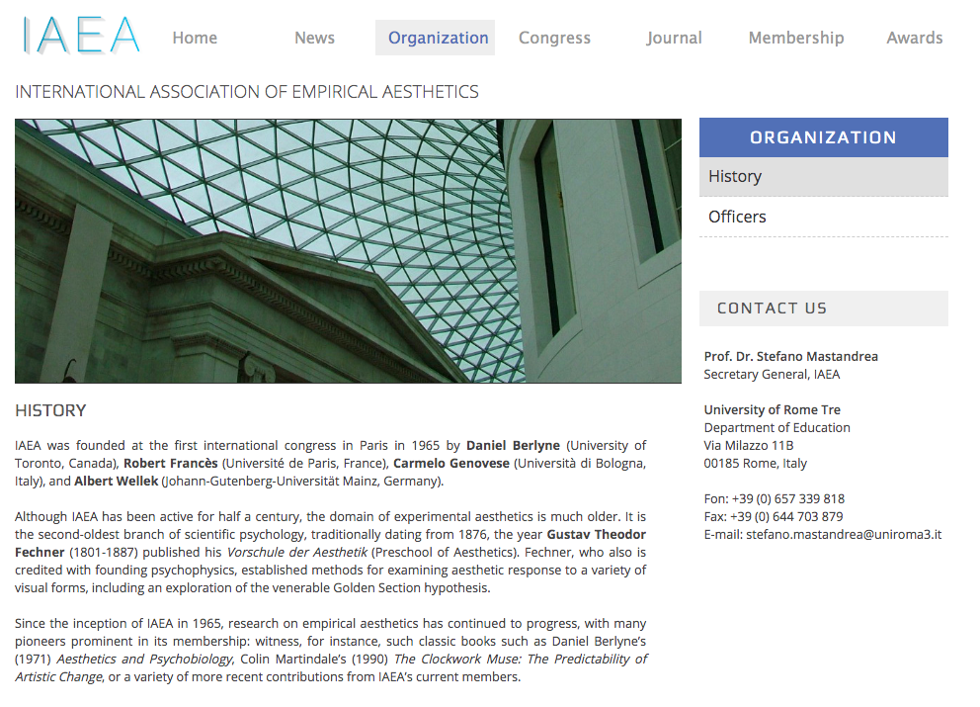
International Association of Empirical Aesthetics

Slide 11
The Visual Science of Art Conference (VSAC)
It is a satellite of the European Conference on Visual Perception (ECVP)
The next one (2020) is going to be in Rijeka (Croacia)

Slide 12
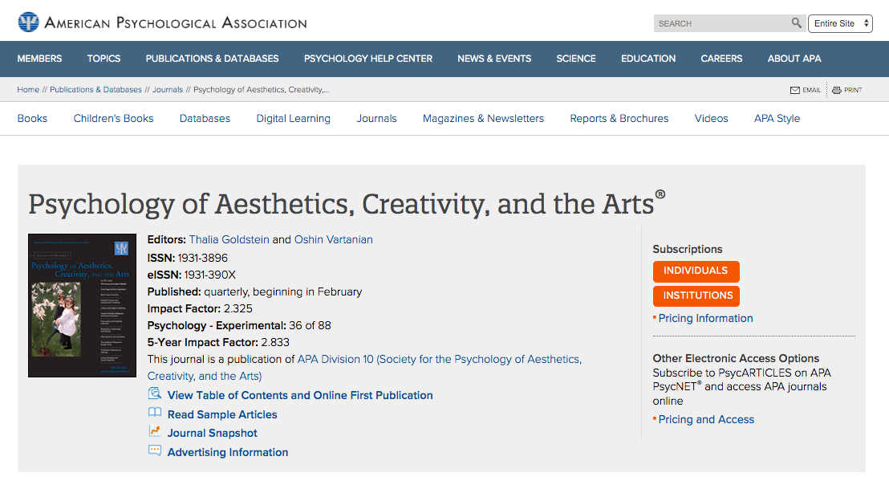
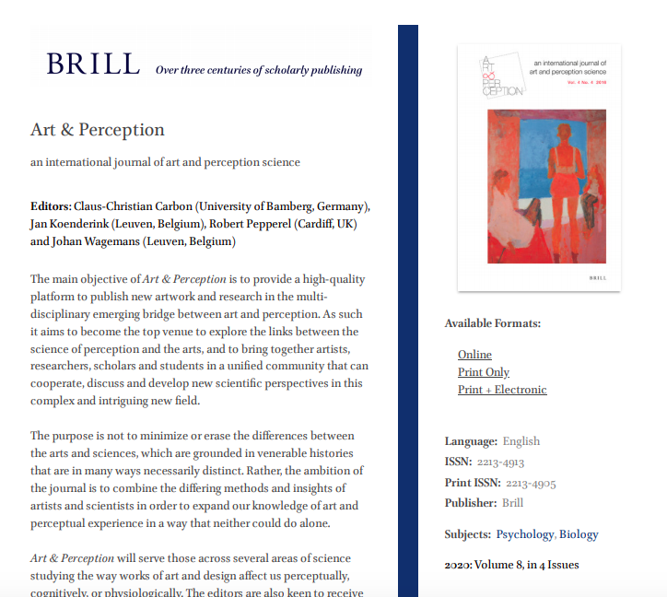
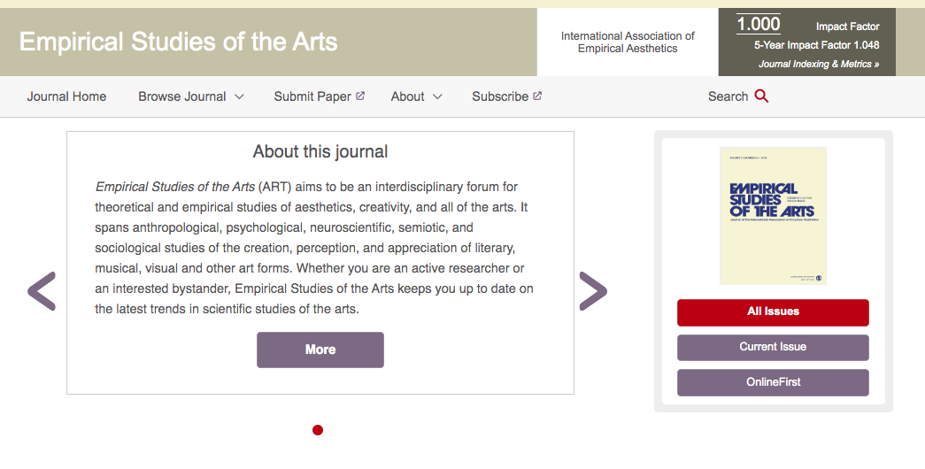
Journals
Psychology of Aesthetics, Creativity and the Arts
Empirical Studies of the Arts
Art & Perception

Slide 13
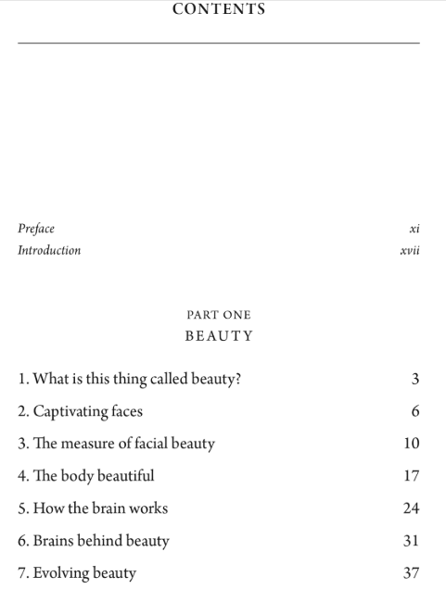
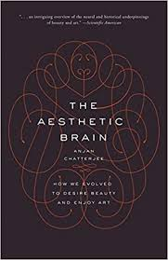
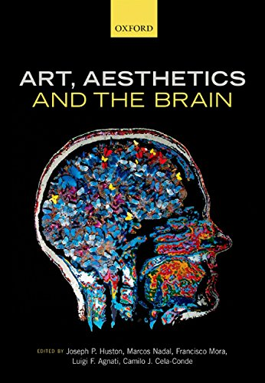
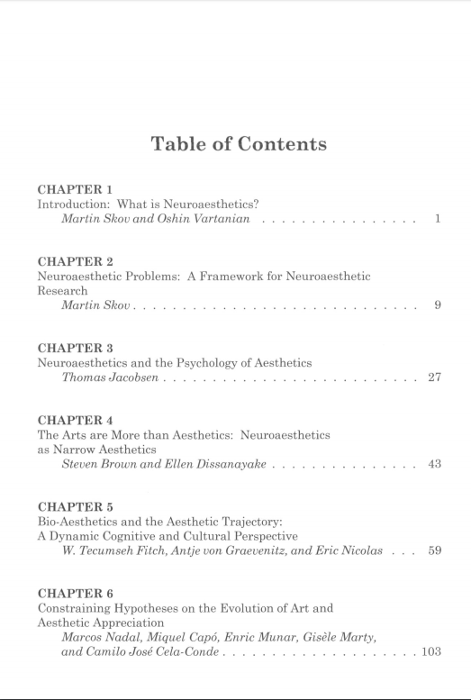
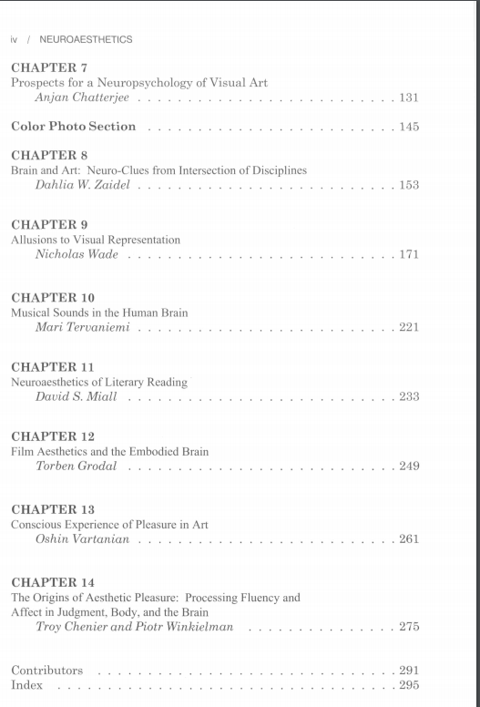
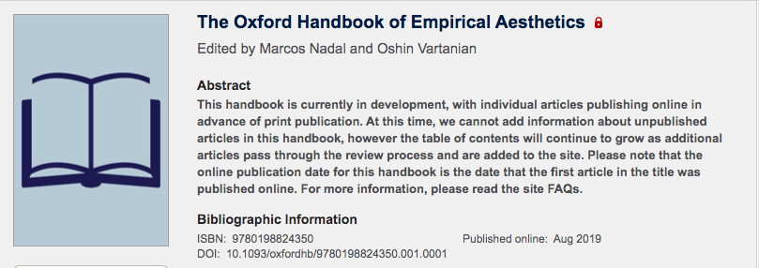
A few books
2009
2014
2015
2014

Slide 14
Topics
Conceptual Foundations
Methods
The Object
The Person
The Context
Applications

Slide 15
Conceptual Foundations
What is empirical aesthetics?
History of empirical aesthetics
Theoretical approaches
The link between empirical and philosophical aesthetics
Subjectivity and objectivity of aesthetic valuation
Aesthetic emotions
Aesthetics and neural valuation systems
The evolution of aesthetic productions and appreciation

Slide 16
Methods
Fechner’s methods
Observation
Implicit measures
Eye movements
Electrophysiology
Neuroimaging
Brain stimulation
Comparative method
Historiometric approach
Drawing
Integrating methods

Slide 17
The object 1
Statistical features
Collative variables
Fluency
Color and texture
Balance, symmetry and composition
Contour
Attractiveness of faces
Attractveness of people

Slide 18
The object 2
Aesthetics of sound
Aesthetics of music
Aesthetics of action and movement
Aesthetics of dance
Aesthetics of touch
Aesthetics of smell and taste
Film
Theatre
Literary aesthetics
Authenticity

Slide 19
The Person
Memory and attention
Personality
Experience and expertise
Viewer history
Brain lesions and diseases
Development
Aesthetic Sensitivity
Cross cultural empirical aesthetics

Slide 20
The Context
Information and framing
Museum studies
Everyday environments
Social content
Physical context

Slide 21
Applications
Architecture
Design
Consumer behaviour
Education

Slide 22
That’s all!

