Slide 1
Preference for Curvature
Enric Munar
University of the Balearic Islands

Slide 2
Context
Visual preference based on low-level visual properties.
Balance, Brightness, Contrast, Curvature, Proportion, Self-similarity, Symmetry, maybe others.
Is aesthetic sensitivity based on these preferences?
Aesthetic primitives?

Slide 3
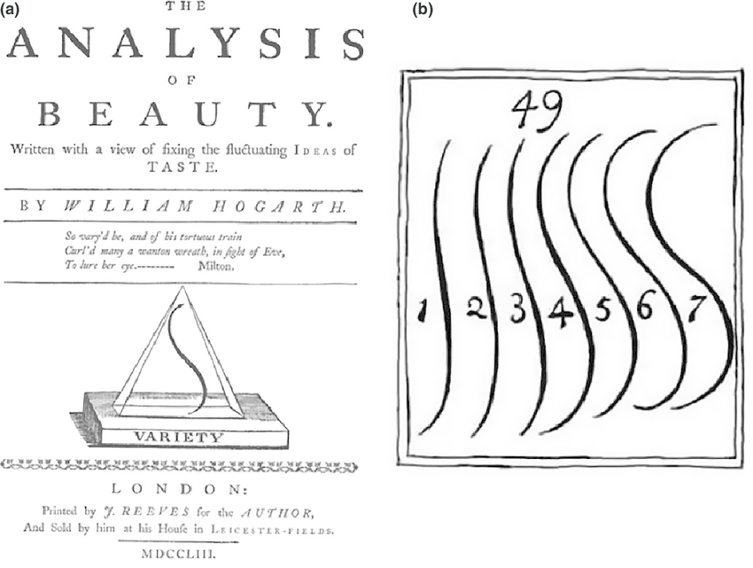
Preference for curvature
A well-known effect since ….?
1753

Slide 4
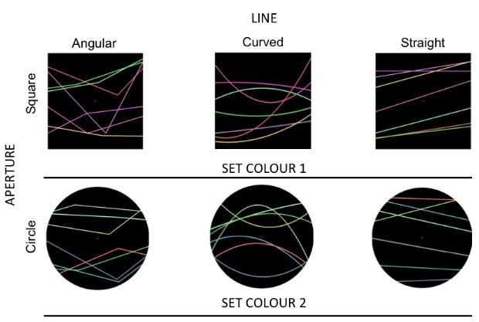
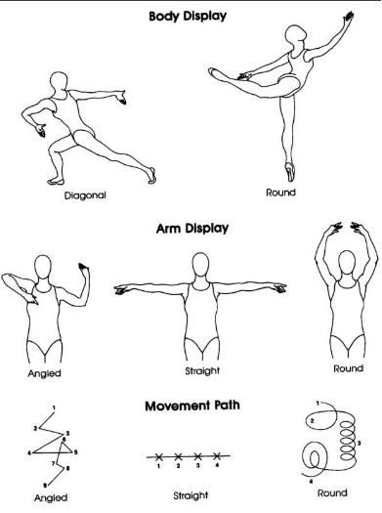
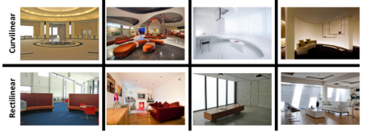
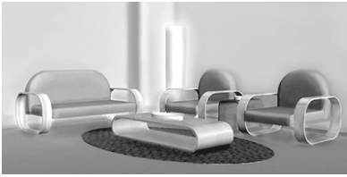
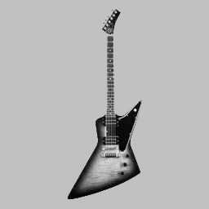
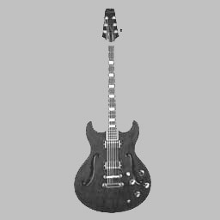
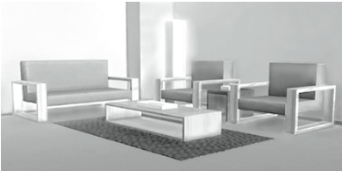
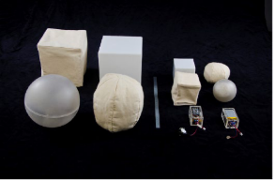
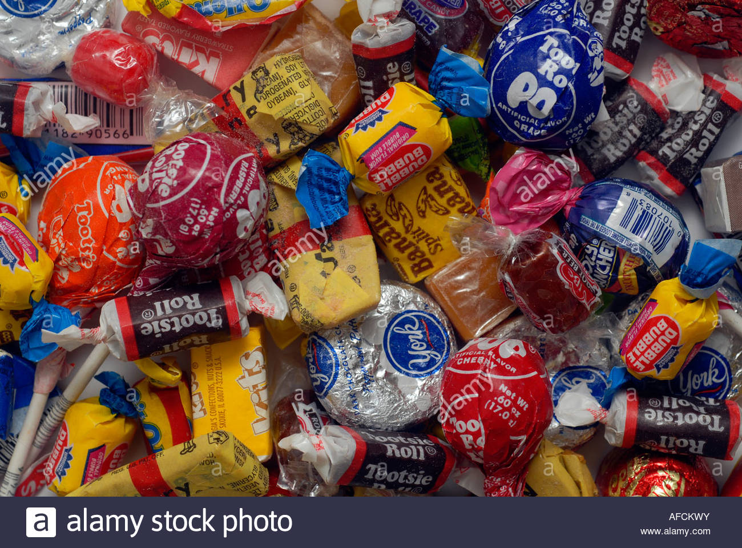
Lines
Typefaces
Car interior designs
Familiar objects
Meaningless patterns
Toys
Furniture
Building interior designs
Product designs
Dancing movements
Interactive objects
Sweets

Slide 5
Adults (most of the research)
Newborns (Fantz, 1961, Ruff & Birch, 1974; Fantz & Miranda, 1975, Quinn et al., 1997; Amir et al., 2011).
Infants (Hopkins et al, 1976; Munroe et al, 1976; Jadva et al, 2010).
Non-western participants from small villages (Gomez-Puerto at al, 2017).
Great apes (Munar et al, 2015)
Chicks (Fantz, 1961; Schneirla, 1965)

Slide 6
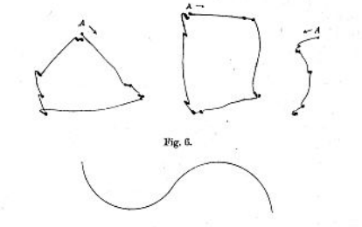
Stratton (1902, 1906)
Hypothesized that eye movements to follow sharp lines must be more abrupt and, consequently, less pleasant than those to follow curved lines
Rectangle
Circle

Slide 7
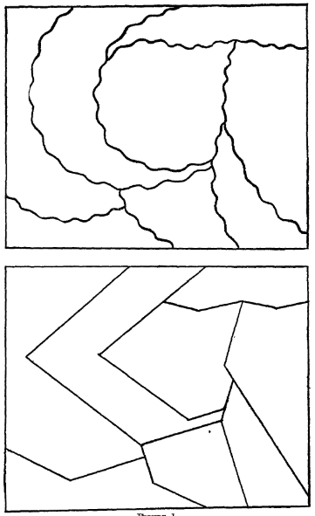
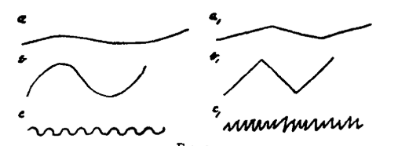
Lundholm (1920), Poffenberger & Barrow (1924), Hevner (1935)
Related specific lines to specific feelings.
Curved lines to sad, quiet, lazy, merry, playful, weak, gentle, …
Sharp lines to agitating, furious, robust, vigorous, hard, …

Slide 8
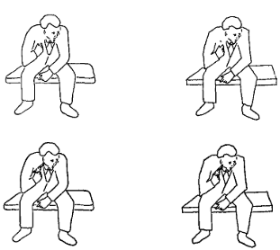
Guthrie & Wiener (1966) A subliminal perception study
The overall sharpness, more than the presence of a gun, determined the image was perceived as threatening and negative

Slide 9
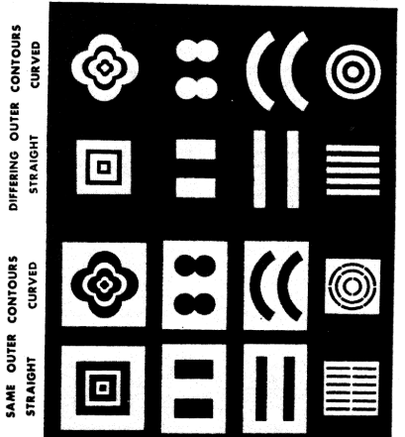
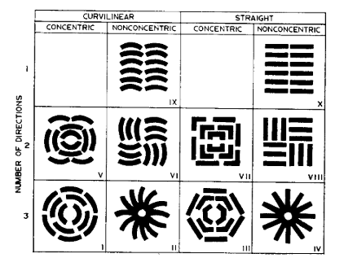
Ruff & Birch (1974) Fantz & Miranda (1975)
13-week-old infants and 1-week-old neonates
fixated longer on curved forms than on straight or sharp-angled contours

Slide 10
Munroe (1976)
Asked 175 children to select two pieces of wrapped candies.
There were spherical wrapped candies and cube-shaped ones.
Both sexes chose the spherical candy more frequently.
However, girls chose it 83% and boys 57%.
Since then, current studies are no finding any sex differences.

Slide 11
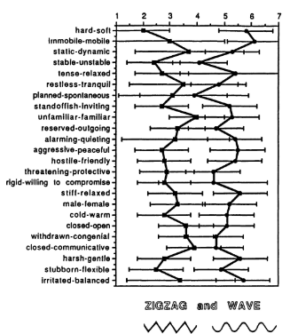
Uher (1991)
1,100 participants

Slide 12
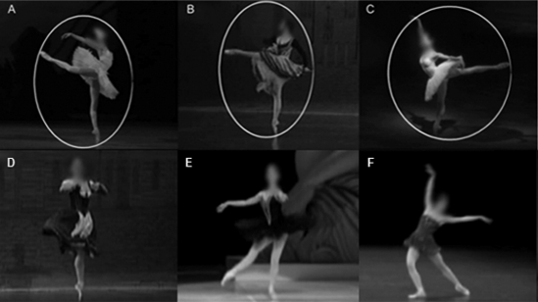
Aronoff et al. (1992)
Videotapes of classical ballet
Roundness was strongly associated with warm characters
Angularity was strongly associated with threatening characters
Christensen et al. (2017)

Slide 13
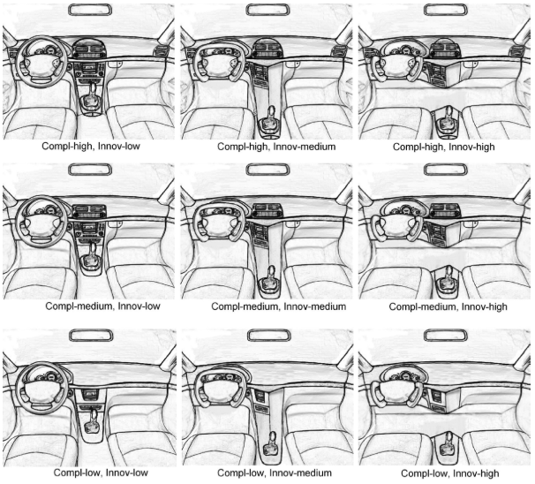
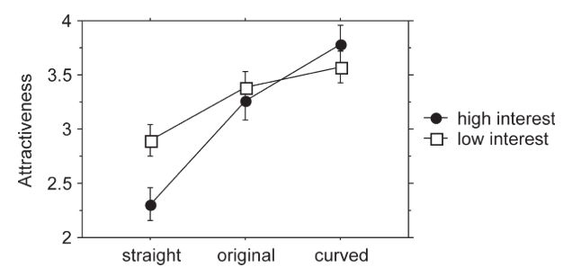
Leder & Carbon (2005)
To explain their results, they relied on familiarity, mere exposure and innovativenness
Carbon (2010)

Slide 14
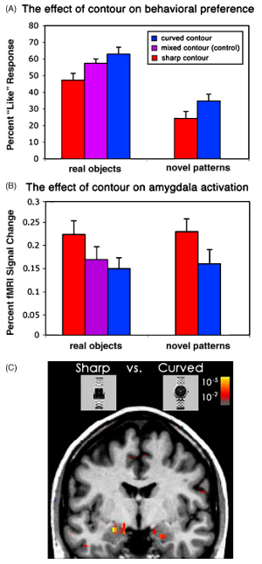
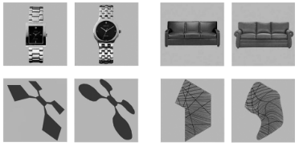
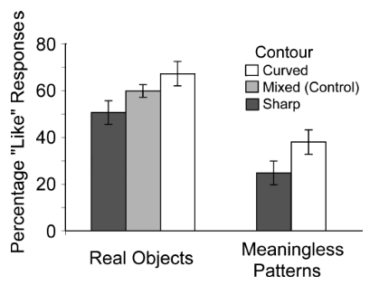
Bar & Neta (2006, 2007)
Like/dislike task
A fMRI study
The threat hypothesis

Slide 15
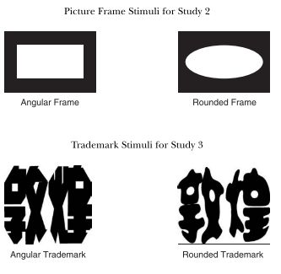
Zhang et al. (2006)
With brand logos and trademarks
Participants emphasizing compromise and collectivism perceived curved as more attractive than people emphasizing confrontation and individualism.
Countries high on collectivism (Hong Kong, Korea, and Japan) tended to use less angular logos than countries high on individualism (United States, Canada, United Kingdom, and Germany).

Slide 16
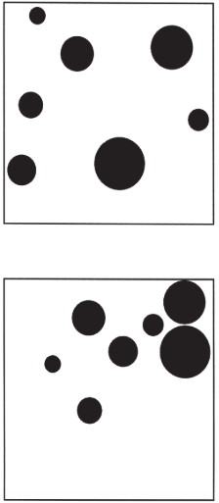
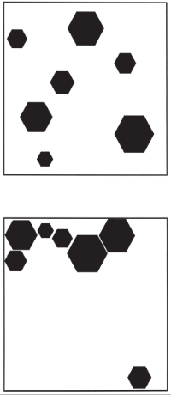
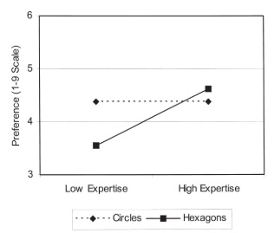
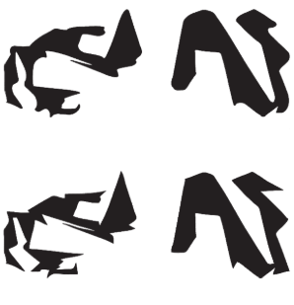
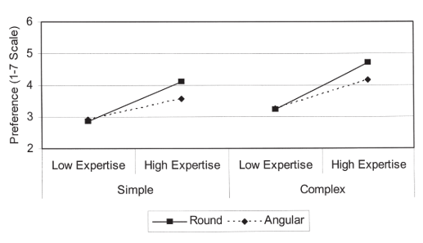
Silvia & Barona (2009)
Compared low and high-expertise participants in arts
With more conventional stimuli, only low-expertise participants showed the effect
With novel-complex stimuli, only high-expertise participants showed the effect

Slide 17
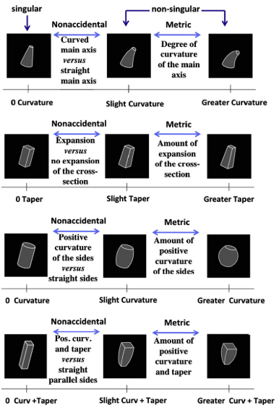
Amir et al. (2011)
Eye-tracker experiment (2 stimuli at the same time) with adults and infants (5 m.y.o.)
fMRI study only adults with 1 stimuli
Adults and infants looked first, and adults looked longer, at curved geons.
Curved geons produced great BOLD activity in Lateral Occipital Cortex and Posterior Fusiform Gyrus.

Slide 18
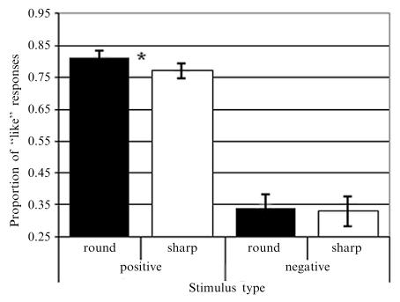
Leder, Tinio & Bar (2011)
Hypothesized that the negative valence could override positive cues such as the curvature
Curved stimuli were preferred to sharp ones, but only when the objects had a positive or neutral valence.
They argued that this showed that semantic evaluation takes precedence over the evaluation of contour, overriding the effects of preference for curvature.

Slide 19
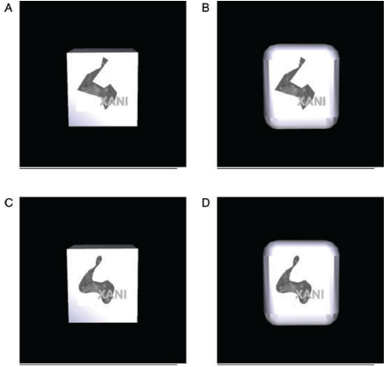
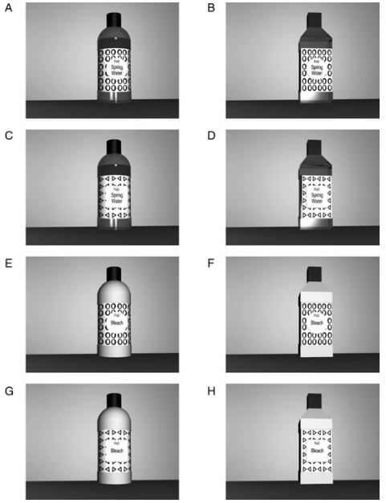
Westerman et al. (2012)
Tested the congruence of the product and preference for curvature on logos and packages
They found no beneficial effect of semantic congruence associated with using angular and round shapes
Preference for curved designs for different products (chocolate, water, and bleach) and different packaging designs (box vs. bottle).
Preference for curved designs was extended to self-report purchase likelihood.

Slide 20
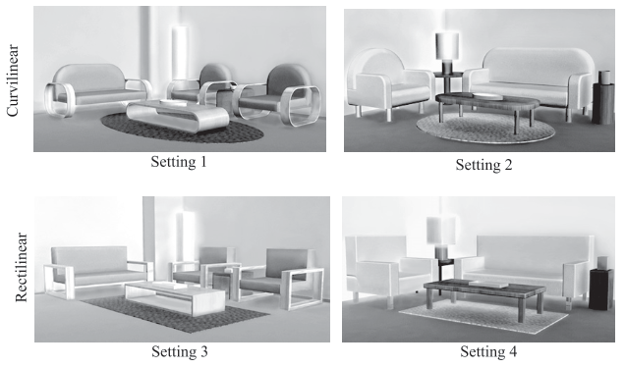
Dazkir & Read (2012)
Tested pleasure and approach reactions with furniture forms
The curvilinear forms elicited higher amounts of pleasant emotions (feeling relaxed, peaceful, calm).
Also, the participants desired to approach curvilinear settings.

Slide 21
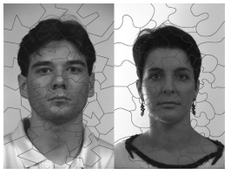
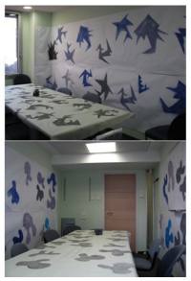
Hess, Gryc & Hareli (2013)
In experiment 1, participants assembled a puzzle
In experiment 2, they played a game and were told that their decisions would be paired with the decisions from other participants.
1. When the photo was assembled from round shapes, they rated the photo as significantly less aggressive
2. When the room was decorated with sharp objects, they chose the aggressive option more often

Slide 22
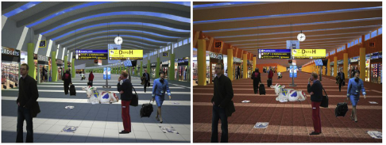
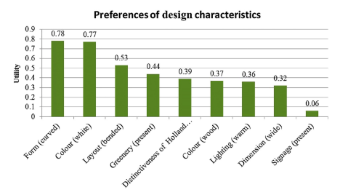
Van Oel & Van den Berkhof (2013)
Investigated the way passenger value architectural airport design characteristics
The “form” was curvilinear or orthogonal roof. It was the most influential characteristic in choosing the most preferred passenger area.
The curvilinear form was more preferred than the orthogonal one.
The layout was a straight or curved area layout.
In general, passengers had preference for an area with curved hallways.

Slide 23
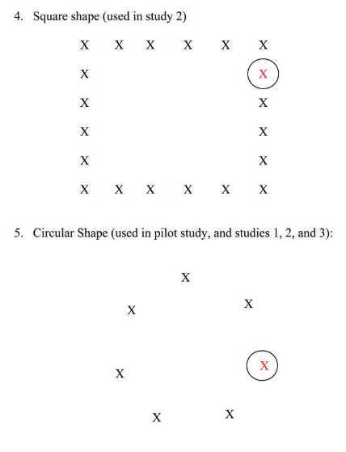
Zhu & Argo (2013)
H﻿ypothesis: the shape of seating arrangements could prime the need to belong and the need to be unique, and to be most favorable toward persuasion material
When arrangement was circular, consumers evaluated persuasive material more favorably and consistent with a belongingness need (family-oriented information or a majority endorsement).
When it contained angles, they preferred a persuasive message related to a uniqueness need (self-oriented information or a minority endorsement).

Slide 24
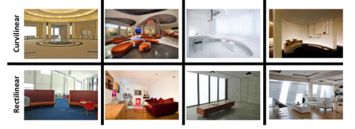
Vartanian et al (2013)
Behavioural and fMRI study.
Participants carried out beauty judgments and approach-avoidance decisions.
﻿Participants judged curvilinear spaces as more beautiful.
Beautiful and curvilinear spaces activated the anterior cingulate cortex exclusively (related to the reward properties and emotional salience of objects).
Contour did not affect approach-avoidance decisions.

Slide 25
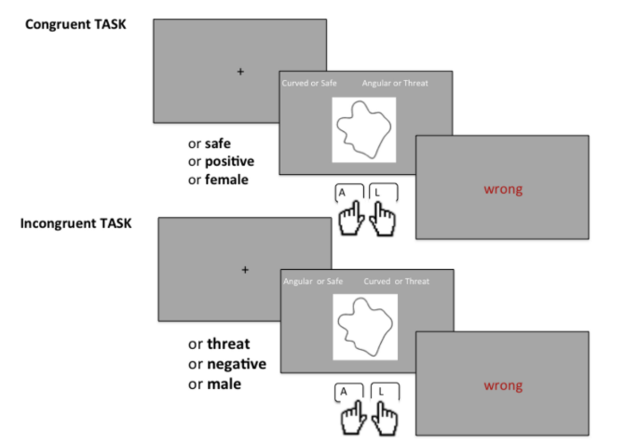
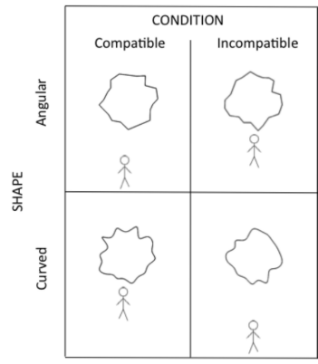
Palumbo, Ruta & Bertamini (2015)
Implicit Tests
Exp. 1 tested association between contours (curved or sharp) with danger, valence, and gender.
Exp. 2 Manikin test
﻿Curved was associated with safe, positive valence and female names.
Angular was with danger, negative valence and male names.
With curved shapes, participants were faster approaching than avoiding.
With sharp-angled shapes, there was no difference between approaching and avoiding

Slide 26
Babouchkina & Robbins (2015)
﻿Examined whether mandalas have specific efficacy for reducing negative mood states.
(a) coloring a blank circle to express feelings,
(b) coloring a blank circle to draw freely,
(c) coloring a square to express feelings,
(d) coloring a square to draw freely.
﻿The two circle (mandala) groups reported significantly greater mood improvement.

Slide 27
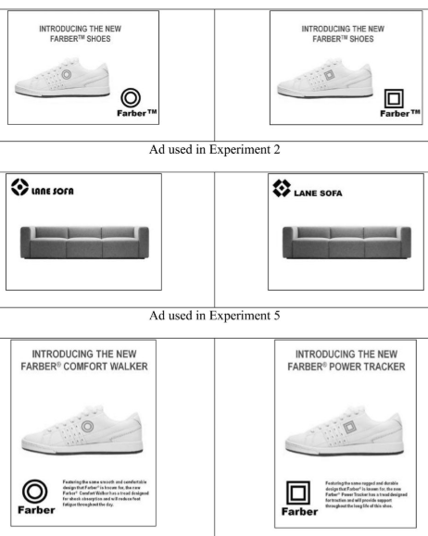
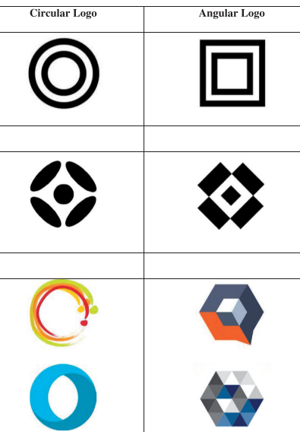
Jiang et al (2015)
Does curved shape of a logo influence consumers’ inferences about products and their attitudes toward them?
A curved brand logo activated mental associations related to “softness” and a sharp-angled brand logo activated mental associations related to “hardness,”
These activated associations subsequently influenced product and company attribute judgments.

Slide 28
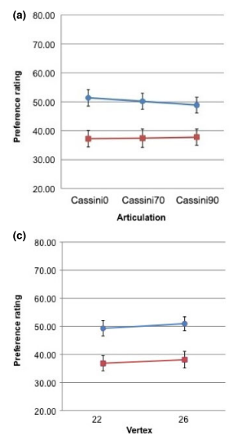
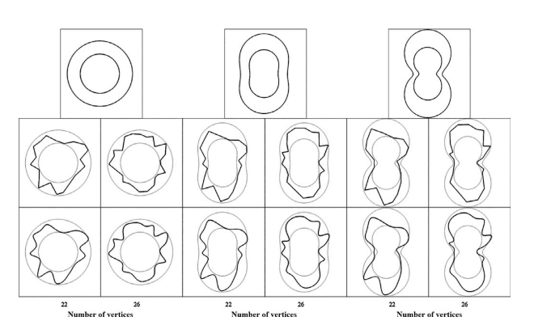
Bertamini et al. (2016). Exp 1
﻿Different forms of the stimuli and different number of vertices

Slide 29
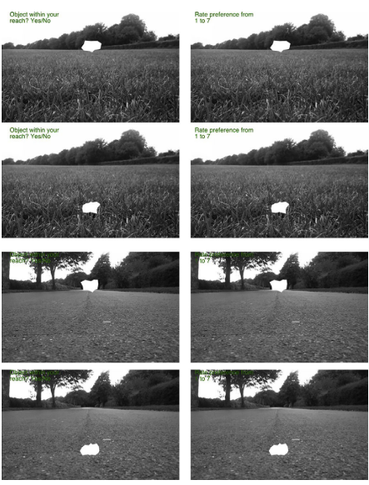
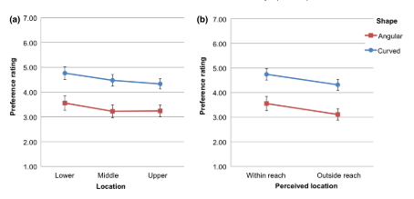
Bertamini et al. (2016) Exp 2
﻿I the threat hypothesis is right, preference for curvature must depend on the perceived distance

Slide 30
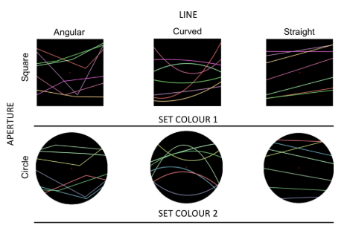
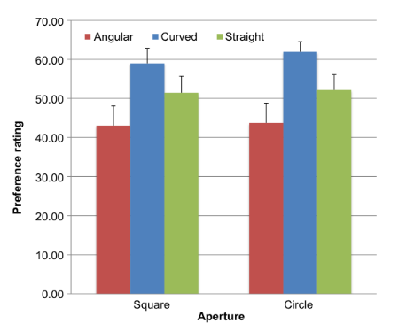
Bertamini et al. (2016) Exp 3
Lines: curved, sharp-angled and straight

Slide 31
Hareli et al. (2016)
Participants evaluated:
Leaves
Houses
Curved shaped leaves were rated as more beautiful, friendlier, more comforting, and warmer
Houses surrounded by sharp leafed vegetation were evaluated as safer and more expensive

Slide 32
Hula & Flegr (2016)
Determined which flower colors and shapes were more preferred
According to their analyses, sharp contours positively affected the flower beauty scores, whereas mixed contours had no effect.

Slide 33
Banaei et al. (2017)
Used a mobile EEG setup synchronized to head-mounted virtual reality
Rooms with lower pleasure and arousal ratings contained more linear geometries, whereas rooms with higher pleasure and arousal ratings contained more curved geometries.
The Anterior Cingulate Cortex showed pronounced activity with higher responses in terms of pleasure and arousal related to rooms with more curved geometries.

Slide 34
Cotter et al. (2017)
Measured openness to experience with the HEXACO Inventory, the Neo-Five-Factor Inventory, and the Big Five Aspects Scale.
Participants scoring higher on these scales showed greater curvature effect in irregular polygons, but not in arrays of circles and hexagons.

Slide 35
Gómez-Puerto et al. (2017)
﻿Investigate whether preference for curved contours was also present in 2 small-scale societies relatively uninfluenced by Western culture.
﻿We conclude that preference for curved-contour objects is common across cultures and conjecture that it is a constituent of a natural propensity for aesthetics

Slide 36
Vartanian et al. (2017)
﻿Collected from experts (architects and designers) and nonexperts that expertise moderates sensitivity to curvilinear contour within architectural spaces
﻿﻿When assessing beauty, experts found curvilinear spaces more beautiful, whereas contour had no effect among nonexperts.
When making approach-avoidance decisions, non experts were more likely to opt to enter curvilinear, whereas had no effect among experts.

Slide 37
Carbon et al. (2018)
﻿Investigated whether the shape of the outline of diagrams influences the aesthetic judgments: beauty and interest
﻿﻿﻿Diagrams with curvier outlines were perceived as more beautiful.
While diagrams with more complex outlines were considered to be more interesting.

Slide 38
Liu et al. (2018)
﻿Examined the impact of shape cues –curved versus sharp-angled– on customer satisfaction
In non-busy settings, curved shape cue enhanced customer satisfaction.
Sharp-angled shape cues increased customer satisfaction in busy settings

Slide 39
Soranzo et al. (2018)
﻿﻿Examined the aesthetics of interactive objects, which were three-dimensional physical artefacts that exhibit autonomous behaviour when handled.
The results showed preference for curvature.
The difference between preference for curved against sharp decreased when the object displayed behaviors (vibrating or flickering)

Slide 40
Ruta et al. (2018)
﻿﻿﻿Generated four versions of the same reference building, varying only the amount of curvature introduced in the façade.
﻿﻿Forced choices showed that the curved façade was the most preferred

Slide 41
Corradi et al. (2018)
﻿﻿﻿Determined whether different presentation times influence the effect.
Used images of real objects and meaningless novel patterns
﻿﻿﻿With real objects, the preference for curved was greatest when presented for 84 ms, and it faded with unlimited viewing time.
To real objects, preference for meaningless patterns increased significantly in the unlimited viewing time condition

Slide 42
Corradi et al. (2019)
﻿﻿﻿﻿Aimed to determine whether curvature in real objects and abstract designs influenced participants' preference to the same extent.
﻿Participants prefered stimuli with curved contours.
But a remarkable breadth of variation in individual preferences.
Participants who were highly sensitive to curvature in real objects were also highly sensitive to curvature in abstract designs
And who were insensitive to curvature in one kind of stimulus were also insensitive to the other.

Slide 43
Bertamini, Palumbo & Redies (2019)
﻿﻿﻿﻿﻿4 experiments using abstract shapes and comparing sharp-angled and curved polygons: a detection task, comparison between shapes, comparison after a rotation, and detection of bilateral symmetry
﻿In all tasks, responses for curved stimuli were faster
There was also an interaction with type of response: Trials with smooth shapes were faster when a positive response was produced.
Overall, there was evidence that smooth shapes with continuous change in curvature along the contour are processed more efficiently, and they tend to be classified as targets.

Slide 44
These are the results and the conclusions are yours!

